Slide 1
Low-Latency Gentrification Prediction with airbnb reviews
Leo Kitchell – Claremont McKenna College

Slide 2
AGENDA
Background
Motivation
Methodology
Data
Results

Slide 3
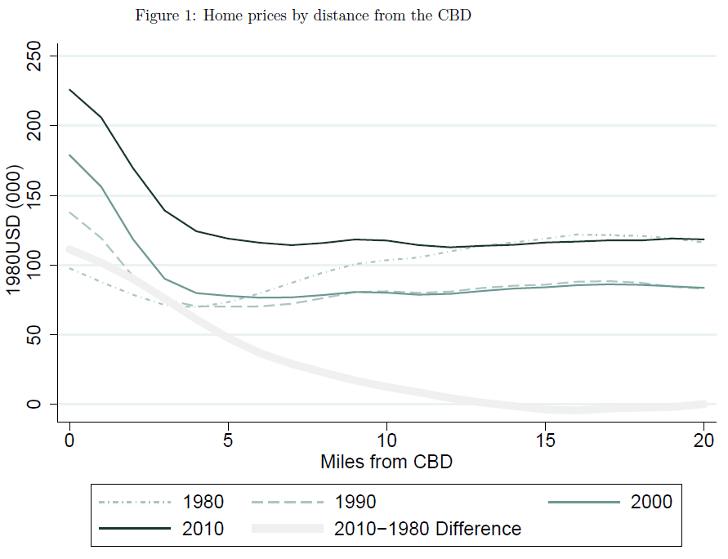
Gentrification Background
Urban America has changed dramatically in the last 30 years
New demand for urban living from wealthy residents
Government urban reinvestment programs coming to fruition
Concerns of displacement and neighborhood change
Gentrification: neighborhood change where higher-income and higher-educated residents move into a historically marginalized neighborhood
Increased housing costs
Changes in cultural character of neighborhood
Displacement of vulnerable residents
Plot courtesy of Edlund, Machado, & Sviatschi (2019)

Slide 4
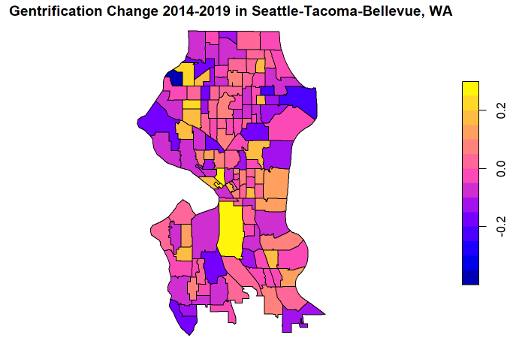
Motivation: Data Challenges
Gentrification is:
Local
Few data sources release at the neighborhood geography
Dynamic
Data that does are infrequent (Census/ACS 5 Year) or inconsistent
Cultural
Information on cultural change can be difficult to capture in data

Slide 5
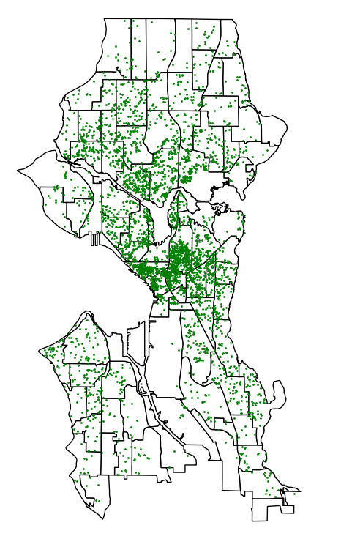
Potential Solution: Airbnb Data
Airbnb Listings in Seattle 2019
Airbnb Data is:
Local
Airbnb listing data have precise locations and can provide robust data in sub-ACS geographies in urban centers
Dynamic
Review data and listing data is scraped monthly
Cultural
Guest reviews describe neighborhood characteristics that aren’t usually captured
Plot courtesy of Sho Arata

Slide 6
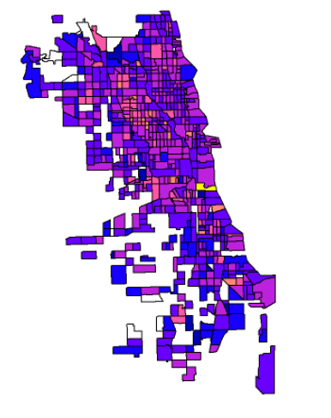
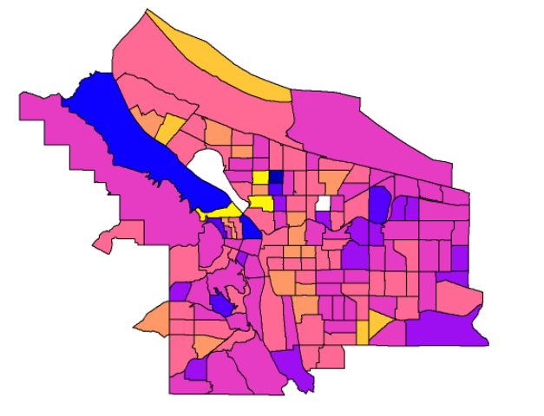
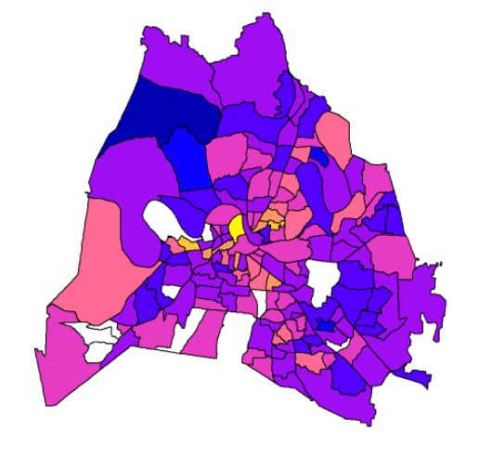
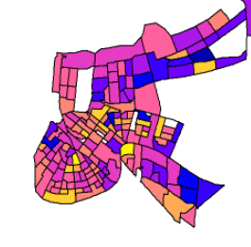
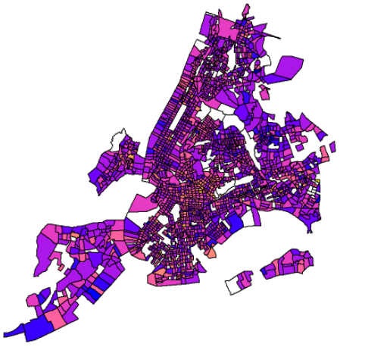
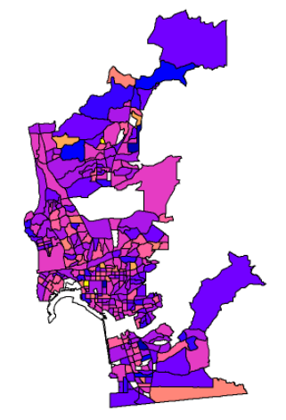
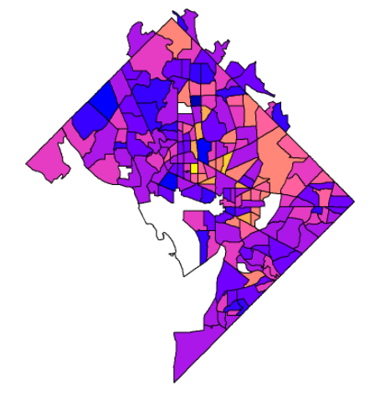
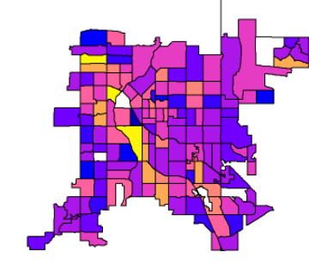
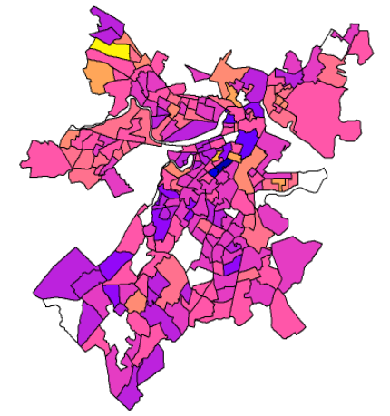
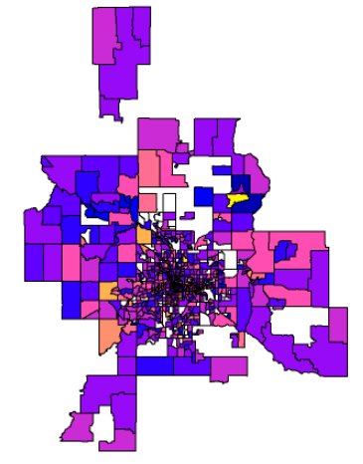
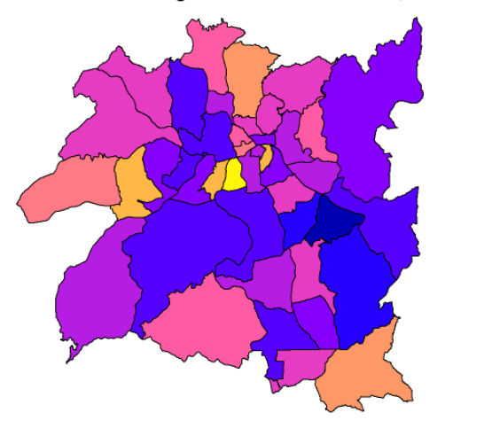
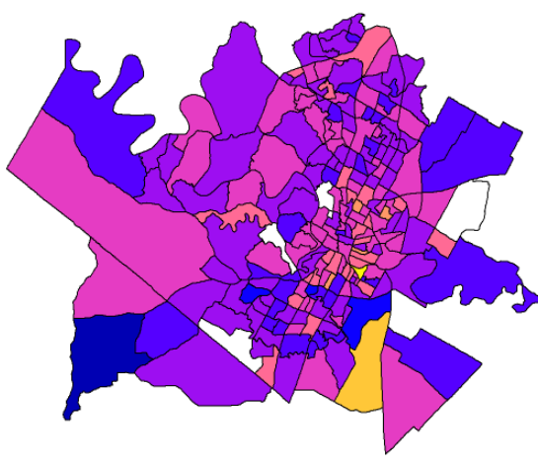
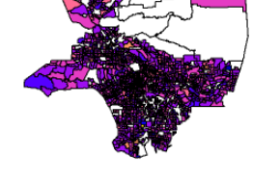
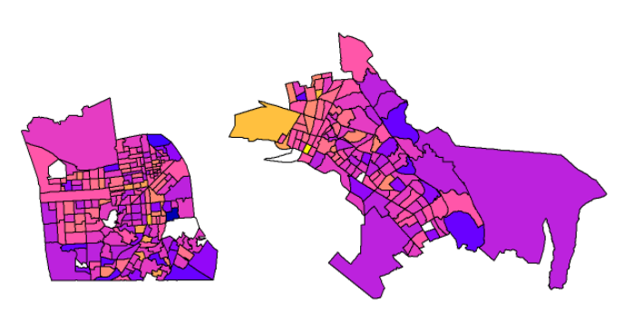
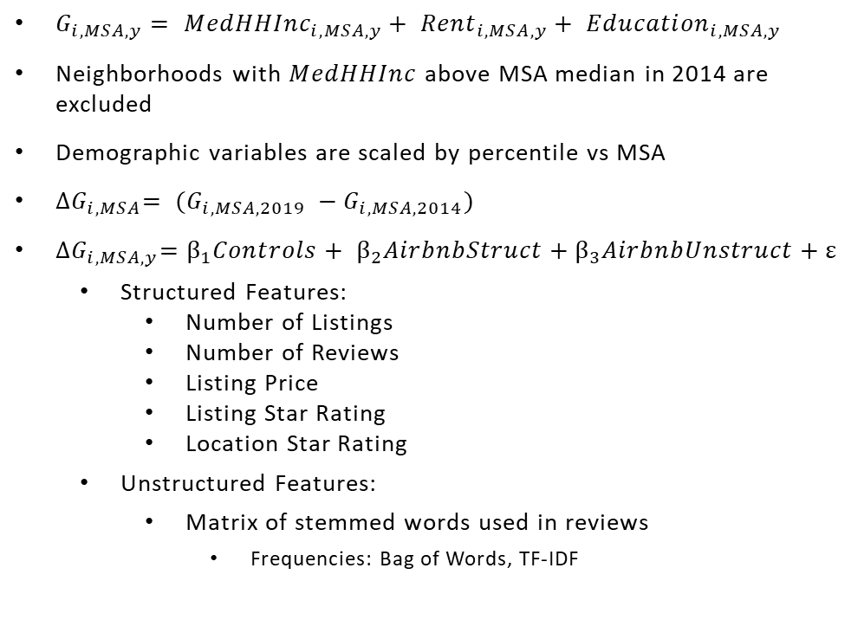
Methodology
$G_{i,MSA,y}= {MedHHInc}_{i,MSA,y}+ {Rent}_{i,MSA,y}+ {Education}_{i,MSA,y}$
Neighborhoods with $MedHHInc$above MSA median in 2014 are excluded
Demographic variables are scaled by percentile vs MSA
${∆G}_{i,MSA}= {(G_{i,MSA, 2019} −G}_{i,MSA, 2014})$
${∆G}_{i,MSA,y}=β_{1}Controls+ β_{2}AirbnbStruct+β_{3}AirbnbUnstruct+ε$
Structured Features:
Number of Listings
Number of Reviews
Listing Price
Listing Star Rating
Location Star Rating
Unstructured Features:
Matrix of stemmed words used in reviews
Frequencies: Bag of Words, TF-IDF

Slide 7
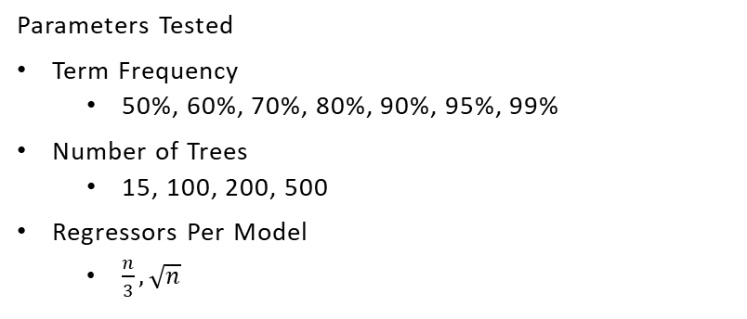
Results: Model Selection
Models Tested
Ridge Regression
Lasso Regression
Random Forest – Bag of Words
Random Forest – Term Frequency Inverse Document Frequency
Parameters Tested
Term Frequency
50%, 60%, 70%, 80%, 90%, 95%, 99%
Number of Trees
15, 100, 200, 500
Regressors Per Model
$\frac{n}{3},\sqrt{n}$
Final Model Specifications
Bag of Words & TF IDF
Sparsity: 70%
Number of Trees: 200
Regressors Per Model: 46
Final Model Results
R Squared
BOW: 13.04%
TF IDF: 9.9%
MSE
BOW: 0.00740
TF IDF: 0.00756

Slide 8
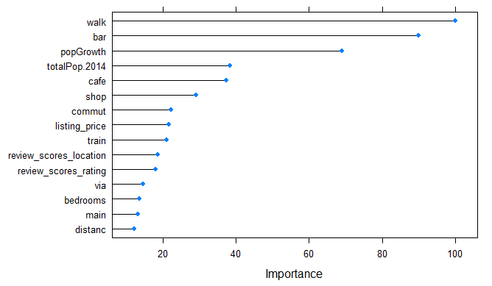
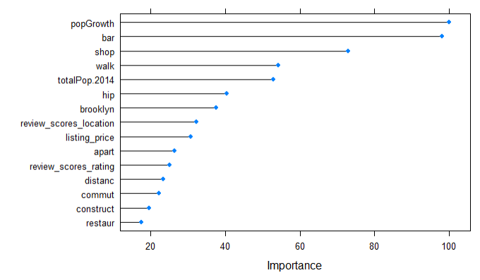
Results: Important Variables
Bag of Words
TF – IDF Model
In both models, unstructured features from Airbnb reviews add significant explanatory power.
Gentrification appears to be higher in growing and urban neighborhoods that are walkable, have bars, cafes, shops, transit, and positive reviews.

Slide 9
Thank You
Leo Kitchell
Claremont McKenna College
LKitchell21@cmc.edu

