Slide 1
Geolocalizing Twitch Ingest Servers
LEE, HSIN-YUN 李昕耘
Network and Systems Laboratory
Graduate Institute of Electrical Engineering
National Taiwan University

Slide 2
Outline
Introduction
Experiment Design
Packet Collection and RTT Measurement
Measurement Examination
Evaluate Experimental Results
Evaluate CBG - Shortest Distance Method
Conclusion

Slide 3
Introduction
Motivation
Prior Geolocation Methods
Goal
Reference Point and Target
VPN
Twitch Ingest Server
Contribution

Slide 4
Motivation
Importance of geolocalization
Limit resource/information availability to specific regions
Recommend different advertisement according to the region
Provide a nearby CDN server for the user with less delay time
Observe different online behaviors of people in different regions
Track the footprints of Cybercrime

Slide 5
Prior Geolocation Methods
Check existing databases
Verifies correspondence between [ip, geolocation] of DBs like MaxMind, NetAcuity
Reverse DNS
Use PTR record which stores the domain name corresponding to an IP to find the geolocation hint of an ip address
Measurement-based geolocation
Uses network latency to geolocalize target
Shortest Ping - 2001
GeoPing - 2001
Constraint-Based Geolocation (CBG) - 2004
45.113.130.250
DNS Server
User
video-edge-6ab7ae.tpe03.justin.tv

Slide 6
Goal
Evaluate measurement–based geolocation methods
Shortest Ping
GeoPing
Constraint-Based Geolocation (CBG)
Need reference points and targets

Slide 7
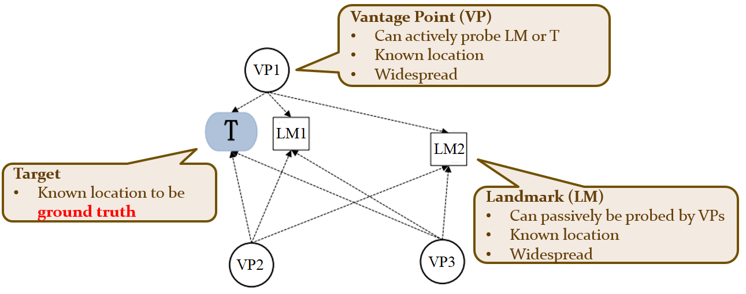
Reference Point and Target
Reference Point = VP+LM
Implement
Geolocation Methods
Geolocalize
Target
Evaluate the performance
probe
probe

Slide 8

VPN
Widespread
Known location
Can actively probe other LMs or targets ➔ VP
Can be probed simply by ping ➔ LM
➔ Reference Points (VP + LM) = VPN

Slide 9
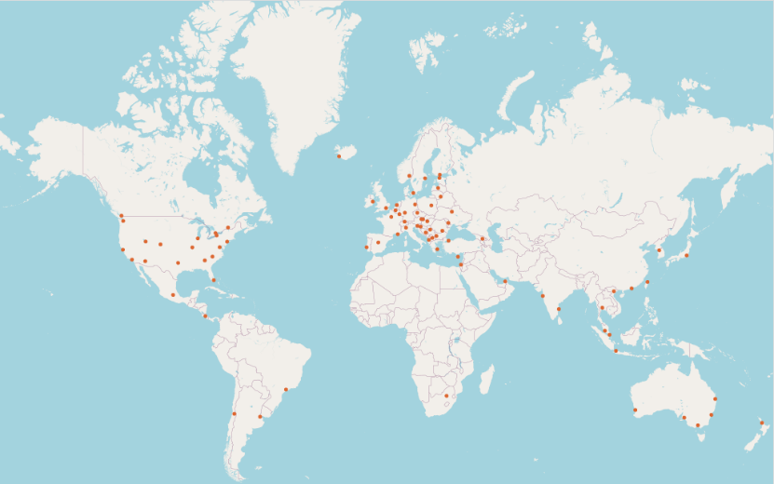
VPN Distribution
There about 5000 VPN servers distributed on 82 locations for geolocalizing the target

Slide 10

Twitch Ingest Server
Known location
Widespread
Allow streamers to upload live videos
➔ Target = Ingest Server
Viewer
Streamer
CDN Server
Upload
Distribute
CDN Server
Viewer
Streamer
.
.
.
Ingest Servers
Transcode
.
.
.
Viewer
Streamer
Twitch live video delivery architecture
CDN Server
Viewer

Slide 11
Contribution
Provide VPN as a new tool for geolocation method
Discover additional usefulness of VPN
Evaluate the performance of these existing methods with VPNs as reference
Provide a hybrid geolocation method for evaluation
We can use the best geolocation method to geolocalize other unknown location target with VPN

Slide 12
Experiment Design
Exploit VPN to Implement These Geolocation Methods
Shortest ping
GeoPing
CBG
Shortest Distance

Slide 13
Exploit VPN to Implement These Geolocation Methods
Implement these geolocation methods by using VPN as VPs and LMs, and using twitch ingest servers as targets
Shortest Ping
GeoPing
CBG
Shortest Distance

Slide 14
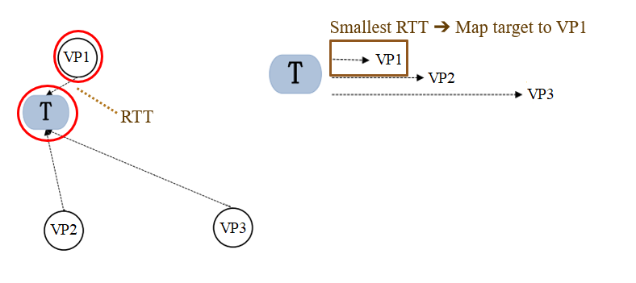
Shortest Ping
Calculate the RTT between each VP and the target
Map target to the VP location with the smallest RTT

Slide 15
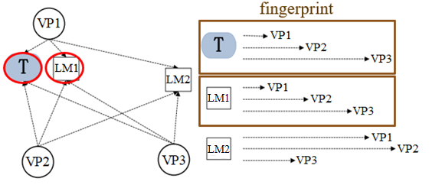
GeoPing
Calculate the RTT between all VP and a target to form a Target fingerprint
Calculate the RTT between all VP and a LM to form a LM fingerprint
If a LM fingerprint is more similar to Target fingerprint ➔ map target to the LM location

Slide 16
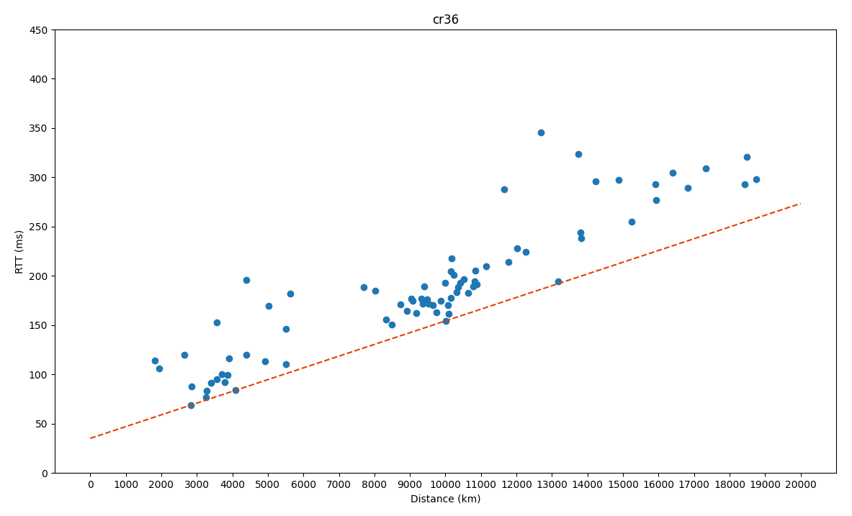
CBG
① RTT
② Geo-Distance
Calculate
Find the bestline “ ” with smallest total distance to all points “●”
Calculate to estimate
● e.g.
VP
All LMs symbol “●”
RTT
Geo-Distance
VP
Target
VP
Target
100 ms
converted by bestline
5500 km
VP: cr36
Target
VP: cr36
Target
Draw the circle
VP’s location as center
Estimated target distance as radius
VP: cr36
5500 km
cr36
target

Slide 17
CBG
Map target to the LM’s location covered by the most circles e.g.
VP1 ➔ Bestline1 ➔ Estimated target dist1 ➔ Circle1
VP2 ➔ Bestline2 ➔ Estimated target dist2 ➔ Circle2
VP3 ➔ Bestline3 ➔ Estimated target dist3 ➔ Circle3
LM “a” is covered by the most circles
➔ Map target to LM “a” location
VP2
dist2
d
b
a
VP3
dist1
VP1
c
dist3

Slide 18
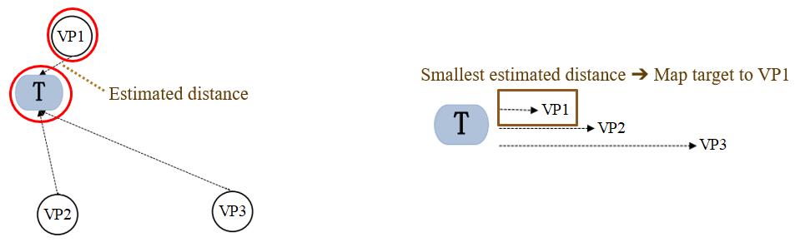
Shortest Distance
After getting all estimated target distance from VPs by bestlines
Map the target to the VP location with smallest estimated distance.

Slide 19
Packet Collection and RTT Measurement
These geolocation methods need the 3 RTTs
Get Packet Transmission and RTT between
NSLAB and VPN
VPN and Twitch Ingest Server
VPNs

Slide 20
Packet Collection Architecture
①
②
Ingest Server
NSLAB
VPN
③
Other 81 VPN (LM)
To Get ②
①
②
To Get ③
①
③
VPN 1
Probe Ingests
Ingest 1
VPN 1
Probe VPNs
VPN 1 (LM)
Connect to VPN
Connect to VPN
NSLAB
VPN 2
Ingest 2
NSLAB
VPN 2
VPN 2 (LM)
Get ① + ②
Get ① + ③
.
.
.
.
.
.
.
.
.
.
.
.
VPN 82
Ingest 60
VPN 82
VPN 82 (LM)

Slide 21
Get RTT1 between NSLAB and VPN
Packet Collection
Ping each VPN from NSLAB
Intercept the traffic
RTT Computation
Take the minimum RTT in all pairs
22:07:27.219059 IP 140.112.42.155 > 172.83.40.219: ICMP echo request, id 3, seq 16 ... 22:07:27.373360 IP 172.83.40.219 > 140.112.42.155: ICMP echo reply, id 3, seq 16 ...
NSLAB
VPN
RTT = 373.360 - 219.059
= 154.301 (ms)
VPN
NSLAB
VPN 1
ping
NSLAB
VPN 2
.
.
.
VPN 82

Slide 22
Get RTT2 between VPN and Twitch Ingest Server
Packet Collection
Twitch ingest servers block ICMP packets
Streaming on twitch to generate the traffic between VPN and ingest server
Intercept traffic
RTT2
VPN 1
Streaming
Ingest 1
Connect to VPN
NSLAB
VPN 2
Ingest 2
.
.
.
.
.
.
VPN 82
Ingest 60

Slide 23
Get RTT2 between VPN and Twitch Ingest Server
RTT Computation
If seqnum(i) = acknum(j) ➔ pair packet(i) and packet(j)
RTT = Time(j) – Time(i)
Take the min RTT in all pairs = RTT1 + RTT2
RTT2 = min RTT – RTT1
09:05:39.912347 IP 10.8.3.3.33882 > 52.223.218.164.1935: Flags [P.], seq 568718:569481 ...
…
09:05:39.986342 IP 52.223.218.164.1935 > 10.8.3.3.33882: Flags [.], ack 569481 ...
VPN
Ingest Server
RTT = 986.342 - 912.347 = 73.995 (ms)
Ingest Server
VPN
RTT1
RTT2
NSLAB
Connect
VPN
Streaming
Ingest
Get RTT1+RTT2
.
.
.
.
.
.
VPN 82
Ingest 60

Slide 24
Get RTT3 between VPNs
Packet Collection
Ping other 81 VPNs
Intercept traffic
RTT Computation
Take the min RTT in all pairs = RTT1 + RTT3
RTT3 = min RTT – RTT1
22:49:05.787483 IP 10.8.2.6 > 84.17.37.226: ICMP echo request, id 4, seq 39, length 64
22:49:06.122541 IP 84.17.37.226 > 10.8.2.6: ICMP echo reply, id 4, seq 39, length 64
VPN 1
RTT3
VPN 1 (LM)
ping
RTT1
Connect
NSLAB
VPN 2
VPN 2 (LM)
Get RTT1+RTT3
.
.
.
.
.
.
VPN 82
VPN 82 (LM)

Slide 25
Measurement Examination
RTT between NSLAB and VPN
RTT between VPN and Twitch Ingest Server
RTT between VPNs

Slide 26
RTT1 between NSLAB and VPN
Asia
RTT1
Oceania
NSLAB
VPN
North America
South America
Europe
Africa
VPN | RTT_{(ms)} | VPN | RTT_{(ms)} | VPN | RTT_{(ms)} | VPN | RTT_{(ms)}
Taipei | 27 | Phoenix | 143 | Chisinau | 227 | Sofia | 263
Tokyo | 33 | Seattle | 151 | Warsaw | 229 | Steinsel | 263
Seoul | 52 | Salt Lake City | 158 | Vilnius | 231 | Tirana | 265
Hong Kong | 57 | Vancouver | 158 | Marseille | 232 | Sarajevo | 271
Kuala Lumpur | 72 | Denver | 163 | Milan | 233 | Tallinn | 272
Hanoi | 76 | Kansas City | 172 | Paris | 235 | Skopje | 272
Bangkok | 77 | Dallas | 172 | Riga | 235 | Reykjavik | 274
Singapore | 79 | Saint Louis | 186 | Brussels | 237 | Oslo | 276
Mumbai | 132 | Toronto | 190 | Frankfurt | 240 | Prague | 283
Istanbul | 249 | Chicago | 191 | Dublin | 243 | Ukraine | 283
Nicosia | 315 | Buffalo | 197 | London | 244 | Copenhagen | 285
Tel Aviv | 317 | Manassas | 198 | Amsterdam | 244 | Budapest | 286
Jakarta | 72 | New York | 198 | Lisbon | 245 | Athens | 289
Perth | 125 | Charlotte | 199 | Berlin | 246 | Helsinki | 290
Sydney | 131 | Montreal | 200 | Vienna | 251 | Stockholm | 296
Adelaide | 138 | Atlanta | 201 | Bratislava | 251 | Bucharest | 302
Melbourne | 141 | Miami | 203 | Madrid | 252 | Brazil | 310
Brisbane | 146 | Mexico | 195 | Zagreb | 254 | Tbilisi | 340
Auckland | 157 | San Jose | 263 | Ljubljana | 254 | Johannesburg | 372
Los Angeles | 130 | Santiago | 297 | Belgrade | 258
San Francisco | 136 | Buenos Aires | 337 | Zurich | 263
small
large
small

Slide 27
RTT between NSLAB across VPN and Twitch Ingest Server
RTT1
RTT2
NSLAB
VPN
Ingest server
 | Sydney | HK | Tokyo | Singapore | Copenhagen | Helsinki | London | Toronto | New York | Atlanta
Sydney | 132.103 | 254.181 | 295.18 | 223.025 | 389.237 | 394.846 | 376.974 | 375.431 | 382.195 | 312.87
HK | 218.907 | 23.535 | 73.56 | 55.603 | 275.262 | 290.616 | 216.386 | 209.839 | 225.084 | 220.447
Tokyo | 238.654 | 79.097 | 32.411 | 112.291 | 279.971 | 294.323 | 253.646 | 186.823 | 194.565 | 188.146
Singapore | 338.148 | 134.129 | 175.082 | 101.122 | 359.147 | 366.235 | 282.554 | 323.063 | 328.543 | 319.671
Copenhagen | 596.341 | 493.471 | 539.332 | 462.212 | 287.089 | 296.306 | 305.503 | 385.26 | 375.167 | 391.109
Helsinki | 616.653 | 529.269 | 536.325 | 454.795 | 282.18 | 274.17 | 298.439 | 367.873 | 357.72 | 374.585
London | 641.08 | 525.425 | 524.739 | 523.938 | 291.46 | 302.197 | 273.422 | 352.468 | 354.676 | 361.098
Toronto | 470.609 | 464.409 | 450.086 | 466.825 | 292.419 | 300.672 | 288.631 | 199.619 | 209.708 | 225.391
New York | 495.777 | 419.674 | 343.896 | 424.664 | 289.366 | 297.646 | 270.48 | 211.532 | 201.864 | 218.981
Atlanta | 479.777 | 458.404 | 435.509 | 448.14 | 307.378 | 317.794 | 296.766 | 227.145 | 221.98 | 201.424
Ingest
VPN
Ingest
Connected VPN

Slide 28
Unadjusted RTT2 between VPN and Twitch Ingest Server
RTT2
VPN
Ingest server
 | Sydney | HK | Tokyo | Singapore | Copenhagen | Helsinki | London | Toronto | New York | Atlanta
Sydney | 1.103 | 123.181 | 164.18 | 92.025 | 258.237 | 263.846 | 245.974 | 244.431 | 251.195 | 181.87
HK | 161.907 | -33.465 | 16.56 | -1.397 | 218.262 | 233.616 | 159.386 | 152.839 | 168.084 | 163.447
Tokyo | 205.654 | 46.097 | -0.589 | 79.291 | 246.971 | 261.323 | 220.646 | 153.823 | 161.565 | 155.146
Singapore | 259.148 | 55.129 | 96.082 | 22.122 | 280.147 | 287.235 | 203.554 | 244.063 | 249.543 | 240.671
Copenhagen | 311.341 | 208.471 | 254.332 | 177.212 | 2.089 | 11.306 | 20.503 | 100.26 | 90.167 | 106.109
Helsinki | 326.653 | 239.269 | 246.325 | 164.795 | -7.82 | -15.83 | 8.439 | 77.873 | 67.72 | 84.585
London | 397.08 | 281.425 | 280.739 | 279.938 | 47.46 | 58.197 | 29.422 | 108.468 | 110.676 | 117.098
Toronto | 280.609 | 274.409 | 260.086 | 276.825 | 102.419 | 110.672 | 98.631 | 9.619 | 19.708 | 35.391
New York | 297.777 | 221.674 | 145.896 | 226.664 | 91.366 | 99.646 | 72.48 | 13.532 | 3.864 | 20.981
Atlanta | 278.777 | 257.404 | 234.509 | 247.14 | 106.378 | 116.794 | 95.766 | 26.145 | 20.98 | 0.424
Ingest
VPN
Ingest
Connected VPN

Slide 29
Adjust the RTT2 between VPN and Twitch Ingest Server
For each VPN, if there is a RTT between this VPN and an ingest server is minimum and < 0
➔ Each RTT between this VPN and each ingest server is subtracted by this RTT
VPN
Ingest
 | Sydney | Hong Kong | Tokyo | Singapore | Copenhagen | Helsinki | London | Toronto | New York | Atlanta
Helsinki | 326.653 | 239.269 | 246.325 | 164.795 | -7.820 | -15.830 | 8.439 | 77.873 | 67.720 | 84.585
Subtract -15.830
VPN
Ingest
 | Sydney | Hong Kong | Tokyo | Singapore | Copenhagen | Helsinki | London | Toronto | New York | Atlanta
Helsinki | 342.483 | 255.099 | 262.155 | 180.625 | 8.010 | 0 | 24.269 | 93.703 | 83.550 | 100.415

Slide 30
Adjusted RTT2 between VPN and Twitch Ingest Server
Adjusted RTT2
RTT is very small if the VPN and ingest server are in the same city
RTT is small if the VPN and ingest server are in the same continent
is similar to in the same continent
VPN
Ingest server
VPN A
RTT
Ingest B
VPN B
RTT
Ingest A
 | Sydney | HK | Tokyo | Singapore | Copenhagen | Helsinki | London | Toronto | New York | Atlanta
Sydney | 1.103 | 123.181 | 164.18 | 92.025 | 258.237 | 263.846 | 245.974 | 244.431 | 251.195 | 181.87
HK | 195.372 | 0 | 50.025 | 32.068 | 251.727 | 267.081 | 192.851 | 186.304 | 201.549 | 196.912
Tokyo | 206.633 | 47.076 | 0.39 | 80.27 | 247.95 | 262.302 | 221.625 | 154.802 | 162.544 | 156.125
Singapore | 259.148 | 55.129 | 96.082 | 22.122 | 280.147 | 287.235 | 203.554 | 244.063 | 249.543 | 240.671
Copenhagen | 311.341 | 208.471 | 254.332 | 177.212 | 2.089 | 11.306 | 20.503 | 100.26 | 90.167 | 106.109
Helsinki | 342.483 | 255.099 | 262.155 | 180.625 | 8.01 | 0 | 24.269 | 93.703 | 83.55 | 100.415
London | 397.08 | 281.425 | 280.739 | 279.938 | 47.46 | 58.197 | 29.422 | 108.468 | 110.676 | 117.098
Toronto | 280.609 | 274.409 | 260.086 | 276.825 | 102.419 | 110.672 | 98.631 | 9.619 | 19.708 | 35.391
New York | 297.777 | 221.674 | 145.896 | 226.664 | 91.366 | 99.646 | 72.48 | 13.532 | 3.864 | 20.981
Atlanta | 284.676 | 263.303 | 240.408 | 253.039 | 112.277 | 122.693 | 101.665 | 32.044 | 26.879 | 6.323
Ingest
Connected VPN

Slide 31
RTT3 between VPNs
Adjusted RTT3
VPN
81 VPN (LM)
RTT is small if the two VPNs are in the same continent
is similar to in the same continent
Connected VPN A
VPN B (LM)
Connected VPN B
VPN A (LM)
RTT
RTT
VPN (LM)
 | Sydney | HK | Tokyo | Singapore | Copenhagen | Helsinki | London | Toronto | New York | Atlanta
Sydney | 0 | 122.204 | 99.093 | 92.21 | 256.181 | 322.814 | 253.441 | 188.256 | 194.397 | 184.645
HK | 123.033 | 0 | 47.197 | 32.196 | 246.841 | 311.243 | 238.894 | 222.636 | 199.757 | 215.802
Tokyo | 98.683 | 52.488 | 0 | 67.136 | 257.347 | 253.619 | 262.827 | 167.999 | 149.161 | 148.153
Singapore | 89.111 | 27.441 | 64.278 | 0 | 160.006 | 296.646 | 158.658 | 225.663 | 223.335 | 213.66
Copenhagen | 258.689 | 211.614 | 260.211 | 164.062 | 0 | 18.888 | 24.066 | 101.833 | 87.252 | 114.558
Helsinki | 307.33 | 254.472 | 248.76 | 301.343 | 0.866 | 0 | 17.486 | 100.532 | 85.356 | 99.915
London | 246.251 | 182.36 | 248.936 | 157.464 | 17.287 | 31.706 | 0 | 74.936 | 70.755 | 84.484
Toronto | 188.125 | 210.895 | 168.035 | 227.785 | 99.421 | 115.375 | 81.785 | 0 | 20.04 | 35.252
New York | 183.989 | 208.616 | 138.067 | 219.023 | 74.646 | 90.667 | 62.923 | 10.1 | 0 | 8.267
Atlanta | 234.989 | 201.367 | 135.265 | 206.119 | 92.839 | 102.305 | 77.483 | 22.181 | 7.992 | 0
Connected VPN

Slide 32
Evaluate Experimental Results
Evaluation Methodology
Result of Target Mapping by Each Geolocation Methods
Ground Truth
Evaluation Parameter
Rank Difference
Error Distance
Evaluation Result

Slide 33
Evaluation Methodology
Result of target mapping by each geolocation methods
Ground Truth
Ingest: Toronto |  | Shortest Ping |  | GeoPing |  | CBG |  | Shortest Dist
Mapping Priority | VPN | RTT _{(ms)} | VPN | Eu_Dist | VPN | Covers _{(circles)} | VPN | Estimated Dist­ _{(km)}
1 | Toronto | 9.619 | Chicago | 223.660 | Toronto | 6 | Chicago | 703.764
2 | Chicago | 9.901 | Saint-Louis | 233.070 | Chicago | 5 | Toronto | 795.801
3 | Montreal | 11.994 | Miami | 240.357 | Manassas | 5 | Montreal | 855.075
4 | New York | 13.532 | Manassas | 248.048 | Buffalo | 5 | New York | 1170.576
5 | Manassas | 16.844 | Montreal | 250.196 | Montreal | 4 | Saint-Louis | 1285.269
6 | Saint-Louis | 17.364 | Buffalo | 254.543 | New York | 4 | Manassas | 1393.594
7 | Charlotte | 27.803 | Toronto | 260.993 | Saint-Louis | 3 | Charlotte | 2233.570
Ingest server (Target) | Corresponding VPN (Ground Truth)
Helsinki | Helsinki
London3 | London
London4 | London
Berlin | Berlin
Düsseldorf1 | Brussels / Amsterdam
Houston | Dallas
Toronto | Toronto
Singapore | Singapore
Seoul1 | Seoul

Slide 34
Evaluation Parameter
Rank Difference
If the mapping priority is k ➔ rank difference will be k-1
Error Distance
Geo-distance between a mapped VPN geolocation and the Target’s ground truth location
Ingest: Toronto |  | Shortest Ping |  | GeoPing |  | CBG |  | Shortest Dist
Rank Different | VPN | RTT _{(ms)} | VPN | Eu_Dist | VPN | Covers _{(circles)} | VPN | Estimated Dist­ _{(km)}
0 | Toronto | 9.619 | Chicago | 223.660 | Toronto | 6 | Chicago | 703.764
1 | Chicago | 9.901 | Saint-Louis | 233.070 | Chicago | 5 | Toronto | 795.801
2 | Montreal | 11.994 | Miami | 240.357 | Manassas | 5 | Montreal | 855.075
3 | New York | 13.532 | Manassas | 248.048 | Buffalo | 5 | New York | 1170.576
4 | Manassas | 16.844 | Montreal | 250.196 | Montreal | 4 | Saint-Louis | 1285.269
5 | Saint-Louis | 17.364 | Buffalo | 254.543 | New York | 4 | Manassas | 1393.594
6 | Charlotte | 27.803 | Toronto | 260.993 | Saint-Louis | 3 | Charlotte | 2233.570
Ingest: Toronto | Shortest Ping | GeoPing | CBG | Shortest Dist
Mapped VPN | Toronto | Chicago | Toronto | Chicago
Error Distance (km) | 0 | 701 | 0 | 701

Slide 35
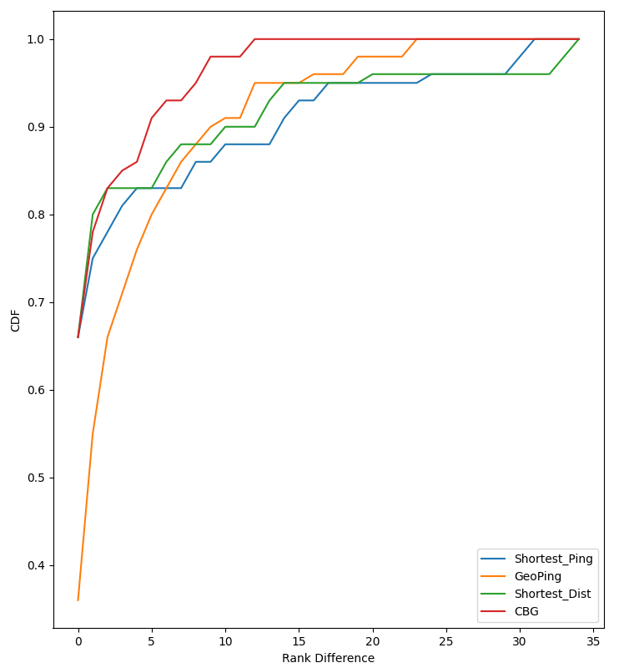
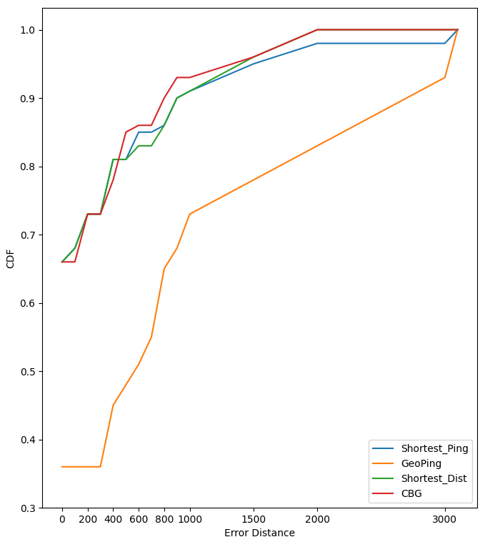
Evaluation Result
Rank 3 4 2 1
Rank 3 4 2 1 | Total error (km) 16249 48528 13139 12435

Slide 36
Evaluate CBG - Shortest Distance Method
Introduction of CBG - Shortest Distance Method
Evaluation on Hybrid Method

Slide 37
Introduction of Hybrid Method
In each VPN:
Circle Cover is more ➔ higher Cover Rank
Estimated distance to target is smaller ➔ higher Short distance Rank
Each rank give point_cover and point_dist to form a scaled score
Look up the scaled score to convert the rank to point to get total point
Map Target to the VPN location with highest total point
Scaled score
Target: Toronto ingest server
Rank | point_cover | point_dist
1 | 100 | 100
2 | 95 | 90
3 | 90 | 80
4 | 87 | 77
5 | 84 | 74
6 | 81 | 71
VPN | Circle Covers | Estimated dist
New York | 4 | 1170.576
Toronto | 6 | 795.801
Manassas | 5 | 1393.594
. | . | .
. | . | .
VPN | Cover Rank | Short dist Rank
New York | 5 | 4
Toronto | 1 | 2
Manassas | 2 | 6
. | . | .
. | . | .
VPN | point_ cover | point_ dist | Total
New York | 84 | 77 | 161
Toronto | 100 | 90 | 190
Manassas | 95 | 71 | 166
. | . | . | .
. | . | . | .

Slide 38
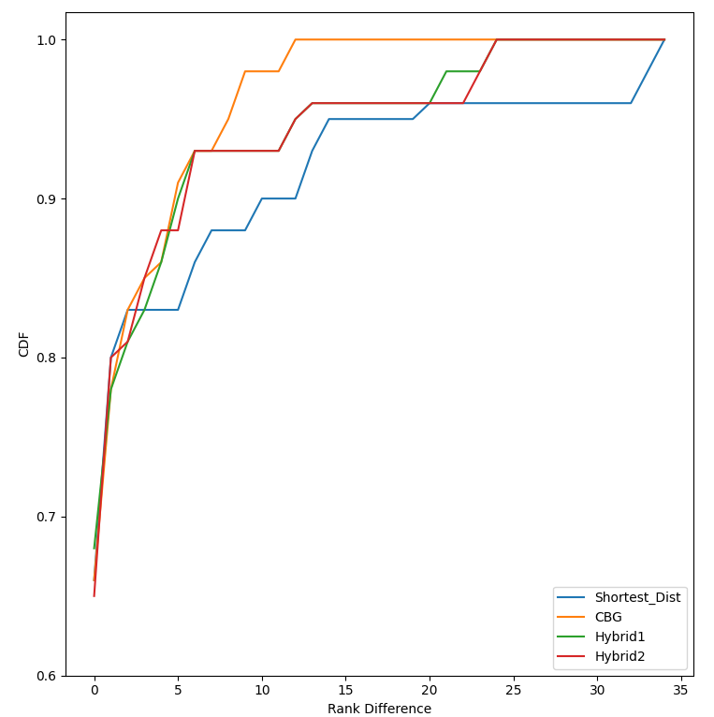
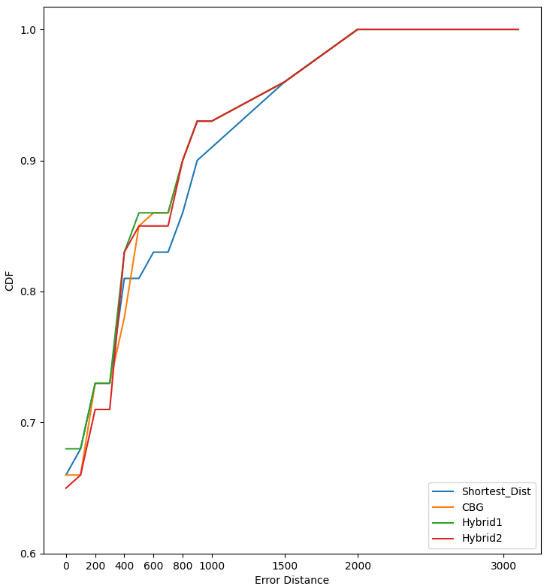
Evaluation on Hybrid Method
Rank 4 1 3 2
Rank 4 3 1 2 | Total error (km) 13139 12435 11608 12239

Slide 39
Conclusion
The goal of this study is to evaluate the performance of existing geolocation methods that helps choose appropriate methods for future geolocalization
Among the four methods: Shortest Ping, GeoPing, CBG, and Shortest Distance, CBG method outperform than others
Hybrid method may lead to better performance which provides a hint for the development of future geolocation methods

Slide 40
Q&A

Slide 41
Get VPN Information
Use the command to get a json format VPN information curl --silent "https://api.nordvpn.com/v1/servers?limit=50000" | jq
"id": 963593,
"created_at": "2020-06-09 10:37:53",
"updated_at": "2022-04-13 17:44:24",
"name": "Japan #556",
"station": "89.187.161.144",
"ipv6_station": "",
"hostname": "jp556.nordvpn.com",
"load": 21,
"status": "online",
"locations":
"id": 3984,
"created_at": "2018-06-18 14:45:14",
"updated_at": "2018-06-18 14:45:14",
"country":
"id": 108,
"name": "Japan",
"code": "JP",
"city":
"id": 4633349,
"name": "Tokyo",
"latitude": 35.685,
"longitude": 139.751389,
"dns_name": "tokyo",

Slide 42
Establish a VPN List
Codename | jp566
IP | 89.187.161.144
Country | Japan
City | Tokyo
Latitude | 35.685
Longitude | 139.751
VPN List:
Location 1: [latitude1], [longitude1], [Country1], [City1], [numbers of Servers1], [codename 1.1], [codename 1.2], [codename 1.3], ...
Location 2: [latitude2], [longitude2], [Country2], [City2], [numbers of Servers2], [codename 2.1], [codename 2.2], [codename 2.3], ...
.
.
.

Slide 43
VPN Selection
Select exactly one VPN for one location.
R1: VPs perspectives are the same
R2: LMs are also in the same location
R3: Select at least one VPN from different locations to avoid wasting VPN resources
Select exactly one VPN
Location 1: [latitude1], [longitude1], [Country1], [City1], [numbers of Servers1], [codename 1.1], [codename 1.2], [codename 1.3], ...
Location 2: [latitude2], [longitude2], [Country2], [City2], [numbers of Servers2], [codename 2.1], [codename 2.2], [codename 2.3], ...
.
.
.
Select exactly one VPN

Slide 44
The Reason Why RTT May < 0
RTT1_{ping} > RTT1_{connection} + RTT2
RTT2 is small ➔ imply VPN is close to ingest server
RTT1_{ping} : low priority ➔ more delay time
RTT1_{connection} : high priority ➔ less delay time
NSLAB
VPN
Ingest server
RTT1_{connection}
RTT2
RTT1_{ping}
NSLAB
VPN
Decrease RTT1_{ping}
After adjustment RTT1_{ping}
NSLAB
VPN
RTT1_{connection} + RTT2 - RTT1_{ping} = 0
=> RTT2 = 0

Slide 45
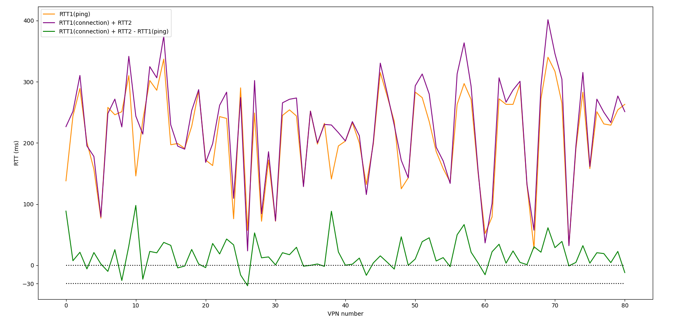
Distribution of RTT_{min}
For each VPN, RTT_{min} = RTT1_{connection} + RTT2 - RTT1_{ping}
-15.830
Helsinki
e.g. Minimum RTT between VPN_{Helsinki} and all ingest servers is RTT_{min} = -15.830 ms
VPN
Ingest
 | Sydney | HK | Tokyo | Singapore | Copenhagen | Helsinki | London | Toronto | New York | Atlanta
Helsinki | 326.653 | 239.269 | 246.325 | 164.795 | -7.820 | -15.830 | 8.439 | 77.873 | 67.720 | 84.585

Slide 46
Evaluation Result on Rank Difference
Count the number of ground truth of each Rank Difference under each method
E.g. Shortest Ping have 40 ground truth in the first mapping priority , and 5 ground truth are ranked 2th priority of mapping
Rank Diff. | Shortest Ping | GeoPing | Shortest Dist | CBG
0 | 40 | 22 | 40 | 40
1 | 5 | 11 | 8 | 7
2 | 2 | 7 | 2 | 3
3 | 2 | 3 | 0 | 1
4 | 1 | 3 | 0 | 1
5 | 0 | 2 | 0 | 3
6 | 0 | 2 | 2 | 1
7 | 0 | 2 | 1 | 0
8 | 2 | 1 | 0 | 1
9 | 0 | 1 | 0 | 2
≥ 10 | 8 | 6 | 7 | 1

Slide 47
Evaluation Result on Error Distance
Count the number of mapped VPN of each Error Distance region under each method
E.g. Shortest Ping have 40 mapped VPN’s error distance are 0, and 3 mapped VPN’s error distance are located in 100~200 km
Error Dist. | Shortest Ping | GeoPing | Shortest Dist | CBG
0 km | 40 | 22 | 40 | 40
50~100 | 1 | 0 | 1 | 0
100~200 | 3 | 0 | 3 | 4
200~300 | 0 | 0 | 0 | 0
300~400 | 5 | 5 | 5 | 3
400~500 | 0 | 2 | 0 | 4
500~600 | 2 | 2 | 1 | 1
600~700 | 0 | 2 | 0 | 0
700~800 | 1 | 6 | 2 | 2
800~900 | 2 | 2 | 2 | 2
900~1000 | 1 | 3 | 1 | 0
1000~1500 | 2 | 3 | 3 | 2
1500~2000 | 2 | 3 | 2 | 2
2000~3000 | 0 | 6 | 0 | 0
> 3000 km | 1 | 4 | 0 | 0

Slide 48
Evaluation Result
Rank Diff. | Shortest Ping | GeoPing | Shortest Dist | CBG
0 | 66 | 36 | 66 | 66
1 | 75 | 55 | 80 | 78
2 | 78 | 66 | 83 | 83
3 | 81 | 71 | 83 | 85
4 | 83 | 76 | 83 | 86
5 | 83 | 80 | 83 | 91
6 | 83 | 83 | 86 | 93
7 | 83 | 86 | 88 | 93
8 | 86 | 88 | 88 | 95
9 | 86 | 90 | 88 | 98
≥ 10 | 100 | 100 | 100 | 100
Error Dist. | Shortest Ping | GeoPing | Shortest Dist | CBG
0 km | 66 | 36 | 66 | 66
50~100 | 68 | 36 | 68 | 66
100~200 | 73 | 36 | 73 | 73
200~300 | 73 | 36 | 73 | 73
300~400 | 81 | 45 | 81 | 78
400~500 | 81 | 48 | 81 | 85
500~600 | 85 | 51 | 83 | 86
600~700 | 85 | 55 | 83 | 86
700~800 | 86 | 65 | 86 | 90
800~900 | 90 | 68 | 90 | 93
900~1000 | 91 | 73 | 91 | 93
1000~1500 | 95 | 78 | 96 | 96
1500~2000 | 98 | 83 | 100 | 100
2000~3000 | 98 | 93 | 100 | 100
> 3000 km | 100 | 100 | 100 | 100
Total err(km) | 16249 | 48528 | 13139 | 12435
Cumulative probability of rank difference (in %)
Cumulative probability error distance (in %)

Slide 49
Evaluation on Hybrid Method
Rank Diff. | Shortest Dist | CBG | Hybrid1 | Hybrid2
0 | 66 | 66 | 68 | 65
1 | 80 | 78 | 78 | 80
2 | 83 | 83 | 81 | 81
3 | 83 | 85 | 83 | 85
4 | 83 | 86 | 86 | 88
5 | 83 | 91 | 90 | 88
6 | 86 | 93 | 93 | 93
7 | 88 | 93 | 93 | 93
8 | 88 | 95 | 93 | 93
9 | 88 | 98 | 93 | 93
≥ 10 | 100 | 100 | 100 | 100
Error Dist. | Shortest Dist | CBG | Hybrid1 | Hybrid2
0 km | 66 | 66 | 68 | 65
50~100 | 68 | 66 | 68 | 66
100~200 | 73 | 73 | 73 | 71
200~300 | 73 | 73 | 73 | 71
300~400 | 81 | 78 | 83 | 83
400~500 | 81 | 85 | 86 | 85
500~600 | 83 | 86 | 86 | 85
600~700 | 83 | 86 | 86 | 85
700~800 | 86 | 90 | 90 | 90
800~900 | 90 | 93 | 93 | 93
900~1000 | 91 | 93 | 93 | 93
1000~1500 | 96 | 96 | 96 | 96
1500~2000 | 100 | 100 | 100 | 100
2000~3000 | 100 | 100 | 100 | 100
> 3000 km | 100 | 100 | 100 | 100
Total err(km) | 13139 | 12435 | 11608 | 12239
Cumulative probability of rank difference (in %)
Cumulative probability error distance (in %)

Slide 50
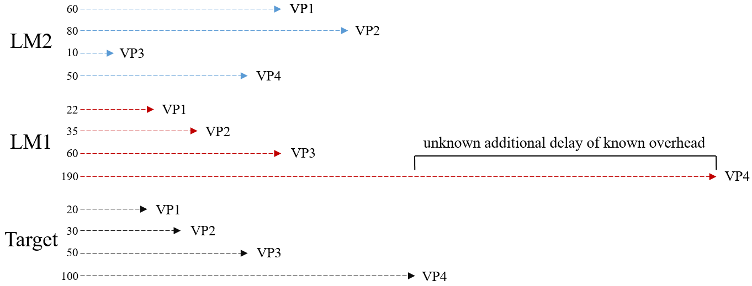

Why GeoPing perform Poorly
$$Euclidean distance of two fingerprint= \sqrt{\sum_{i=1}^{ 82}{{RTT_difference}^{2}}}$$

