Slide 1
Simple model of landslide failure surface and displacement
Developing a python interface to estimate the SLBL surface and the displacement according to the model, and comparing to field data
Léo Letellier - intern
UNIL – Risk Group
08/2023

Slide 2
SFA - Setup
Install python using miniconda
Run install_miniconda.bat
Configure a virtual environment installing needed packages
Run env_setup.bat
Start the python interface
Run SFA.bat
All the process is automated within the bat files, all that is needed is to launch them one by one and wait that the console window disappear before launching the next one. Once the virtual environment is ready, you just need to launch SFA when you need it, no need to modify again the environment.

Slide 3
Warning:
The graphs displayed by this interface are powered by matplotlib. The majority of them are displayed with automatic scale. Thus the scale is often different for the axis. With different scales, the displayed angles are actually deformed. Consider manual adjustment in the graph parameters if you need angle accuracy for display purpose. A checkable button next to the graph button allows to set the same scale for each axis if checked.

Slide 4
Preparing the data
All points must be sorted according to the x-axis.
Be wary that python use a dot decimal separator (« 3.1415 » instead of « 3,1415 »).
The column order in the loaded files is important, please refer to the README file.

Slide 5

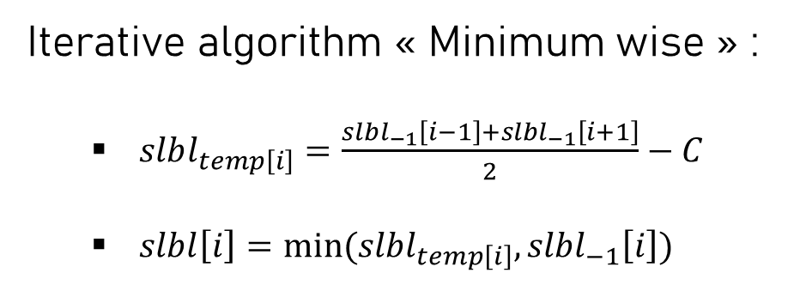
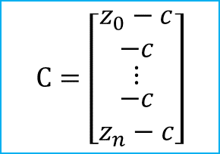
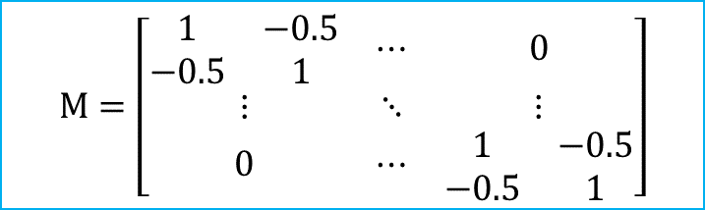
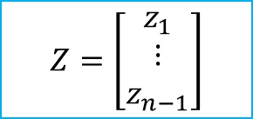
Modeling the failure surface : SLBL approach
Overview of the method:
Toward preliminary hazard assessment using DEM topographic analysis and simple mechanic modelling by mean of the sloping local base level, Jaboyedoff et al., 2004
Iterative algorithm « Minimum wise » :
$slbl_{temp\left[i\right]}=\frac{{slbl}_{−1}\left[i−1\right]+{slbl}_{−1}\left[i+1\right]}{2}−C$
$slbl\left[i\right]=min⁡(slbl_{temp\left[i\right]},{slbl}_{−1}\left[i\right])$
Matrix expression:
$$M.Z=C$$
C is a tolerance parameter relative to the landslide geometric features
$$M=\left[\begin{matrix}\begin{matrix}1 & −0.5 \\ −0.5 & 1\end{matrix} & ⋯ & 0 \\ ⋮ & ⋱ & ⋮ \\ 0 & ⋯ & \begin{matrix}1 & −0.5 \\ −0.5 & 1\end{matrix}\end{matrix}\right]$$
$$C=\left[\begin{matrix}\begin{matrix}z_{0}−c \\ −c\end{matrix} \\ ⋮ \\ \begin{matrix}−c \\ z_{n}−c\end{matrix}\end{matrix}\right]$$
$$Z=\left[\begin{matrix}z_{1} \\ ⋮ \\ z_{n−1}\end{matrix}\right]$$
z
x
Case 1
Case 2
Minimum is temp value
Minimum is current value

Slide 6
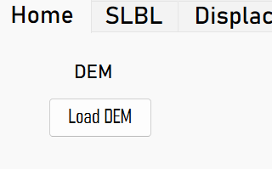
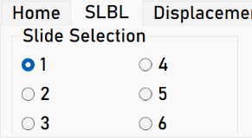
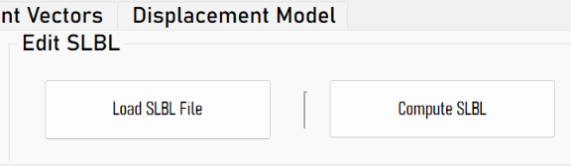
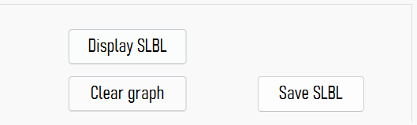
Modeling the failure surface : SLBL approach
Implementation in the python interface:
1. Loading the DEM along the profile
3. SLBL can be loaded from a file or computed
2. Selecting the memory slot to edit
The SLBL data it computed according to the points of the DEM.
Six SLBL can be stored at the same time.
The file formats are specified in the README.md.
Opens the window for computation.
4. Display the computed SLBL
5. Export the computed SLBL for external use
Display the SLBL of the selected slot along with the DEM.

Slide 7
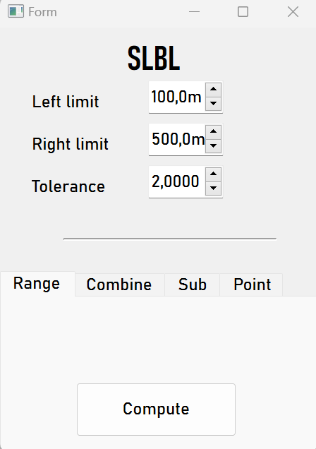
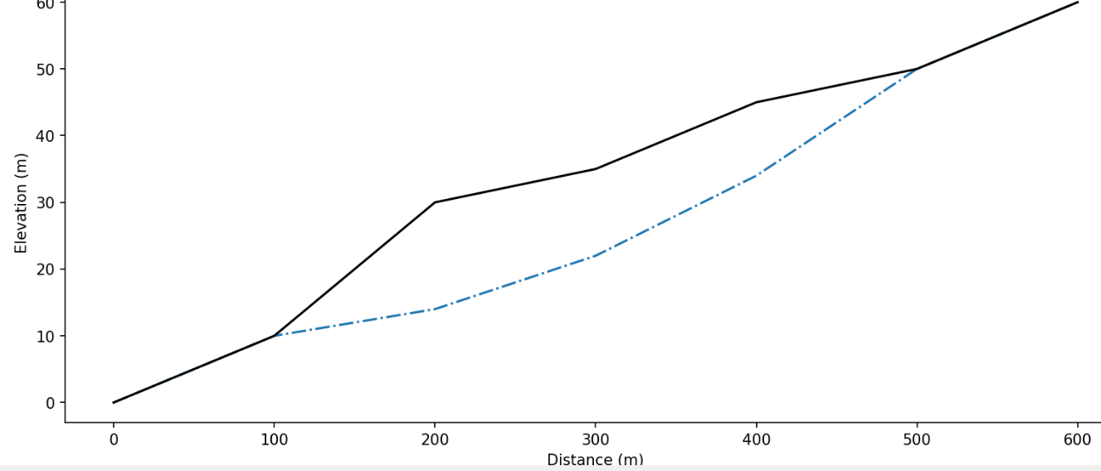
Modeling the failure surface : SLBL approach
Compute SLBL with known range within the cross-section:
C value
Left limit
Right limit

Slide 8
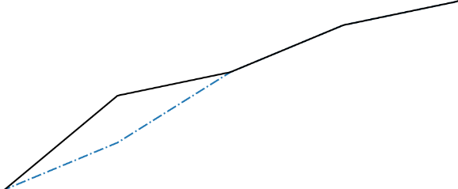
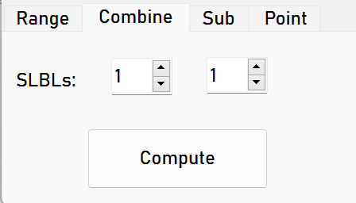
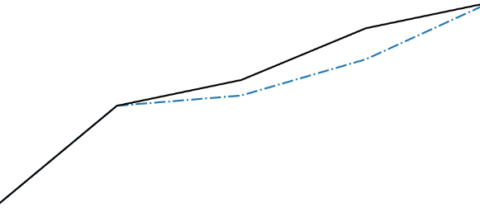
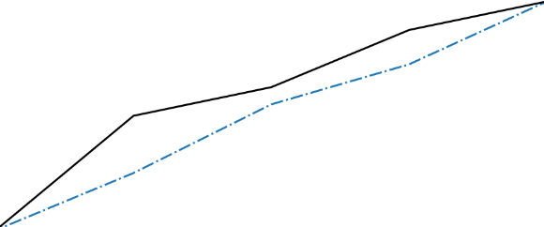
Modeling the failure surface : SLBL approach
Compute SLBL using two existing features:
Content of slot 1:
Slot references
+
2
Content of slot 2:
Minimum of two features (SLBL)

Slide 9
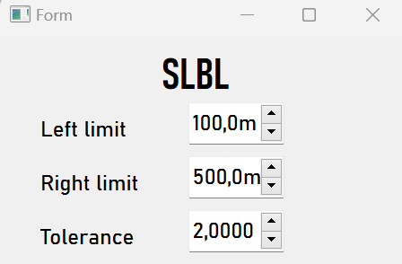
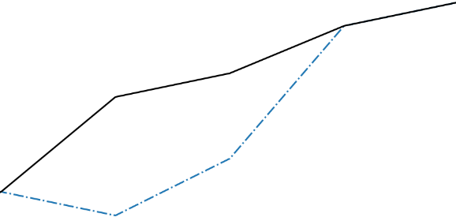
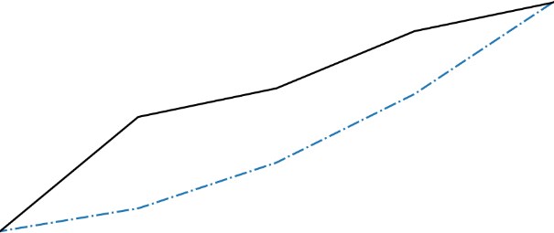
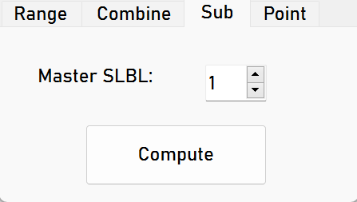
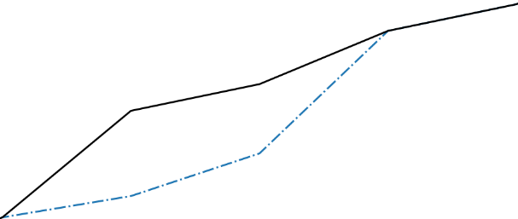
Modeling the failure surface : SLBL approach
Compute SLBL using one existing features:
Computed as range
+
Content of master
Maximum of two features (SLBL, faults, …)

Slide 10
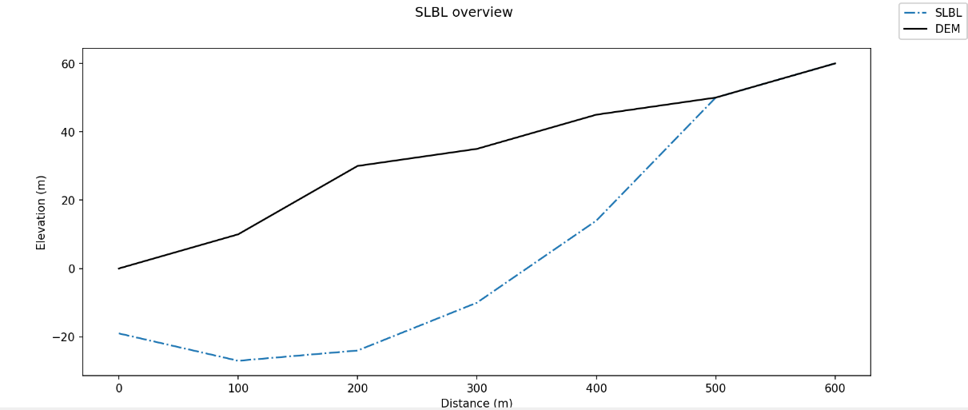

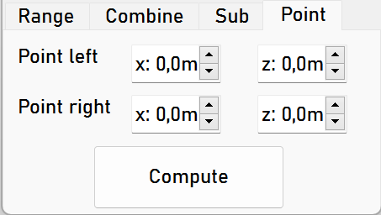
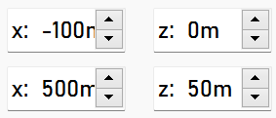
Modeling the failure surface : SLBL approach
Compute SLBL using two points (inside or outside cross-section):
Point right [x,z]
Point left [x,z]

Slide 11
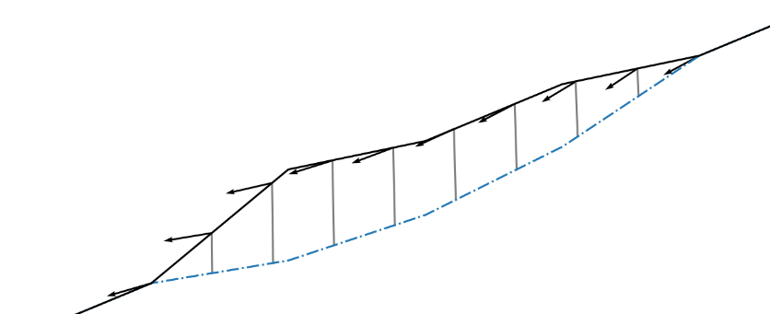
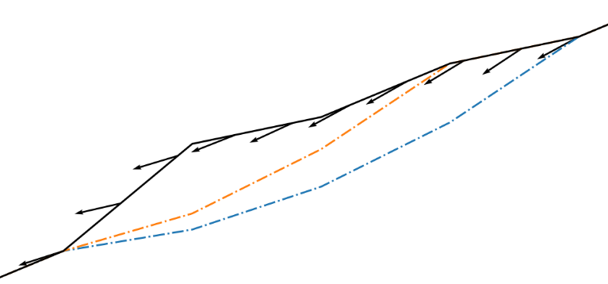
Model of displacement
Basic displacement:
Following the failure surface (orientation of the vector)
Movement is conserved along the section (normalized vectors)
Movement is the same on one slide of the landslide (perpendicular to the local slope)
1
1
Single SLBLs with normal vectors
Multi-layered failure surface:
Global displacement is the sum of weighted basic displacement for each failure surface
1
2
Multiple SLBLs with weights

Slide 12
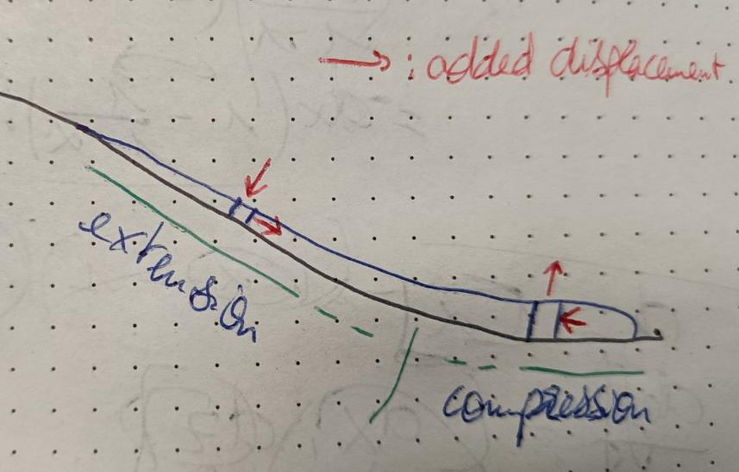
Model of displacement
NOT IMPLEMENTED
With material deformation:
Incompressible but deformable material leads to a loss of thickness in the upper, whereas material is accumulating in the lower part (total volume is conserved)
Upper parts : decreasing thickness -> negative vertical displacement and positive horizontal displacement (relatively to the landslide)
Lower parts: increasing thickness -> positive vertical displacement and negative horizontal displacement

Slide 13
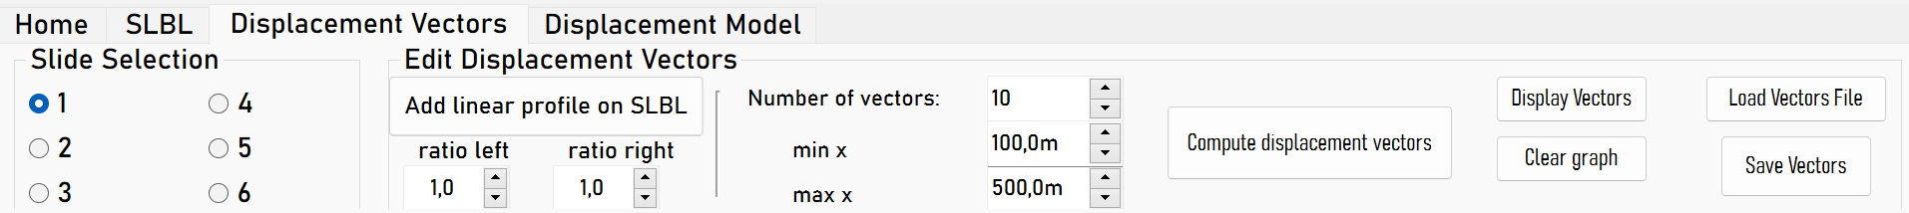
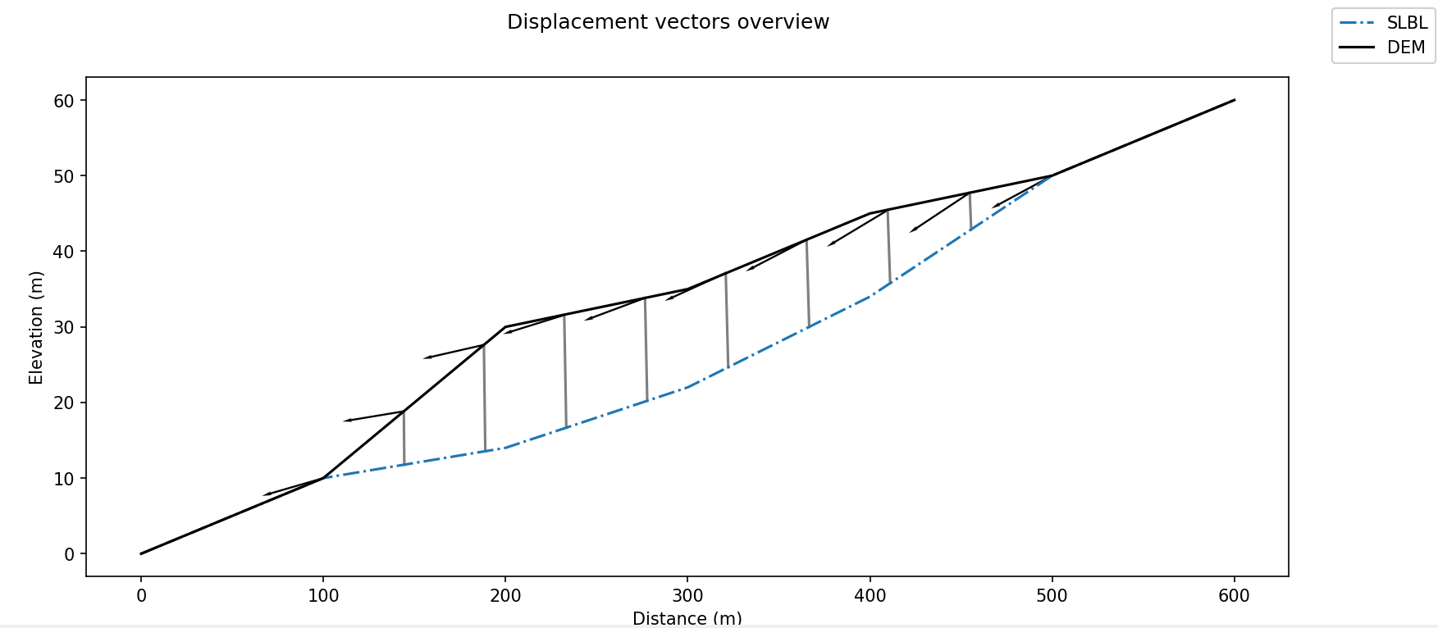
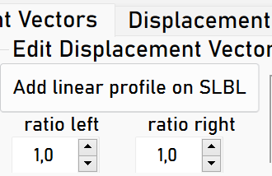
Modeling the displacement with one SLBL
Set the number of vectors and the range of the model. Must be common for all Slides.
Display the computed vectors.
Select the corresponding SLBL
Compute the vectors according to the local slope.
Export the results.
Weight the displacement along the SLBL using linear profile defined by his two extremum valures.

Slide 14
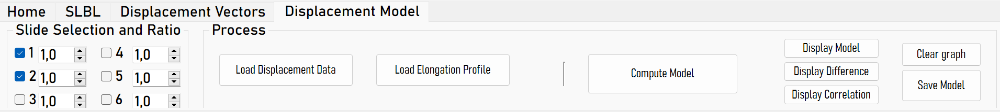
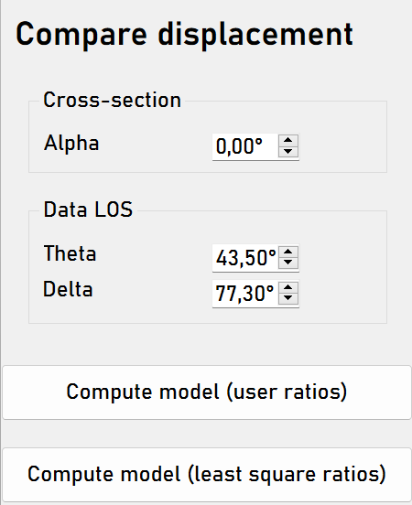
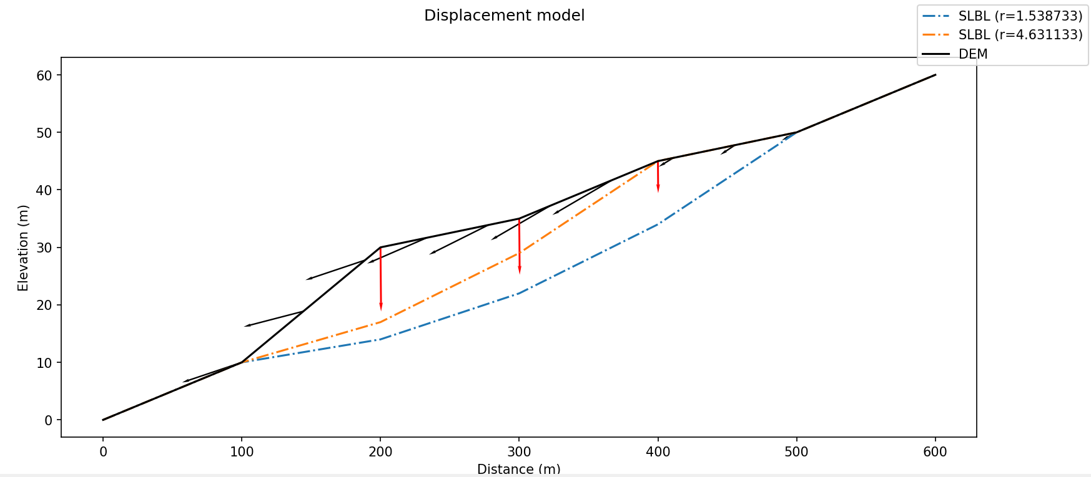
Modeling the displacement with multiples SLBL
Display the computed vectors.
Select all corresponding SLBLs. The vectors must have previously been computed for all selected SLBLs.
Compute the model using user’s ratios.
Export the results.
Effective ratios are shown here.
If the displacement is loaded, the projection of the LOS in the cross-section is shown with the corredponding displacement value

Slide 15
Recommandation
If you want to change some parameters and do a new model, consider saving the current model into a project file, closing and opening again the python interface.
Reseting and reusing already used slots and parameters is currently not handled and could ends in unexpected behaviours or errors.

Slide 16
Comparing the displacement with field data : the geometry
Cross-section
LOS
N
N
alpha
LOS azimuth
Slope angle
Incidence angle
delta
theta
LOS
x
z
Descending satellite azimuth

Slide 17


Ajusting the model to field data
Display the computed vectors.
Select all corresponding SLBLs. The vectors must have previously been computed for all selected SLBLs.
Load the displacement data from file
Export the results.
Indicate the geometry of the cross-section and the external data. The ratios will be computed via a least-square function.
The final model can be weighted via an elongation profile file. It is automatically used when loaded.

Slide 18
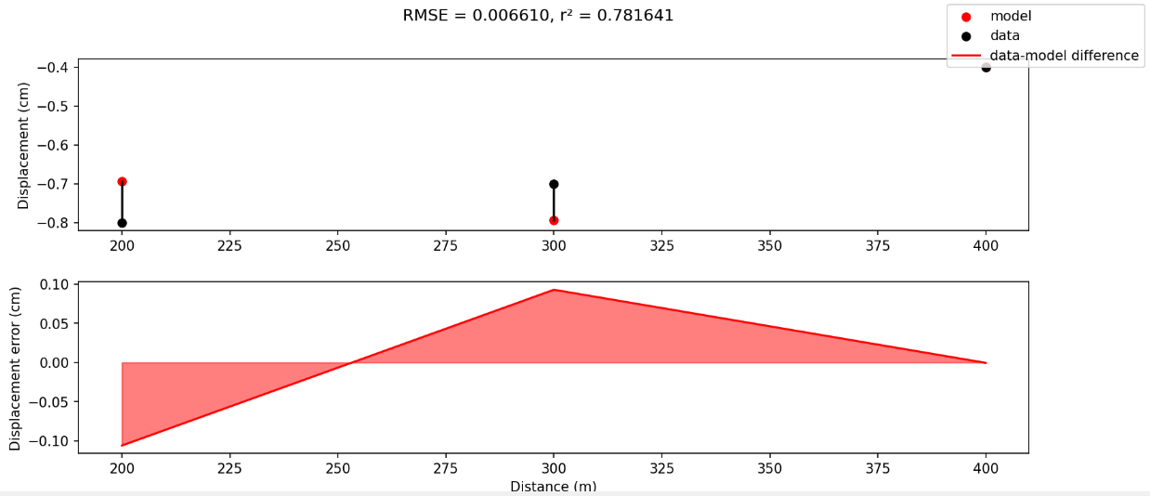
Ajusting the model to field data
RMSE and r² coefficients are automatically computed and displayed.
After computing the model, the difference between the data and the model can be displayed.
Sign convention:
-Positive displacement:
Ground moving towards the satellite
-Negative displacement
Ground moving away from the satellite

Slide 19
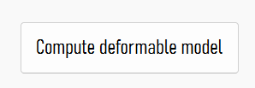
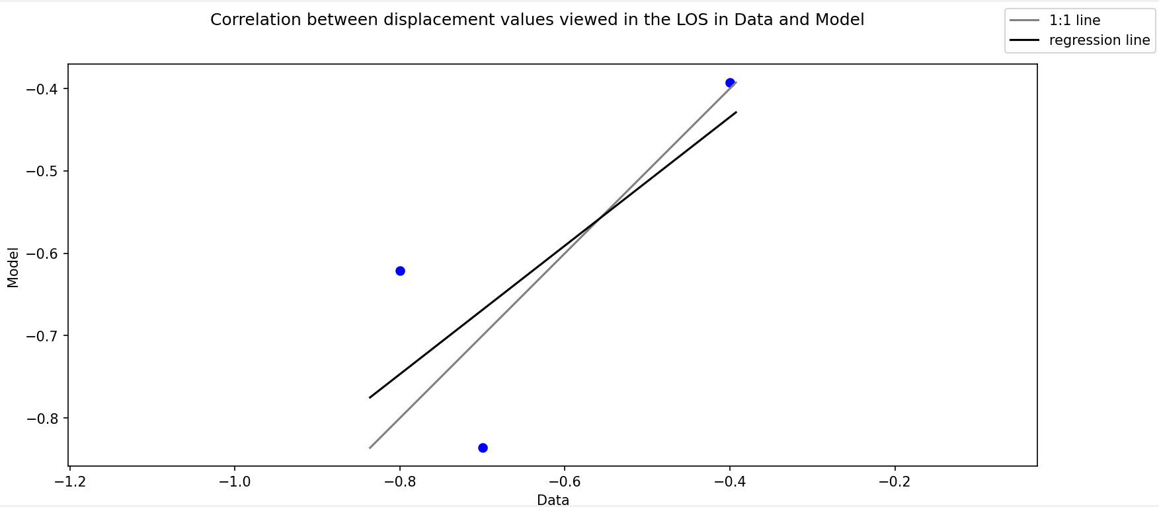
Ajusting the model to field data
After computing the model, the correlation between the data and the model can be displayed.

Slide 20
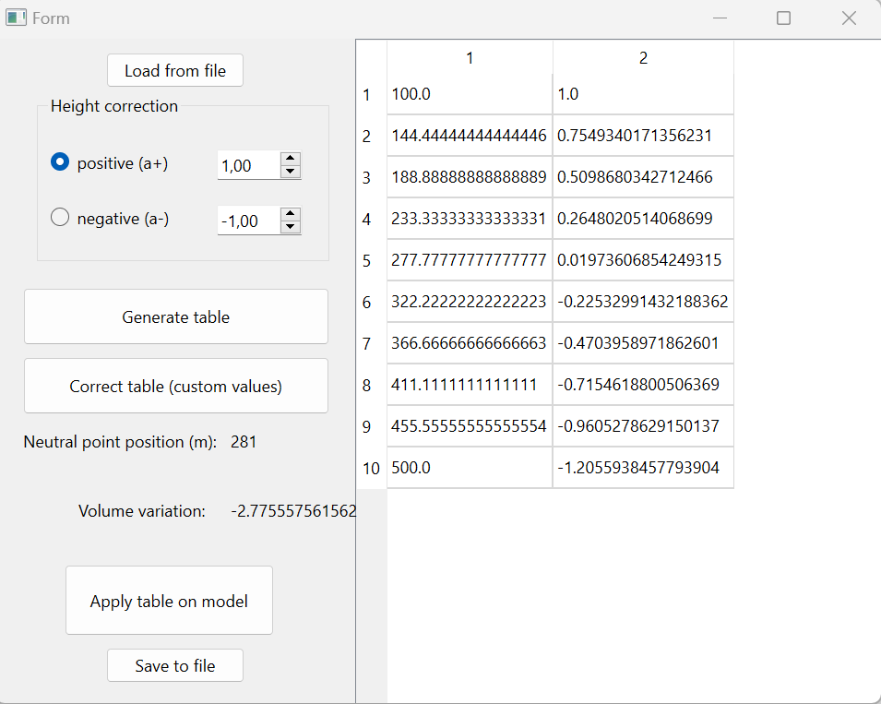
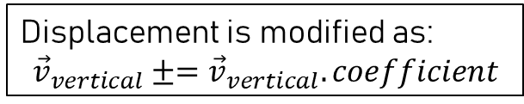
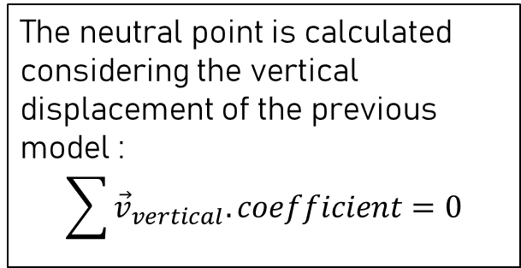
Model considering a deformable material at constant volume
X_reg
coefficient
One of the two extremities
The neutral point is calculated considering the vertical displacement of the previous model :
$$\sum{{\vec{v}}_{vertical}.coefficient}=0$$
Can be manually modified
Displacement is modified as:
$${\vec{v}}_{vertical}±={\vec{v}}_{vertical}.coefficient$$

Slide 21
Project file Exemple
1
2
3
4
5
6
7
8
9
10
11
12
13
14
15
16
GLOBAL
NAME test_project2
DEM_PATH path/example/dem.csv
SLIDE1
METHOD RANGE
LEFT_LIM 100
RIGHT_LIM 500
TOL 2.0
SLIDE2
METHOD RANGE
LEFT_LIM 100
RIGHT_LIM 400
TOL 2.0
17
18
19
20
21
22
23
24
25
26
27
28
29
DISP_VEC
N_VEC 10
X_MIN 100
X_MAX 500
DISP_MODEL
SLIDES 1;2
COEFFS 1.538732675989716;4.631133165901916
METHOD LEAST_SQUARE
DISP_PATH path/example/disp.csv
ALPHA 12.0
THETA 35.0
DELTA 285.0

