Slide 1
Seminar 2: Project Definition, Stakeholders, and Comms
IB3820 Project Management

Slide 2
Seminar Tutor
Expectations
[name]
[professional background]
[research specialism]
Pay attention
Follow instructions
Ask questions
Answer questions
Submit work

Slide 3
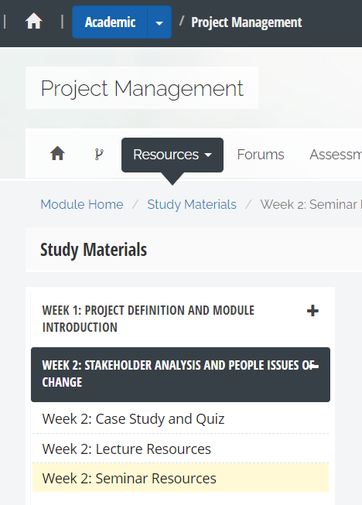

Slide 4
Recap: Project Definition
Explains what the project needs to achieve
Includes:
Purpose (the overall goal of the project + the reason/-s for the change)
Objectives (SMART predetermined results the project sets to achieve; measurable improvements)
Scope (defines the boundaries of the project: the work that needs to be done + what is excluded from the project)
Deliverables (tangible outcomes of project tasks, e.g. specific products, services, documentation)

Slide 5

Case Study
You and your production team are tasked with creating a music video for the rising singer Sophie’s latest single. The project involves intricate choreography, vibrant set designs, and creative visual effects to align with the song’s theme. The aim is to ensure that the final video perfectly match the song’s tone and Sophie's artistic vision.

Slide 6
Task 1: Project Definition
Match the statements to the correct elements of the Project Definition (Task 1 Worksheet)
Purpose
The overall goal of the project
The reasons for the change
Objectives
Predetermined results towards which your effort is directed
SMART and TCQ focused
Scope
The work that needs to be done
Including limitations, boundaries and exclusions
Deliverables
The outcomes (tangible and intangible) of project tasks
Documents that will be produced during the projects
10 minutes

Slide 7
Purpose Objectives Scope Deliverables
The overall goal of the project (the reason/-s for the change)
SMART and TCQ focused predetermined results
The work that needs to be done (inc. boundaries and exclusions)
Outcomes that will be produced during the project
Help to strengthen Sophie’s artistic identity
Work with a star we admire
Make money
Create a visually compelling video for Sophie that reflects her style and personality, within a month and a $50k budget
Storyboarding, casting dancers, securing filming locations, costume and set design
Shooting the video, managing choreography, lighting, and camera work
Editing the video, adding visual effects, colour grading, and sound synchronization
The project does not include release and distribution of the video
Final music video - fully edited and polished, ready for release
Detailed storyboards and scripts showing the video’s scenes, camera angles, and narrative structure
Raw footage - unedited footage from the shoot
All documentation, including contracts, progress reports and final report
Answers

Slide 8
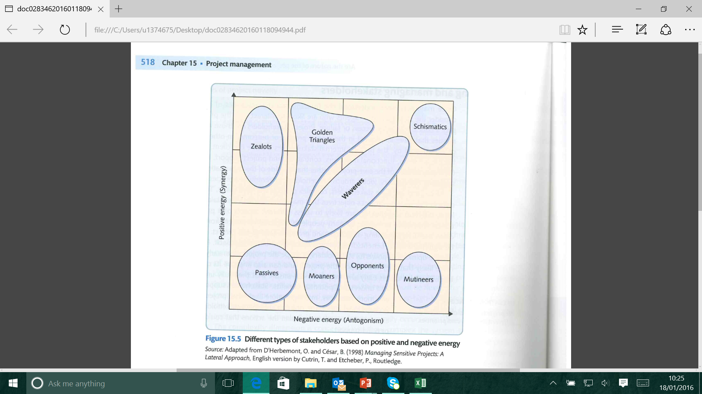
Recap: Stakeholder Analysis
Stakeholders are:
Individuals and groups with an interest in the project process or outcome
Stakeholder analysis and management is:
the systematic identification, analysis, planning and implementation of actions designed to engage with stakeholders
Stakeholder analysis tools:

Slide 9
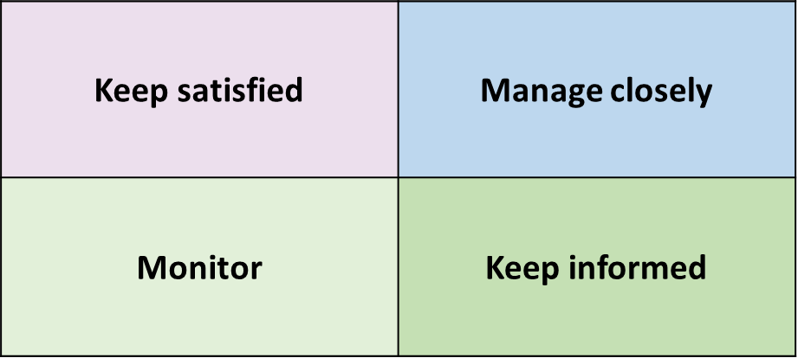
Task 2: Stakeholder Analysis
15 minutes
Read the profiles of the people involved in the music video and map their positions on the Stakeholder Analysis Worksheet:
the TCQ triangle,
energy grid,
power-interest grid.
TIME
COST
QUALITY

Slide 10
Task 3: Communications
10 minutes
Use the understanding you have gained from Task 2 to help you come up with a stakeholder management plan (Task 3 worksheet)
Stakeholder | Interests / Concerns | Engagement Strategy | Management Method | Communication channel and frequency
Project Sponsor | - Project goals and success - To stay on time and on budget; no surprises | Manage Closely | Provide regular updates | Phone call updates for milestones; weekly email summaries
Example

Slide 11
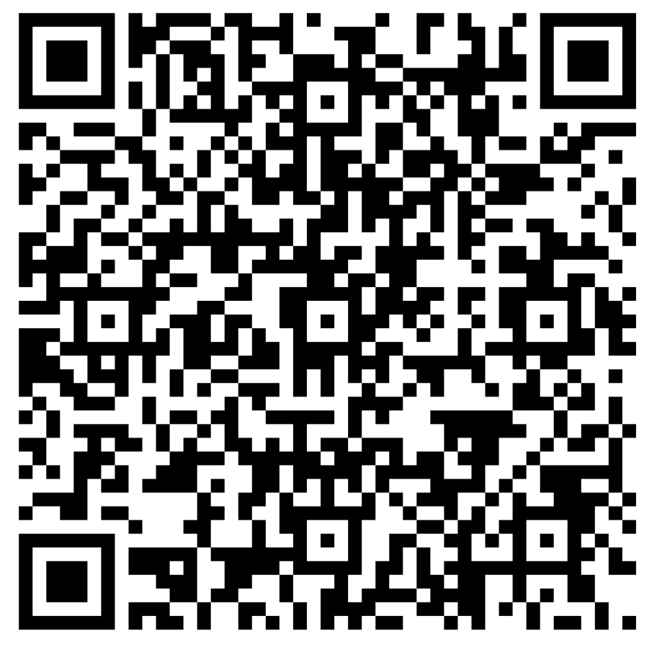
Submit your work
Use QR Code or follow the link on my.wbs
Login: U1234567@live.warwick.ac.uk

Slide 12


