Slide 1
Analysis of A/B Test Results
Data Scientist: Leo Lin
© 2024 Udacity.

Slide 2
Agenda
Findings of A/B test analysis for an e-commerce website
1. Experiment Setup
Dataset overview, group sizes, and country distribution
2. Conversion Rates
Probability analysis by group, country, and interaction effects
3. Experiment Results
Hypothesis test via simulation, p-value, and recommendation

Slide 3
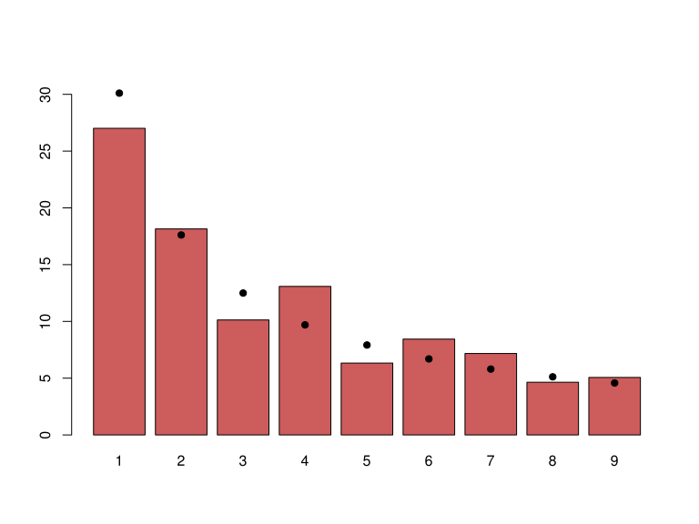
How Was the Experiment Implemented?
Dataset: 69,889 visitors from an e-commerce A/B test
Total Treatment Visitors: 35,211 (50.4%)
Total Control Visitors: 34,678 (49.6%)
Visitors by Country:
US: 48,850 (69.9%)
UK: 17,551 (25.1%)
CA: 3,488 ( 5.0%)
No missing values in the dataset.
Groups are approximately evenly split (50/50).

Slide 4
Conversion Rates
 | U.S. | U.K. | CA
Control | Your Values Here | Your Values Here | Your Values Here
Treatment | Your Values Here | Your Values Here | Your Values Here
Overall conversion rate: 13.0%
By Group:
Control: 10.5% | Treatment: 15.5%
By Country:
US: 13.3% | UK: 12.5% | CA: 12.5%
By Country x Group:
US UK CA
Control: 10.7% 10.2% 9.4%
Treatment: 15.8% 14.9% 15.4%
Executive Summary:
The treatment page shows ~5pp higher conversion across ALL countries.
No interaction effect: country does not moderate treatment impact.

Slide 5
Experiment Results
Treatment Conversion Rate: 15.53%
Control Conversion Rate: 10.53%
Delta (Treatment - Control): +5.01 percentage points
Hypothesis Test:
H0: p_treatment - p_control <= 0 (no improvement)
H1: p_treatment - p_control > 0 (treatment is better)
Method: 500 simulations under the null
Significance level: alpha = 0.05
p-value: 0.0000
Conclusion:
We reject the null hypothesis. The treatment page has a statistically
significant higher conversion rate than the control page. None of the
500 simulated differences under the null exceeded the observed +5.01pp
difference. The company should implement the new treatment page.

