Slide 1
Sleep Health and Lifestyle Analysis
Descriptive Statistics Analysis
Data Scientist: Leo Lin
© 2024 Udacity.

Slide 2
Agenda
Results of sleep health and lifestyle analysis
Data Description
Typical Amount of Physical Activity
Number of Daily Steps
Distribution of Heart Rates

Slide 3
Data Description
Sleep Duration is an example of a continuous variable in the dataset.
→ Values like 5.9, 6.1, 7.8 hours; can take any decimal value in a range.
Daily Steps is an example of an integer variable in the dataset.
→ Recorded as whole numbers (e.g., 4200, 10000, 3000 steps).
Quality of Sleep is an example of an ordinal categorical variable in the dataset.
→ Rating scale 1-10 with natural ordering; higher = better sleep quality.
Occupation is an example of a nominal categorical variable in the dataset.
→ Categories (Doctor, Engineer, Teacher) with no inherent ordering.

Slide 4
Typical Amount (Minutes) of Physical Activity
Measures of Center for Physical Activity Level (minutes/day):
Mean: 59.17 minutes/day
Median: 60.0 minutes/day
Mode: 60.0 minutes/day
Skewness Analysis:
The mean (59.17) is slightly less than the median (60.0),
indicating a slightly left-skewed (negatively skewed) distribution.
This suggests a small tail of lower physical activity values pulling
the mean below the median.

Slide 5
Analysis of Daily Steps Taken
Measures of Spread for Daily Steps:
Standard Deviation: 1,617.92 steps
Maximum: 10,000 steps
Minimum: 3,000 steps
Range: 7,000 steps
Additional Measures of Spread:
Q1 (25th percentile): 5,600 steps
Q3 (75th percentile): 8,000 steps
IQR (Q3 − Q1): 2,400 steps
Variance: 2,617,651.14

Slide 6
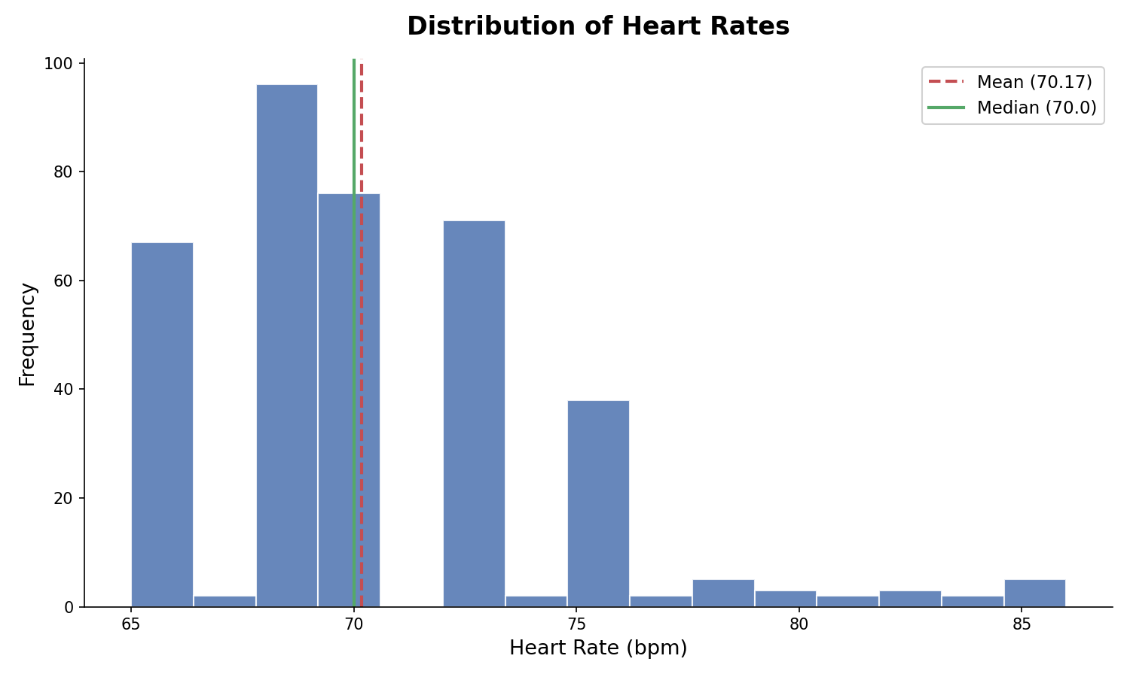
Distribution of Heart Rates
Distribution Shape: Right-skewed (positively skewed)
Mean (70.17 bpm) > Median (70.0 bpm), confirming right skew.
Outliers (IQR method, bounds: 62–78 bpm):
Values above 78 bpm: 80, 81, 82, 83, 84, 85, 86 bpm
These 7 high heart rate values may indicate individuals with
elevated cardiovascular stress or sleep disorders.

