Slide 1
Midterm Test Plan - Sealnote
組員:
105598003 劉彥麟
105598048 陳政皓
105598074 呂昭陞

Slide 2

Sealnote
SealNote is simple notes/notepad application which focuses on security and simplicity.
Your notes are password protected using 256-bit AES encryption.

Slide 3
Purpose of test plan
我們的test plan分成兩種:
1. 針對畫面上的 UI 反映之後的事件進行測試，並看與我們的需求是否一致
2. 針對系統負載下去進行測試，看會不會對程式造成影響

Slide 4
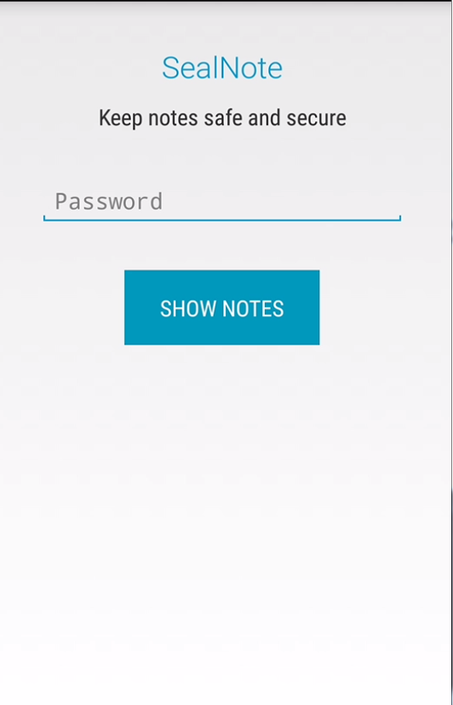
Features To Be Tested
建立帳戶
密碼錯誤事件

Slide 5
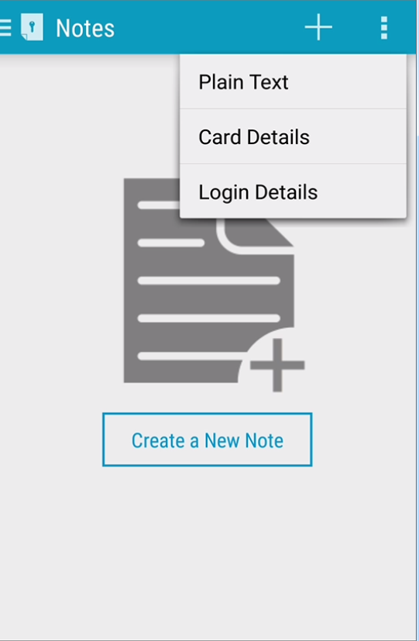
Features To Be Tested
建立新的plain text
建立新的credit card note
建立新的login details

Slide 6
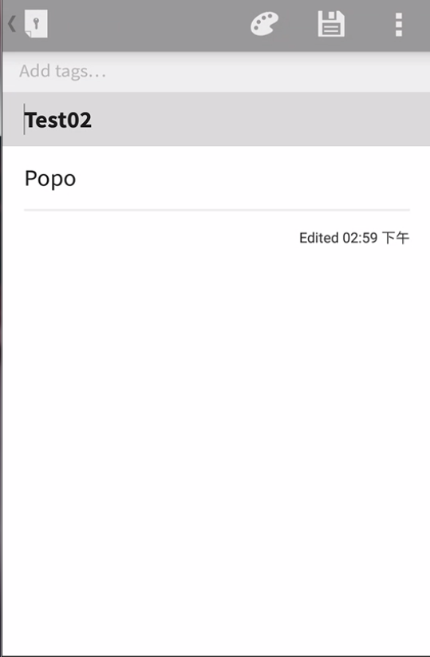
Features To Be Tested
編輯plain text
編輯credit card note
編輯login details

Slide 7
Features To Be Tested
建立新的plain text
建立新的credit card note
建立新的login details

Slide 8
Features To Be Tested
建立新的plain text
建立新的credit card note
建立新的login details

Slide 9
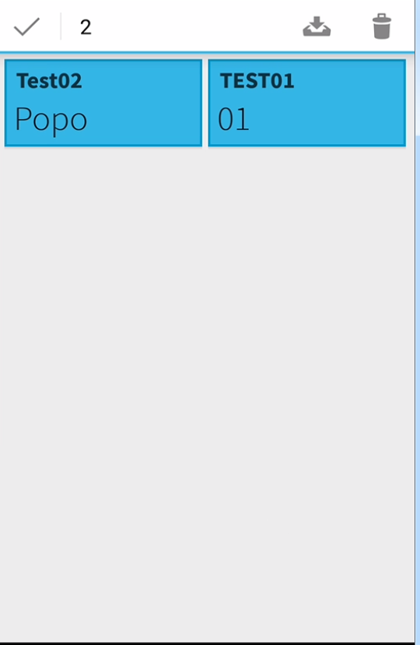
Features To Be Tested
刪除一個note
刪除多個note

Slide 10
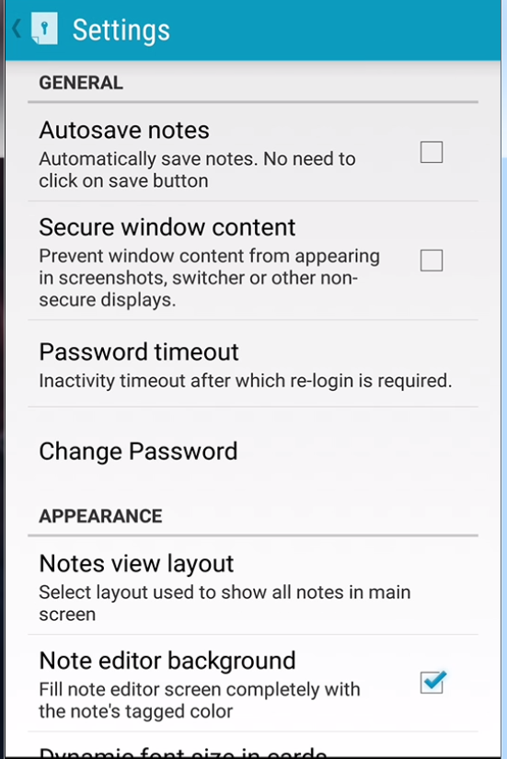
Features To Be Tested
自動儲存note

Slide 11
Features To Be Tested
更換密碼

Slide 12
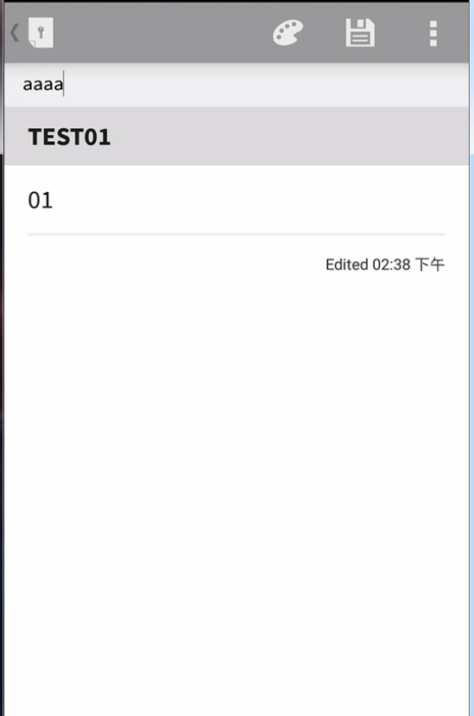
Features To Be Tested
新增tag分類區

Slide 13
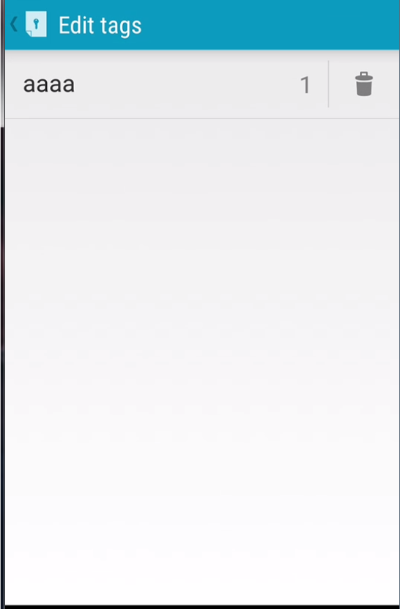
Features To Be Tested
刪除tag分類區

Slide 14
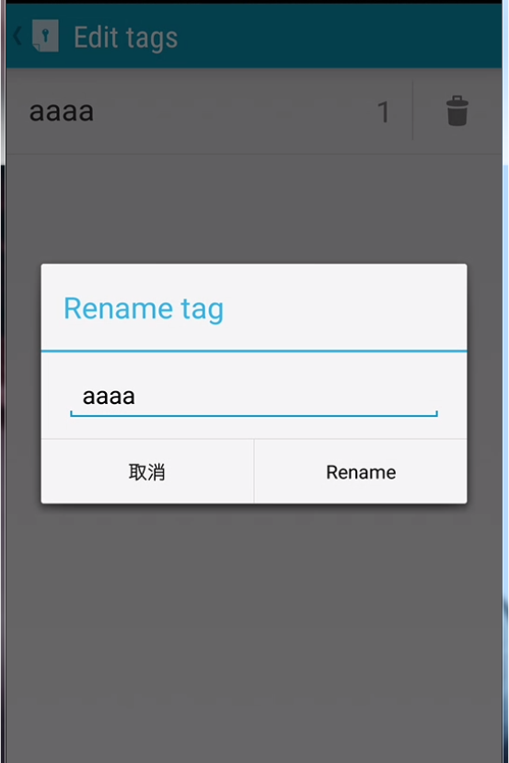
Features To Be Tested
編輯tag分類區

Slide 15
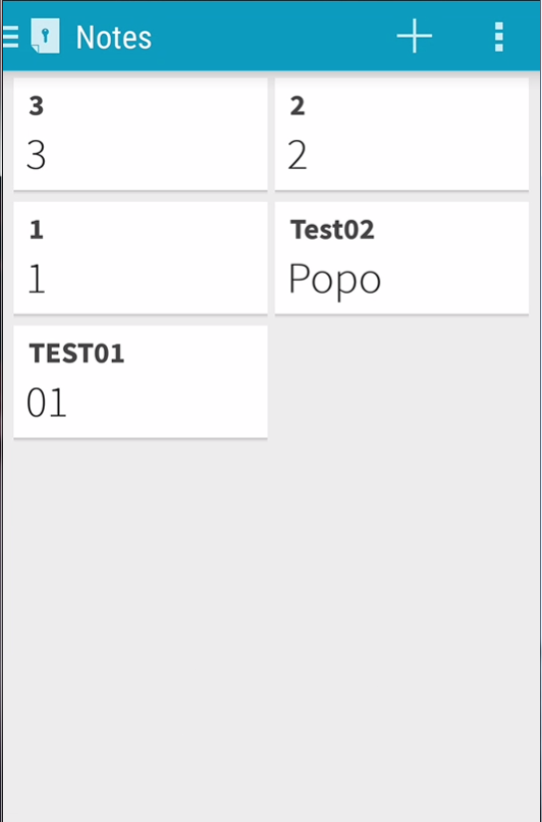
Features To Be Tested
最大創建note數量

Slide 16
Features Not To Be Tested
Not To Be Tested | Reason
Secure window content | 暫時不知如何驗證
Notes view layout | 暫時不知如何驗證
Notes背景顏色 | 暫時不知如何驗證
資料備份、還原 | 需跳脫App做驗證
Share note | 需橫跨兩個App做驗證

Slide 17


Test Tool
WebDriver

