Slide 1
PMHD final assignment
Ermi & Leo

Slide 2
Questions
Transform the non-Gaussian outcome ‘tot.vase.days’ into a longitudinal binary outcome (i.e. fresh=1/not fresh=0), and analyze the data taking into account the available covariates
a
Explore/Visualize the Gaussian outcome ‘width of the flower’ (T0 up to T20) with a multivariate method.
c
3

Slide 3
Question a – model selection
Binary response: fresh (yes/no)
Longitudinal outcome: each flower is measured repeatedly over 30 days -> need to consider clustering.
Research question: what are the compounds that can improve the probability that flowers stay fresh?
Besides, we are asked to consider available covariates
-> Select: GEE – generalized estimating equation, group by Flower_ID

Slide 4
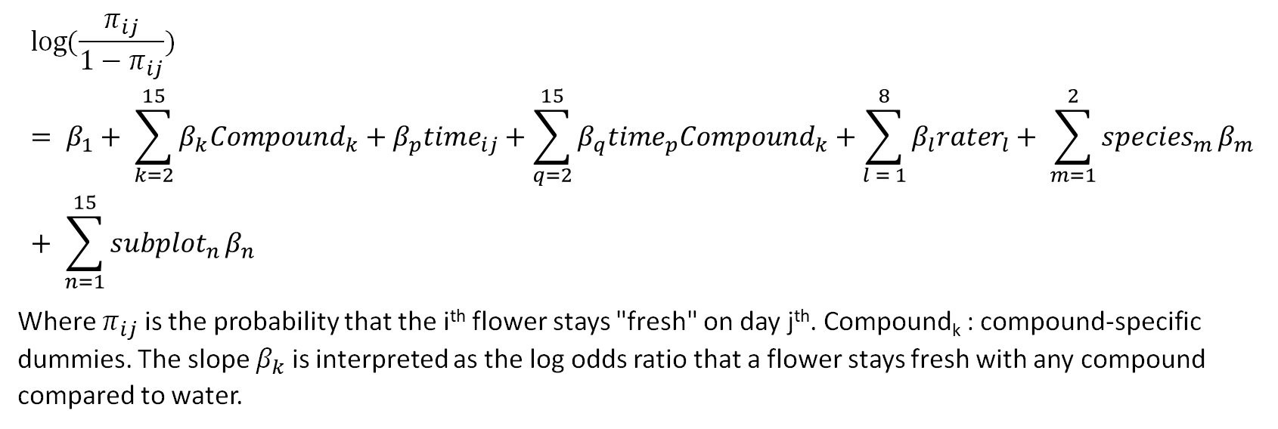
Question a – model notation
$$\log{(\frac{π_{ij}}{1−π_{ij}}}) = β_{1}+ \sum_{k=2}^{15}{β_{k}{Compound}_{k}}+β_{p}{time}_{ij}+\sum_{q=2}^{15}{β_{q}{time}_{p}{Compound}_{k}}+\sum_{l = 1}^{8}{β_{l}{rater}_{l}}+ {\sum_{m=1}^{2}{{species}_{m}}β}_{m}+ {\sum_{n=1}^{15}{{subplot}_{n}}β}_{n}$$
Where $π_{ij}$ is the probability that the i^{th} flower stays "fresh" on day j^{th}. Compound_{k} : compound-specific dummies. The slope $β_{k}$ is interpreted as the log odds ratio that a flower stays fresh with any compound compared to water.
Notes:
Add interaction effect time*compound

Slide 5
Question a – benefits and drawbacks of GEE
Can adjust for repeated measurement
Have the marginal interpretation
Straightforward model formulation
Should go for GLMM? But then
No marginal interpretation
Complex nested model structure
Can’t take into account other clustering effect: i.e. species, subplot, rater --> can added as covariates in GEE model

Slide 6
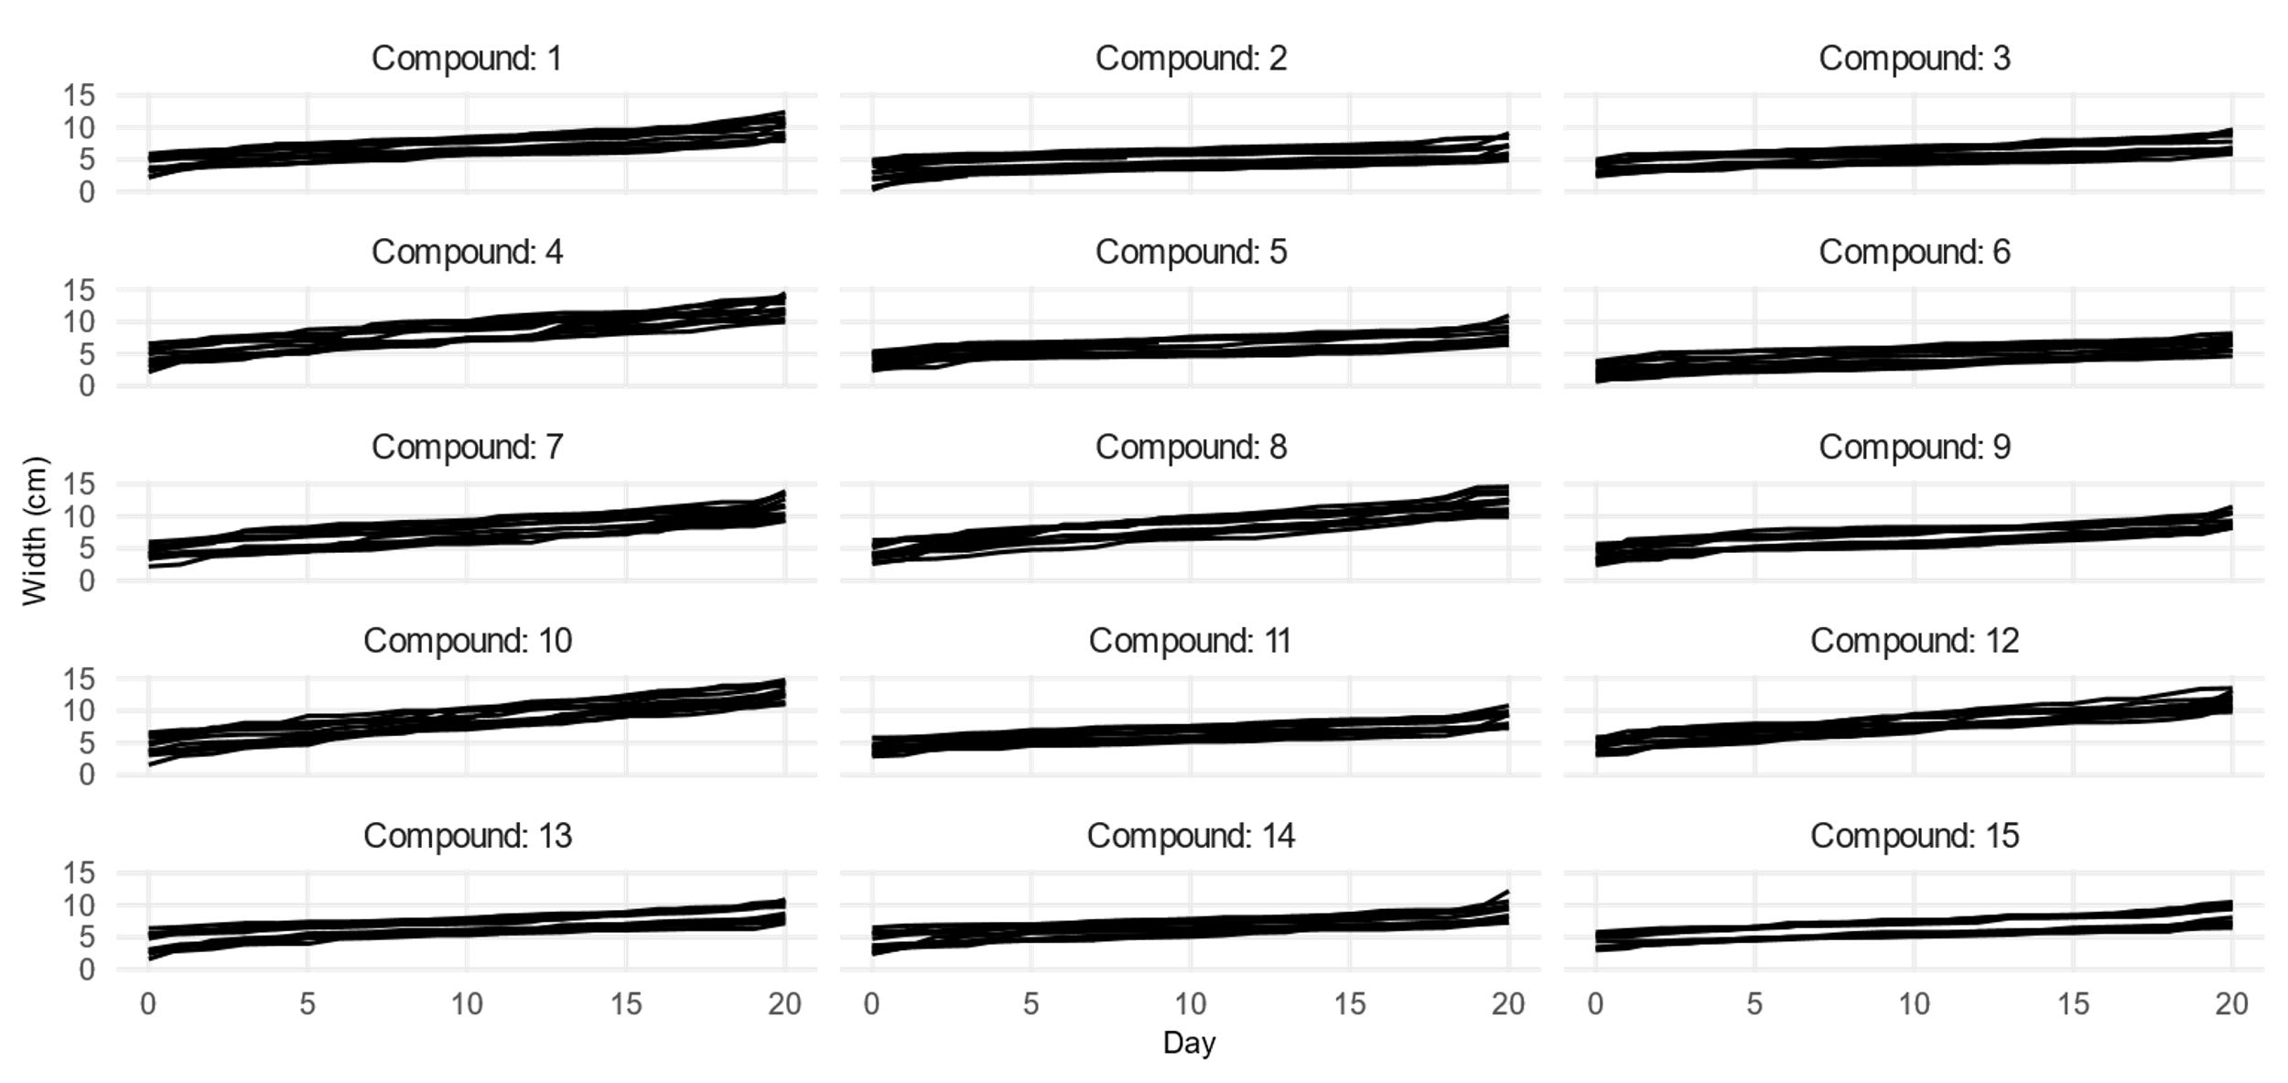
Question c – EDA

Slide 7
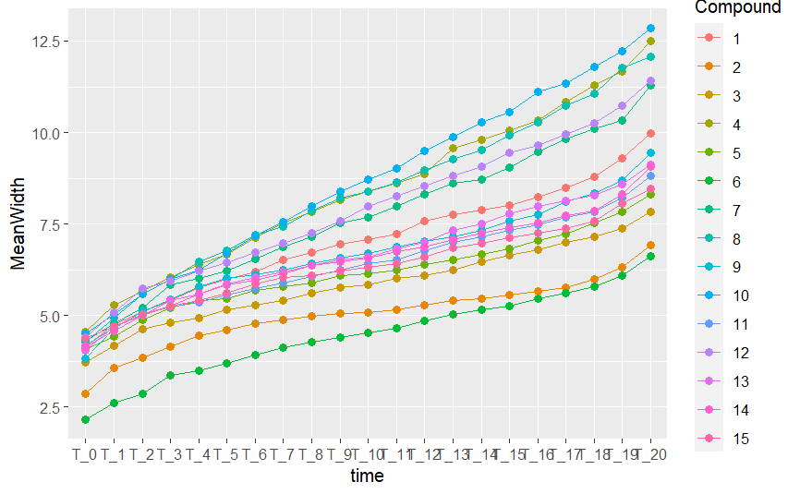
Question c – EDA

Slide 8
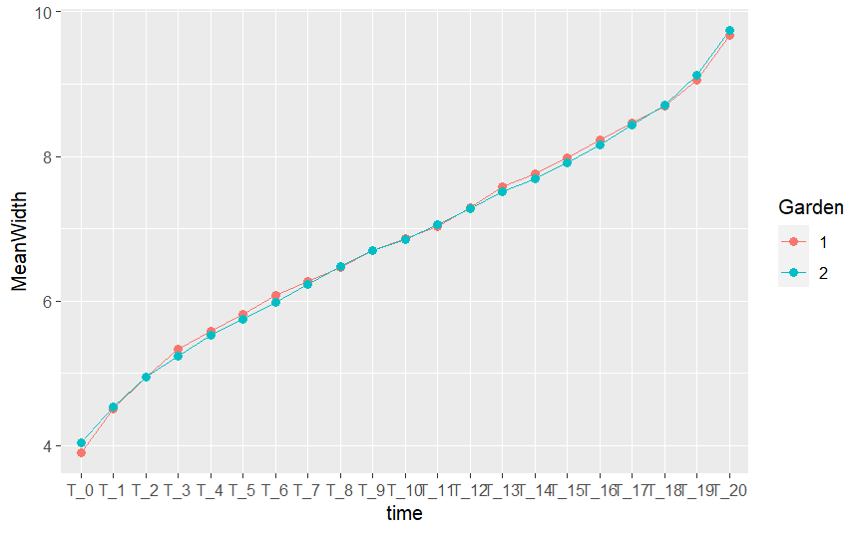
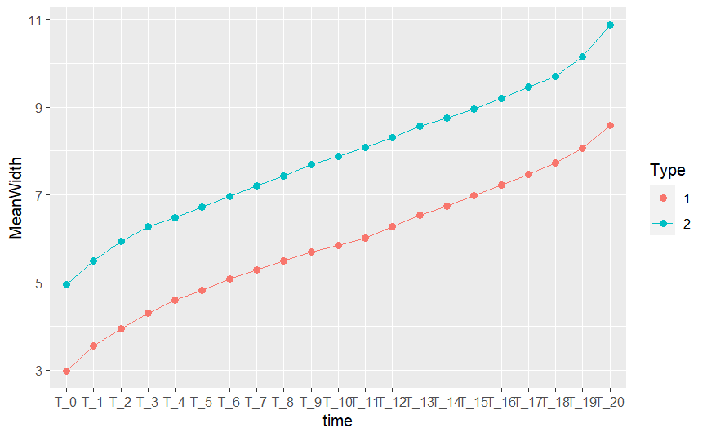
Question c – EDA
Pattern by Garden Pattern by Type

Slide 9
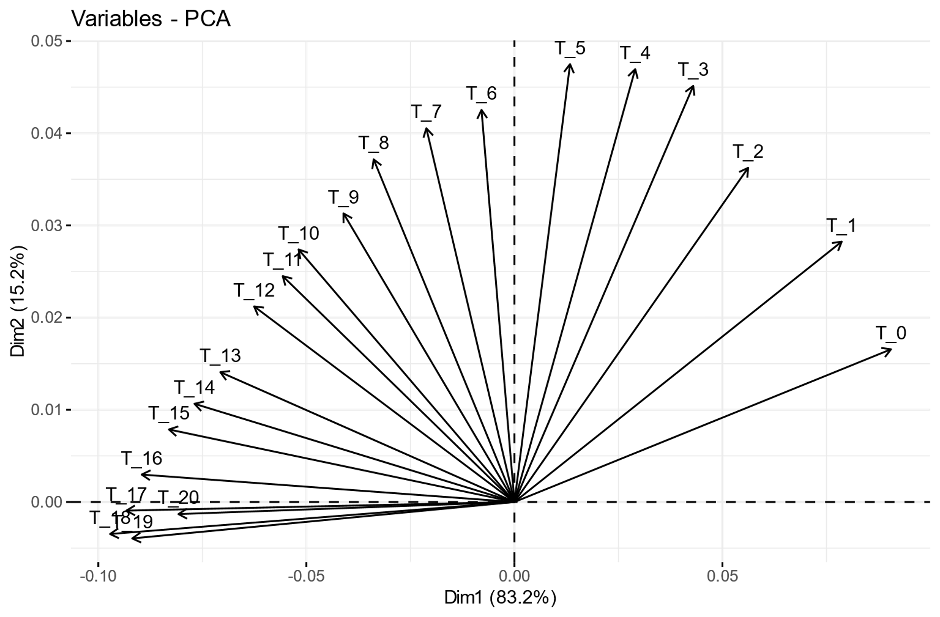
Question c – PCA. Biplot

Slide 10
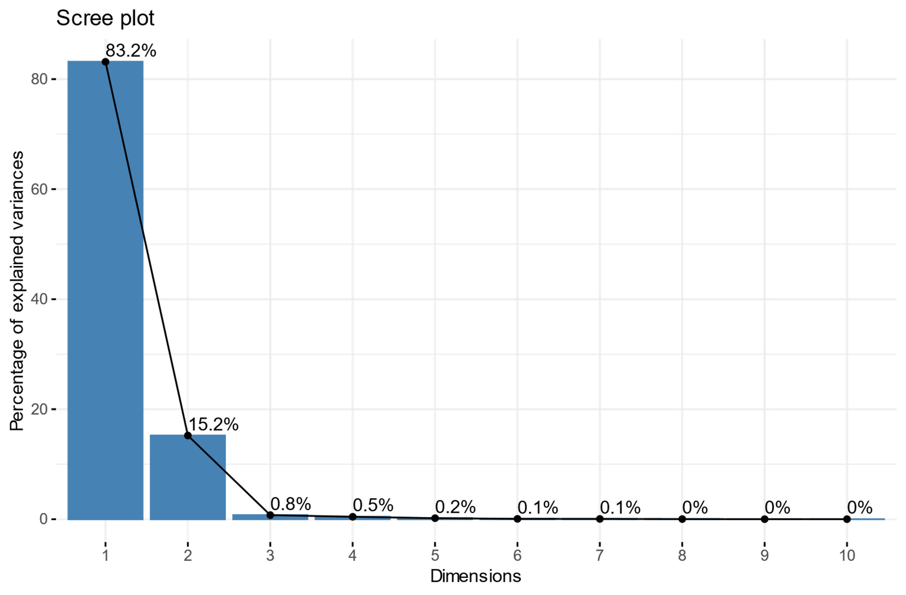
Question c – PCA. Scree plot

