Slide 1
PMHD final assignment
Ermi & Leo

Slide 2
Questions
Transform the non-Gaussian outcome ‘tot.vase.days’ into a longitudinal binary outcome (i.e. fresh=1/not fresh=0), and analyze the data taking into account the available covariates.
a
Explore/Visualize the Gaussian outcome ‘width of the flower’ (T0 up to T20) with a multivariate method.
c
3

Slide 3
Question a – model selection
Binary response: fresh (yes/no)
Longitudinal outcome: each flower is measured repeatedly over 30 days -> need to consider clustering.
Research question: what are the compounds that can improve the probability that flowers stay fresh?
Besides, we are asked to consider available covariates
-> Select: GEE – generalized estimating equation, group by Flower_ID

Slide 4
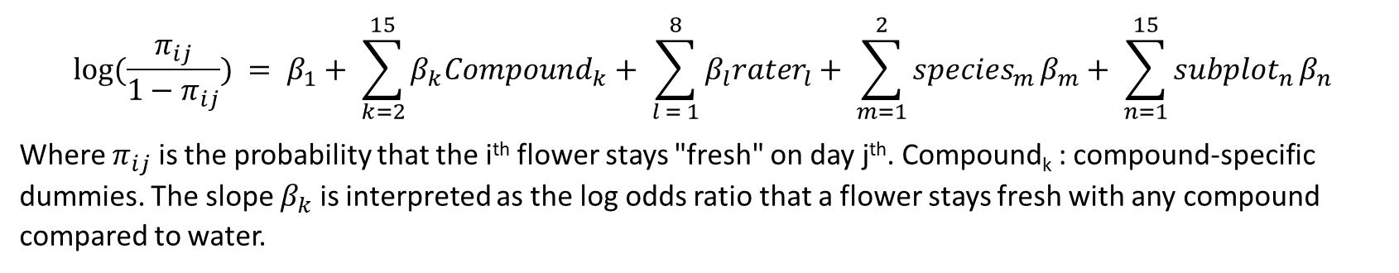
Question a – model notation
$$\log{(\frac{π_{ij}}{1−π_{ij}}}) = β_{1}+ \sum_{k=2}^{15}{β_{k}{Compound}_{k}}+ \sum_{l = 1}^{8}{β_{l}{rater}_{l}}+ {\sum_{m=1}^{2}{{species}_{m}}β}_{m}+ {\sum_{n=1}^{15}{{subplot}_{n}}β}_{n}$$
Where $π_{ij}$ is the probability that the i^{th} flower stays "fresh" on day j^{th}. Compound_{k} : compound-specific dummies. The slope $β_{k}$ is interpreted as the log odds ratio that a flower stays fresh with any compound compared to water.

Slide 5
Question a – benefits and drawbacks of GEE
Can adjust for repeated measurement
Have the marginal interpretation
Straightforward model formulation
Can’t take into account other clustering effect: i.e. compound, species, subplot, rater
Should go for GLMM? But then
No marginal interpretation
Complex nested model structure

Slide 6
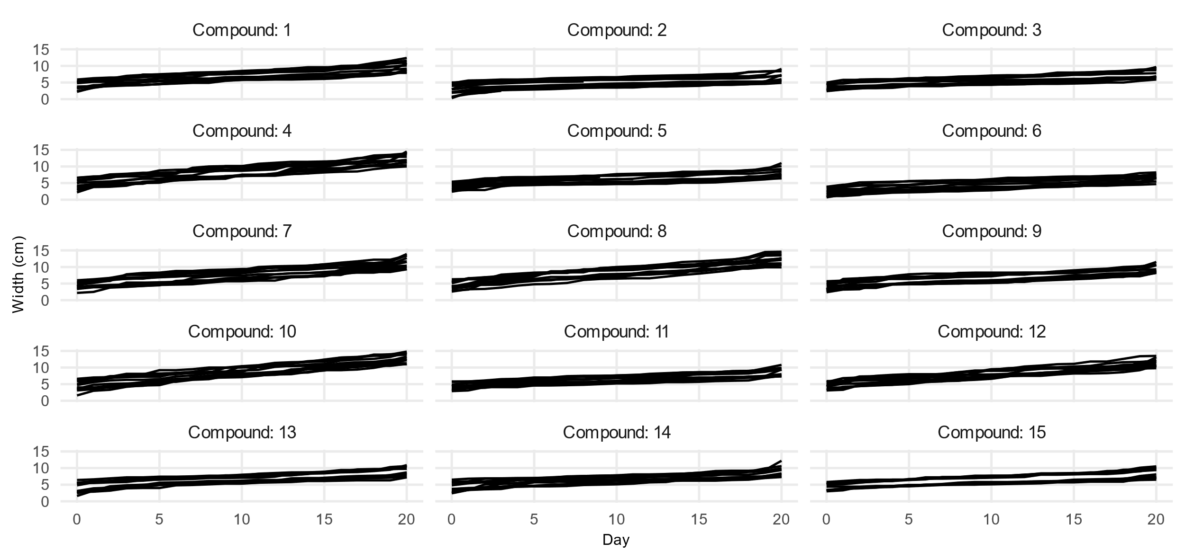
Question c – EDA

Slide 7
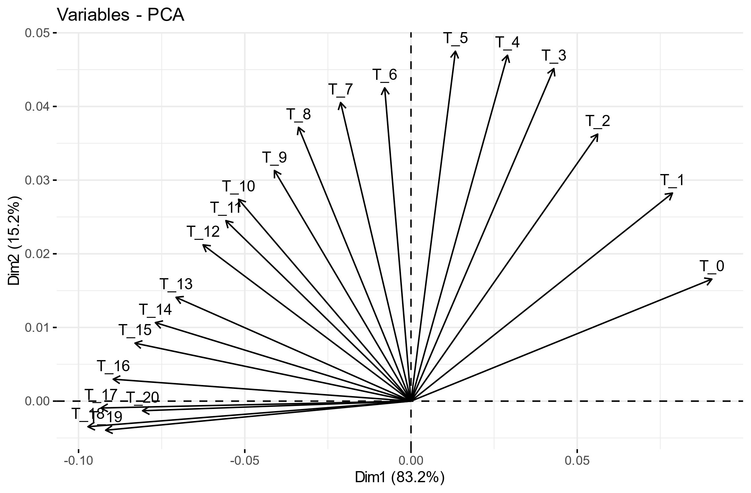
Question c – PCA. Biplot

Slide 8
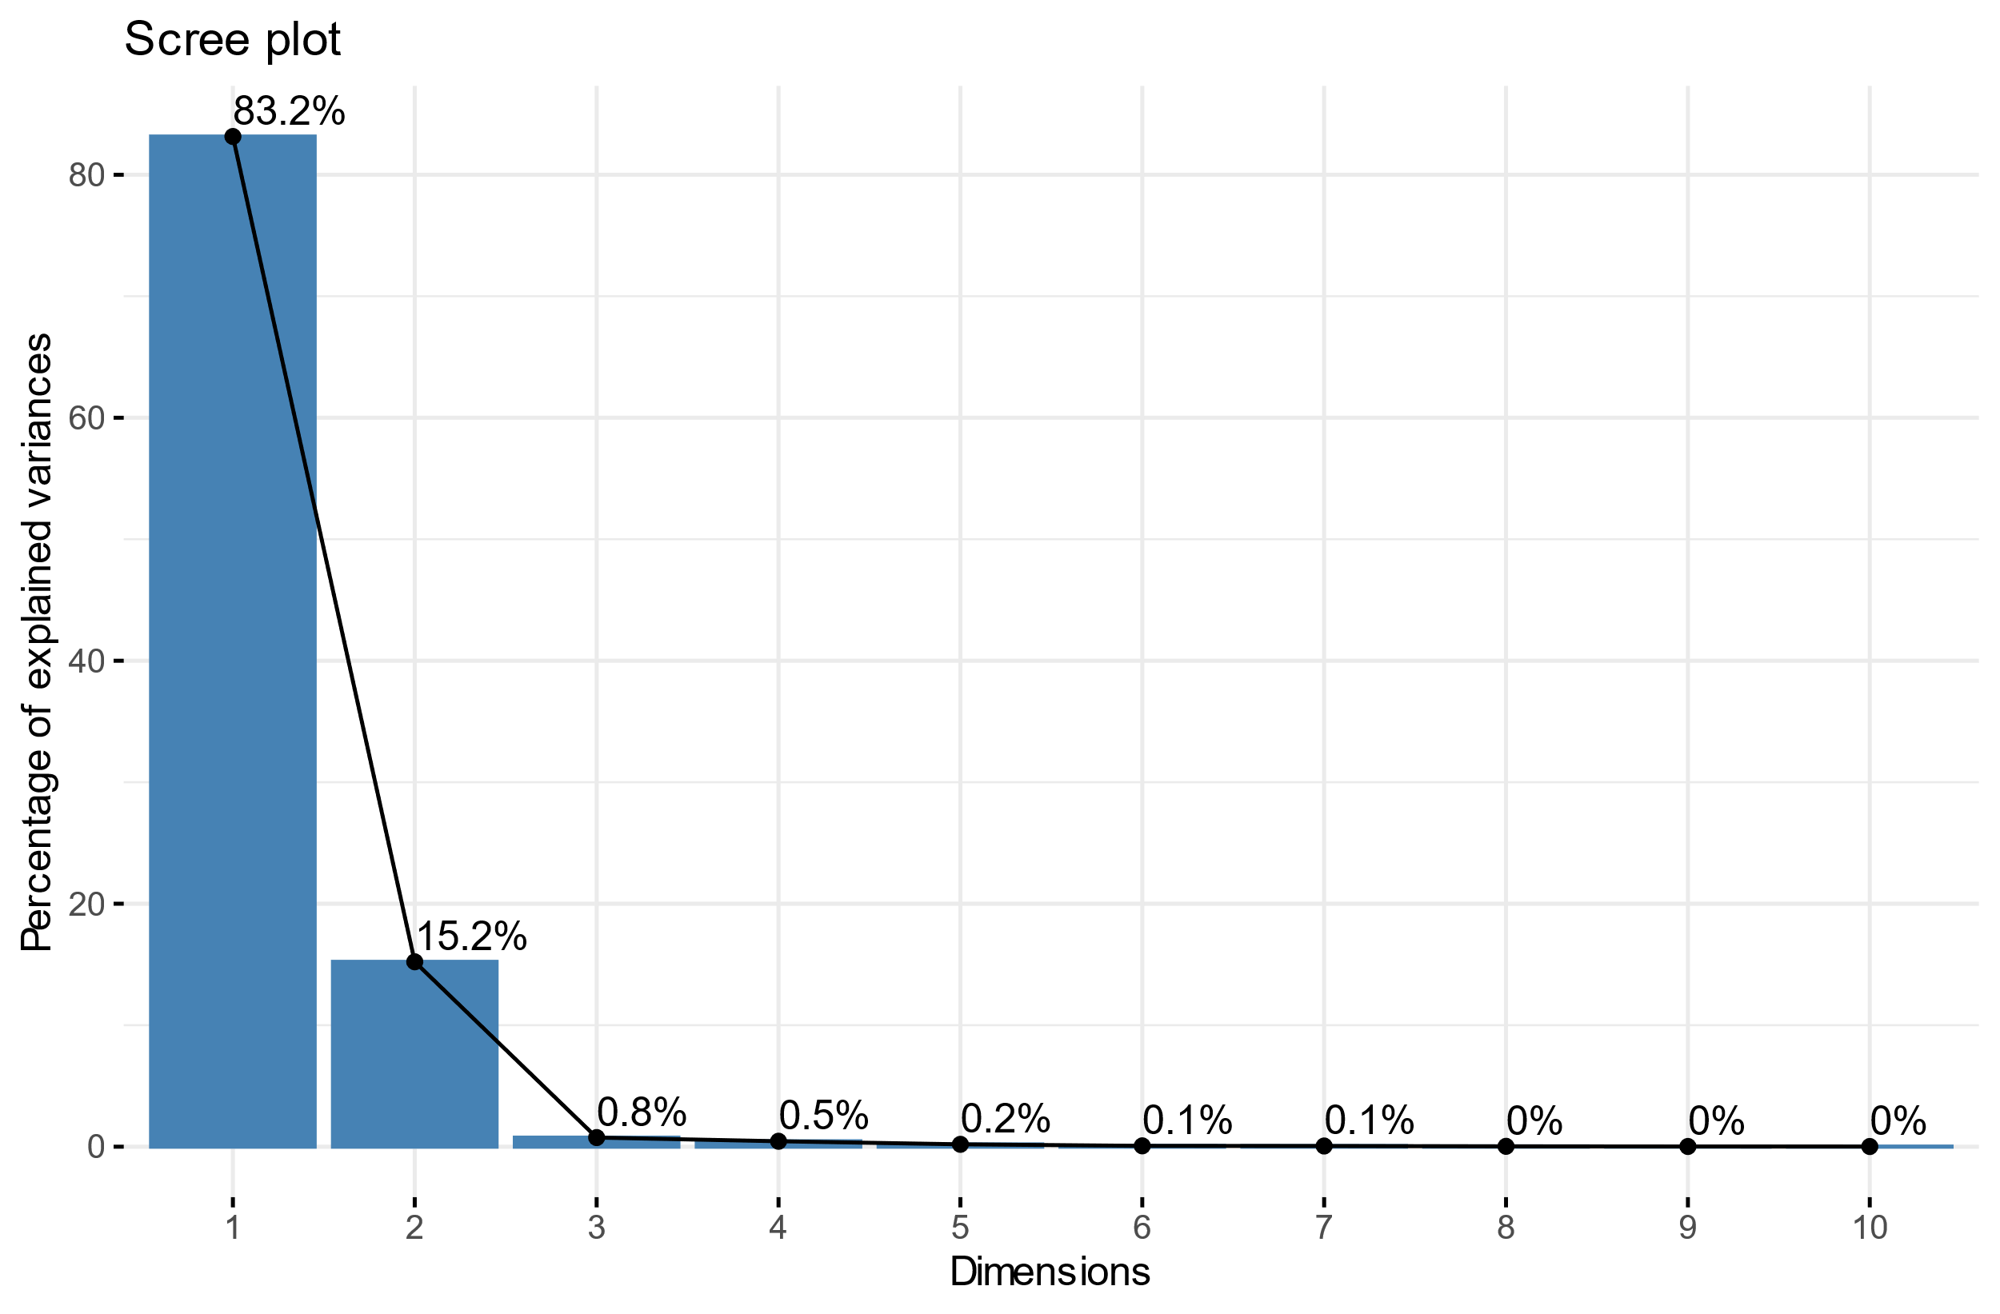
Question c – PCA. Scree plot

