Slide 1
The Rose Study - Presentation of Results
Group 17
Ermioni Athanasiadi
Henry Hockliffe
Mane Minasyan
Henry Oduor
Görkem Uyanık
Luong Vuong
Project: Multivariate and Hierarchical Data
Hasselt University
17/05/2024

Slide 2
Research Questions
Analyse the non-gaussian outcome (Total number of days) in order to find the compound with maximum period of freshness using a generalized mixed effects model
Compare´/confirm the result of (1) by using a Poisson model to estimate the effects
Analyse the binary outcome Freshness Yes/No taking into account the available covariates
Analyse the Gaussian outcome ‘width of the flower’ taking into account the covariates and the subplot effect
Explore/Visualize the Gaussian outcome ‘width of the flower’ (T0 up to T20) with a multivariate method
Confirm (part of) the conclusions of your data analysis on the Gaussian outcome ‘width of the flower’ using a multivariate method
Notes:
What is the optimal compound that allows flowers to stay fresh for the longest period of time (among 15 compounds)?

Slide 3
Question 1 & 2
Which compound allows the maximum period of vase days?

Slide 4
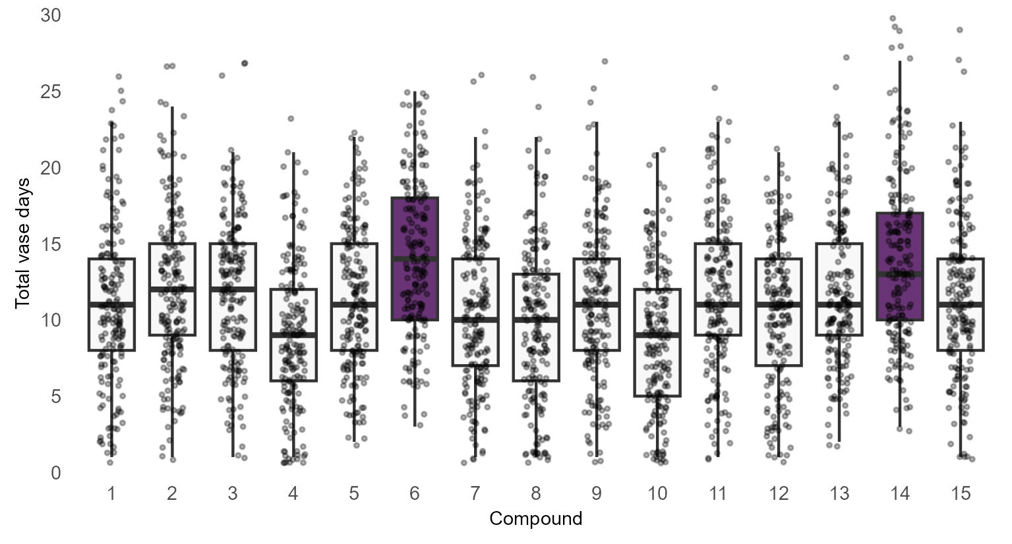
Exploratory Data Analysis on Count data
1 Distilled Water
2: Apathic Acid
3: Beerse Brew
4: Concentrate of Caducues
5: Distilled of Discovery
6: Essence of Epiphaneia
7: Four in December
8: Granule of Geheref
9: Kar-Hamel Mooh
10: Lucifer’s Liquid,
11: Noospherol
12: Oil of John’s Son
13: Powder of Perlimpinpin
14: Spirit of Scienza
15: Zest of Zen

Slide 5
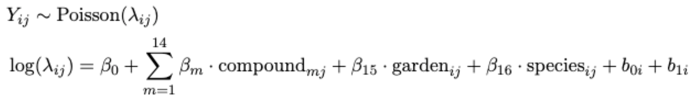
Statistical Models
Generalized mixed effect model (Poisson)
Generalized mixed effect model (Normal assumption)
Notes:
- random intercept for compounds and raters
-

Slide 6
Best Compound
Statistical Model | Compounds significantly better than water | The best Compound
Generalized Mixed effect model (Poisson) | Essence of Epiphaneia Spirit of Scienza | Essence of Epiphaneia
Generalized mixed effect model (Normal assumption) | Essence of Epiphaneia Spirit of Scienza | Essence of Epiphaneia

Slide 7
Question 3
Which compound is optimal for maximizing the Probability of Freshness over time?
What role do the covariates rater, species, subplot play?

Slide 8
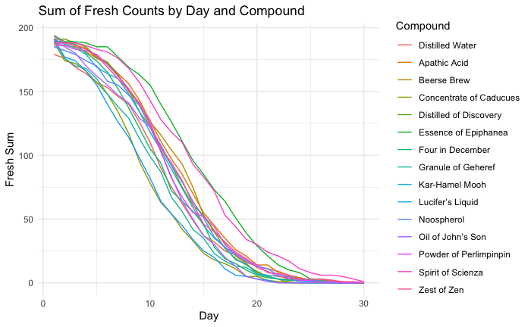
Exploratory Data Analysis on Binary data

Slide 9
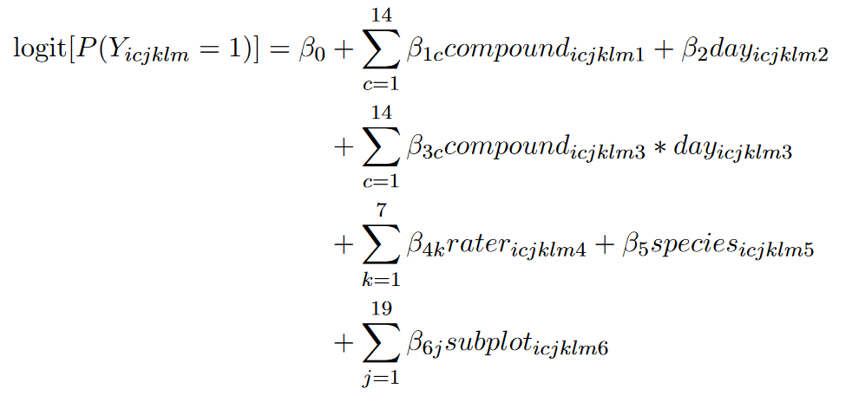
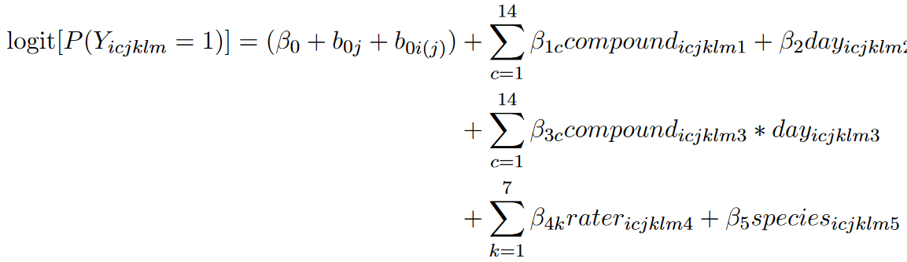
Statistical Models – Question 3
GEE (Generalised Estimating Equation)
GLMM (Generalised Linear Mixed Model)
logit[P(Yᵢ꜀ₖₗₘ = 1)] represents the logit of the probability for the iᵗʰ flower on jᵗʰ subplot of mᵗʰ type to stay fresh after being cut by the kᵗʰ rater and placed in the cᵗʰ compound measured on the lᵗʰ day

Slide 10
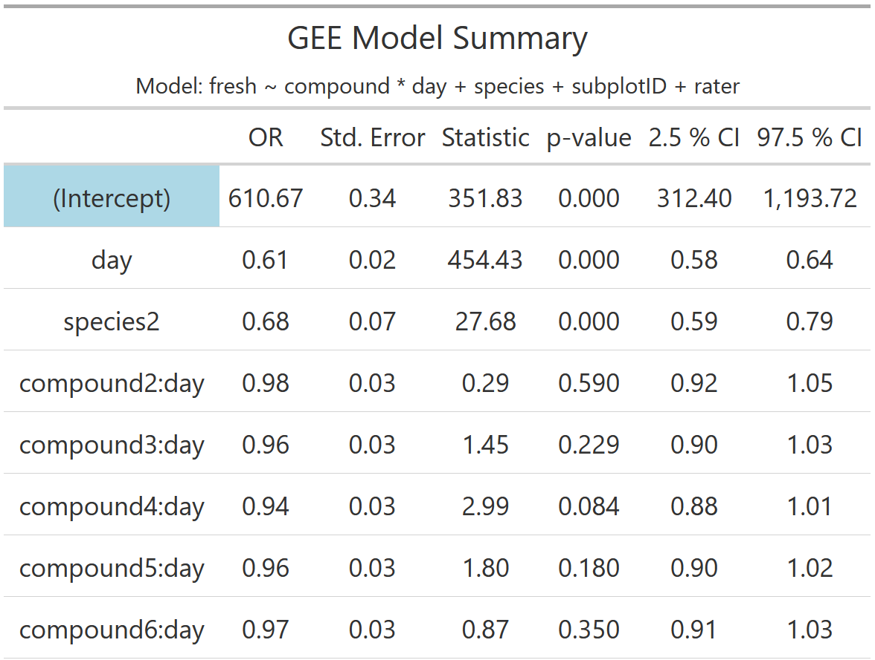
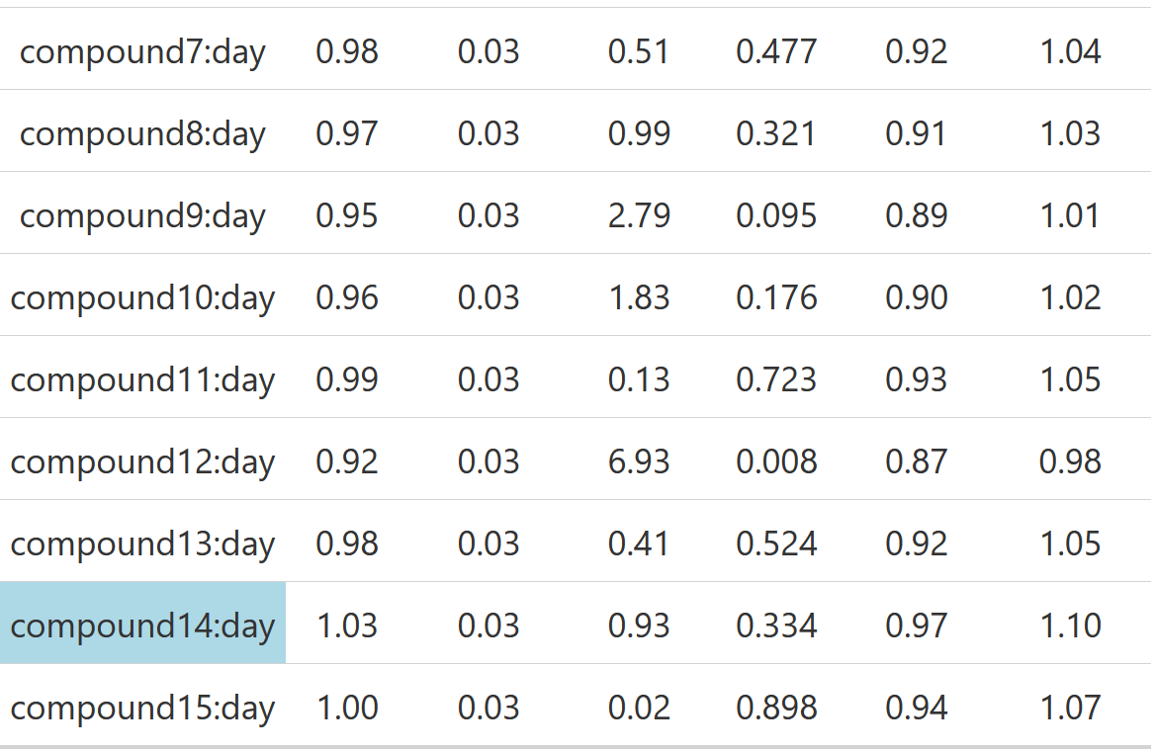
First results (GEE)

Slide 11
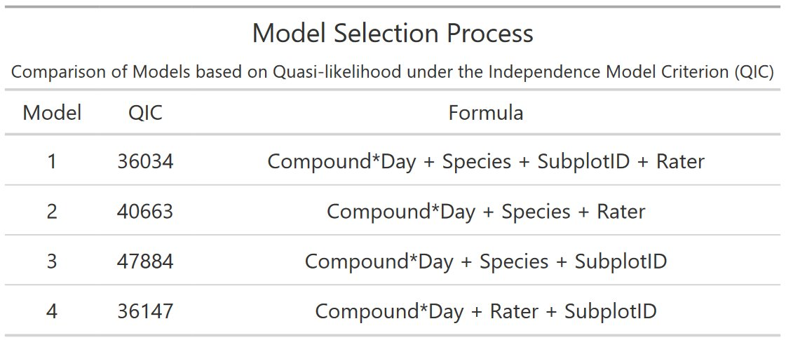
Procedure for model selection
Analysis was conducted on full model

Slide 12
Question 4
How does the Flower Width change over time and for different compounds?
What role do the covariates rater, species, subplot play?

Slide 13
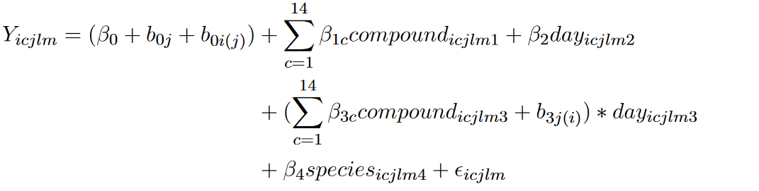
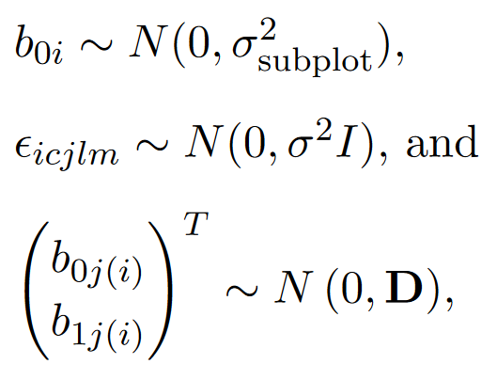
Statistical Model – Question 4
LMM (Linear Mixed Effects Model)
where D is a 2 × 2 variance-covariance matrix of the random effects for roses

Slide 14
Model results
Analysis of Variance Table for Fixed Effects
 | Parameters | Sum Sq | Mean Sq | F value
Day | 1 | 8045 | 8045 | 48197.3
Compound | 14 | 34 | 2 | 14.3
Day:Compound | 14 | 820 | 59 | 351.0

Slide 15
Question 5
Multivariate Exploration & Visualization of Flower Width over time (T0-T20)

Slide 16
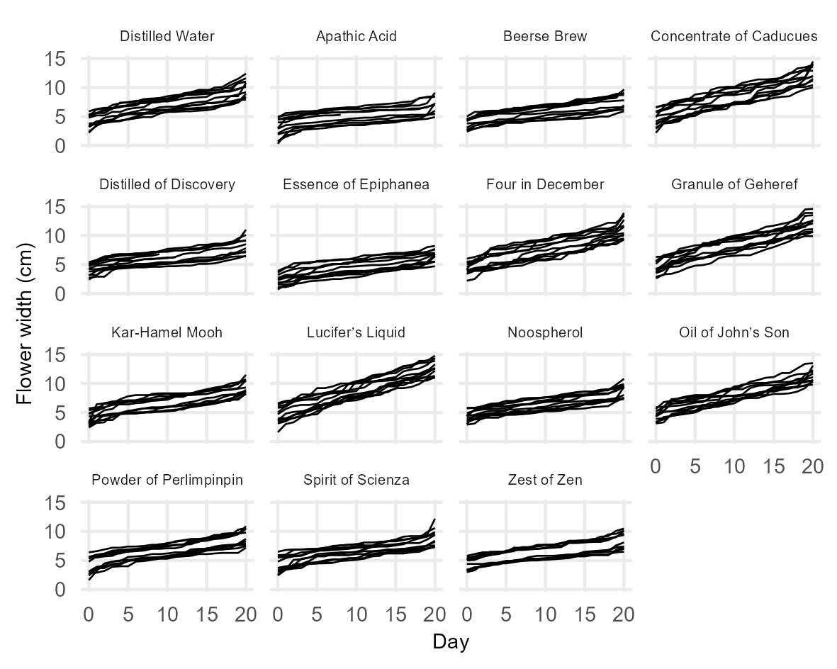
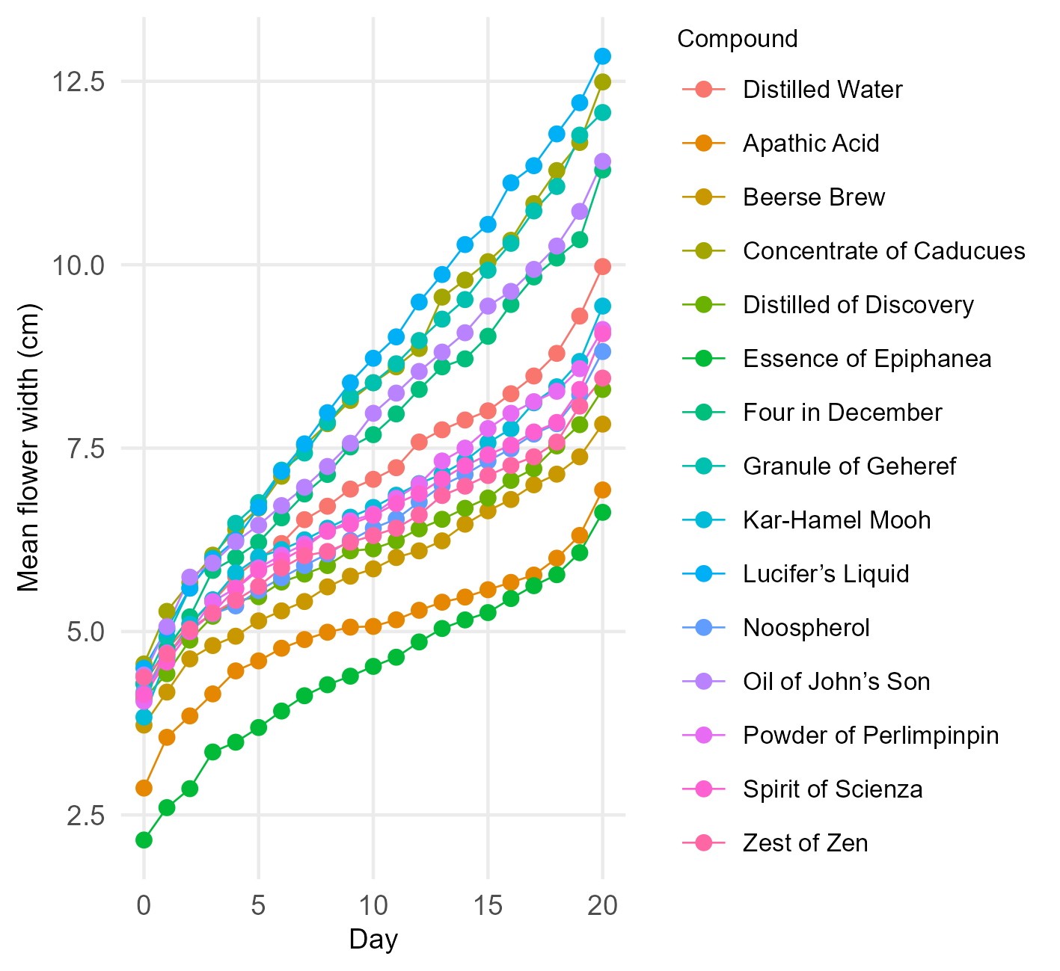
Exploratory Data Analysis on Gaussian data

Slide 17
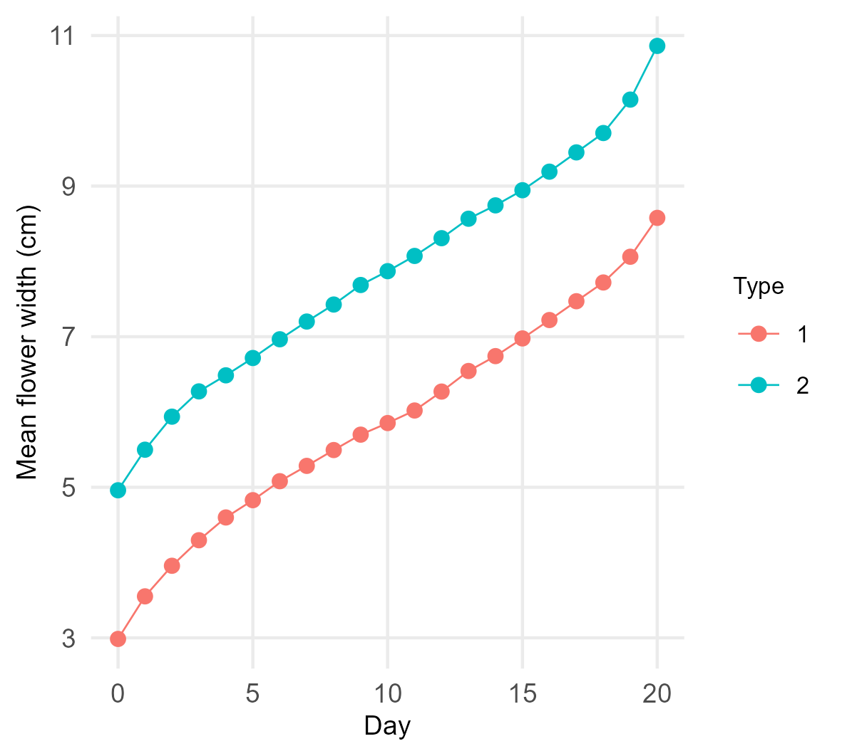
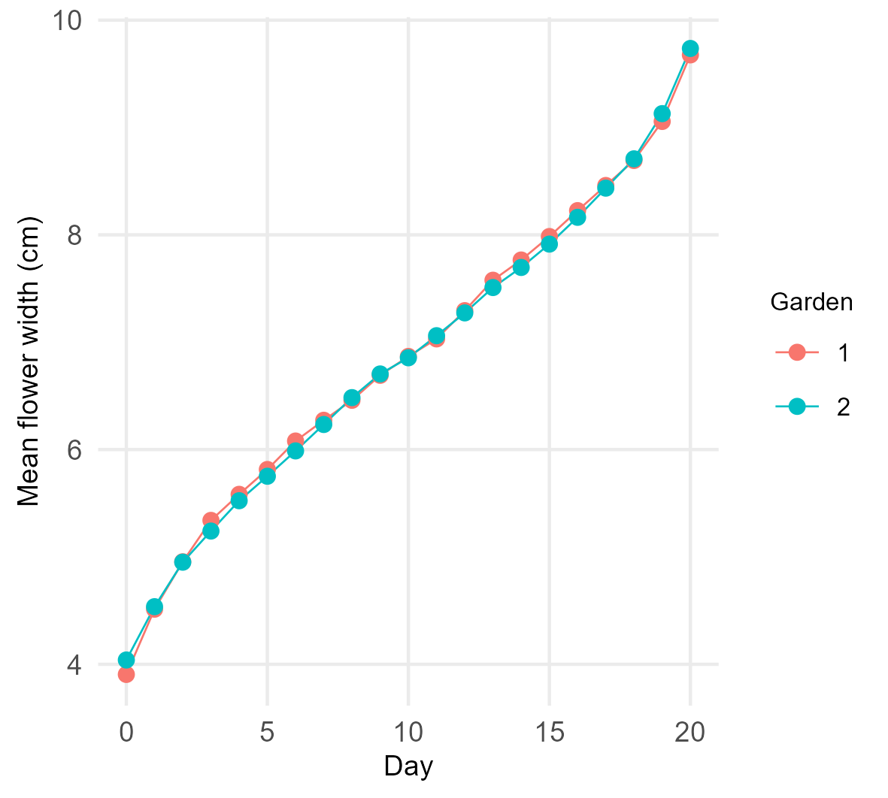
Exploratory Data Analysis on Gaussian data

Slide 18
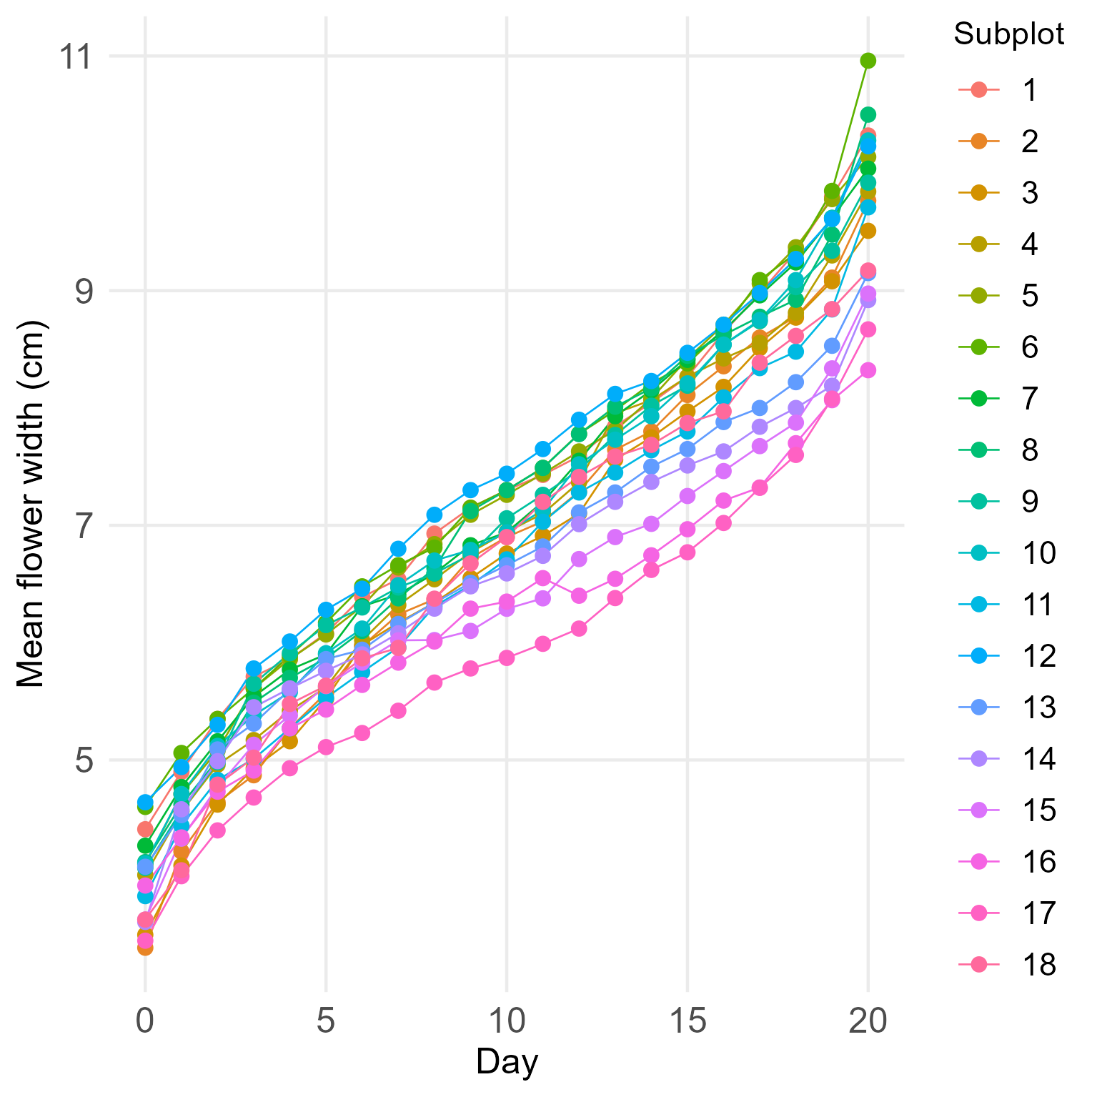
Exploratory Data Analysis on Gaussian data

Slide 19
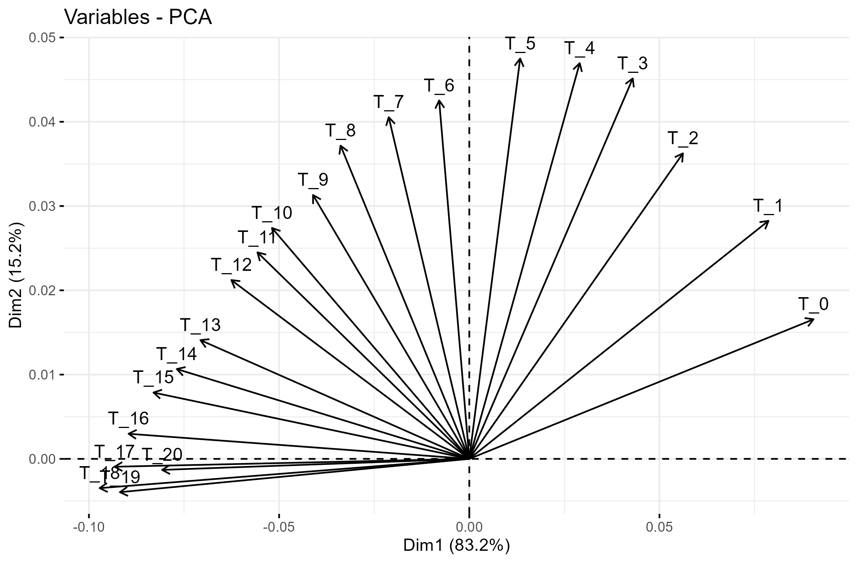
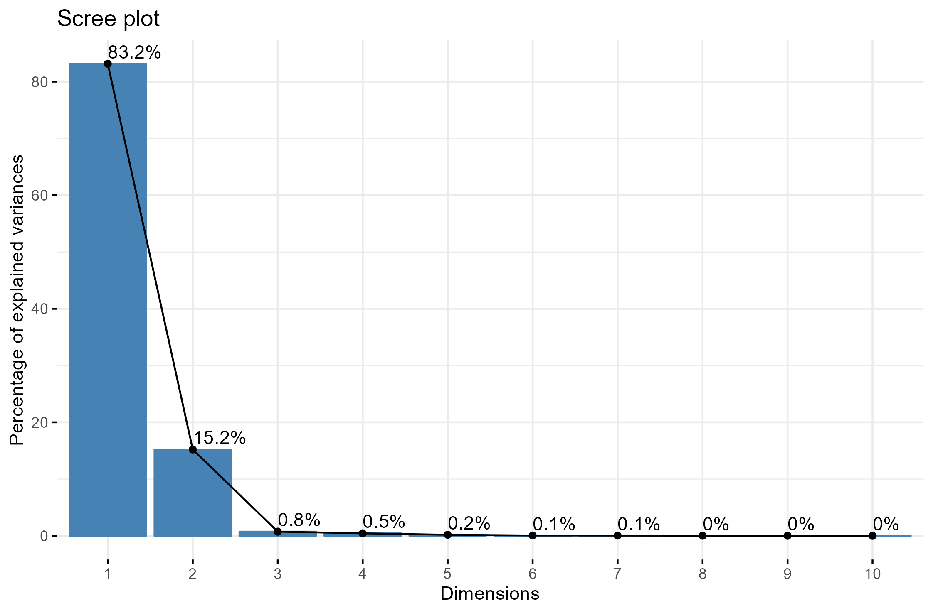
Multivariate Exploration of 'Flower Width' using PCA

Slide 20
Question 6
Can (part of) the conclusions of the analysis of Flower Width be confirmed with a multivariate method?

Slide 21
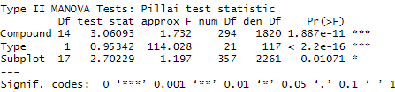
Multivariate regression analysis
Outcome variables: T_0 to T_20
Covariates: Compound + Type + Subplot
All the 3 covariates significantly influence the widths of the 20 days.
Question: How to find the best compound with this model?

