Slide 1
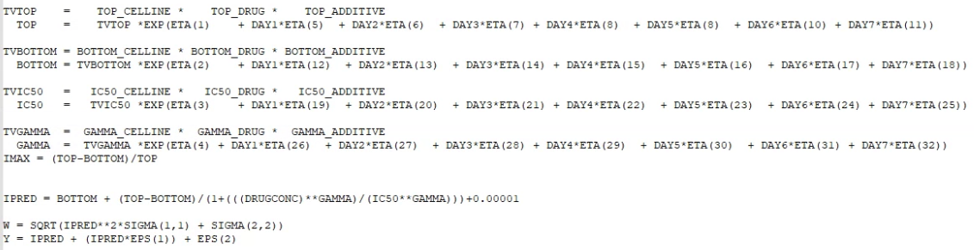
Dactolisib/Erlotinib
WT
R183W
NONMEM ID
TV_parameters
ATUX=0
ATUX=3
ATUX=4.5
ATUX=6
day 1
day 2
day 3
day 4
IOV
parameter=TV*IOV*IIV
IPRED
replicate 1
replicate 1
IIV
replicate 2
…
replicate 2
replicate 3
replicate 3
The individual parameter estimate should be different in each replicate?
Notes:
- each combination of drug, cell line (5 cell lines – WT, S256F, EGFP, P179R, R183W), and additive drug concentration (i.e. OA, either 0 or 10) -> makes one NONMEM ID
- The experiment is repeated 3 times per day, in 7 days -> inter-day variability & within day (inter-replicate) variability

Slide 2
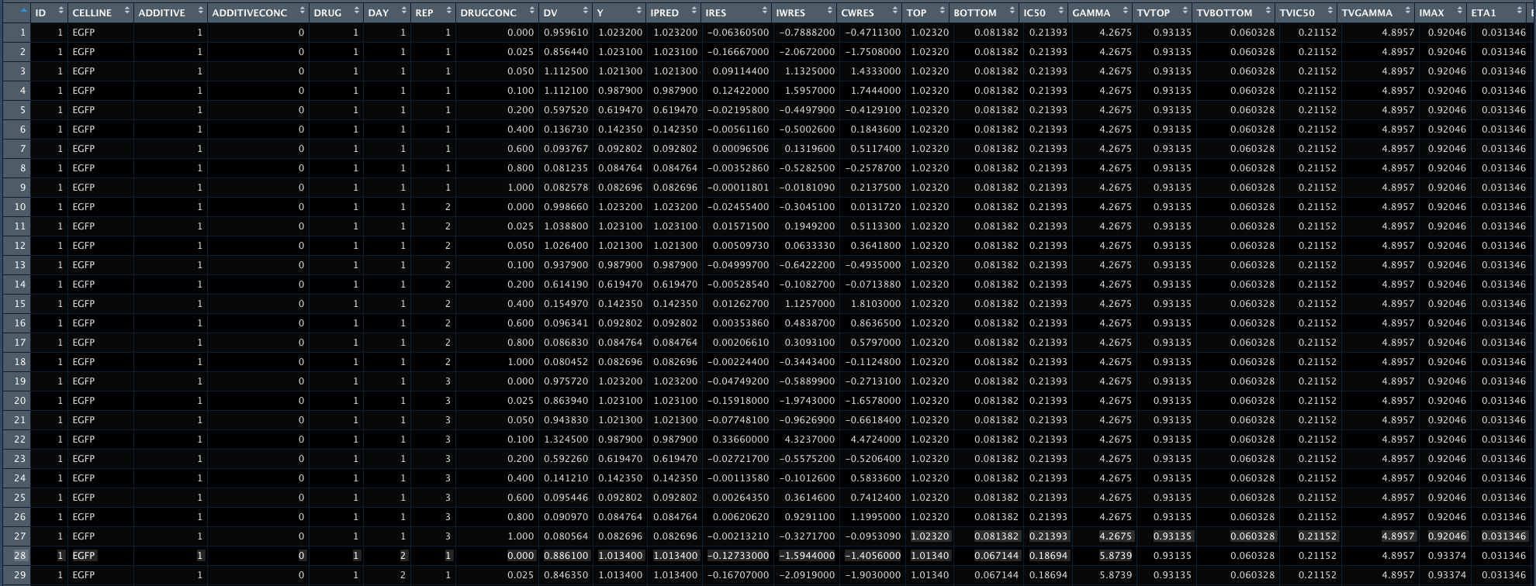
Question:
The model only had IIV on TOP, why individual prediction of BOTTOM,IC50 and GAMMA varies between days?
Why different replicates have the same invididual parameters?

