Slide 1

Writing models
Running models
Example code
model <- function(){
ini({
tka <- log(1.5)
tcl <- log(4)
tv <- log(20)
eta.ka ~ 0.5
eta.cl ~ 0.5
eta.v ~ 0.2
prop.err <- 0.1
})
model({
ka <- exp(tka + eta.ka)
cl <- exp(tcl + eta.cl)
v <- exp(tv + eta.v)
d/dt(depot) = -ka * depot
d/dt(cent) = ka * depot - cl / v * cent
cp = cent / v
cp ~ prop(prop.err)
})}
nlmixr( model, data, est = "saem", saemControl(print=50,
nBurn=200, nEm=300),
tableControl(cwres=TRUE))
Solved system
Cheat Sheet
Fixed effects (<- or =)
Model
model <- function() { ini({
lcl <- log(0.135) #log Cl (L/h) lv <- log(8) #log V (L) prop.err <- 0.15 #RUV (SD/mean) eta.cl ~ 0.1 eta.v ~ 0.1 }) model({ cl <- exp(lcl + eta.cl) v <- exp(lv + eta.v) linCmt() ~ prop(prop.err)})}
NONMEM/RxODE data
June 2022 https://nlmixr2.org/
Initial estimates
Estimation method
Random effects (~)
Control parameters
Calculate conditional weighted residuals
Getting nlmixr
Residual error (<-)
What you need:
R-4+; R-4.2.0 preferred
Rtools (if you use Windows)
For installation, run:
install.packages(
"nlmixr2",
dependencies=TRUE)
See our homepage (nlmixr2.org) and blog (blog.nlmixr2.org) for more information.
Estimation method options
Model parameters
est = "focei", "foce", "foi", "fo"
These methods are based on our interpretation of the NONMEM routines.
foceiControl()
outerOpt | Outer optimization routine c("nlminb", "bobyqa", and many others)
sigdig | Controls tolerances of estimation and ODE solving routines. Not the same as NONMEM sigidig parameter but with similar meaning (3)
maxOuterIterations | Maximum number of outer iterations; 0 provides Bayesian feedback estimates
print | Iterations printed to console (1)
... | Additional arguments (too many to mention!)
ODEs
Zero-order absorption
model <- function(){
ini({
ka <- 1.2 #ka (/h)
lcl <- -2.0 #log Cl (L/hr)
v <- 8.0 #V (L)
ltk0 <- 0.5 #log D1 (h)
prop.err <- 0.15
eta.cl ~ 0.1})#IIV Cl
model({
cl <- exp(lcl + eta.cl)
D1 <- exp(ltk0)
d/dt(depot) = -ka*depot
d/dt(C2) = ka*depot - (cl/v)*C2
dur(depot) = D1
cp = C2 / v
cp ~ prop(prop.err)})}
Concentration
Residual error
Optional extras
Model
xpose.nlmixr2 and ggPMX: Graphical diagnostics
shinyMixR: A GUI for building nlmixr models in shiny
Models are defined as functions, with ini (initial estimates) and model (model) blocks. Parameters are best defined on the log scale. Assignments can use <- or =. Random effects are expressed as variances using the tilde (~).
Bounds are supported for FOCEi, parameters can be fixed, and parameters can be labelled with #:
est = "saem"
An implementation of the stochastic approximation expectation-maximization algorithm. No termination criteria, can be slow when using ODEs.
saemControl()
seed | Random seed (99)
nBurn | Number of iterations in the SA (burn-in) step (200)
nEm | Number of iterations in the EM step (300)
nmc | Number of Markov chains (3)
atol | Absolute convergence tolerance (1e-8)
print | Iterations to complete before printing to console (1)
... | Additional arguments
Solved systems
ini
tcl <- c(-3, 0.1, 5) # log CL (FOCEi only) allCL <- fix(0.75) # allometric exponent
Linear compartmental PK models with either oral or IV dosing all have closed-form solutions similar to NONMEM ADVANs.
The linCmt() term replaces the ODEs. nlmixr will guess the model form from the parameters specified. Currently only for nlme and SAEM.
Turnover simultaneous PKPD model
Off-diagonal random effects
model <- function() {
ini({
tcl <- log(0.1) # log CL (L/hr)
tv <- log(8) # log Vc (L)
eta.cl ~ 0.1
eps.pkprop <- 0.1
tc50 <- log(1) #log ec50 (mg/L)
tkout <- log(0.05) #log tkout (/h)
e0 <- 100 #e0
eta.c50 ~ .5
eps.pdadd <- 100})
model({
cl <- exp(tcl + eta.cl)
v <- exp(tv)
c50 = exp(tc50 + eta.c50)
kout = exp(tkout)
cp = center / v
d/dt(center) = - cl * cp
effect(0) = e0
kin = e0*kout
PD = 1-cp/(c50+cp)
d/dt(effect) = kin*PD -kout*effect
#specify CMT or DVID (1/2) in data
cp ~ prop(eps.pkprop) | center
effect ~ add(eps.pdadd) | effect })}
model
linCmt() ~ add(add.err)
Parameter correlations are expressed as triangular blocks (zeroes should not be used):
est = "posthoc"
Uses posthoc step of FOCEi algorithm for Bayesian feedback. Similar to using foceiControl(maxOuterIterations=0).
ini
eta.cl + eta.v ~ c(0.1, 0.005, 0.1)
tableControl()
Controls additional table outputs included in the final nlmixr model.
cwres | Boolean indicating if you need to calculate conditional weighted residuals (CWRES). On by default for FOCE(i) routines. This will also generate WRES, CPRED and CRES. Additionally this will add the FOCEi objective function value
npde | Calculate npde residuals (NPDE). This will also generate EPRED and ERES
nsim | Number of simulations used for NPDE (default 300)
ties | Boolean indicating if noise will be added to avoid ties in NPDE calculation (TRUE)
Seed | Random seed to use for npde calculation (1009)
SAEM random effects and covariates must be added to the population parameters (mu-referencing). This is implemented for exponential random effects as additive on log-scale. While not strictly required for FOCEi, it improces stability. For SAEM, calculate logWT70<-log(WT/70) in the data set, and not in the model block.
Mu-referencing
Residual error
Additive, proportional and combined additive and proportional error models are available.
model
cp ~ add(add.err)
cp ~ prop(prop.err)
cp ~ add(add.err) + prop(prop.err)
model
cl<- exp(tcl + allCL*logWT70 + eta.cl) v <- exp(tv + CovSex*SEX + eta.v)
Adding table items after fit
fit <- fit %>% addCwres() fit <- fit %>% addNpde()

Slide 2

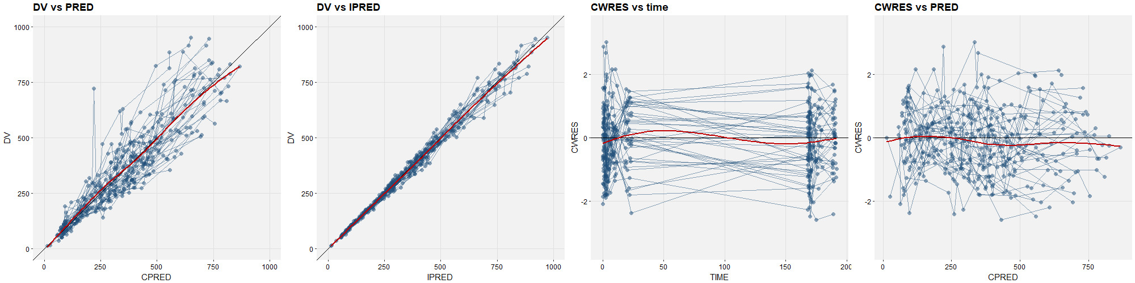
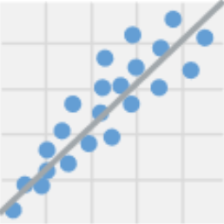
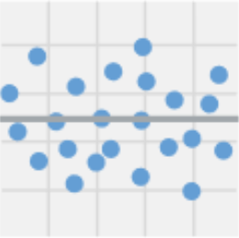
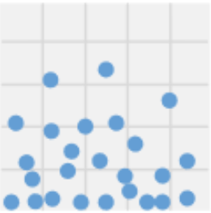
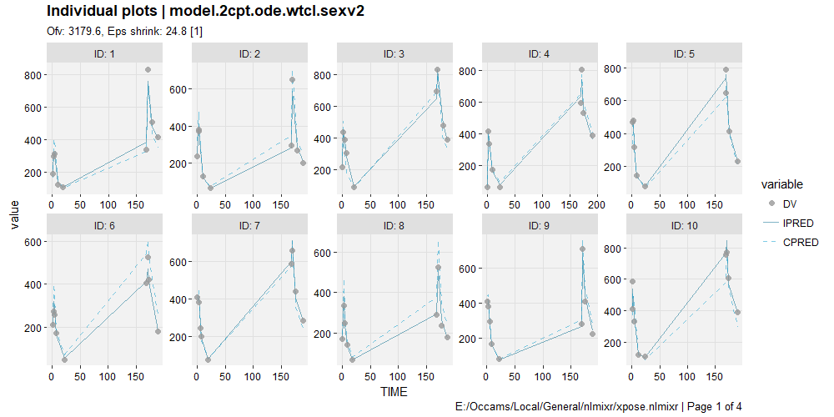
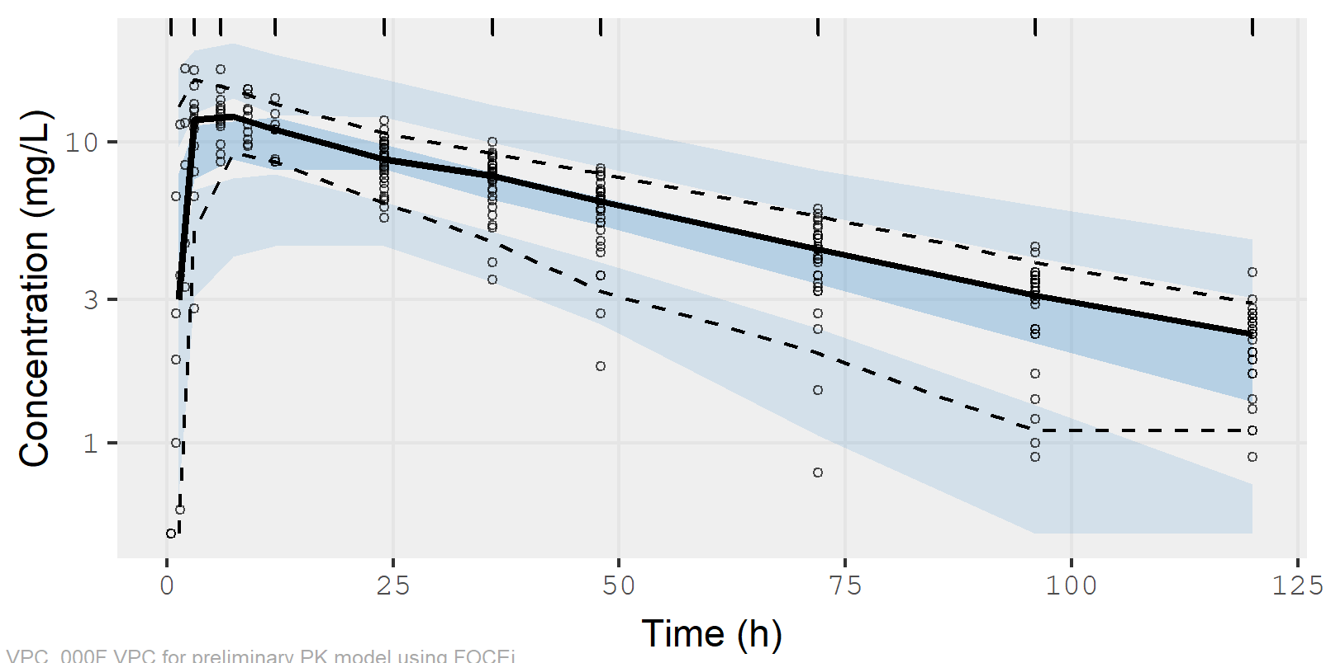
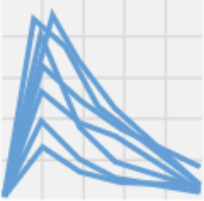
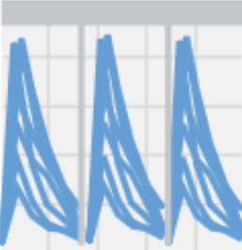
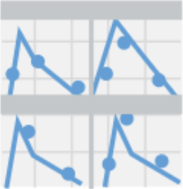
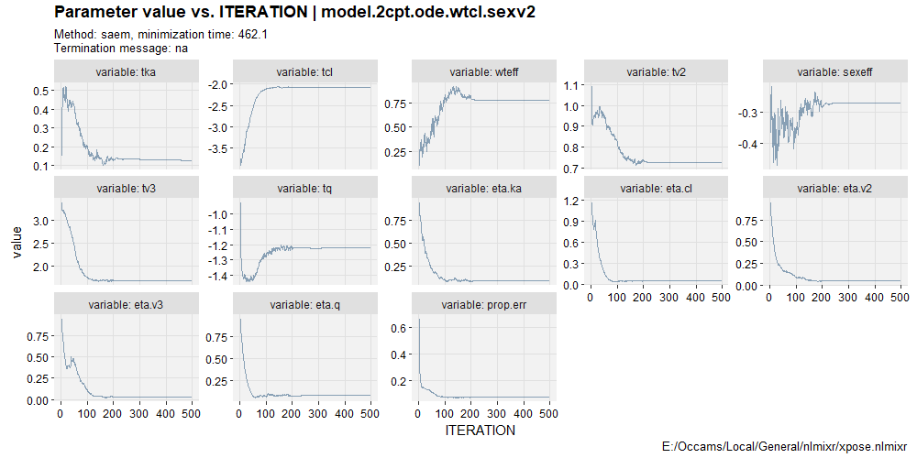
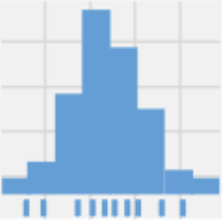
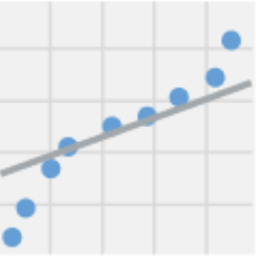
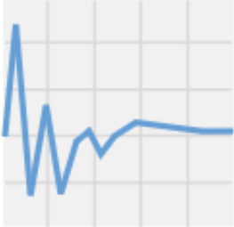
VPCs: vpc
Graphical diagnostics: xpose
nlmixr uses the simulation capabilities of rxode2 and the vpc package to generate VPCs directly from the fitted model object:
Loading a model into xpose
Basic goodness-of-fit
In order to use the functionality of xpose, we first need to convert our nlmixr model object into an xpose database using the xpose.nlmixr2 package.
The xp_theme option allows a ggplot2 theme object (defining how plots will be drawn) to be specified.
 | dv_vs_pred(xpdb)
 | dv_vs_ipred(xpdb)
 | res_vs_idv(xpdb, res="CWRES")
 | res_vs_pred(xpdb, res="CWRES")
 | absval_res_vs_idv(xpdb, res="CWRES")
 | absval_res_vs_pred(xpdb, res="CWRES")
 | dv_vs_idv(xpdb, group="ID")
 | ipred_vs_idv(xpdb, group="ID")
 | pred_vs_idv(xpdb, group="ID")
 | dv_preds_vs_idv(xpdb)
nlmixr
vpcPlot(myfit, n=500,show=list(obs_dv=TRUE), log_y=TRUE, log_y_min=0.5, xlab="Time (h)", ylab="Concentration (mg/L)")
xpose.nlmixr
xpdb <- xpose_data_nlmixr(myfit, xp_theme = theme_xp_nlmixr())
Plot layers and aesthetics
Besides being able to manipulate xpose graphs in the same ways as ggplot2 graphs using layers, plot aesthetics can be directly specified using layer_argument, where layer is the layer, and argument is the argument applying to it.
Individual plots
 | ind_plots(xpdb) #xpose version plot(augPred(myfit)) #nlmixr version
Most useful VPC options
xpose
dv_vs_pred(xpdb, point_color="blue")
fit | nlmixr fit object
n | Number of simulation iterations
bins | Either "density", "time", or "data", "none", or one of the approaches available in classInterval() such as "jenks" (default) or "pretty", or a numeric vector specifying the bin separators
n_bins | When using the "auto" binning method, what number of bins to use
bin_mid | Either "mean" for the mean of all timepoints (default) or "middle" to use the average of the bin boundaries
show | A list of what to show in VPC (obs_dv, obs_ci, pi, pi_as_area, pi_ci, obs_median, sim_median, sim_median_ci); see example
stratify | Character vector of stratification variables (max 2)
smooth | “Smooth" the VPC (connect bin midpoints) or show as rectangular boxes (default T)
pred_corr | Perform prediction-correction (default F)
pi | Simulated prediction interval to plot. Default is c(0.05, 0.95)
ci | Confidence interval to plot. Default is (0.05, 0.95)
facet | "wrap", "columns", or "rows"
log_y | Logarithmic y-axis? (default F)
xlab | Label for x-axis
ylab | Label for y-axis
title | Title
uloq | Upper limit of quantification (default NULL)
lloq | Lower limit of quantification (default NULL)
vpc_theme | Theme. Expects list of class vpc_theme created with function vpc_theme()
Distributions
Layers for scatterplots
point | Options for geom_point
line | Options for geom_line
guide | Options for geom_abline
smooth | Options for geom_smooth
text | Options for geom_text
xscale | Options for scale_x_continuous or scale_x_log10
yscale | Options for scale_y_continuous or scale_y_log10
 | prm_distrib(xpdb)
 | eta_distrib(xpdb)
 | cov_distrib(xpdb)
 | res_distrib(xpdb, res="CWRES")
 | prm_qq(xpdb)
 | eta_qq(xpdb)
 | cov_qq(xpdb)
 | res_qq(xpdb, res="CWRES")
Editing and subsetting data
Editing/filtering data in xpose is performed by dplyr.
filter | Subset data based on logical condition(s)
mutate | Add, modify or remove variables
Layers for distributions
histogram | Options for geom_histogram
density | Options for geom_density
rug | Options for geom_rug
xscale | Options for scale_x_continuous or scale_x_log10
yscale | Options for scale_y_continuous or scale_y_log10
SAEM iteration trace plots
xpose
xpdb %>% filter(WT>70) %>% dv_vs_pred()
 | prm_vs_iteration(xpdb)#xpose version traceplot(myfit) #nlmixr version
Plot types
Editing data types
The xpose package supports different plot types, according to the type of data being plotted.
xpose.nlmixr tries to assign variables to types automatically, and often this works well. Sometimes manual adjustments are needed, though.
xpose
dv_vs_pred(xpdb, type="pls") eta_distrib(xpdb, type="hdr")
Access functions
list_vars(xpdb) | Display variable assignments
set_var_types(xpdb, ...) | Modify variable assignments
get_code(xpdb) | Display model
get_data(xpdb) | Extract data
print(xpdb) | Display summary of xpose data object
Scatterplots
p | Point
l | Line
s | Smooth
t | Text
Distributions
h | Histogram
d | Density line
r | Rug
xpose
list_vars(xpdb1) xpdb2 <- set_var_types(xpdb1, .problem = 1, catcov='sex')
Icons and content for xpose courtesy of Ben Guiastrennec and the xpose team! Xpose can do much more than this – get the official cheat sheet at uupharmacometrics.github.io/xpose/reference/figures/cheatsheet.pdf

