Slide 1
DRAFT PROJECT REPORT
Egocentric Hand Motion To Robot Simulation
Current state
Working prototype
not robot-ready yet
Turning repeated first-person hand videos plus IMU context into smoothed hand intent, averaged motion, and MuJoCo simulation targets.
The simulation can show the averaged hand motion, now including wrist rotation, while exposing where sensing and modeling still fall short.
Interpolated handouts
Five-finger simulation
Training dataset

Slide 2
STARTING INTUITION
The first bet was biological, then practical
Hand meshes
21-point tracking
A full hand mesh should be more faithful than sparse points because real hands are surfaces with anatomical constraints, occlusions, and contact.
MediaPipe landmarks made the project tractable: enough structure to estimate fingers and palm orientation, light enough to iterate quickly.
Left as future work: robust egocentric mesh recovery needs more compute and model tuning than was available for this stage.
Tradeoff: easier to run, harder to recover metric depth and impossible to fully solve occlusion.
Egocentric hand motion to robot simulation
02

Slide 3
SYSTEM FLOW
What the pipeline does now
Video + IMU
MediaPipe points
AHRS filter
IK smoothing
Full-frame data
Average action
MuJoCo render
The important change is that interpolation happens before dataset construction, so the model sees a complete action timeline instead of only the frames where the detector succeeded.
Egocentric hand motion to robot simulation
03

Slide 4
MISSING FRAMES
The hard part was not detection, it was continuity
7,124
72
6
360
observation rows
features
videos averaged
average frames
full-frame dataset
landmarks + root + flags
same action family
canonical timeline
Each source video still has hundreds of IK-filled frames. That is not hidden; the handout overlays label detected versus interpolated frames so the uncertainty remains visible.
Egocentric hand motion to robot simulation
04

Slide 5
LATEST CORRECTION
Wrist rotation moved into the motion target
+
AHRS camera attitude
Palm delta from landmarks
Smoothed root quaternion
The first reliable palm orientation becomes a calibration reference. Later palm poses become relative wrist rotation, composed with IMU/AHRS orientation and smoothed as quaternions.
Egocentric hand motion to robot simulation
05

Slide 6
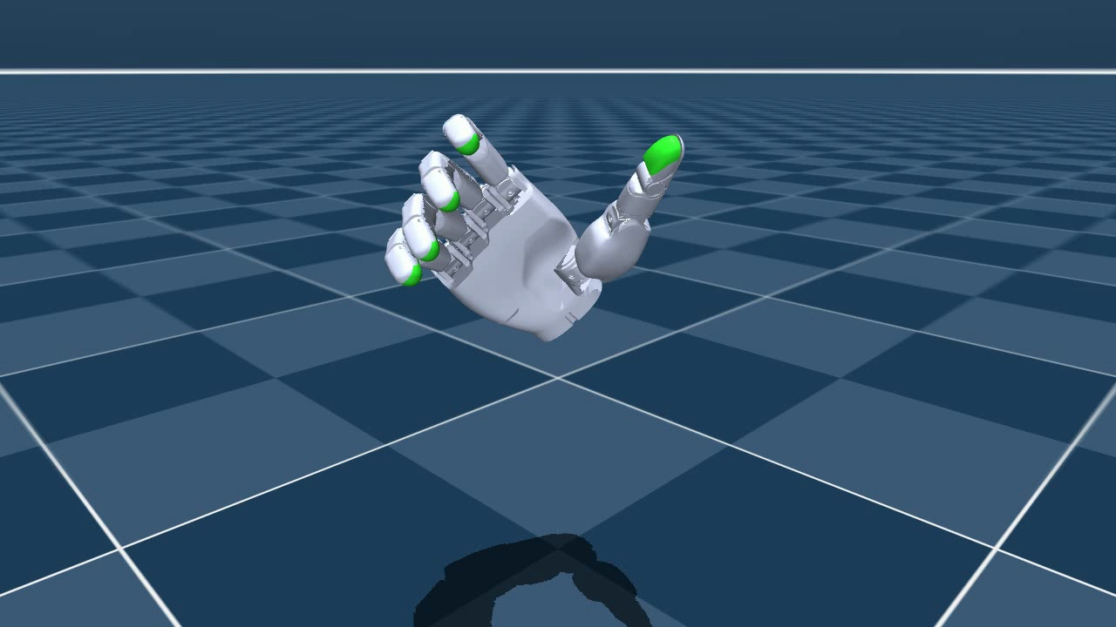
SIMULATION ARTIFACT
Five-finger render before robot attachment
Why Sharpa Wave?
The available Unitree G1 assets expose wrist joints but not a true five-finger articulated hand. Sharpa Wave from MuJoCo Menagerie gives a five-finger proxy for validating hand motion before robot attachment.
Output: outputs/sharpa_fivefinger_average_motion.mp4
Egocentric hand motion to robot simulation
06

Slide 7
BASELINE
Learning signal: useful, but not yet enough
Interpretation
The ridge baseline is a sanity check, not the final policy. Once wrist orientation became real, the wrist errors grew, which points toward a temporal model rather than a linear one.
Next model: GRU, TCN, or small Transformer over smoothed observation windows.
Egocentric hand motion to robot simulation
07

Slide 8
ROADMAP
Limitations are clear, which is progress
Still limited by
Next steps
• Image-normalized depth, not metric 3D
• Occlusion in egocentric footage
• Simple baseline model
• Five-finger proxy, not Unitree embodiment
• Standing balance not solved
• Store world landmarks and timestamps
• Calibrate camera/IMU to robot frame
• Train a temporal policy
• Add whole-body balance controller
• Revisit mesh-based hand recovery with more compute
The prototype now makes the intended motion visible, including uncertainty. That is the right staging point before asking a humanoid robot to imitate it.
Egocentric hand motion to robot simulation
08

