Slide 1
Imecalc
A self-defined FEA package based on IMESH and CALCLIX

Slide 2
Where the idea comes out?
What we already have:
We have already had the IMESH module
We can get some free solver modules also
libMesh, ALBERTA, Calclix, deal.II, FEMPACK, etc.
Then, What we can do?

Slide 3
ANSWER
done
IMESH
We can do here
Free solver
TBD
done

Slide 4
Why calclix?
ABAQUS Input deck file
Easy to use
Julin recommended

Slide 5
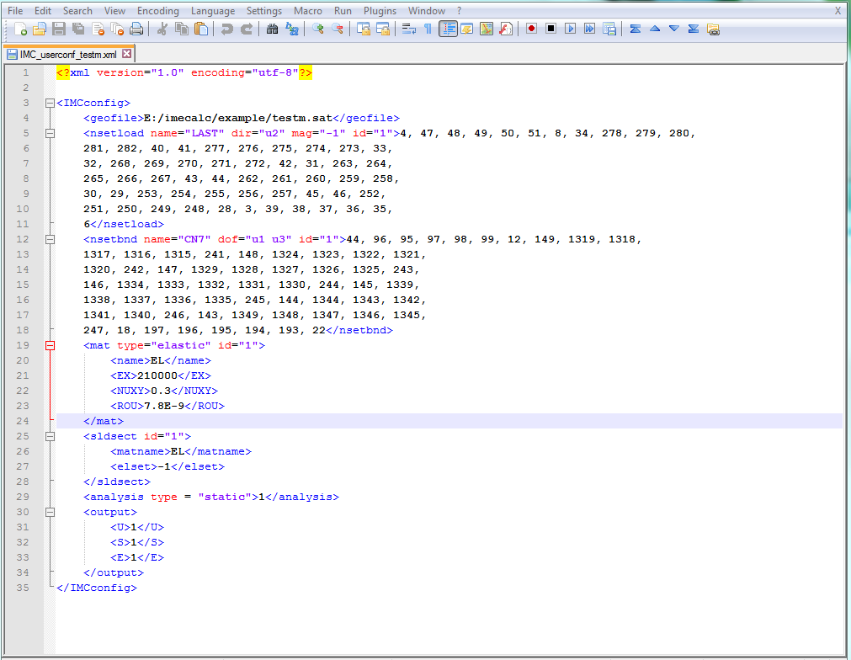
Preprocessor

Slide 6
ICCONVERTOR
Now:
Read Mesh data from IMESH
Read preprocess info from user’s input
Generate the input deck file
Future:
Convert all the file in different format
GUI functionality

Slide 7
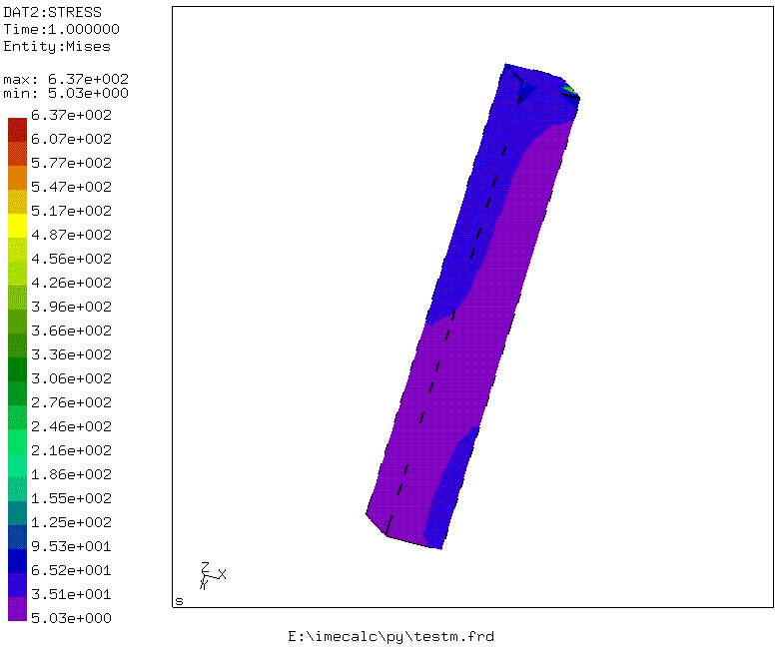
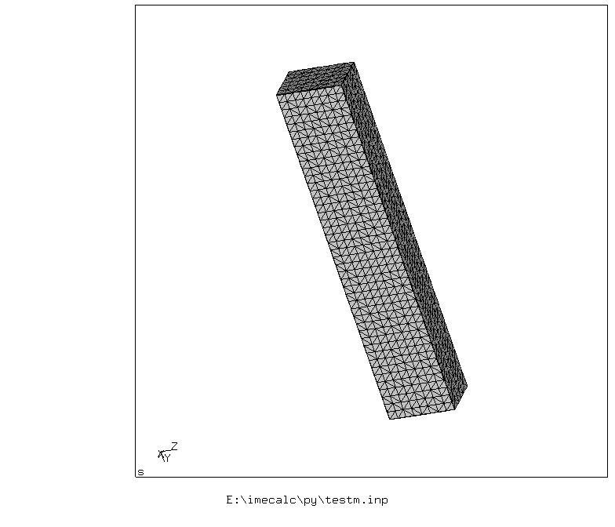
Demo

