Slide 1
Reinforcement Learning Basics
CAPS Session 1

Slide 2

The Markov Decision Process
Robot senses its current state s_{t,} chooses an action a_{t} from a set of all possible actions A, and performs it.
In response, environment “gives” the robot two things:
Immediate reward r_{t}
Subsequent state s_{t+1}
The task of the robot is to learn a “policy” that dictates the choice of its action a_{t} based on its current observed state s_{t:}

Slide 3

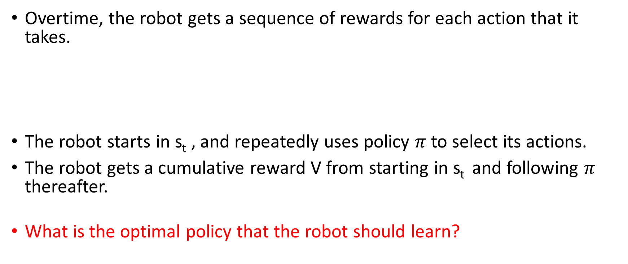
The Cumulative Discounted Reward
Overtime, the robot gets a sequence of rewards for each action that it takes.
The robot starts in s_{t} , and repeatedly uses policy $π$ to select its actions.
The robot gets a cumulative reward V from starting in s_{t} and following $π$ thereafter.
What is the optimal policy that the robot should learn?
Notes:
Answer: Require the optimal policy to produce the greatest possible cumulative reward for the agent over time.
The "discounting factor" specifies the importance of future rewards relative to immediate rewards. For example, = 1 implies that the agent
values immediate reward as much as future rewards.

Slide 4

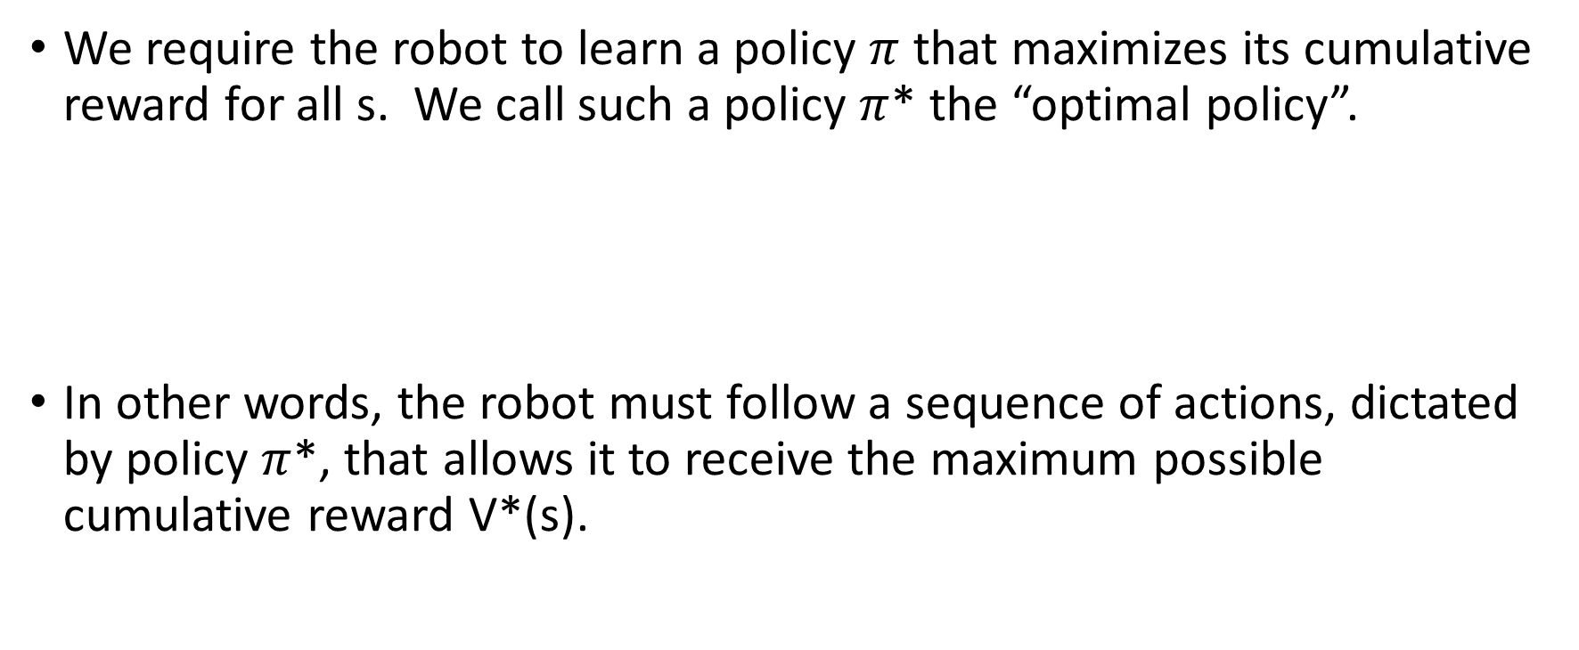
The Learning Task
We require the robot to learn a policy $π$ that maximizes its cumulative reward for all s. We call such a policy $π$* the “optimal policy”.
In other words, the robot must follow a sequence of actions, dictated by policy $π$*, that allows it to receive the maximum possible cumulative reward V*(s).

Slide 5
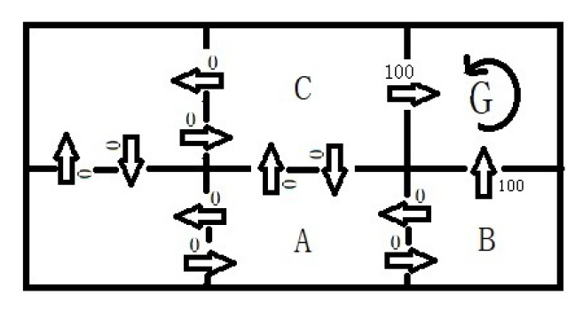
Components of the Six Grid World
G is the goal state.
Discount factor is 0.9.
Arrows represent the possible actions that the robot can perform in each state (grid).
The numbers on the arrows are the immediate rewards.
Robot’s learning task: starting from an arbitrary state, move to grid G through the shortest path.

Slide 6
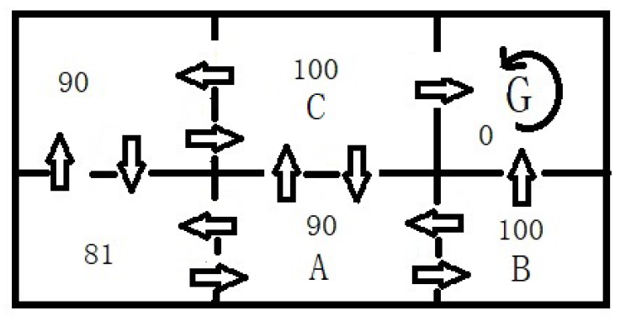

Six Grid World: V*(s) values
The numbers labelled in each grid the bottom figure is the largest possible cumulative reward that the robot receives if it follow the optimal policy.
What is an optimal policy if robot starts in A?

Slide 7

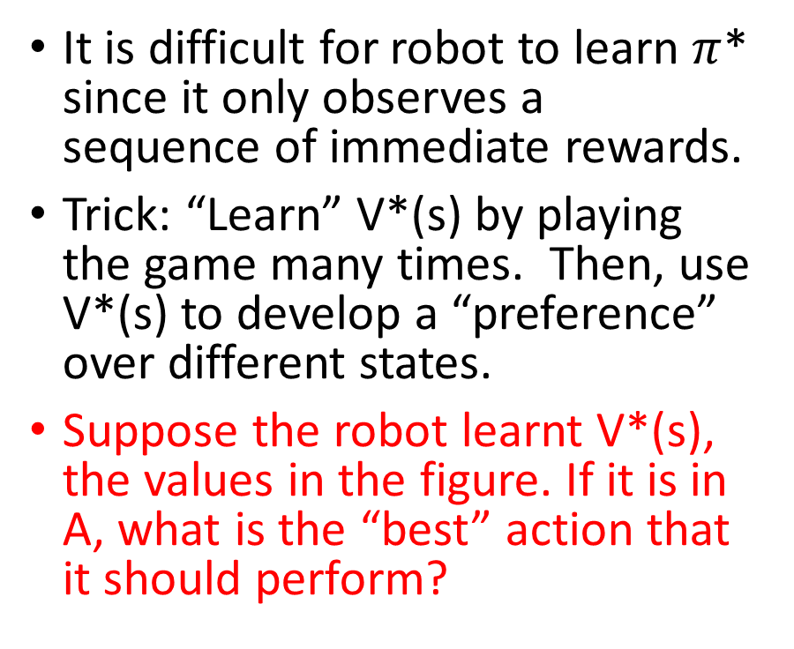
V*(s) as an evaluation function
It is difficult for robot to learn $π$* since it only observes a sequence of immediate rewards.
Trick: “Learn” V*(s) by playing the game many times. Then, use V*(s) to develop a “preference” over different states.
Suppose the robot learnt V*(s), the values in the figure. If it is in A, what is the “best” action that it should perform?

Slide 8
Problem with using V*(s)
What if we don’t have prior knowledge on the immediate reward and the subsequent state for each (s,a)?
Solution: Need to do some “clever rewriting” and “massage” the above equation to bypass this problem.
Notes:
Answer: Require the optimal policy to produce the greatest possible cumulative reward for the agent over time.
The "discounting factor" specifies the importance of future rewards relative to immediate rewards. For example, = 1 implies that the agent
values immediate reward as much as future rewards.

Slide 9
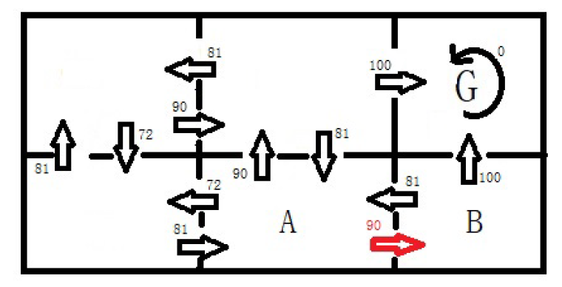


The Q function
Instead of evaluating each state, we now evaluate each “state-action pair”. How good it is to perform action a in state s?
The value “Q” is the immediate reward, plus the discounted” cumulative reward that the robot gets by following the optimal policy thereafter.
Example:

Slide 10

Selecting optimal actions with Q values
To choose the optimal action a in state s, we simply select the action with the highest Q value.
What is the robot’s best action in state A? In state B?
The robot doesn’t need prior knowledge of the reward and the subsequent state that it will get by performing a to select its optimal action, once it learns Q.

Slide 11

The Bellman Equation
The Q function can be rewritten as the “Bellman Equation”:
Learning Q corresponds to learning the optimal policy.
Armed with the Bellman Equation, we can use a “Value Iteration” algorithm (Session 3) to estimate the Q values.
What is Q(s=A, a=right) from the Bellman Equation?

