Slide 1
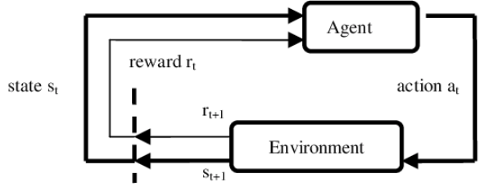
Review: Reinforcement Learning (RL) Basics
RL is suitable to a class of problems known as the Markov Decision Process (MDP)
Outcome of applying action to any state depends only on this action a and state s (and not on preceding a or s)
Information available to the robot: rewards and subsequent state for each state-action transition.
What are the components of a MDP?

Slide 2
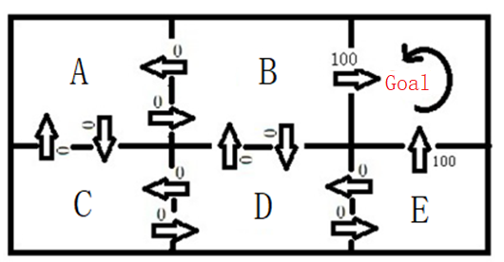


What is the Total (Cumulative) Reward?
After performing action a in state s (state action pair s,a):
Robot receives immediate reward of either 0 or 100.
Robot goes to the next state.
The action that robot chooses in every state s is dictated by a policy π.
The total reward that robot gets (from π) is the sum of the sequence of rewards that it gets by following π, discounted by ϒ.

Slide 3
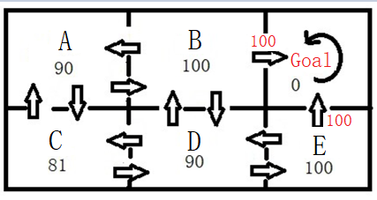
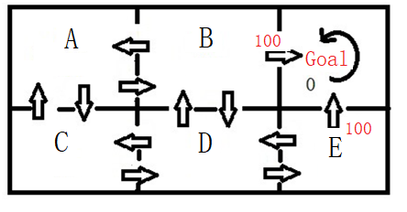


Review: What is the goal of the robot?
What is the goal of the robot that uses RL?
Pick the best policy that will maximize the total rewards that it receives.
How does it do that?
Robot needs to evaluate the “goodness” of each state. How good is it to be in Grid A, in Grid E?
This evaluation can be done if the robot knows the maximum total reward that it can achieve in each state.
We call this the “optimal value function” V*(s)
If we have good estimates of V*(s), then we can choose the optimal policy.

Slide 4
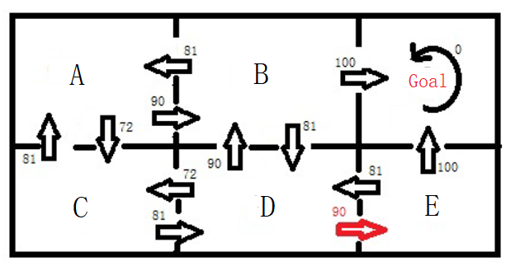

The Q Function
Rather than evaluating the “goodness” of each state, we can also evaluate the goodness of each state-action pair.
How good it is for me to perform RIGHT in state D (as oppose to RIGHT) in state B?
Compare the Q value of doing RIGHT in D and RIGHT in B.
Q value is the maximum achievable total reward that the robot get by performing a in s, and then following optimal policy thereafter.

Slide 5

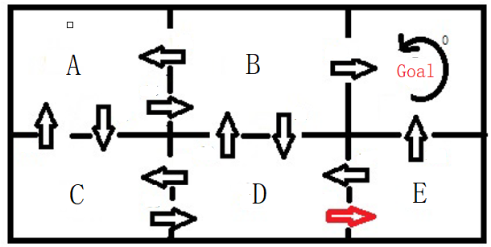


The Bellman Equation
The Q function can be rewritten as the “Bellman Equation”:
What is Q(s=D, a=RIGHT) from the Bellman Equation?
Learning Q corresponds to learning the optimal policy. Assuming Q values are know, what is the optimal policy starting from A?

Slide 6
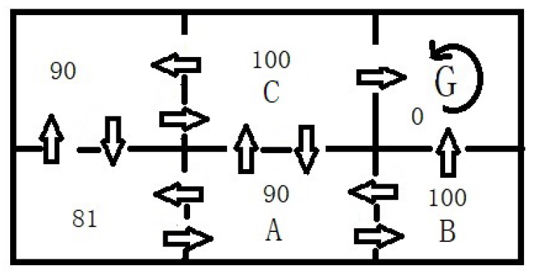

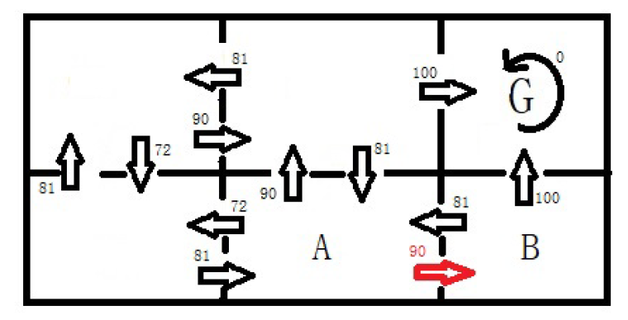

Learn V*(s) or Q(s,a)?
Approach (1): If I know the true V*(s) values, I know the optimal policy policy:
(Approach 2): If I know the true Q values, I know the optimal policy:
Which approach should we choose?

Slide 7
Model-based vs. Model-free Learning
Model-Based Learning
Model Free Learning
Model of the environment : reward and state-transition needs, to be known.
Robot interacts with environment, and from the “history” of its interactions, agent will approximate the reward and state transition.
After that, robot learns the V*(s) using an algorithm called “Value iteration”. Once V*(s) are known, find optimal policy.
Robot will not try to “guess” the reward and state transition functions. It will only “experience” them as it explores the environment.
By trail and error, the robot discovers what are the good and bad actions in each state.
Uses “Q learning” to approximate the Q(s,a) values and find optimal policy.

Slide 8

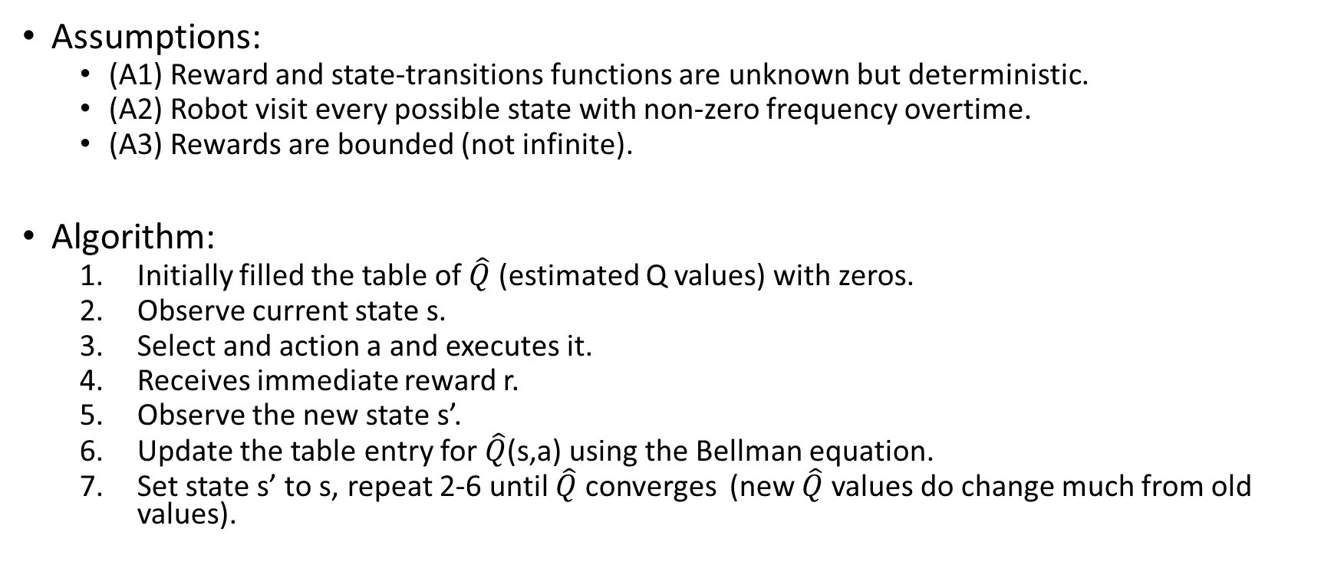
The Q Learning Algorithm
Assumptions:
(A1) Reward and state-transitions functions are unknown but deterministic.
(A2) Robot visit every possible state with non-zero frequency overtime.
(A3) Rewards are bounded (not infinite).
Algorithm:
Initially filled the table of $\hat{Q}$ (estimated Q values) with zeros.
Observe current state s.
Select and action a and executes it.
Receives immediate reward r.
Observe the new state s’.
Update the table entry for $\hat{Q}$(s,a) using the Bellman equation.
Set state s’ to s, repeat 2-6 until $\hat{Q}$ converges (new $\hat{Q}$ values do change much from old values).

Slide 9
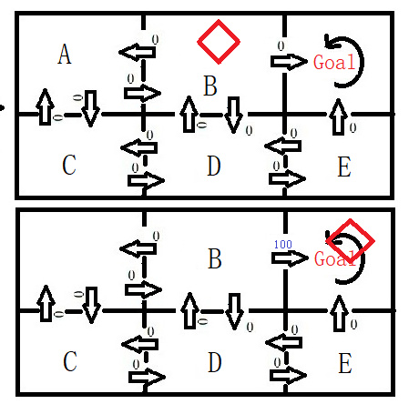
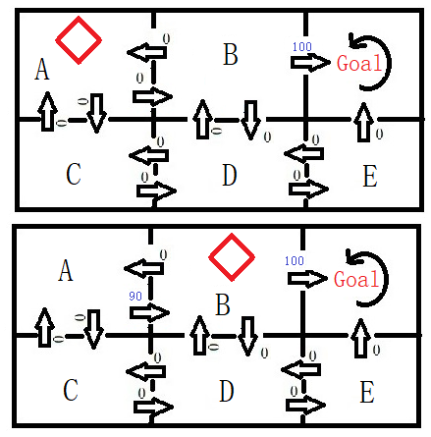
Illustrative Example: Information Propagation
T=t
T=t
T=t+1
T=t+1
Training Episode 1
Some Training Episode after 1

Slide 10
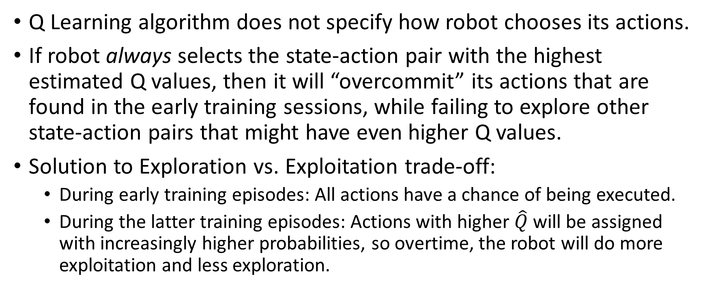
Strategies for Experimentation
Q Learning algorithm does not specify how robot chooses its actions.
If robot always selects the state-action pair with the highest estimated Q values, then it will “overcommit” its actions that are found in the early training sessions, while failing to explore other state-action pairs that might have even higher Q values.
Solution to Exploration vs. Exploitation trade-off:
During early training episodes: All actions have a chance of being executed.
During the latter training episodes: Actions with higher $\hat{Q}$ will be assigned with increasingly higher probabilities, so overtime, the robot will do more exploitation and less exploration.

