Slide 1

Leonard Vincent Ramil – EURECOM, Semester Project

Slide 2

Table Of Contents
Create MIP Image and Labeling
Tabular Data with VesselMetrics
Methodologies
Experiment Results
Conclusions & Future Work

Slide 3
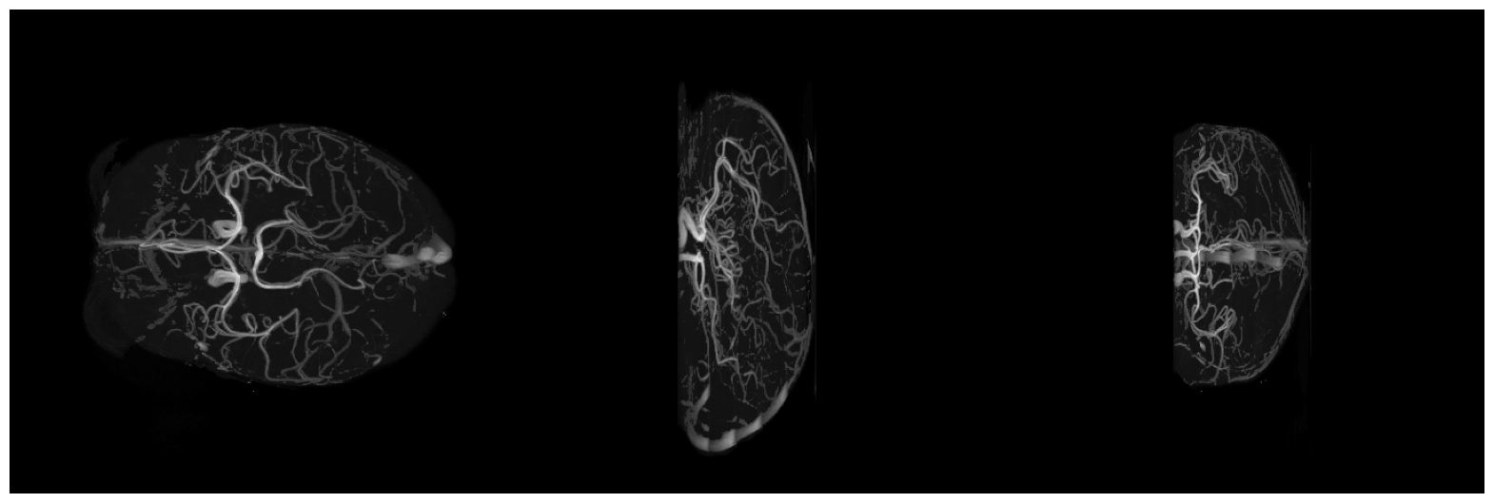
MIP: Maximum Intensity Projection
Create MIP Image and Labeling
Axial
Sagittal
Coronal

Slide 4
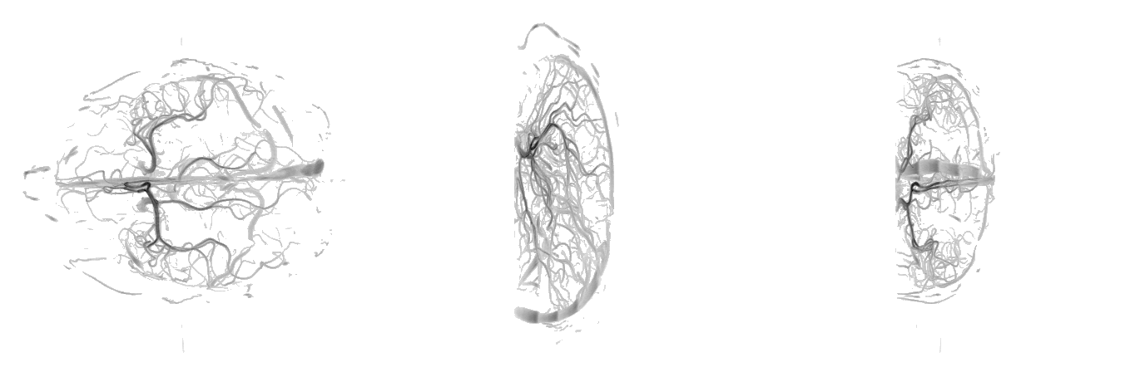
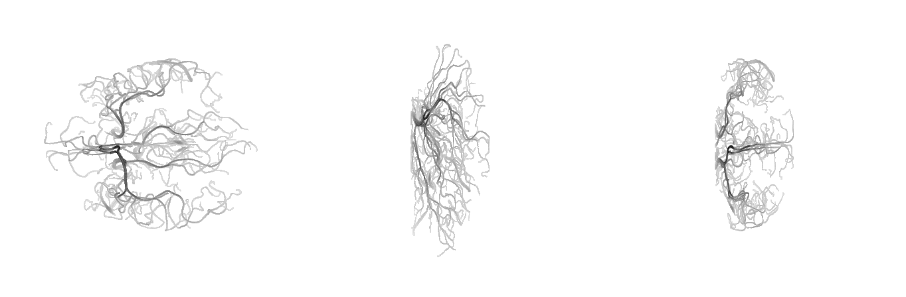
Baseline: Bad and Very Good Segmentation
Create MIP Image and Labeling
Normal002-MRA
From SPOCKMIP
From Manual

Slide 5
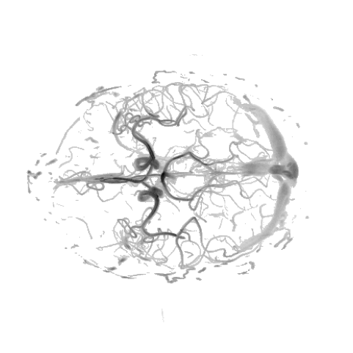
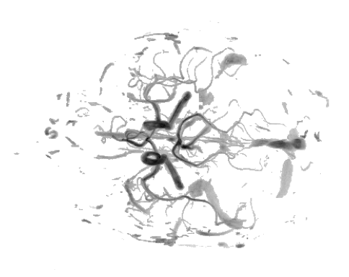
Label Methodologies: Two Way
Create MIP Image and Labeling
  Abnormal Ramifications
  Noise on the right end of the Axial Image
  Defined Distal Cortical Branches (or pial vessels) in a Axial Image
  Fragmented Segmentation
Common
Properties:

Slide 6
Table Of Contents
Create MIP Image and Labeling
Tabular Data with VesselMetrics
Methodologies
Experiment Results
Conclusions & Future Work

Slide 7
VesselMetrics Features
Tabular Data with VesselMetrics
Quantitative features extracted from graph representations divided by four categories
Morphometric Features (Structure)
Quantifies the extent, capacity, and structural integrity of the network:
Total Vessel Length
Volume
Bifurcation Count
Fractal Features (Hierarchical Complexity)
Characterizes self-similarity and spatial texture.
Fractal Dimension
Lacunarity
Topological Features (Connectivity)
Describes the branching architecture and connectivity patterns.
Number of Loops
Loop Lengths
Connected Components
Abnormal-Degree Nodes
Geometric Features (Tortuosity)
Quantifies local vessel morphology and shape irregularity using continuous curves.
Mean Curvature (Tortuosity)
Mean Squared Curvature
Ref: https://github.com/i-vesseg/VESSEL-METRICS

Slide 8
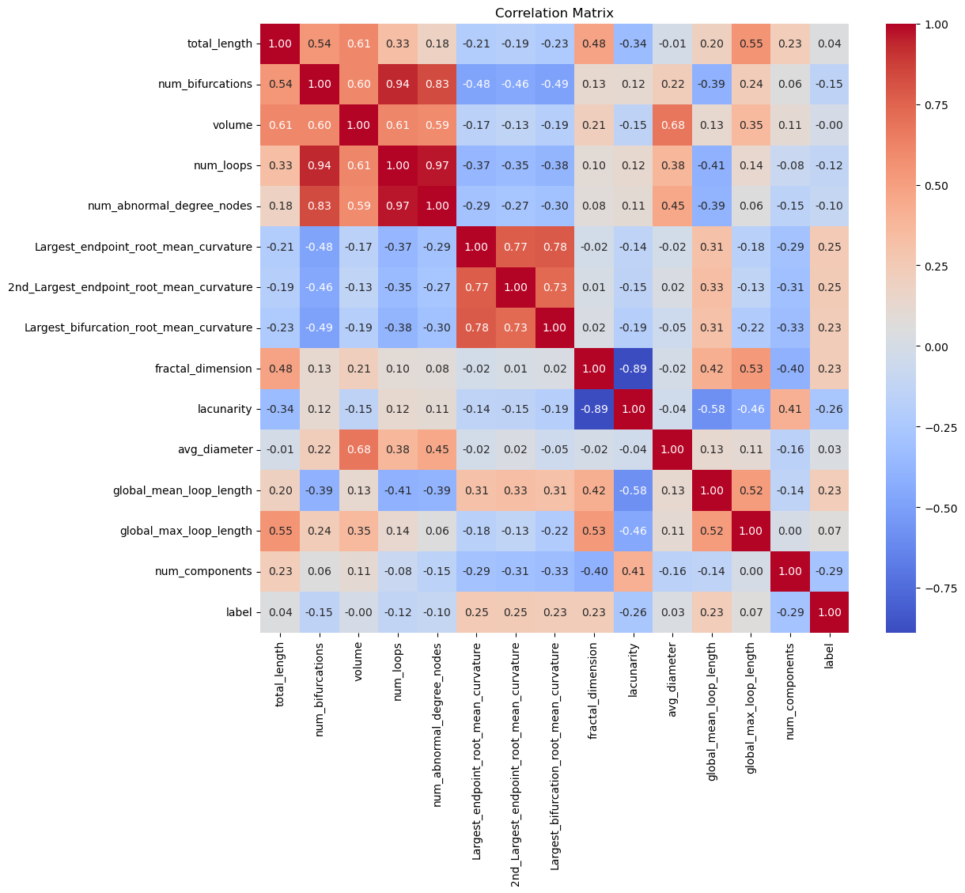
Statistics: Correlation Matrix
Tabular Data with VesselMetrics

Slide 9
Table Of Contents
Create MIP Image and Labeling
Tabular Data with VesselMetrics
Methodologies
Experiment Results
Conclusions & Future Work

Slide 10
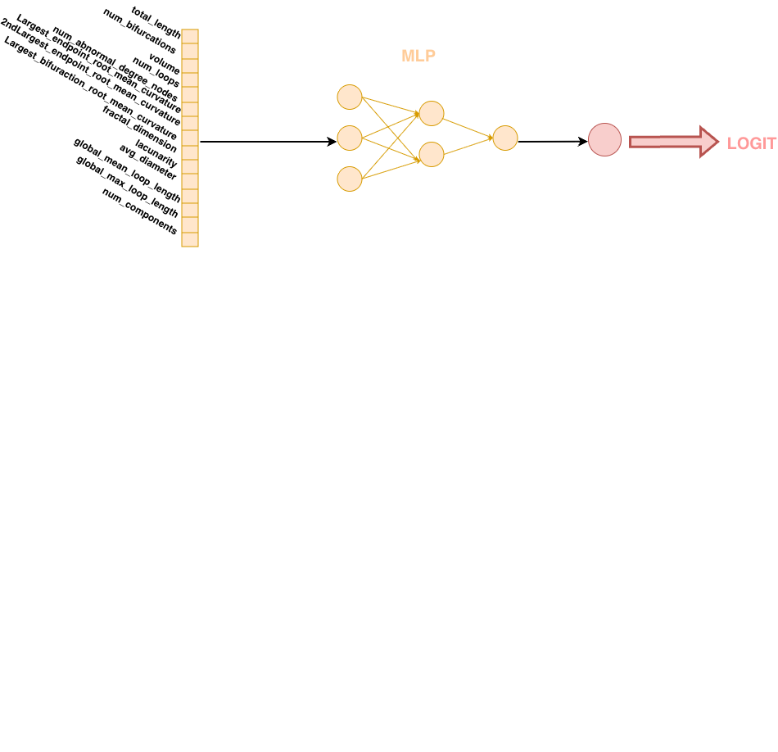
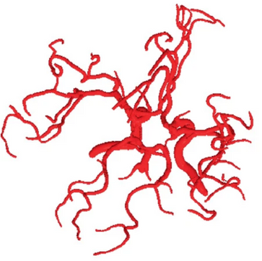
Multi Layer Perceptron Tabular Data
Methodologies
VesselMetrics
Feature Extraction
Vessel Mask

Slide 11
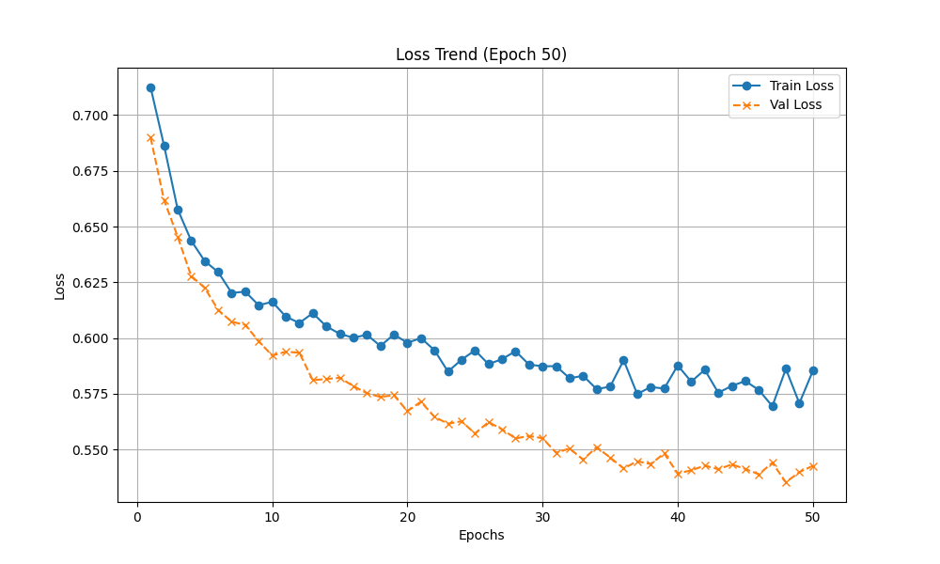
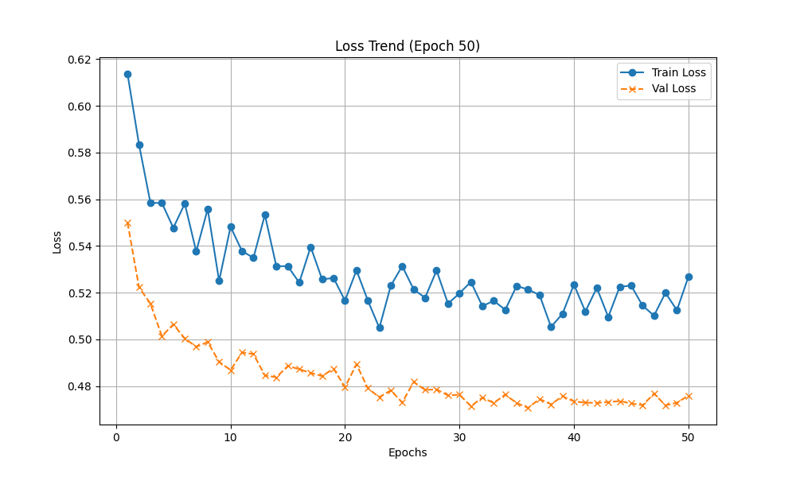
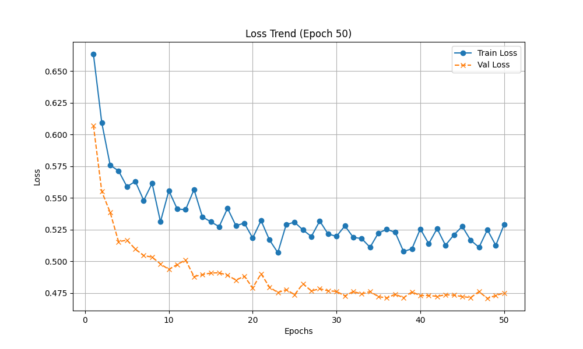
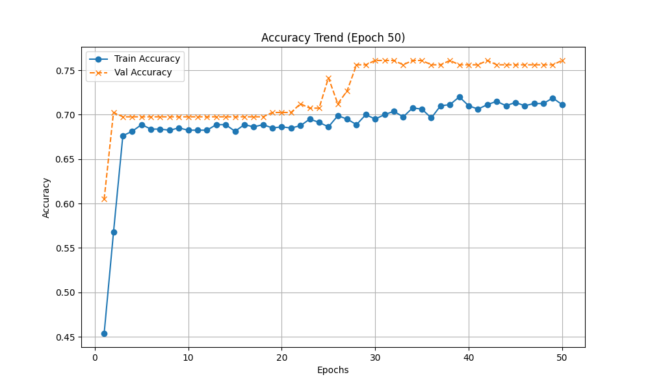
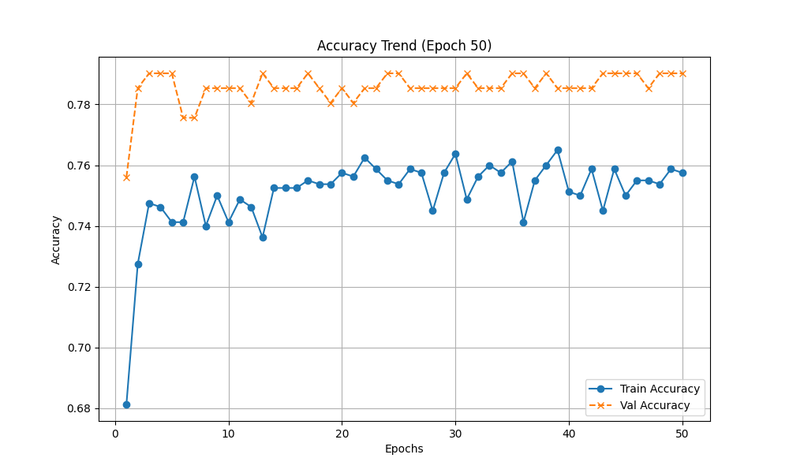
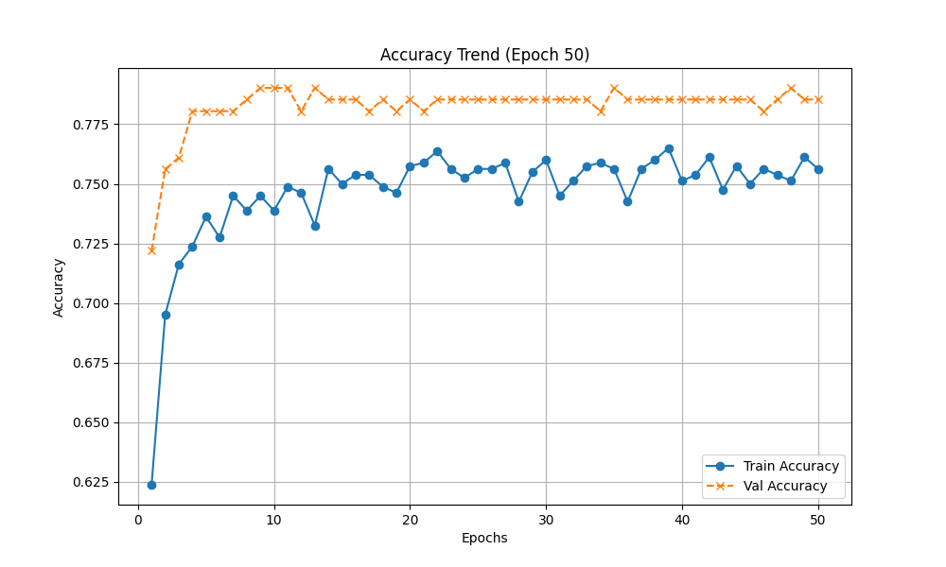
MLP Tabular Performance
Methodologies
SGD
RMSPROP
Adam

Slide 12
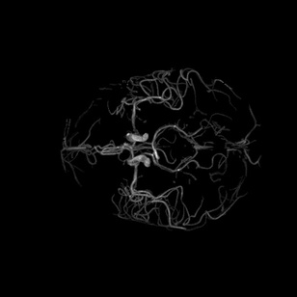
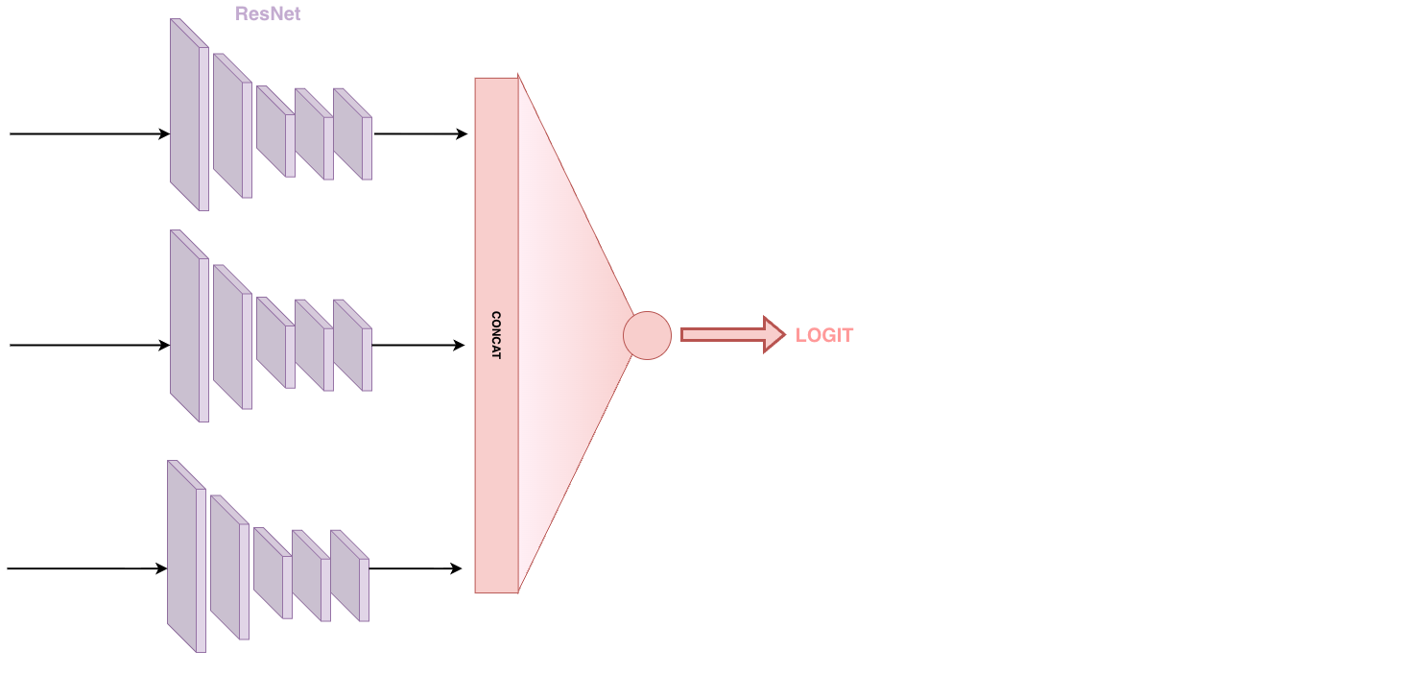
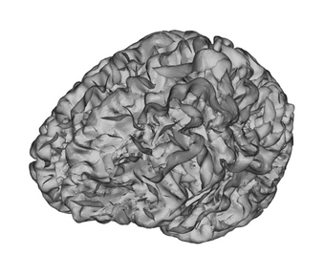

MultiCNN for MIP
Methodologies
Axial
3D NIfTI
Sagittal
MIP Extraction
Coronal
Vessel Mask

Slide 13
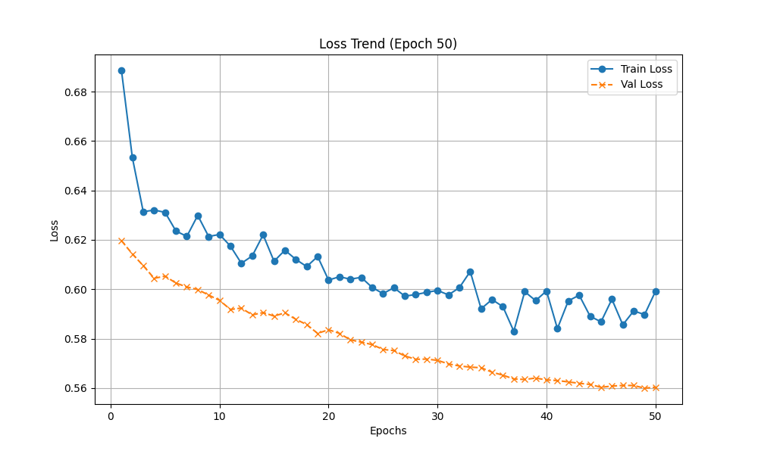
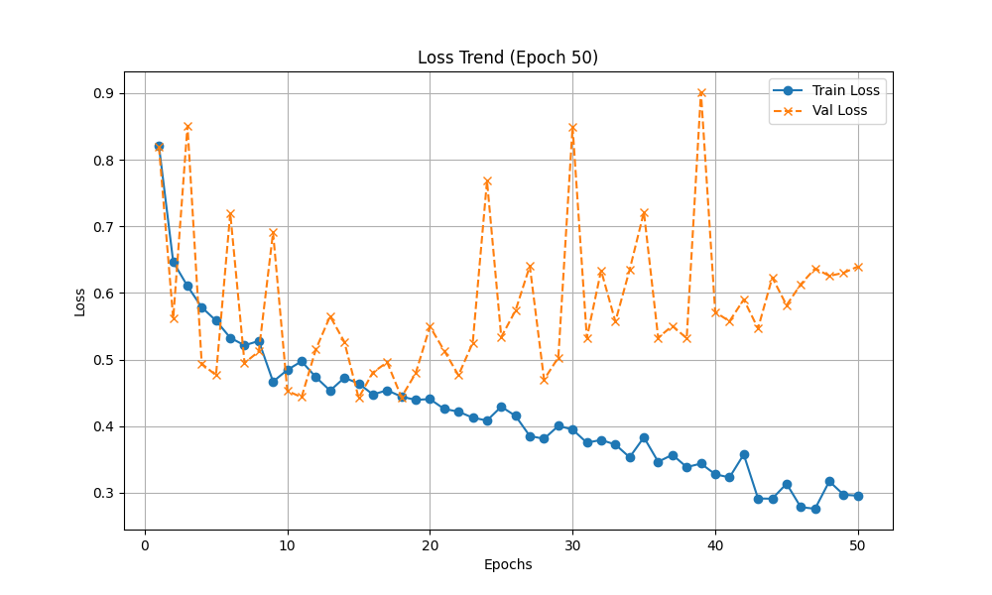
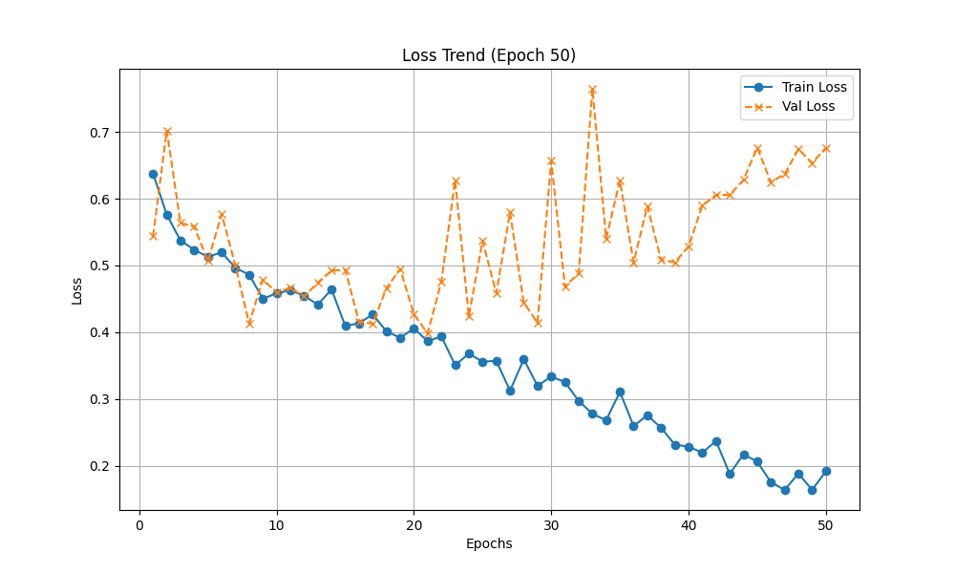
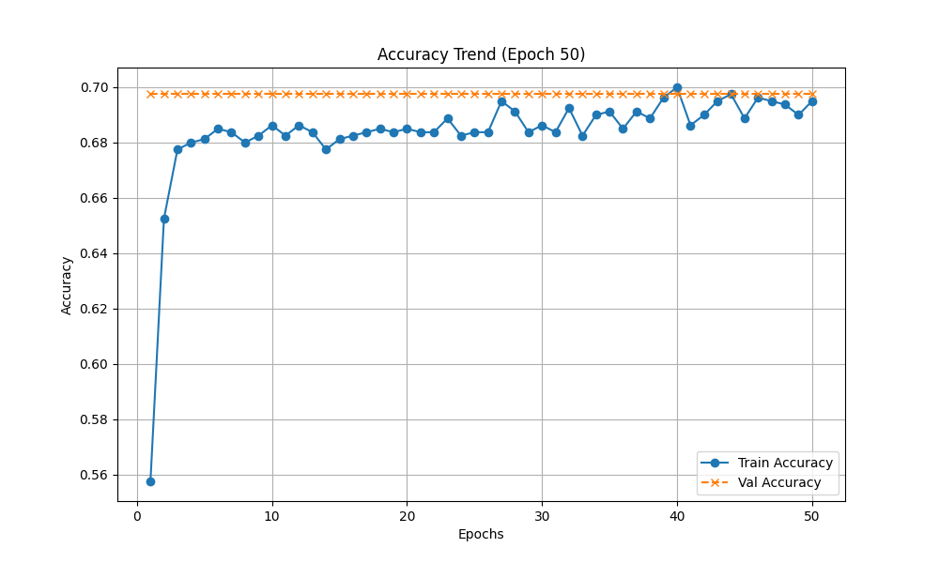
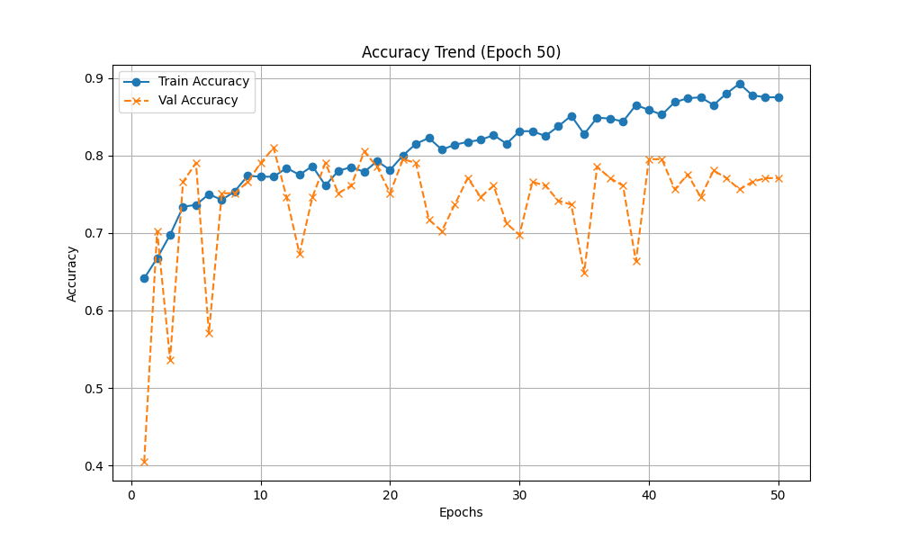
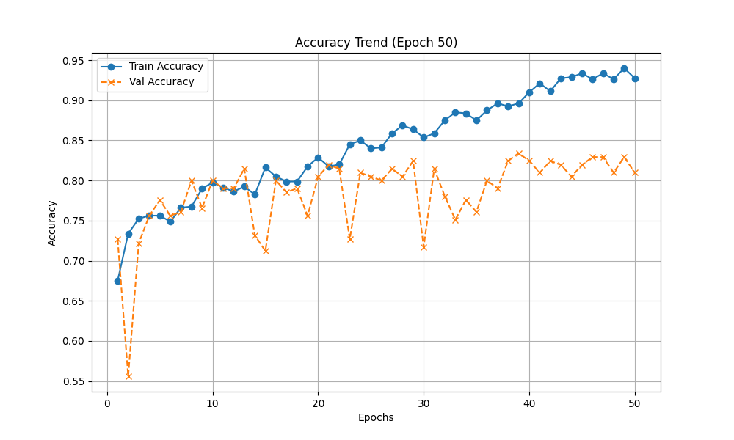
MultiCNN Performance
Methodologies
SGD
RMSPROP
Adam

Slide 14
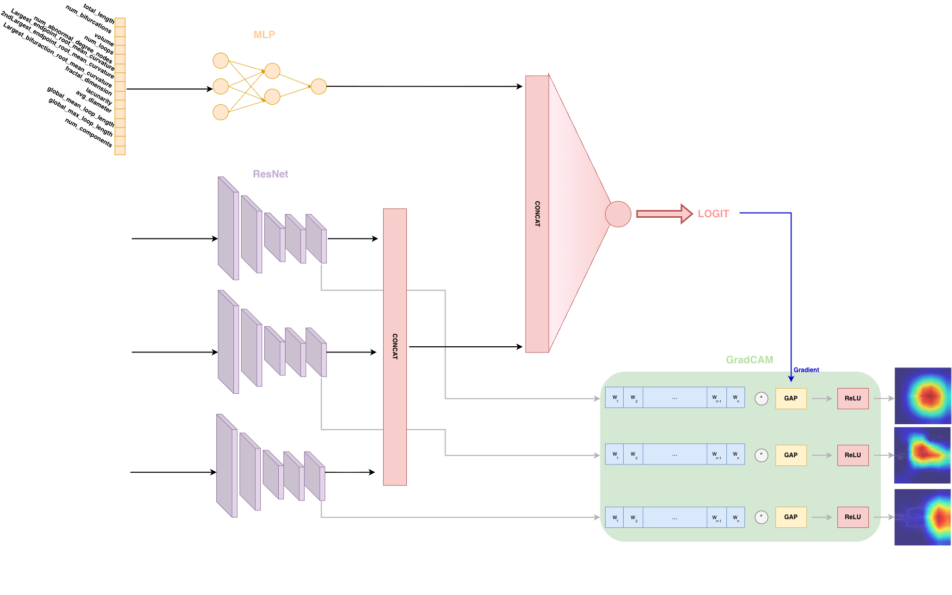

Multimodal WorkFlow
Methodologies

Slide 15
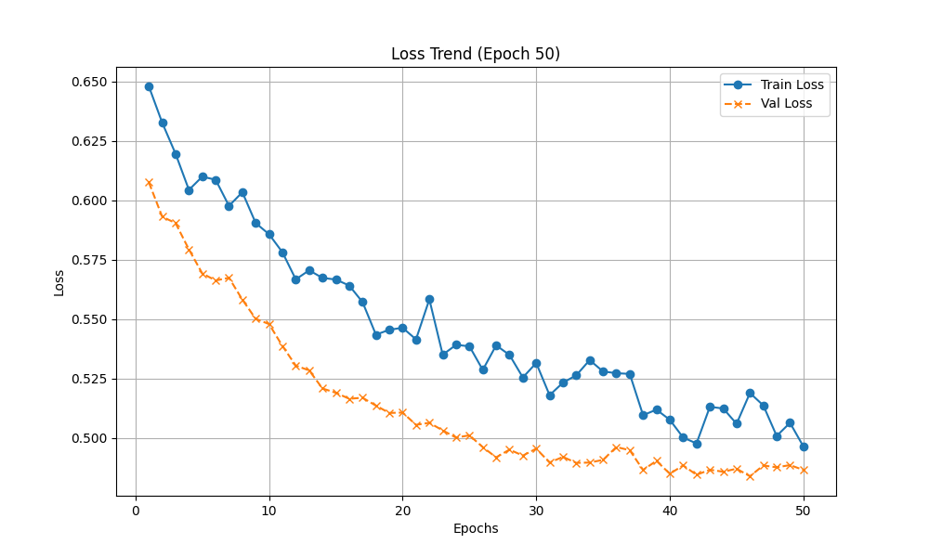
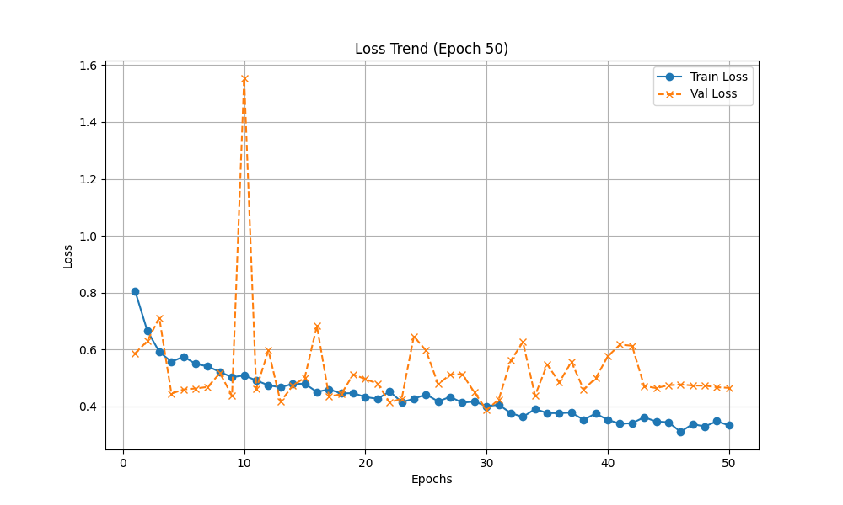
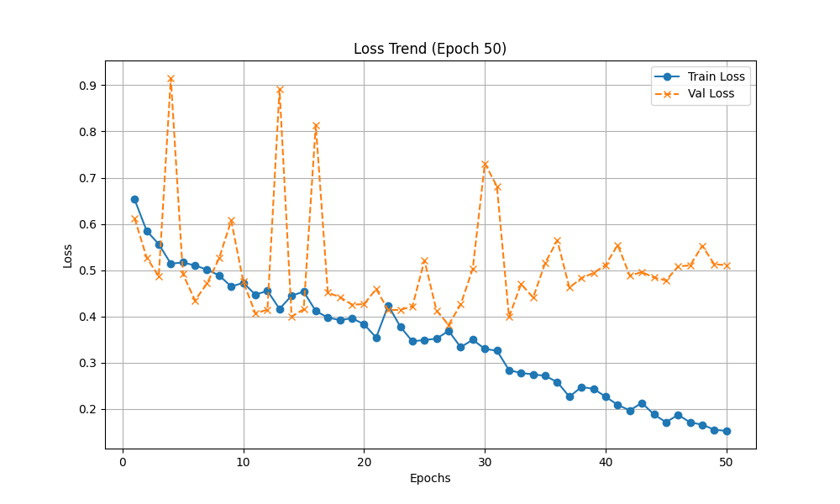
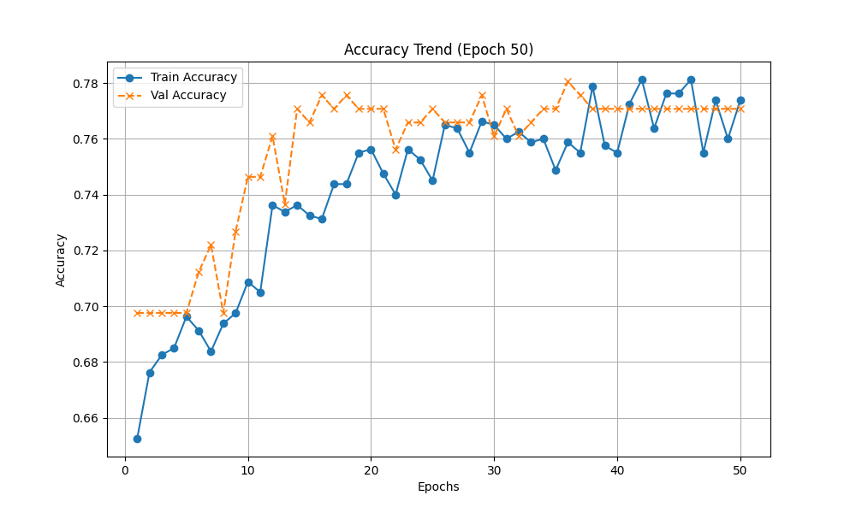
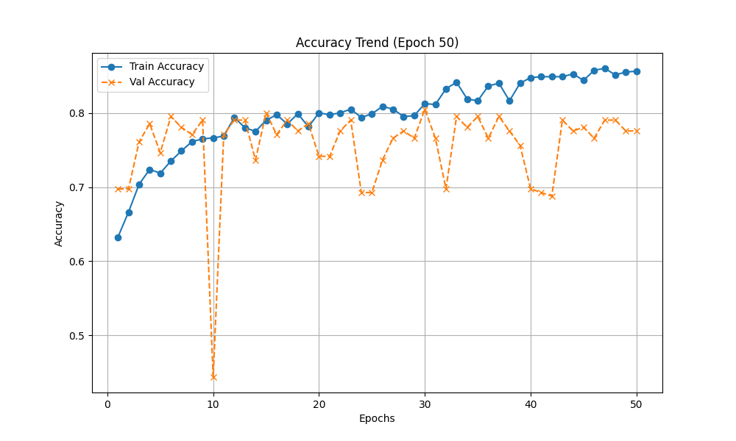
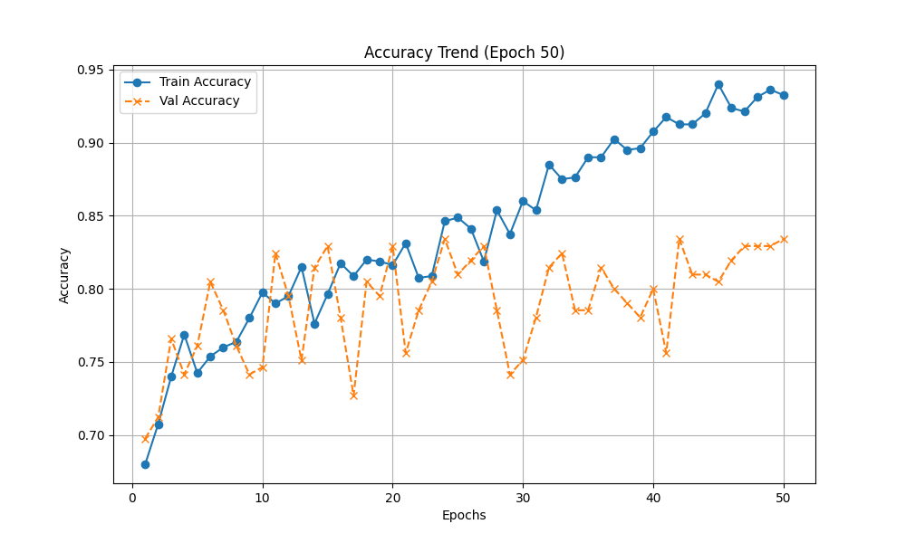
MultiModal Performance
Methodologies
SGD
RMSPROP
Adam

Slide 16
Table Of Contents
Create MIP Image and Labeling
Tabular Data with VesselMetrics
Methodologies
Experiment Results
Conclusions & Future Work

Slide 17
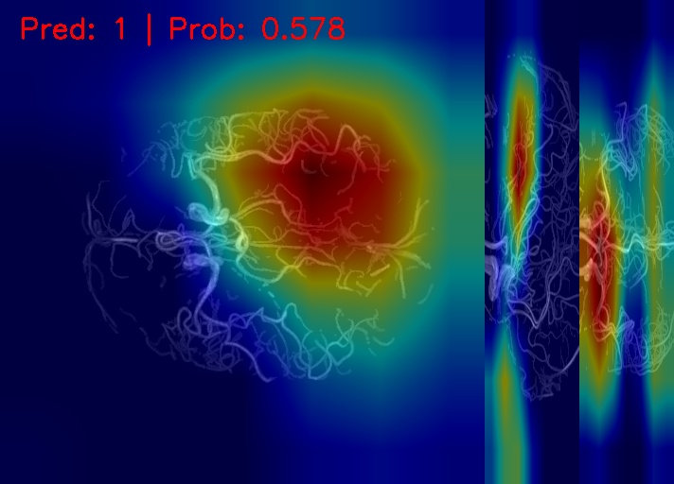
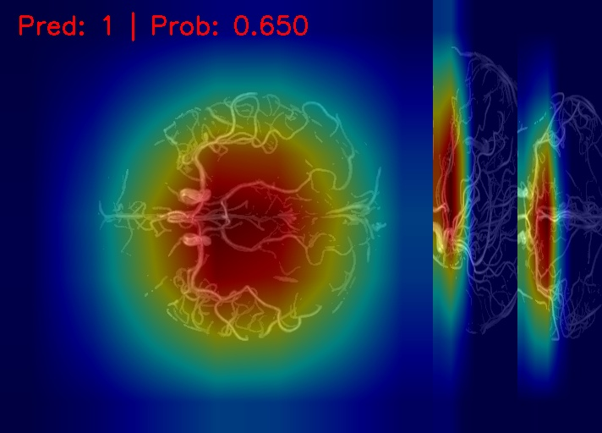
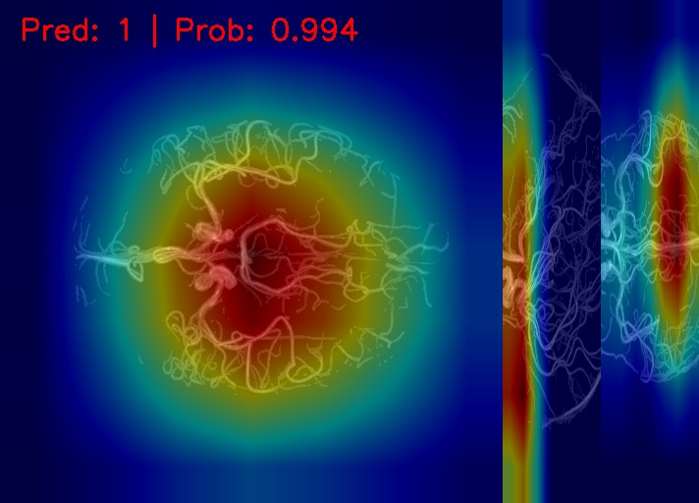
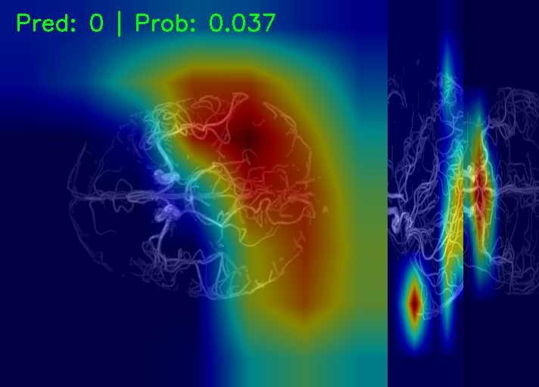
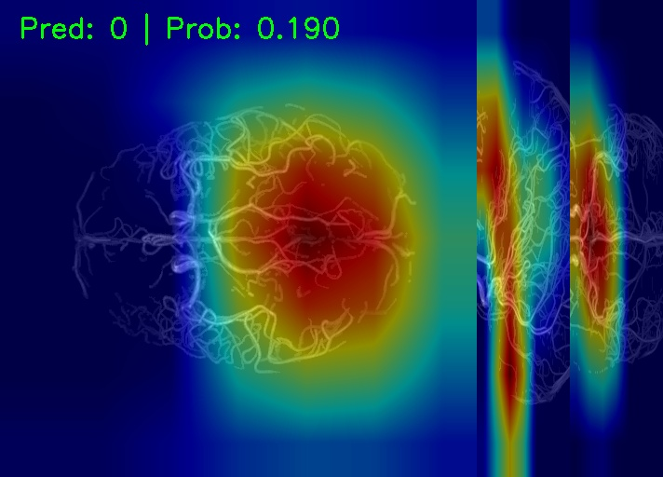
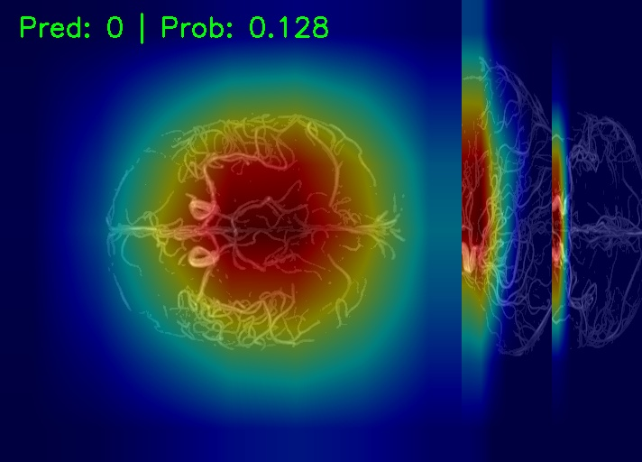
Testing Result: Good Prediction
Experiment Results

Slide 18
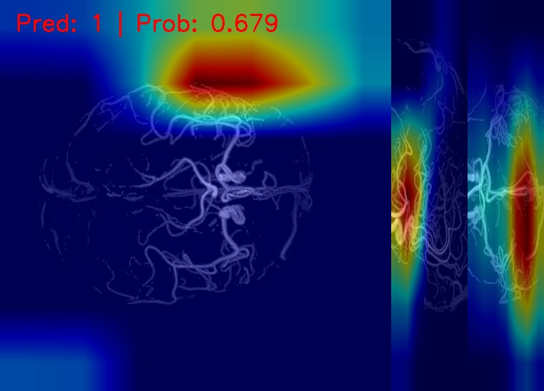
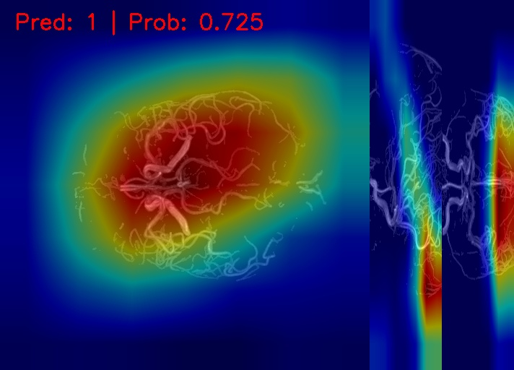
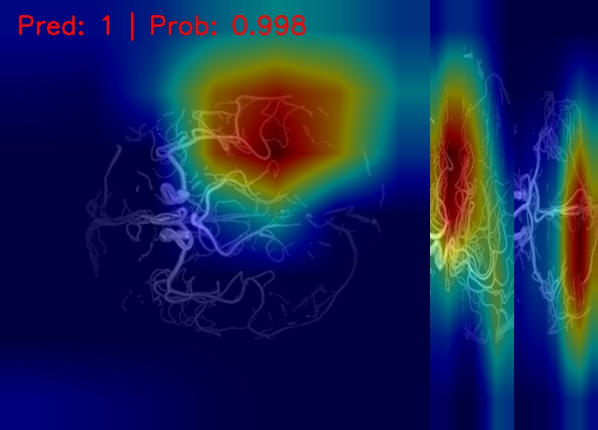
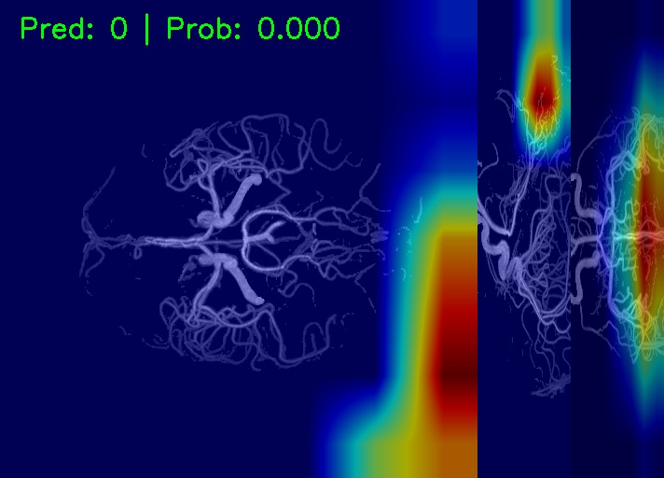
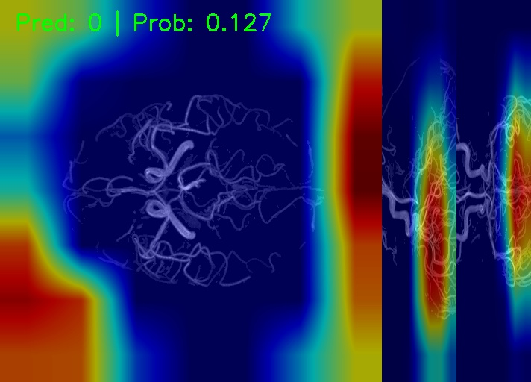
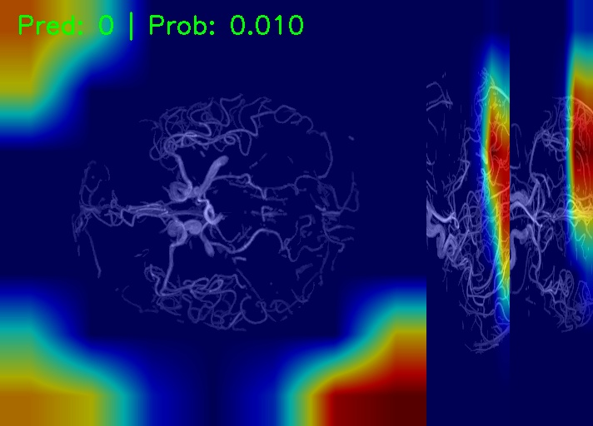
Testing Result: Bad Prediction
Experiment Results

Slide 19
Table Of Contents
Create MIP Image and Labeling
Tabular Data with VesselMetrics
Methodologies
Experiment Results
Conclusions & Future Work

Slide 20
Conclusion and Next Steps
Conclusions & Future Work
We began by analyzing the Tabular MLP model. This model proved to be solid and stable, hitting an accuracy "ceiling" (Validation Accuracy) of ~79% with the Adam optimizer. However, it showed limitations in capturing higher data complexities, failing to break through this threshold. Moving to more complex architectures, the MultiModal model clearly outperformed the baseline; with the Adam optimizer, it reached accuracy peaks of ~83%
In conclusion, the comparative analysis between MLP, MultiCNN, and MultiModal revealed that the MultiModal architecture offers the best performance potential, but requires careful optimization management. And finally, by GradCAM, visual analysis tells us that the high numerical accuracy of the MultiModal model must be taken with caution.
Next Steps?
Perform Hyperparameter Tuning and introduce more forms of regularization (such as aggressive Dropout) to mitigate overfitting
Explore different Backbone architectures, as this project relied solely on ResNet18
Employ advanced fusion techniques like CrossAttention, instead of using simple linear concatenation

Slide 21

Thank you for your attention!
https://github.com/LeoRamill/VesselVerse-QualityControl

Slide 22
References
Selvaraju, R. R., et al. (2019). Grad-CAM: Visual Explanations from Deep Networks via Gradient-based Localization. International Journal of Computer Vision (IJCV), 128, 336–359. (Originally ICCV 2017).
Li, Y., et al. (2024). A review of deep learning-based information fusion techniques for multimodal medical image classification. Computers in Biology and Medicine, 177, 108635.
Hussain, S. S., et al. (2025). AlzFormer: Multi-modal framework for Alzheimer's classification using MRI and graph-embedded demographics. Computerized Medical Imaging and Graphics, 124, 102638. DOI: 10.1016/j.compmedimag.2025.102638.
Falcetta, D., et al. (2025). VesselVerse: A Dataset and Collaborative Framework for Vessel Annotation. Medical Image Computing and Computer-Assisted Intervention (MICCAI) 2025, LNCS 15972, pp. 656–666. Springer Nature.
Falcetta, D., et al. (2026). An Automated Framework for Large-Scale Graph-Based Cerebrovascular Analysis. IEEE International Symposium on Biomedical Imaging (ISBI) 2026. (Preprint arXiv:2512.03869).

