Slide 1
BIGDATA 230B HOMEWORK 3 NIFI
Leo Salemann
Leo.Salemann@me.com leos@uw.edu
8/2/17

Slide 2
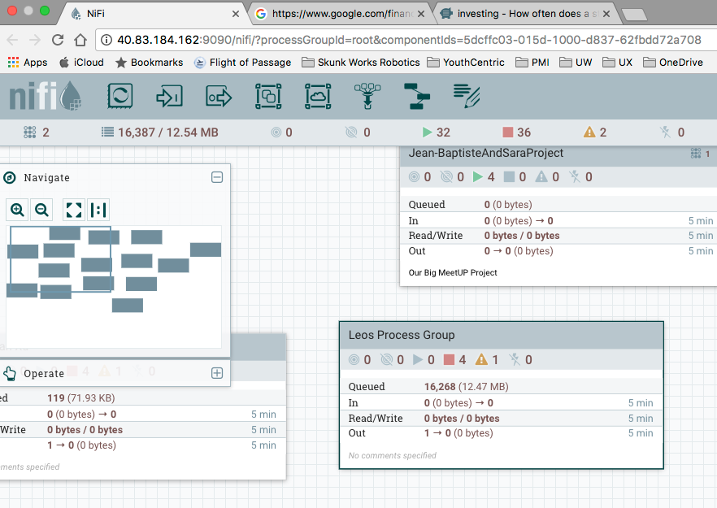
Setting up my Process Group

Slide 3
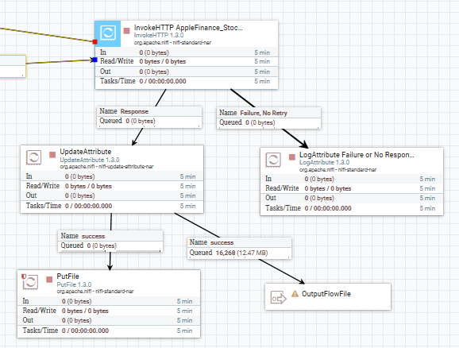
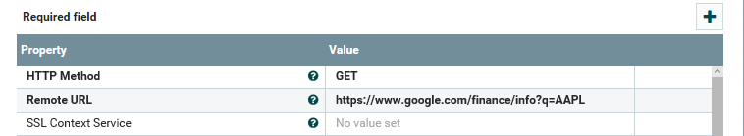
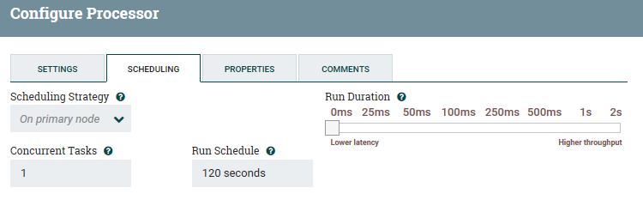
Editing the Input Processor
Rename the Processor
Change the URL Stock Query
Change the Run Schedule

Slide 4
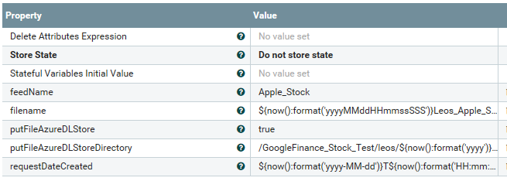
Editing the UpdateAttribute Processor
Make the Feed name reference Apple instead of Google
Change the filename
Create subfolder in the Azure DLstore (hope this doesn’t hurt anything)

Slide 5

Editing the Output Processor
Couldn’t figure out where nifi’s “.” directory, so I made my own folder off my homedir

Slide 6
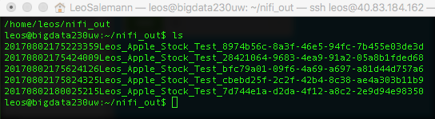
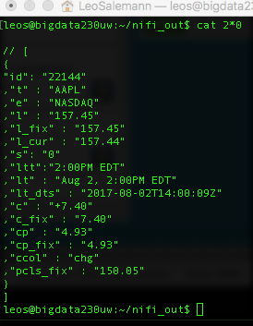
Data! I got Data!
Almost json, but not quite. Gonna hand-edit these with nano, then save with json suffix.

Slide 7
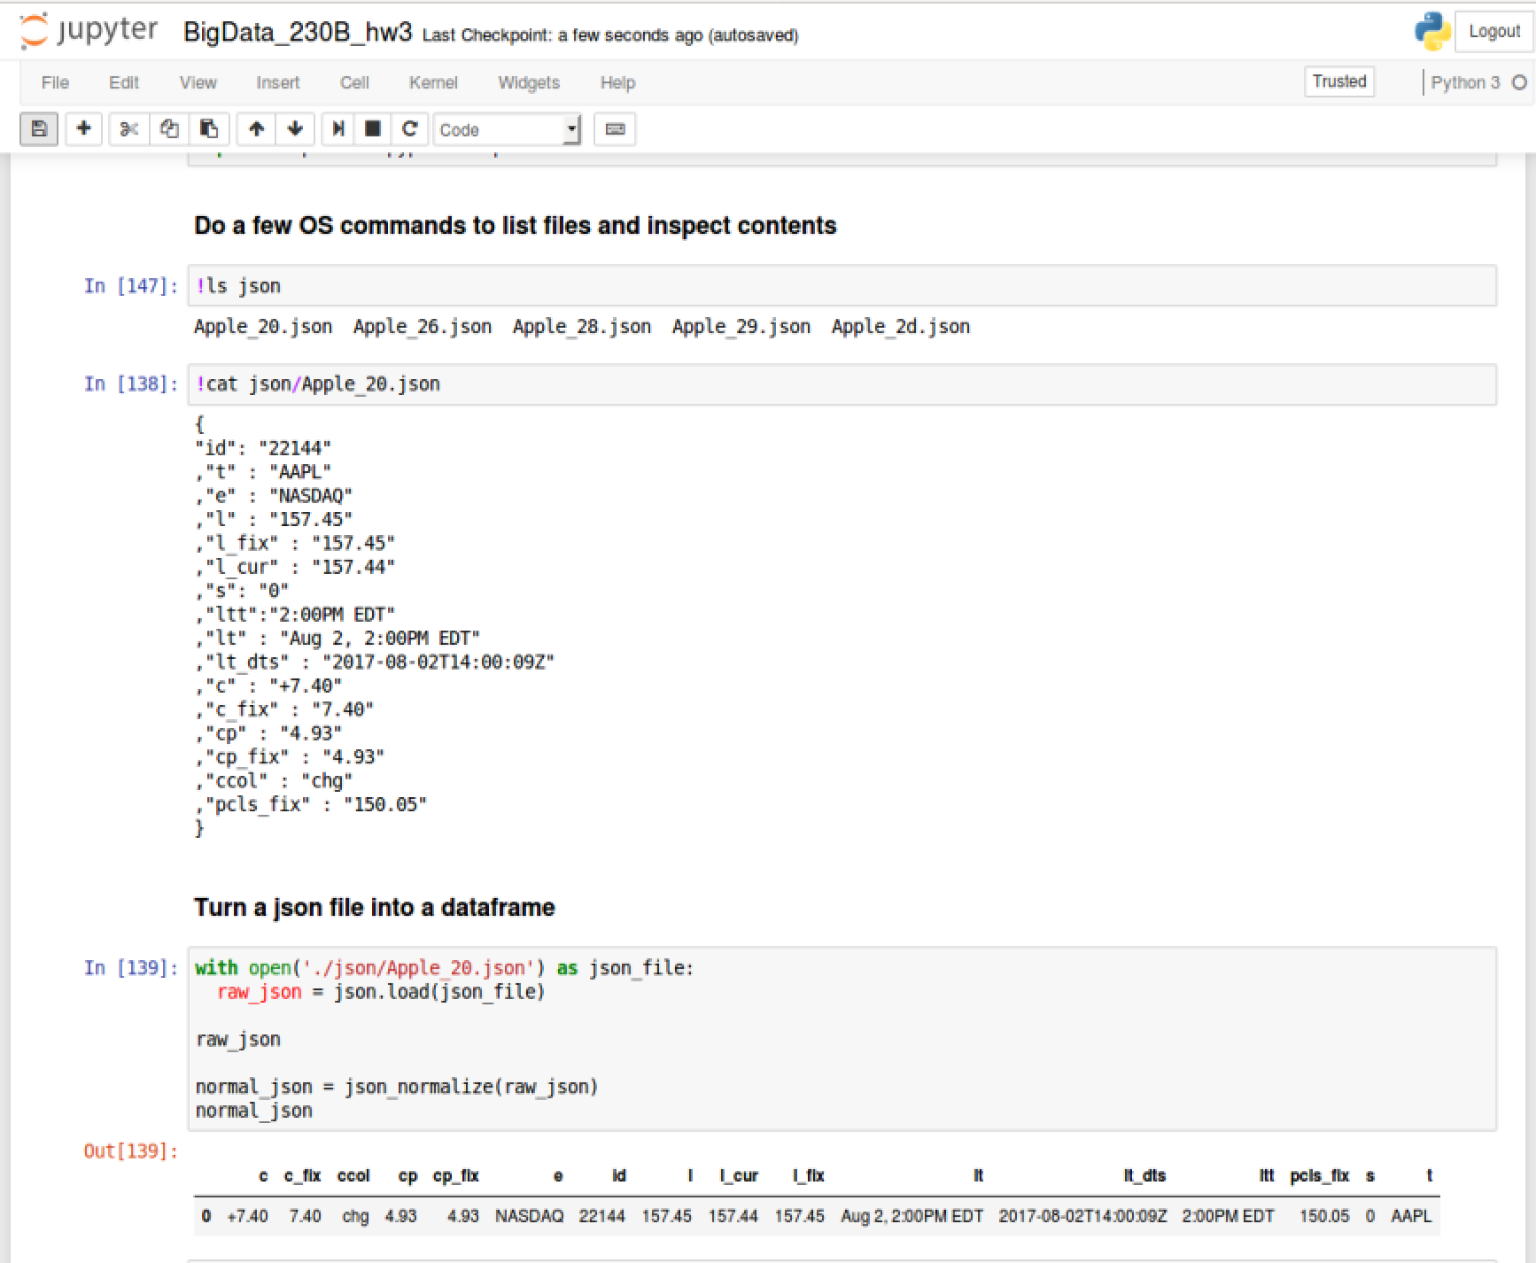
Json to Jupyter to Python to Pandas
Was hoping to do some kind of fancy ftp, scp, wget or curl stuff to get the json from the kafka/nifi server up to Azure Notebooks, but It wasn't to be. So I fired up a full linux VM, ssh'ed to the nifi server, cat/copy/paste and got to work. A few Jupyter snippets are on the left; full notebook submitted with this slide deck.

Slide 8
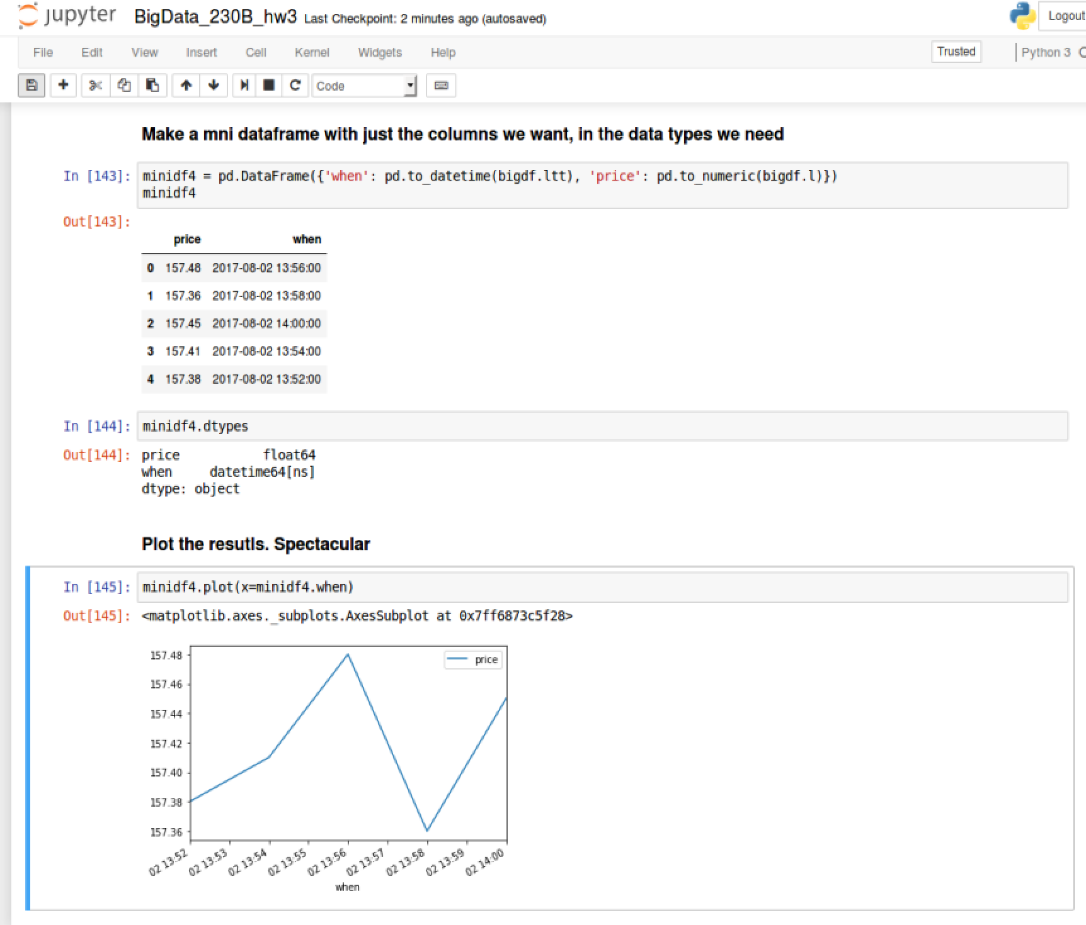
Plot the Results

