Slide 1
You can delete all the info/tips slides once you’re done with making your presentation

Slide 2
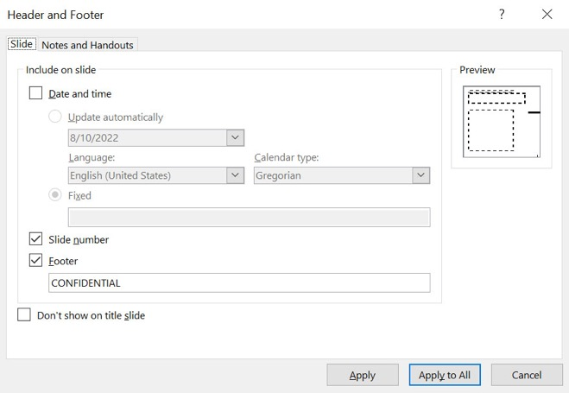
Edit the Footer Text!?
PLEASE READ BEFORE MAKING YOUR GREAT PRESENTATION
Change the footer to suit your presentation. Offers etc. should always be labelled confidential. Change it or hide it, if not needed.
See our classification guidelines in Confluence This placeholder can however also be used “freely” for labelling a document or page.
Choose "Insert / Header & Footer" to change footer text.
In the panel you can change the footer text.
If you want the same changes/footer to all slides choose "Apply to All“

Slide 3
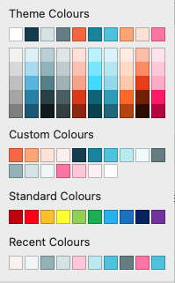
Colours
PLEASE READ BEFORE MAKING YOUR GREAT PRESENTATION
This new template now has the full Gofore colour-palette built in, yay! So, when choosing colors, use the custom colours palette and you’ll be safe. Theme colours are ok too.
Please do not mix too many (different) colours in one slide, less is more. Rule of thumb is to use one ”colour-family” at a time.
Deep Blue, white and the greys can be mixed with all. (Orange also when in logo)
Use one “lane” at a time, either A, B or C. Unless more colours necessary for e.g. a pie chart or graph.
A
Deep Blue
White
Grey Eminence
Grey Area
Light Matter
Silverplanet
Digital Blue
Code Blue
Mint Condition
Paleface
B
Gofore Orange
Salmon Byte
Granny Pants
Incognito
C
Ruby on Rails
Blushing Consultant
Blueberry Milk

Slide 4
Accessibility - Best Contrast Practices
PLEASE READ BEFORE MAKING YOUR GREAT PRESENTATION
White text or background:
Below recommended contrast ratio, but the next best thing →
Aa
Aa
Aa
Aa
Aa
Aa
Rather more contrast, play it safe!
Deep Blue text or background:
Aa
Aa
Aa
Aa
Aa
Aa
Aa
Aa
Aa
Aa
Aa
Aa
Aa
Aa
Aa
Aa
Aa
Aa
Aa
Aa
Aa
Aa
Aa
Aa

Slide 5
Check the Accessibility of Your Presentation
Please read before making your great presentation
Use the templates and write the title of the slide in the Title box.
Write a text description for each image. If the image contains no additional information, mark the image as decorative.
Use only colour combinations that provide adequate contrast.
Check the accessibility using the Accessibility Checker, and fix any errors or warnings, if necessary.
When creating a PDF, use the Export function or the Save As… function. Do not use the Print function!

Slide 6

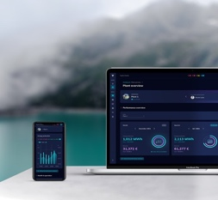
Preferred Shapes & Objects
PLEASE READ BEFORE MAKING YOUR GREAT PRESENTATION
The human speech bubble
THE HUMAN CIRCLE This is our multifunctional, distinguishing visual element.
As general guidance, use only one circle per page unless you use it for infographic purposes, e.g. a process, chart etc.
Insert Text
Copy from these 3 circle options. If you have many circles in your visual, include the different shapes to create variety. DO NOT DRAW YOUR OWN CIRCLES
Use circle with text content
Use circles as background element for illustration, image or layout in general
Use for image cropping (picture or texture fill) NOTE: fix image proportions!
ARROWS & CONNECTORS Prefer these “pen-like” lines & arrows when creating infographics
THE BOX Use these blocks instead of Power Point’s native rectangles. These have a subtle organic touch to them.
Use this one for tall blocks
Use this one for wide blocks
HEADLINE Insert text, or delete text and use as background block
Make a list

Slide 7
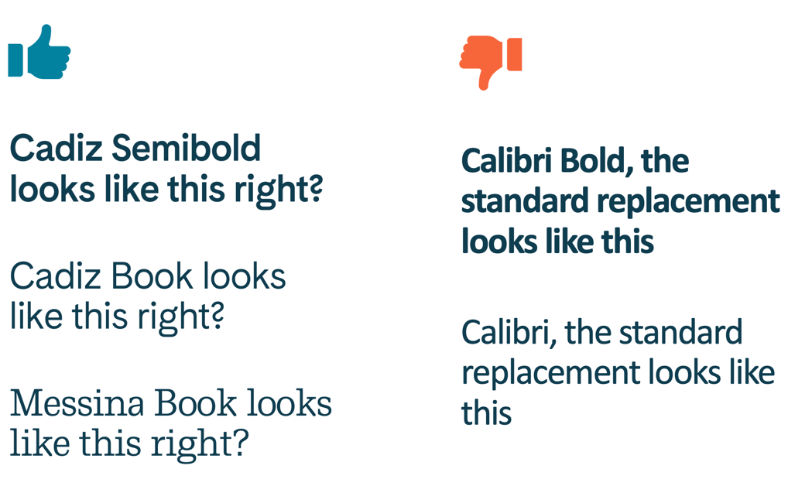
Gofore’s Fonts
PLEASE READ BEFORE MAKING YOUR GREAT PRESENTATION
Use the Cadiz font for most everything, Messina is just a “rare spice”.
These fonts should be pre-installed on your computer by Star IT. If, for some reason, these samples don’t match with what you see here, you should install the fonts manually.
The g and ? help you identify
Cadiz Semibold looks like this right?
Cadiz Book looks like this right?
You can find and download our fonts here on Conflu
Messina Book looks like this right?

Slide 8
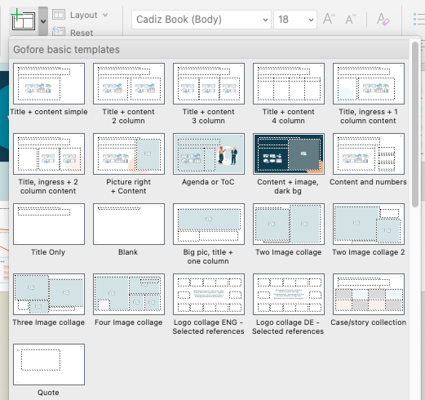
Remember to first check if there’s a suitable template for your need
PLEASE READ BEFORE MAKING YOUR GREAT PRESENTATION
..And then primarily use the placeholder boxes/elements for your content rather than pasting or creating new
To keep styles aligned, paste texts into placeholder boxes without formatting, or choose “use text only” after pasting. This way the source formatting is not included.
Keyboard shortcuts: PC: Ctrl + shift + V
Mac: Shift + ctrl + command + V
If you just start writing in the placeholder box, all settings are fine.

Slide 9
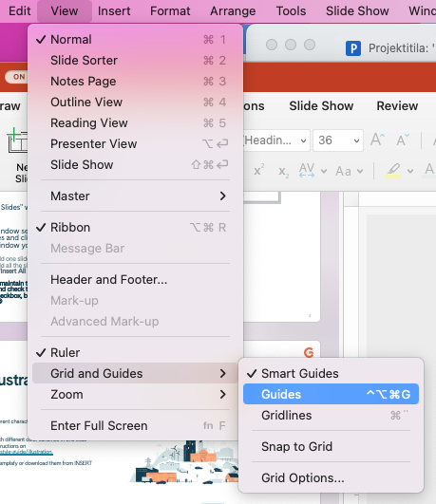
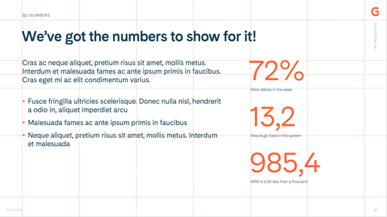
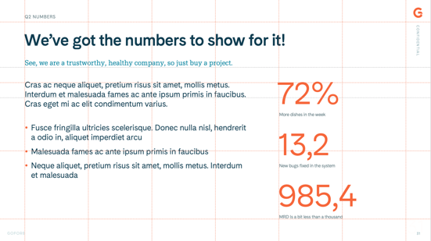
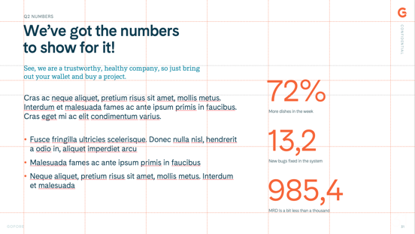

Use the guides, Luke! NOT the gridlines!
Hint:
To help you align and distribute elements on your slide, you can “view guides” to give you support with object placement.
Empty space is good, e.g. the “top third” area with the headline is nice to keep clean, and place the content starting at the next guide below.
If your headline goes on 2 rows, and/or you have an ingress text under the headline, then move the main contents downward (bottom grey guide)
Keep main content to the red guides if you have only a short headline and/or ingress
If you have lots of content and no ingress, you can move the content up to the first grey guide
No, not gridlines

Slide 10








Using our Illustrations
PLEASE READ BEFORE MAKING YOUR GREAT PRESENTATION
We have quite a large set of different characters and also some contextual settings to utilise. Find them in your Power Point templates as a separate document for easy access.
Try not to mix illustrations with different color schemes in one slide (Pink/orange/blue) See instructions on https://brand.gofore.com/visual-style-guide/illustration
You can find the illustrations in the brand book, in Templafy and also as a separate ppt-template from your computer. Same place you found this one.
The illustrations are great to combine with our human circle

Slide 11
Agenda or ToC
Introduction
Lunch
p. 01
12:30

