Slide 1
Why Graph Databases?

Slide 2












Ventajas
The biggest value that graphs bring to the development stack is their ability to store relationships and connections as first-class entities

Slide 3
What Is a Graph?
A graph is composed of two elements: a node and a relationship.
Each node represents an entity (a person, place, thing, category or other piece of data), and each relationship represents how two nodes are associated.
For example, the two nodes “cake” and “dessert” would have the relationship “is a type of” pointing from “cake” to “dessert.” This general-purpose structure allows you to model all kinds of scenarios – from a system of roads, to a network of devices, to a population’s medical history or anything else defined by relationships.

Slide 4
What Is a Graph Database?
A graph database is an online database management system with Create, Read, Update and Delete (CRUD) operations working on a graph data model.
Graph databases are generally built for use with transactional (OLTP) systems.
Accordingly, they are normally optimized for transactional performance, and engineered with transactional integrity and operational availability in mind.
Unlike other databases, relationships take first priority in graph databases. This means your infer data connections using foreign keys or out-of-band processing, such as MapReduce.

Slide 5
Two important properties of graph database technologies:
Graph Storage
Some graph databases use native graph storage that is specifically designed to store and manage graphs, while others use relational or object-oriented databases instead. Non-native storage is often much more latent, especially as data volume and query complexity grow.
Graph Processing Engine
Native graph processing (a.k.a. “index-free adjacency”) is the most efficient means of processing graph data because connected nodes physically “point” to each other in the database. Non-native graph processing uses other means to process CRUD operations that aren’t optimized for graphs, often involving an index lookup which results in reduced performance

Slide 6
What Are the Common Use Cases of Graph Databases?
Fraud detection
Real-time recommendation engines
Master data management (MDM)
Network and IT operations
Identity and access management (IAM)
Graph-based searc

Slide 7
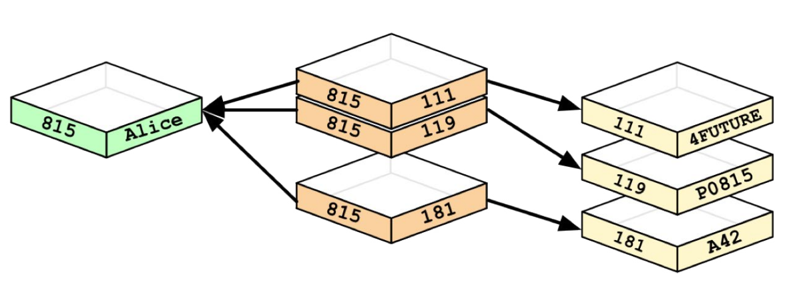
Data Modeling: Relational vs. Graph Models
In some regards, graph databases are like the next generation of relational databases, but with first class support for “relationships,” or those implicit connections indicated via foreign keys in traditional relational databases.

Slide 8
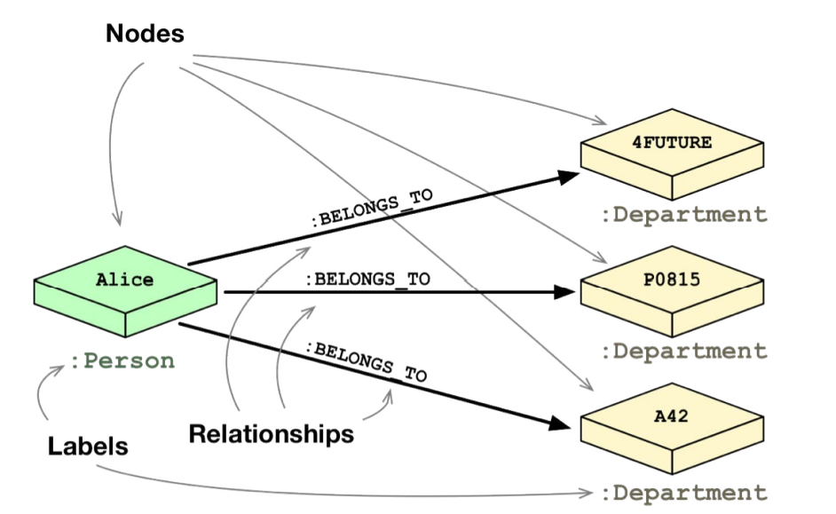
Data Modeling: Relational vs. Graph Models
This ability to pre-materialize relationships into database structures allows graph databases like Neo4j to provide a minutes-to-milliseconds performance advantage of several orders of magnitude, especially for JOIN-heavy queries

Slide 9
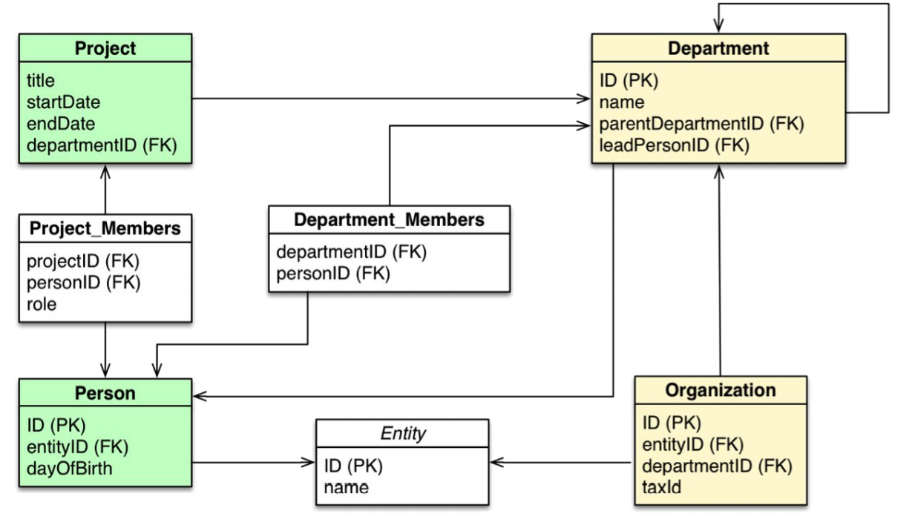
Let’s take a model of the organizational domain and show how it would be modeled in a relational database vs. the graph database

Slide 10
Checklist to help with the transformation:
• Each entity table is represented by a label on nodes
• Each row in a entity table is a node
• Columns on those tables become node properties.
• Remove technical primary keys, but keep business primary keys
• Add unique constraints for business primary keys, and add indexes for frequent lookup attributes
• Replace foreign keys with relationships to the other table, remove them afterwards
• Remove data with default values, no need to store those
• Data in tables that is denormalized and duplicated might have to be pulled out into separate nodes to get a cleaner model
• Indexed column names might indicate an array property (like email1, email2, email3)
• JOIN tables are transformed into relationships, and columns on those tables become relationship properties

Slide 11
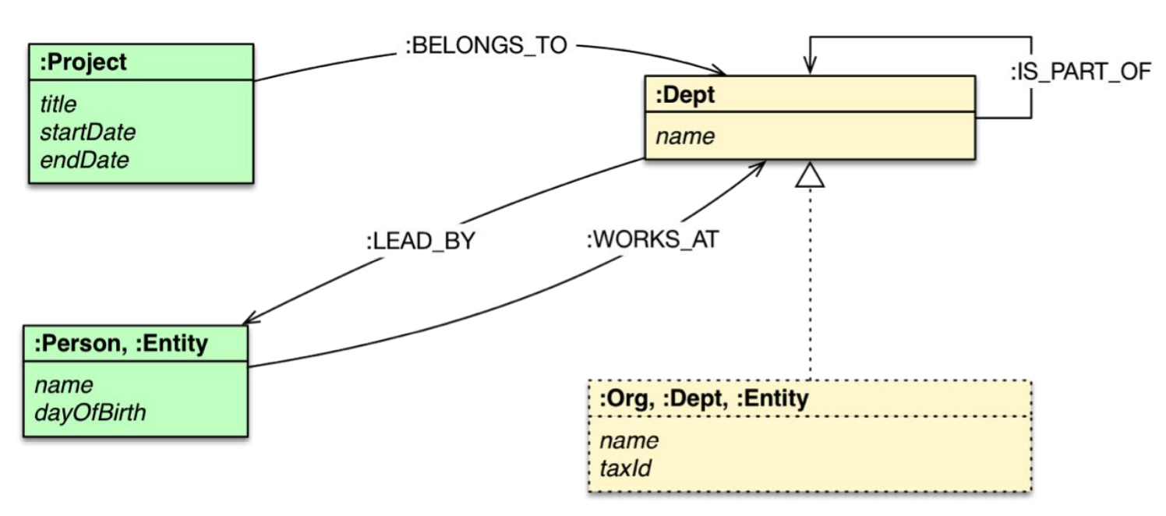
From relational database to graph database

Slide 12

























Slide 13



































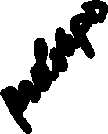












Slide 14

















































Slide 15








































Slide 29






























Slide 30





















Slide 31








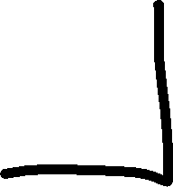





























Slide 32












Slide 33











































