Slide 1
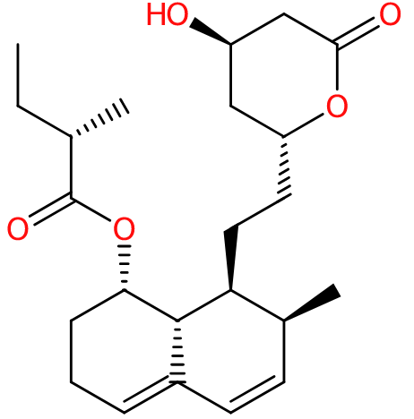
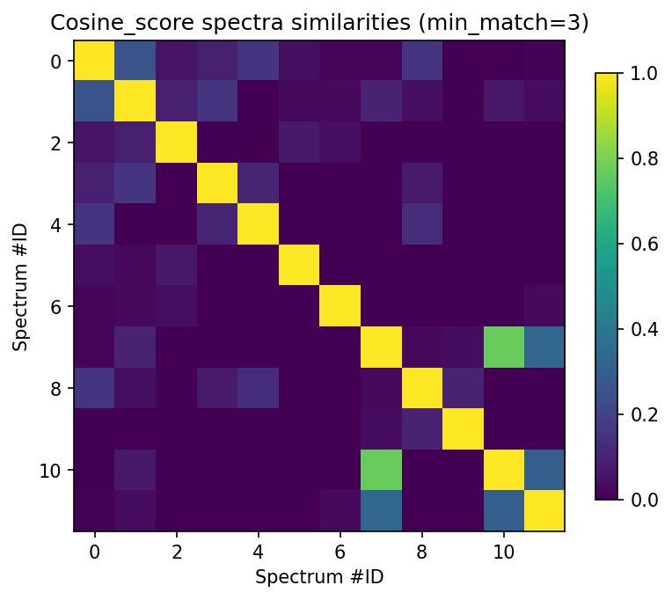
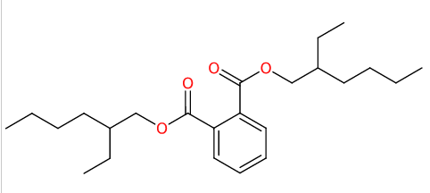
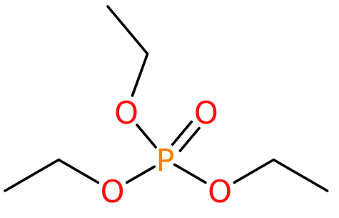
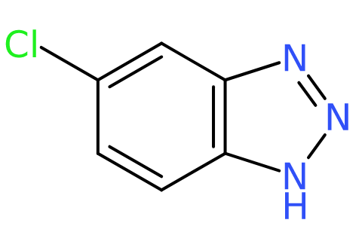
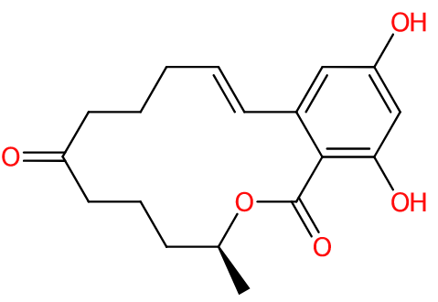
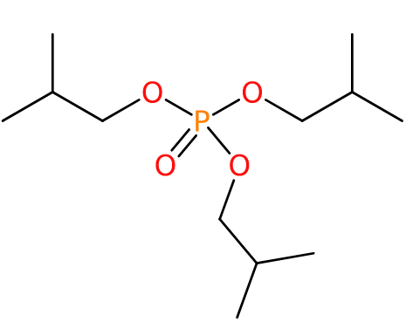
Spectrum ID
0 2 4 6 8 10
Mevastatin
0.25
Di(2-ethylhexyl) phthalate
0.03
Triethyl phosphate
0.77
0.33
5-Chlorobenzotriazole
Zearalenone
Tri-isobutyl phosphate

