Slide 1
Implement Edge Detection on Images using HOG Algorithm with Some Noise Filters 利用方向梯度直方圖演算法及雜訊濾波器實現圖像邊緣檢測
Team Members: 林暄傑、劉亦傑、謝霖泳

Slide 2
Recap of Our Idea

Slide 3
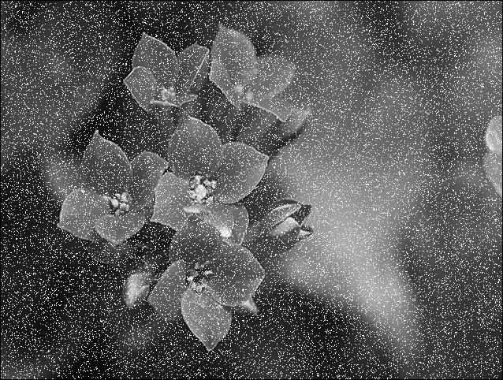
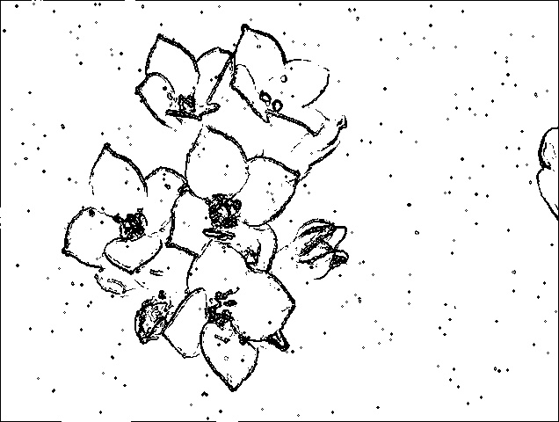
Input V.S. Output
Input image
Output result

Slide 4
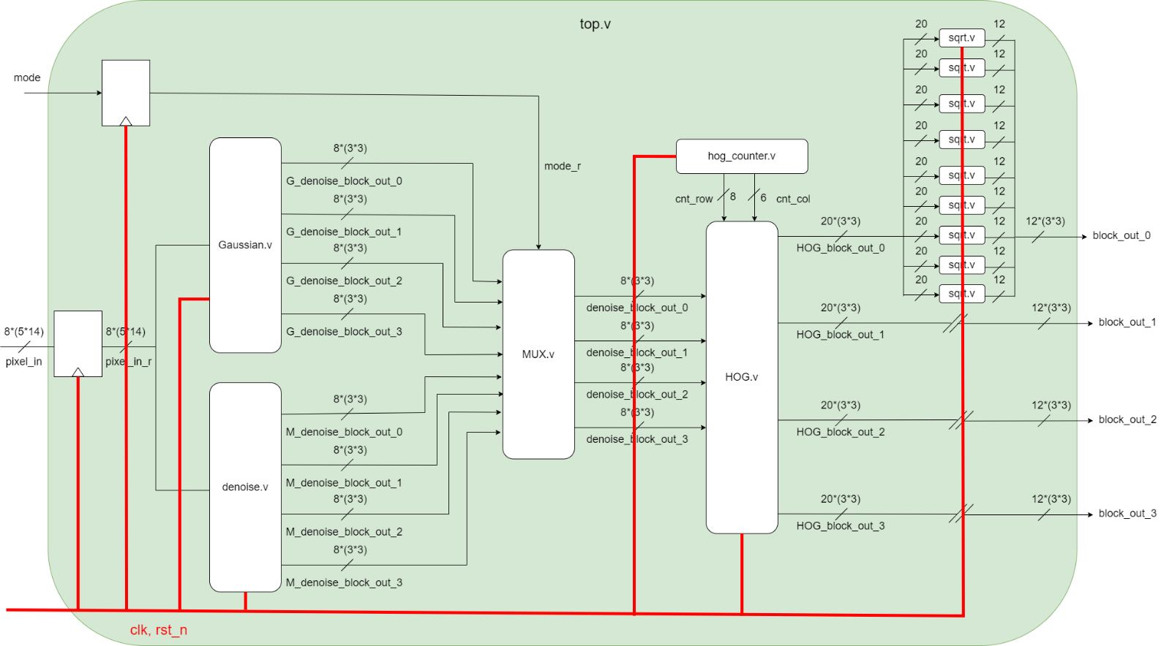
Block Diagram

Slide 5
Specification

Slide 6
I/O definition
image: 638*482 pixels
input: 70 pixels / cycle (each pixel is 8-bit)
output: 36 pixels / cycle
Target performance
timing: 3 ns
area: 750,000 um^2
power: 50 mW
cycle count: 10000

Slide 7
Synthesis performance (with gated-clock)
timing: 3 ns
area: 504,438 um^2
power: 31.8mW
cycle count: 8487
Chip performance (post-layout performance)
timing: 5 ns
area: 562,169 um^2
power: 28.3 mW (ICC)
cycle count: 8487
core utilization: 0.7

Slide 8
Final Result

Slide 9
Completeness of Our Project
 | median filter | Gaussian filter
pre-sim | All pass! | All pass!
gate-sim | All pass! | All pass!
DRC/LVS | Clear! (error=0)
post-sim | All pass! | All pass!

Slide 10
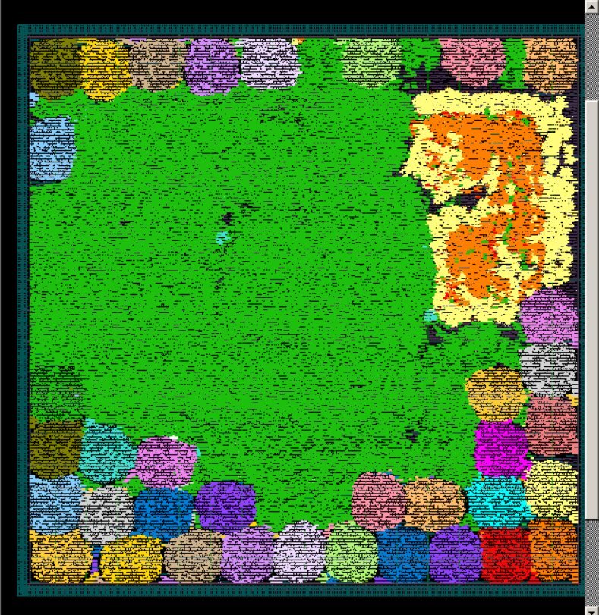
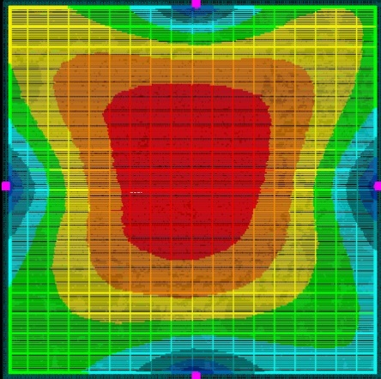
APR Result
routing
PNA voltage drop

Slide 11
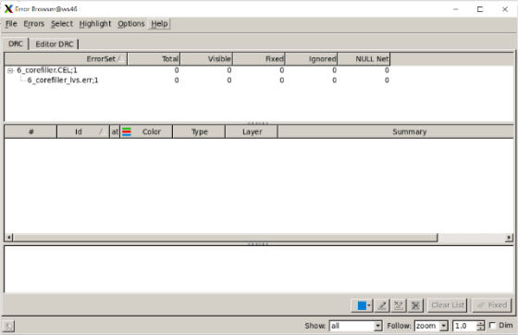
DRC/LVS Report

Slide 12
Prime Time Result
Unit: mW | ICC | Primetime (pre-sim) | Primetime (post-sim)
Total Power | 28.3 | 5.369 | 14.9
Cell Leakage Power | 5.565 | 5.32 | 5.398
Total Dynamic Power | 22.7404 | 0.049 | 9.502

Slide 13
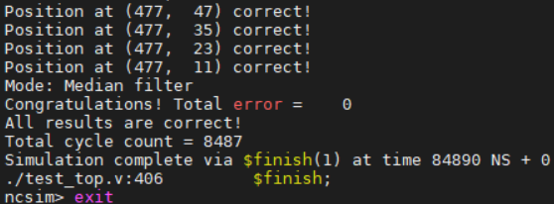
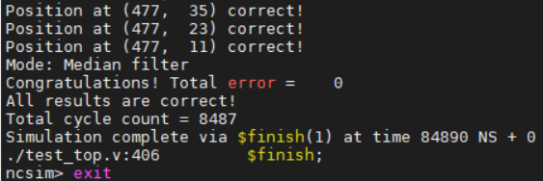
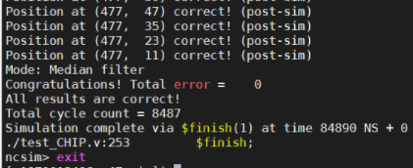
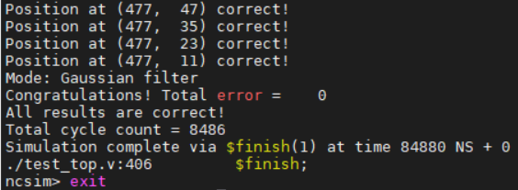
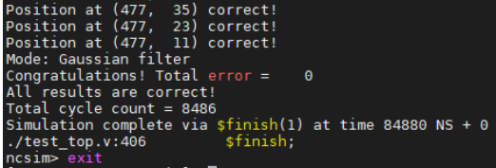
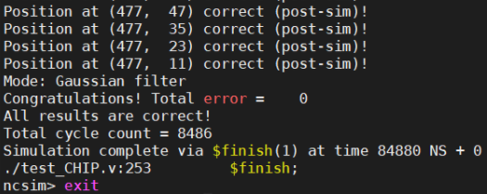
Simulations
Pre-sim
Gate-sim
Post-sim

Slide 14
Contribution of Our Design
After the department store closes, some thieves will sneak into the store.
Our system can detect the edges in an image.
When a thief sneaks into a store, the edges in the monitor screen will change drastically.
It can be applied in a real-time guarding system.

Slide 15
Thank you!

