Slide 1
Implement Edge Detection on Images using HOG Algorithm with Some Noise Filters 利用方向梯度直方圖演算法及雜訊濾波器實現圖像邊緣檢測
Team Members: 林暄傑、劉亦傑、謝霖泳

Slide 2
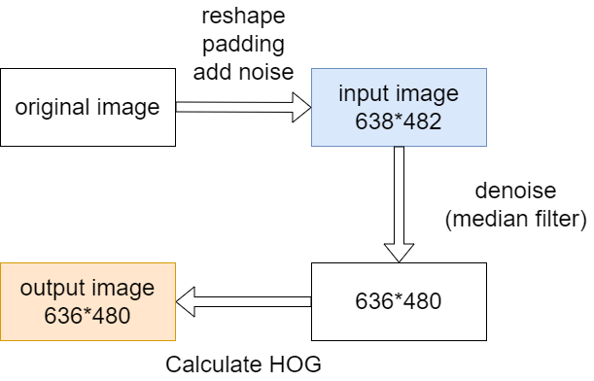
Overview

Slide 3
Expected Result

Slide 4
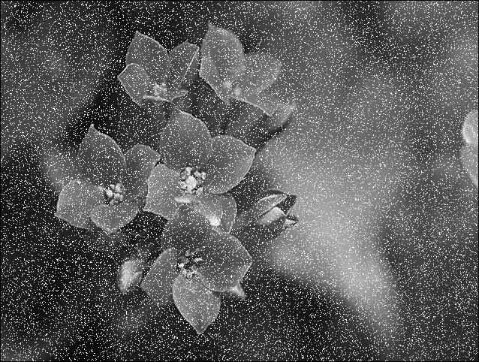
Input Image

Slide 5
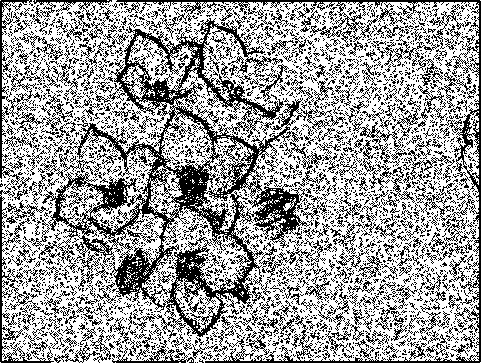
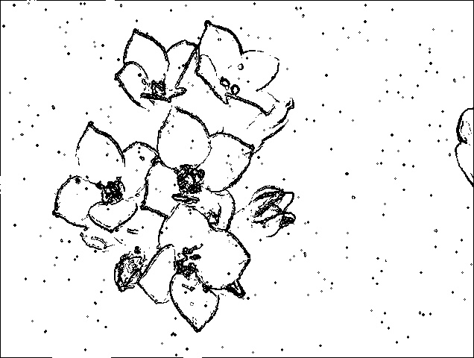
Output HOG Result Comparison
WITHOUT denoising
WITH denoising (median filter)

Slide 6
Current Progress

Slide 7
What we have done
What to be done
hdl
median filter
sim
image preprocessing
golden file
hdl
HOG calculation
Gaussian filter
Non-local means denoiser
syn
gate-sim
APR
post-sim

Slide 8
Thank you!

