Slide 1

Mask-wearing Facial Detector Based on Deep Learning
Yunze Xie Mo Tian Rahul Murali

Slide 2
Presentation Summary
1. Problem Formulation
2. Facial Detector - image inputs - CNN
Model, Hyperparameters, Results
Demo
3. Live Motion Detector for Masks - video demo - CNN
Model, Hyperparameters, Results
Demo
4. Steps to duplicate work
5. Conclusion and Future Work

Slide 3

Problem Formulation
Background: COVID-19 and More
Dataset 7570 [1][2][3][4] : Diversity
3769 Masked, 3801 Unmasked
[1] https://www.kaggle.com/andrewmvd/face-mask-detection
[2] X-zhangyang, Real-World-Masked-Face-Dataset. https://github.com/Xzhangyang/Real-World-Masked-Face-Dataset
[3] https://data.mendeley.com/datasets/hsv83m5zbb/2
[4] https://www.kaggle.com/ciplab/real-and-fake-face-detection

Slide 4
Statement
Propose a facial-mask recognition classifier that will label unmasked as 0 and masked as 1.
Use the trained classifier to detect live motion as a more practical application.
CNN. Pytorch, Tensorflow

Slide 5
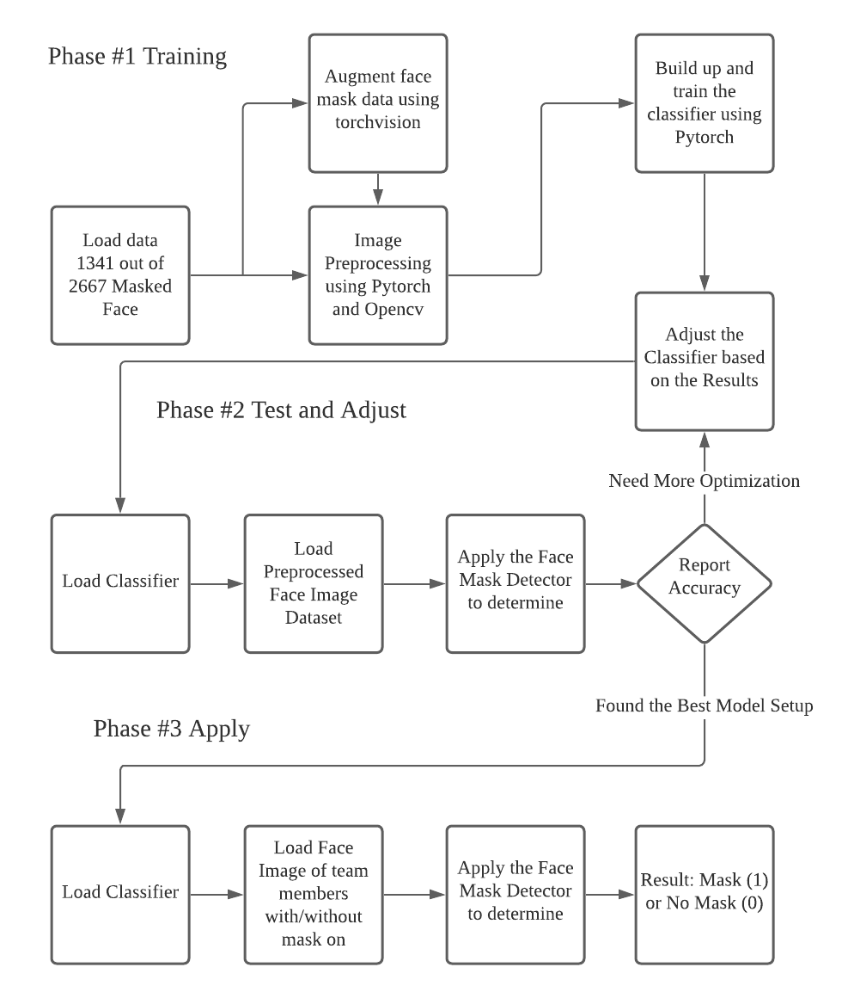
2. Facial Image Mask Detector
Workflow
The model is implemented using PyTorch and the OpenCV package is used to detect the masks and no mask categories.
Accuracy Goal : > 90%

Slide 6
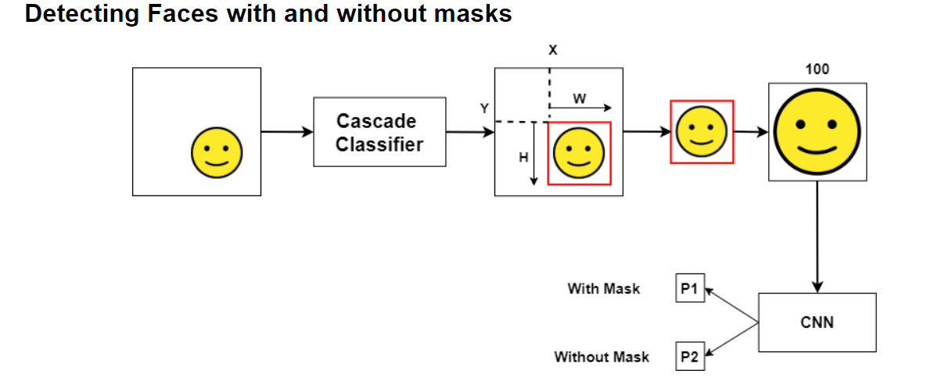
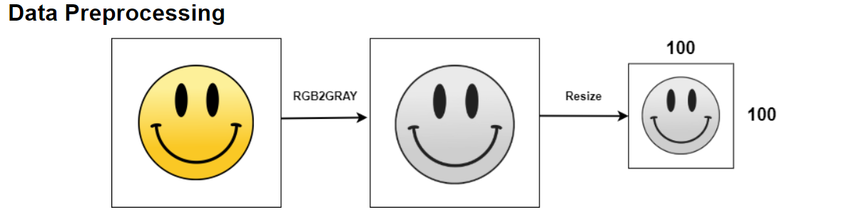
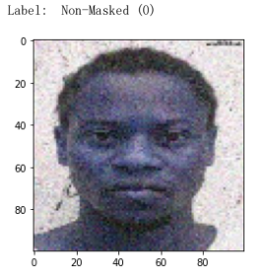
Preprocessing
Pre-processing:
100 x 100 pixel “head shot”
Cascade Classifier: Extract Face
70:30 training and testing partition

Slide 7
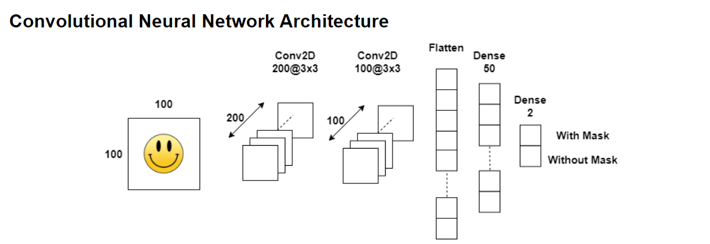
CNN structure
Convolution -> Pooling -> Convolution -> Pooling -> Fully Connected Layer -> Output

Slide 8
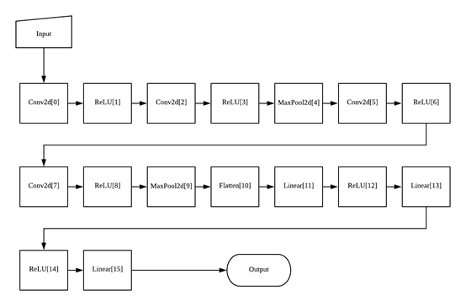
CNN structure

Slide 9

Hyperparameters
Activation Function: ReLU
Loss Function: BCE(Binary Cross-entropy)
Optimizer: Adam
Learning Rate: 0.001 (initial)
Batch-size: 16
Epochs: 10

Slide 10
Real-time Demonstration
Image Labeling

Slide 11
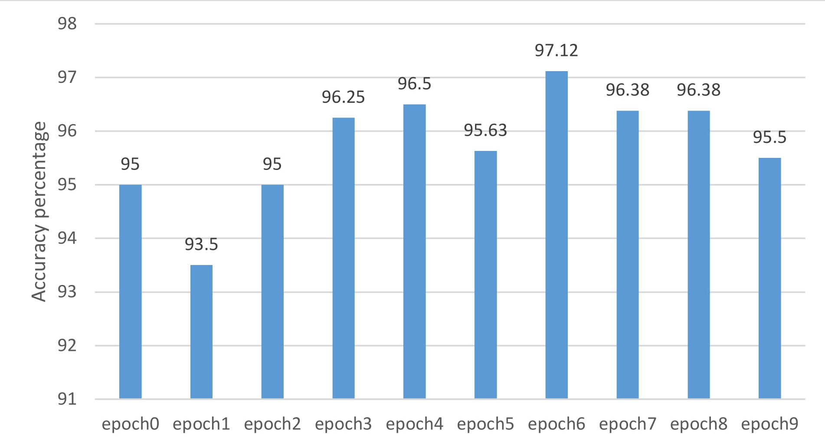
Results
Best Accuracy: 97.12%
Changing Hyperparameters
Increasing Dataset Size

Slide 12
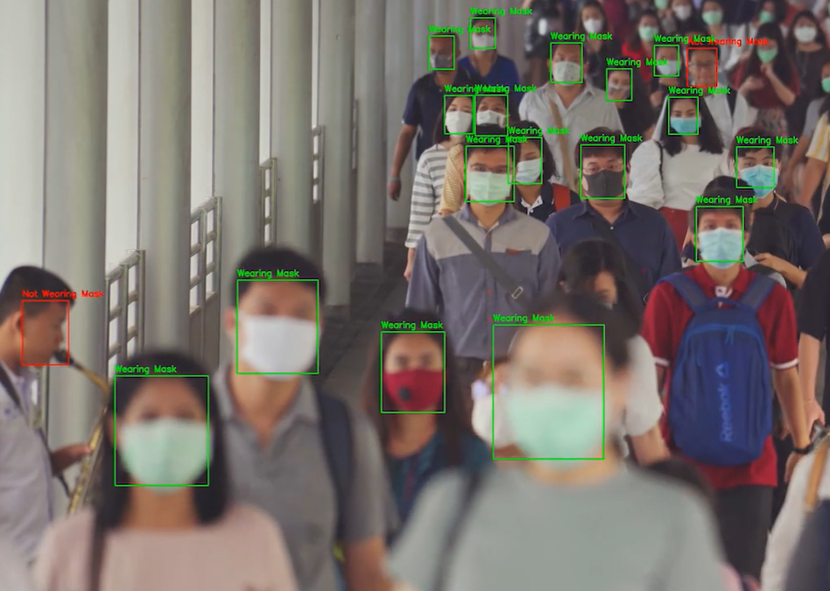
3. Live Motion Mask Detector
Highlight the face with “Unmasked” notice
Able to recognize the mask regardless of color
Tensorflow. Keras
MobileNet V2 architecture

Slide 13
Hyperparameters for live motion detecting
Activation Function: ReLU and Softmax
Loss Function: Categorical Cross-entropy
Optimizer: Adam
Learning Rate: 0.001 (initial)
Epochs: 20
Accuracy: 94.9 %

Slide 14
Real-time Demonstration
Live Motion Detect

Slide 15
4. Duplicate Our Work
System Requirements
GPU – CUDA
10 epochs – 5 minutes
Jupyter Notebook: Python 3.7
CPU: Intel Core I7-8700
GPU: NVIDIA GeForce GTX 1080
Memory: 16GB ddr4

Slide 16
4. Steps to follow
Install Conda: (Jupyter Notebook: Python3.7)
https://docs.conda.io/projects/conda/en/latest/user-guide/install/
Github:
https://github.com/LeoTian6/EEE511Team6FacialMask.git
Install Cuda: https://docs.nvidia.com/cuda/cuda-installation-guide-microsoft-windows/index.html
Or use online computation resources
Libraries: Numpy, Pytorch, OpenCV, tqdm, Keras
conda install -c pytorch pytorch
pip install opencv-python
conda install -c conda-forge keras

Slide 17
5. Discussion and Future Work
Limits - totally irrelevant input ?
Limits - Not proper mask ?
Live-motion detecting - integrated with CCTV ?

Slide 18
References
Elliot. ”How I created a simple mask detector using GPU in PyTorch”.
Jovian. Jun 19, 2020. https://medium.com/jovianml/how-i-created-asimple-
mask-detector-using-gpu-in-pytorch-bd13f3542f46
Adrian Rosebrock, COVID-19: Face Mask Detector with OpenCV, Keras/TensorFlow, and Deep Learning, May 4, 2020 https://www.pyimagesearch.com/2020/05/04/covid-19-face-mask-detector-with-opencv-keras-tensorflow-and-deep-learning/
Gurucharan M K, COVID-19: Face Mask Detection using TensorFlow and OpenCV, May, 29, 2020 https://towardsdatascience.com/covid-19-face-mask-detection-using-tensorflow-and-opencv-702dd833515b
Loey M, Manogaran G, Taha MHN, Khalifa NEM. A hybrid deep transfer learning model with machine learning methods for face mask detection in the era of the COVID-19 pandemic. Measurement (Lond). 2021;167:108288. doi:10.1016/j.measurement.2020.108288

Slide 19
Thank you !
Yunze Xie Mo Tian Rahul Murali

