Slide 1
ANGLERFISH (L. budegassa) - Divisions 8c and 9a.
Noel’s State-Space Surplus Production Model
February 14, 2018

Slide 2
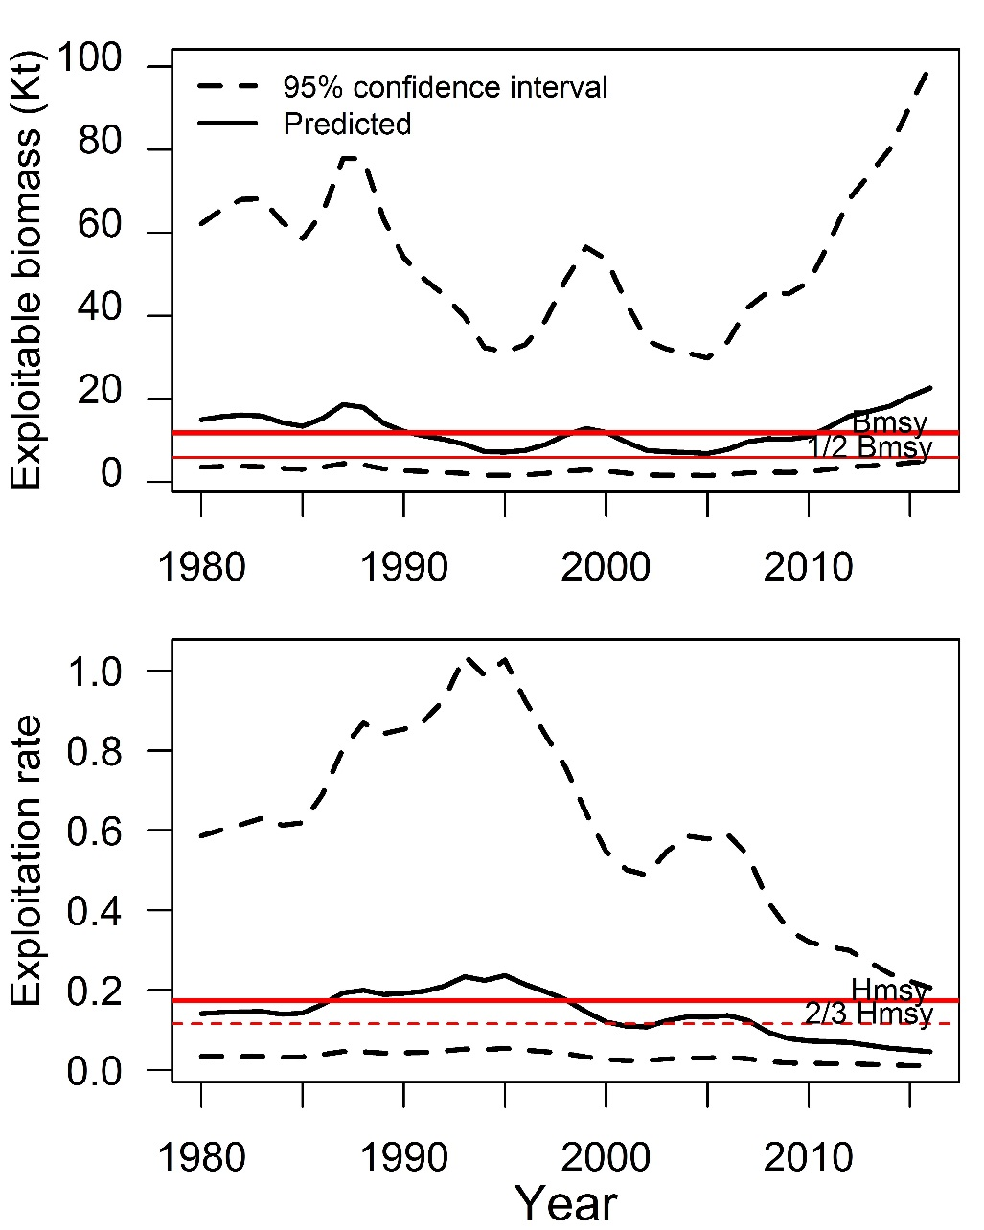
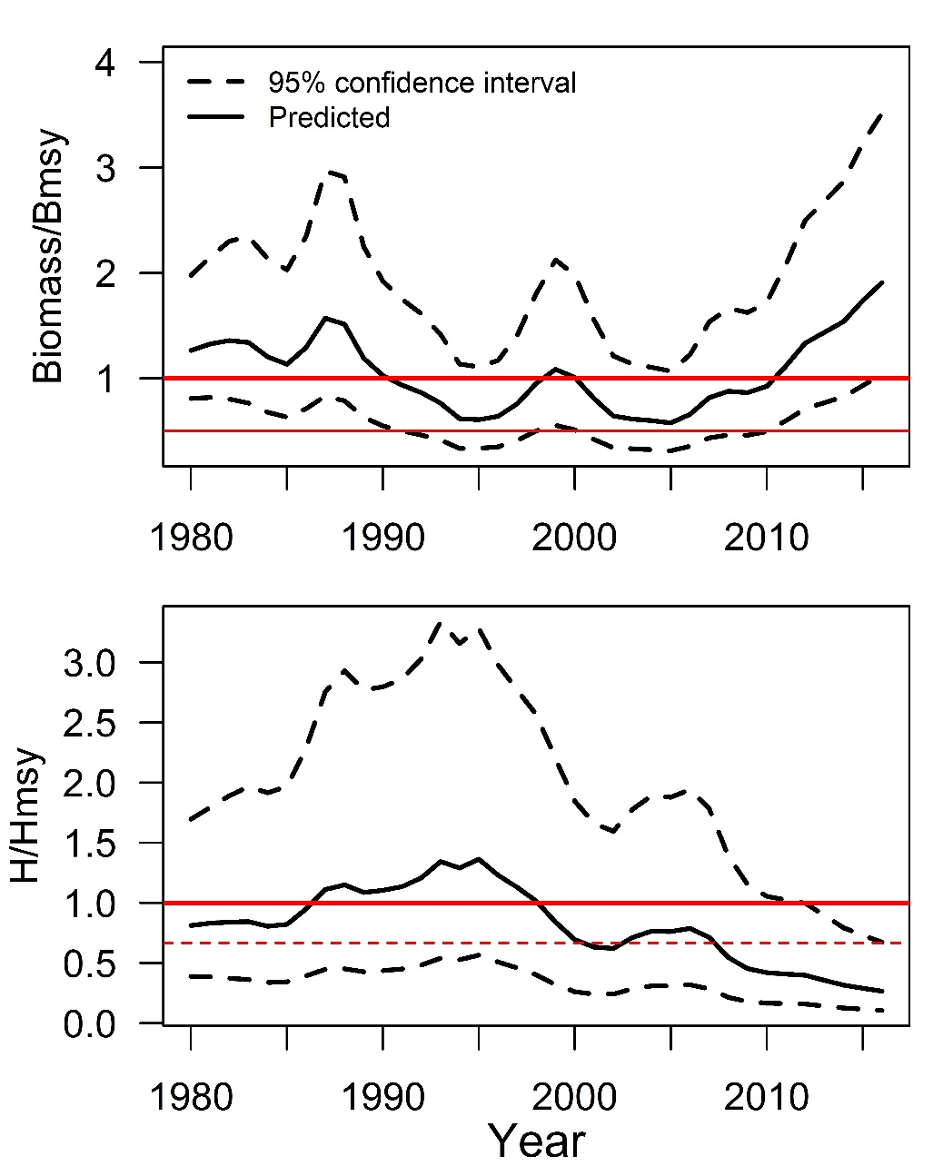
Budegassa 8c9a

Slide 3
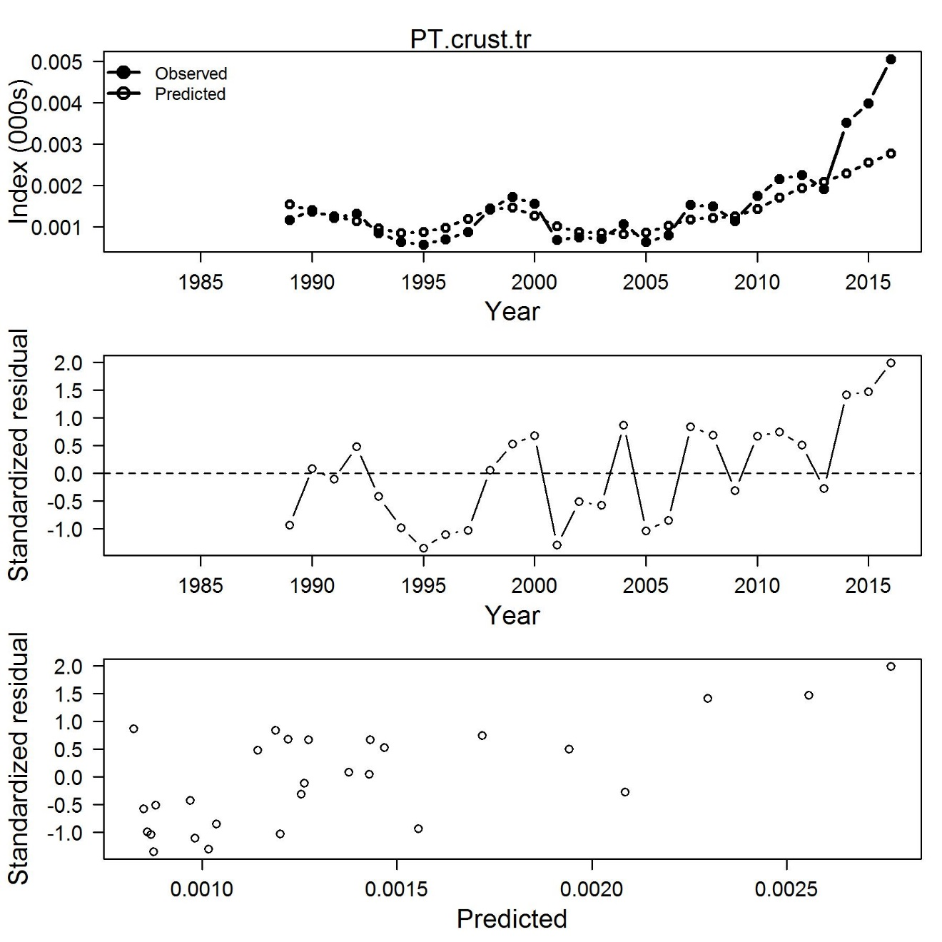
Budegassa 8c9a

Slide 4
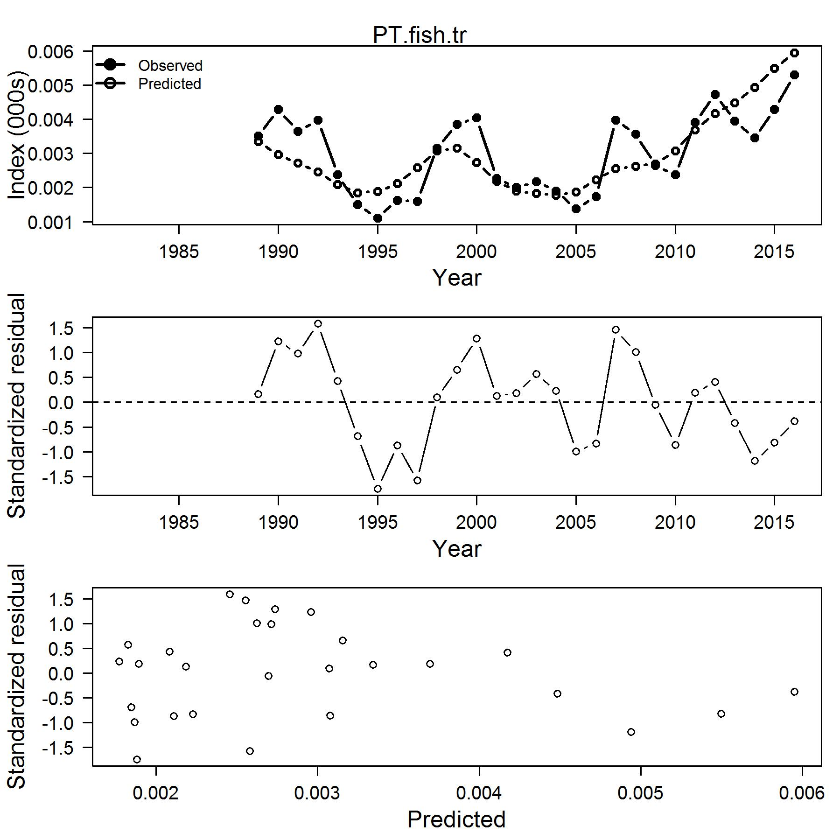
Budegassa 8c9a

Slide 5
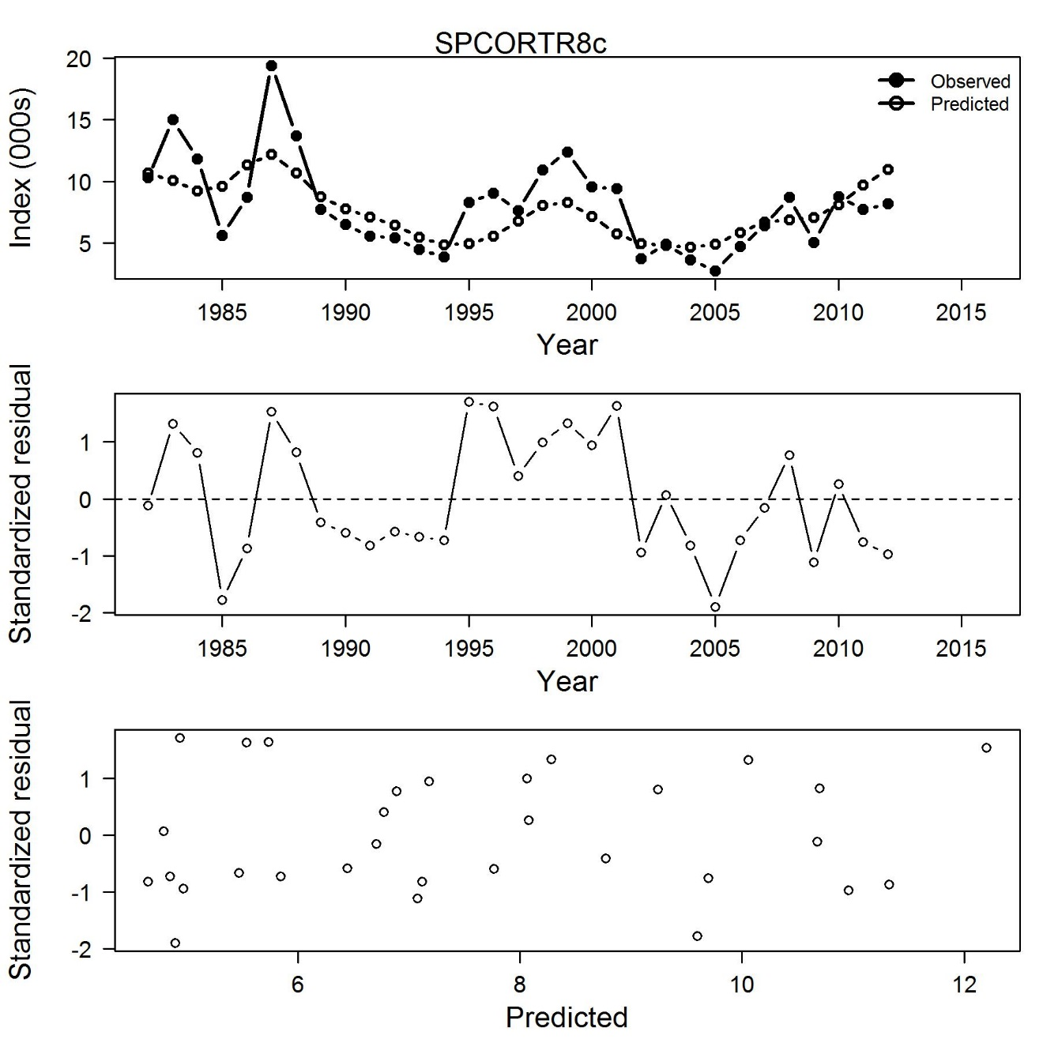
Budegassa 8c9a

Slide 6
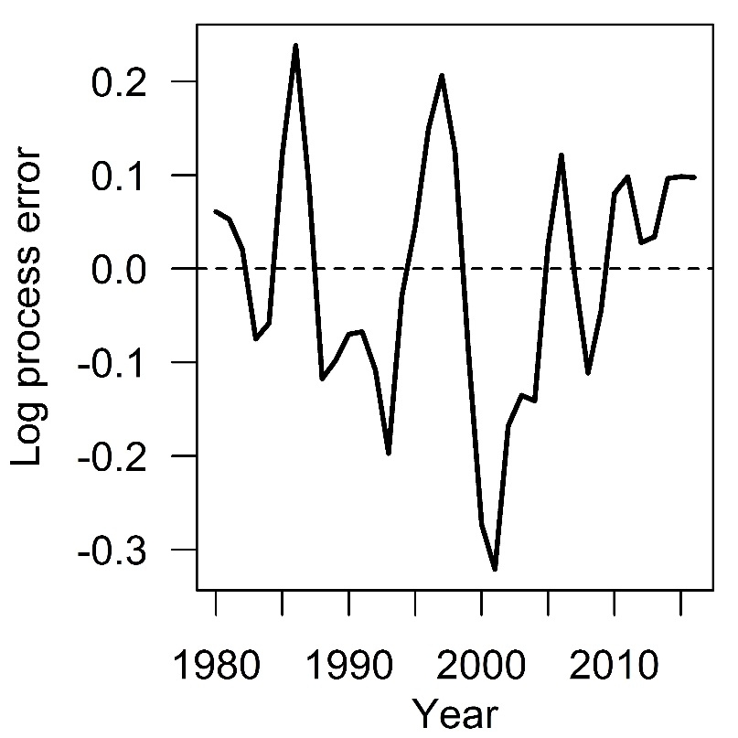
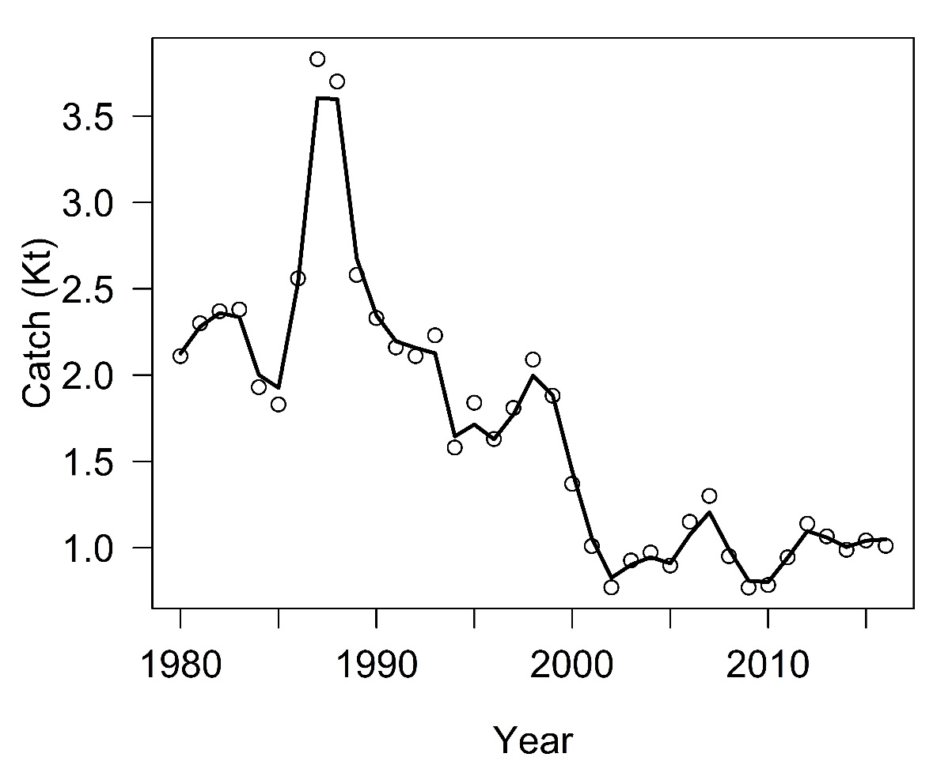
Budegassa 8c9a

Slide 7
Budegassa 8c9a

Slide 8
Budegassa 8c9a
Model output
Year | Biomass | CV(%) | H (%) | CV(%) | B/ Bmsy | CV(%) | H/ Hmsy | CV(%)
2010 | 11 | 75 | 7.3 | 76 | 0.92 | 32 | 0.42 | 47
2011 | 13.3 | 75 | 7.1 | 75 | 1.12 | 32 | 0.41 | 47
2012 | 15.8 | 74 | 6.9 | 75 | 1.33 | 32 | 0.4 | 47
2013 | 17.1 | 75 | 6.2 | 75 | 1.44 | 32 | 0.36 | 47
2014 | 18.3 | 75 | 5.5 | 75 | 1.54 | 32 | 0.32 | 47
2015 | 20.6 | 76 | 5 | 76 | 1.74 | 32 | 0.29 | 47
2016 | 22.7 | 76 | 4.6 | 76 | 1.91 | 31 | 0.27 | 47

