Slide 1
Maximum Likelihood Estimation 10 January 2018
Fitting hierarchical models with TMB
15-20 January, 2018
University of Concepción, Chile
Dr. Cole Monnahan

Slide 2
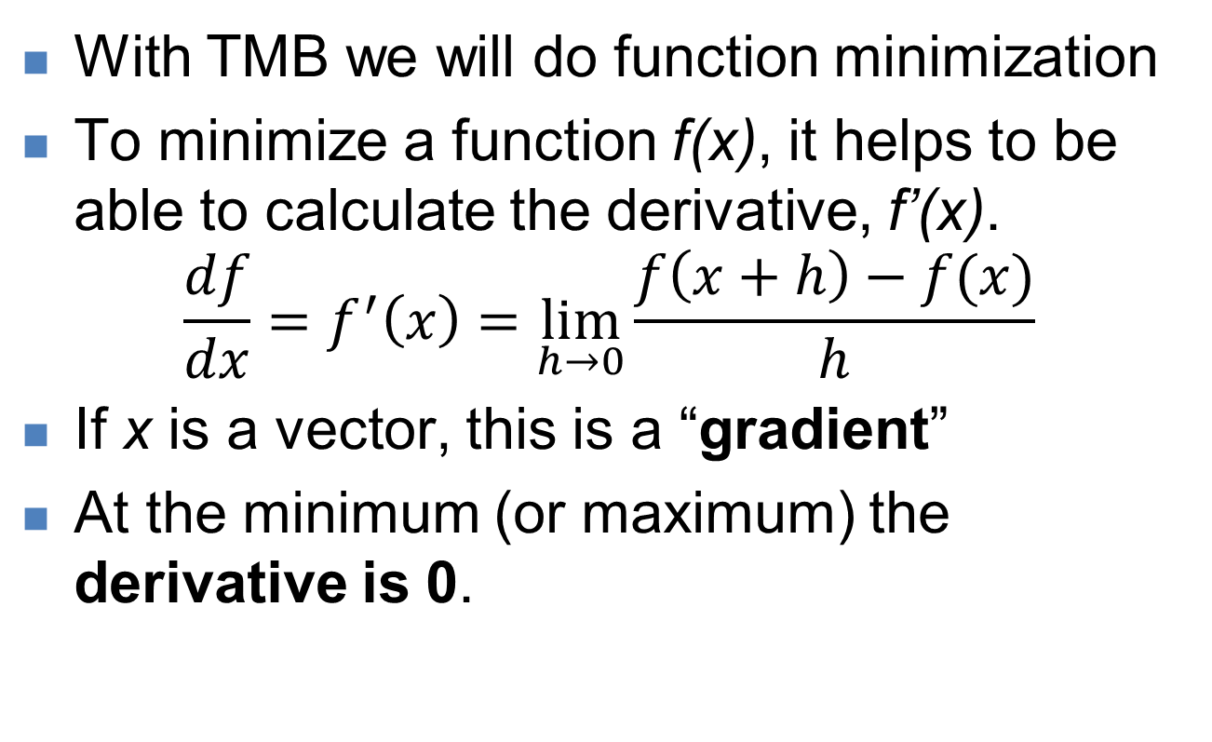
Review: Function minimization
With TMB we will do function minimization
To minimize a function f(x), it helps to be able to calculate the derivative, f’(x).
$$\frac{df}{dx}=f^{′}\left(x\right)=\lim_{h→0}{\frac{f\left(x+h\right)−f(x)}{h}}$$
If x is a vector, this is a “gradient”
At the minimum (or maximum) the derivative is 0.

Slide 3
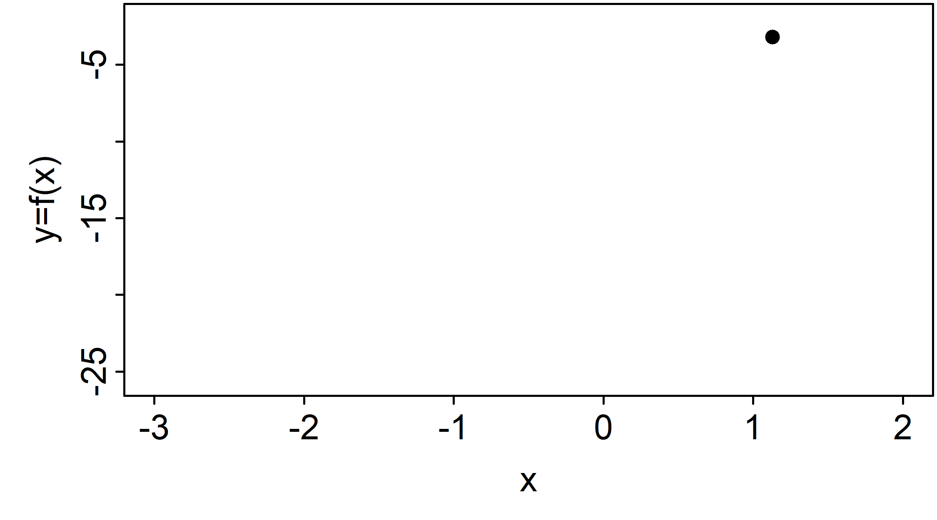
1D Function minimization
Derivatives tell us which way is down
Iterate toward minimum until derivative is 0
This is known as numerical optimization

Slide 4
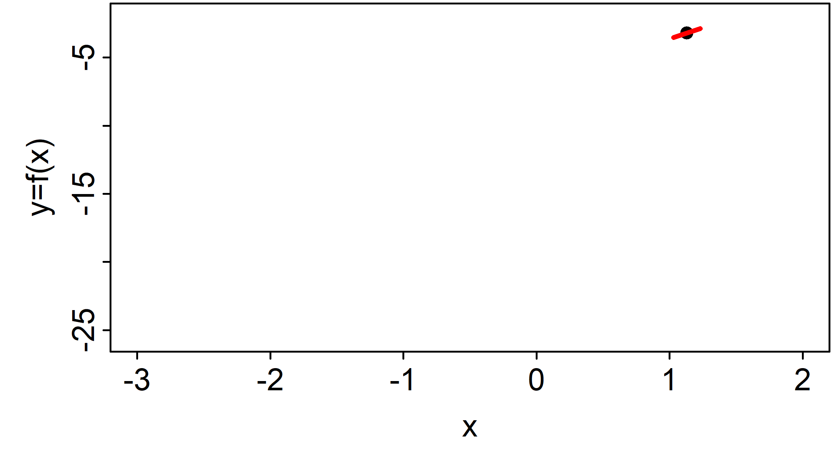
1D Function minimization
Derivatives tell us which way is down
Iterate toward minimum until derivative is 0
This is known as numerical optimization

Slide 5
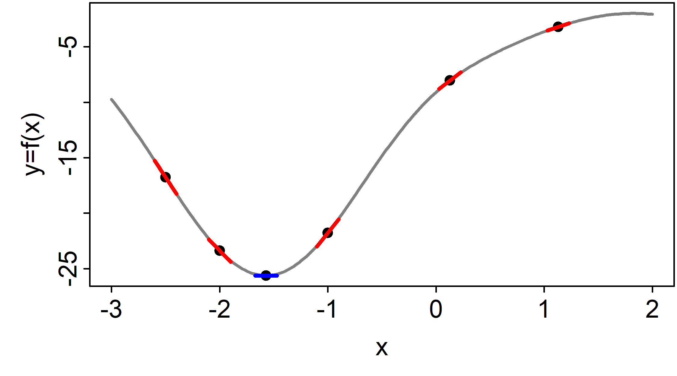
1D Function minimization
Derivatives tell us which way is down
Iterate toward minimum until derivative is 0
This is known as numerical optimization

Slide 6
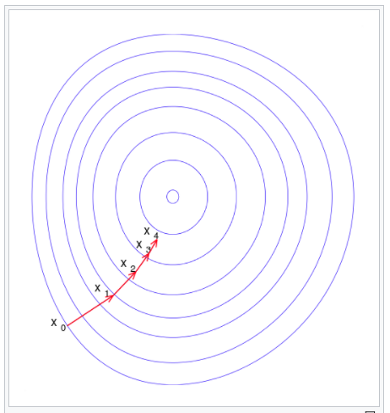
2D function minimization
Contours show level sets
(think of bowl)
Iterative steps toward minimum
Wikipedia.org

Slide 7
Calculating derivatives
Analytical derivatives (i.e., a formula) are ideal, but difficult to find
Numerical derivatives like “finite difference” (e.g., set h=0.0001 in formula) are unreliable
So, how do we calculate gradients of complex functions (e.g., statistical models)?
Solution = “automatic differentiation”
For us, a magic trick the computer does to calculate fast and accurate gradients

Slide 8

Function minimization w/ TMB
How can we calculate derivative of this?
[Show cpp code, demo in R]
compile("tmb_models/polynomial.cpp")
dyn.load(dynlib("tmb_models/polynomial"))
obj <- MakeADFun(data=list(),
parameters=list(x=0))
obj$fn()
obj$gr()
www.vix.com

Slide 9
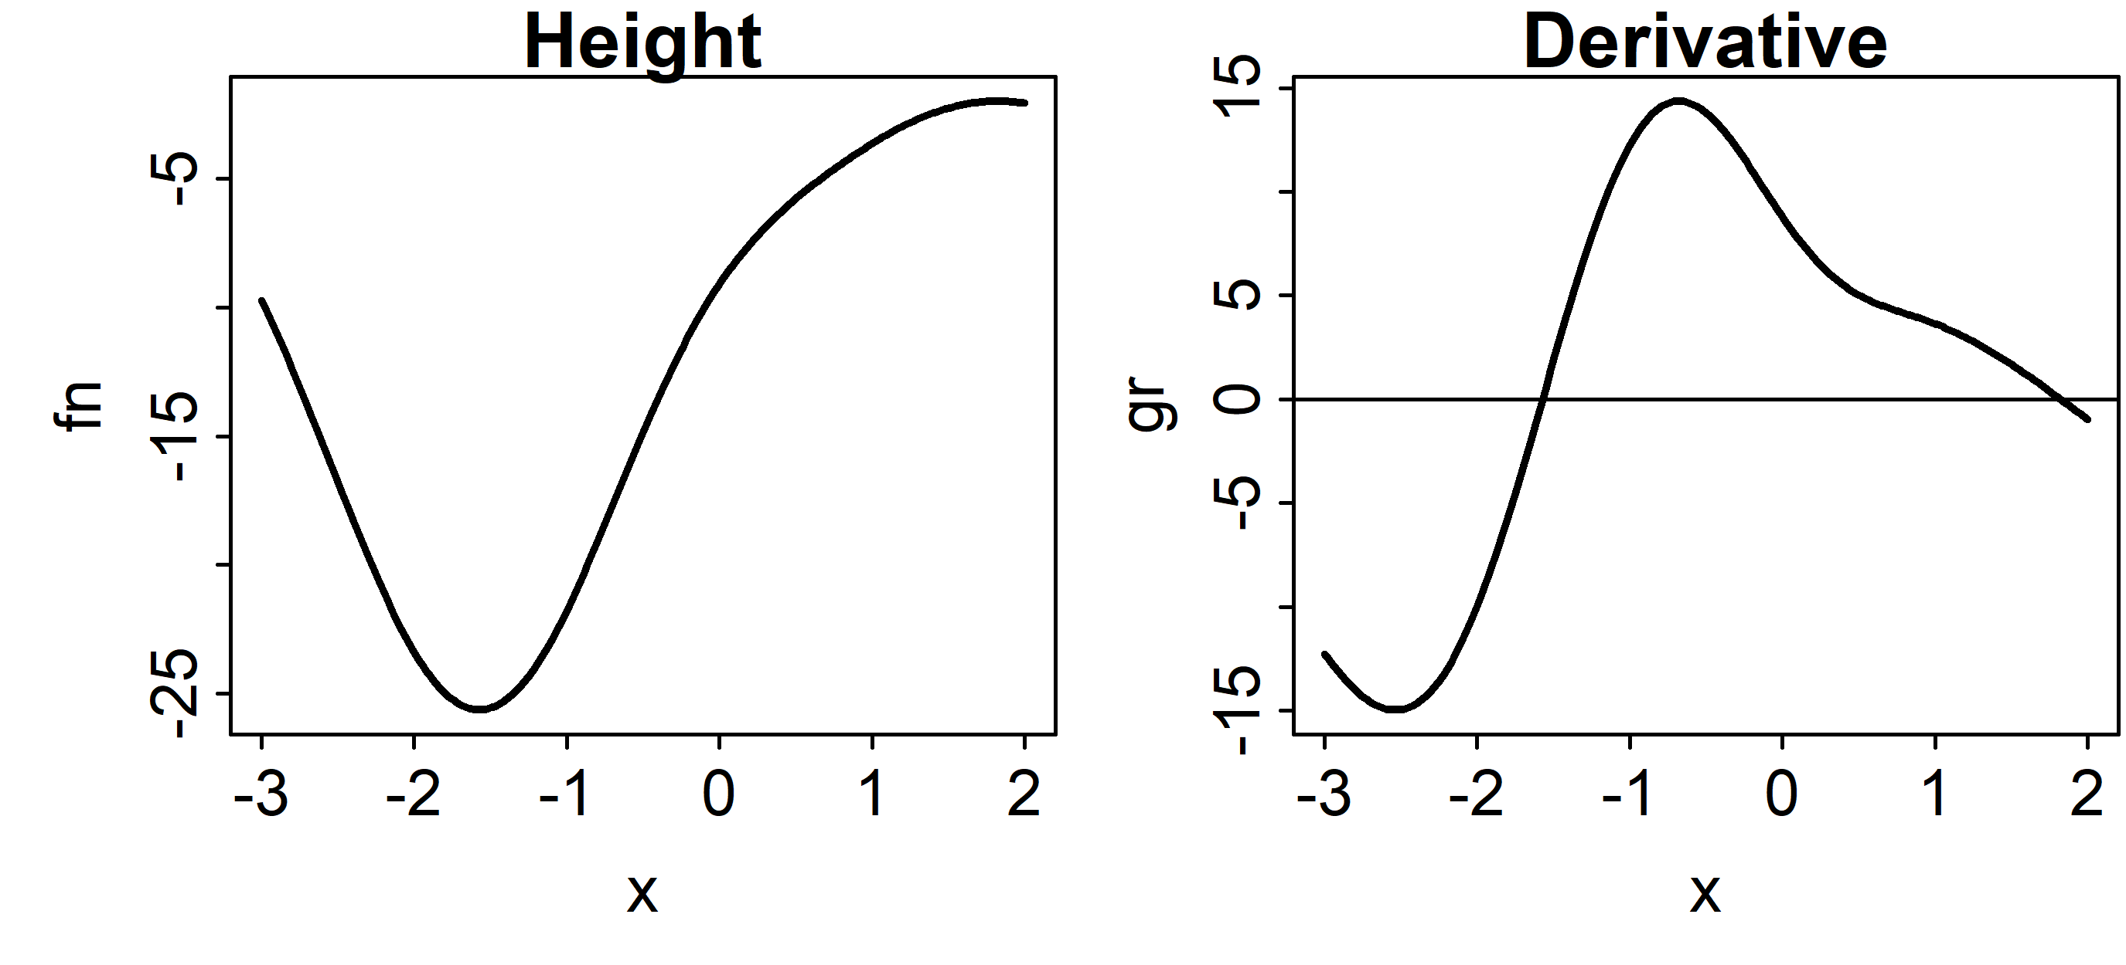
Exercise
Use TMB to recreate this plot
Hint: You need to use a for loop over x in [-3,2]

Slide 10
Maximum likelihood estimation
Fitting statistical models often uses a technique called maximum likelihood estimation
(Technically, we minimize the negative log-likelihood (NLL))
“x” is our parameter vector, “f(x)” is the NLL
Has good properties as data increases, e.g.:
Consistency
Asymptotic normality
But is not always unbiased!
It is widely used, including for our class here

Slide 11


Probabilities vs likelihoods
The difference can be confusing
$$N(μ=?,σ=?)$$
$$N(μ=2,σ=1)$$
Model
Likelihood
Probability
Data
$$x=\{2.1,3.9,−1.2\}$$
$$x=\{??\}$$

Slide 12
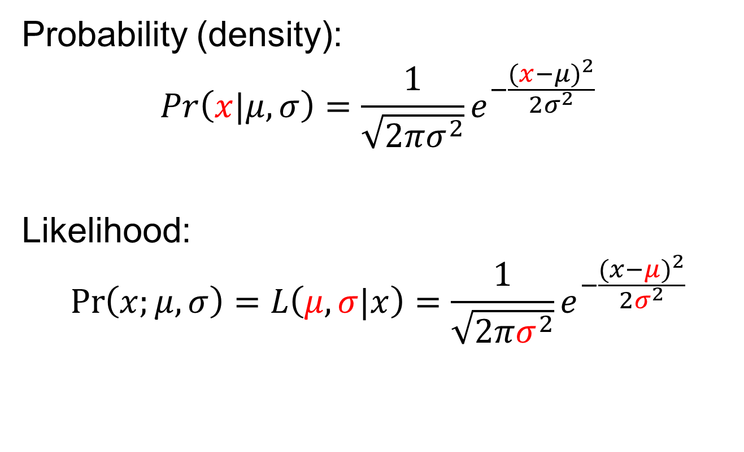
Example: Normal likelihood
Probability (density):
$$Pr\left(x|μ,σ\right)=\frac{1}{\sqrt{2πσ^{2}}}e^{−\frac{{(x−μ)}^{2}}{2σ^{2}}}$$
Likelihood:
$$\operatorname{Pr}\left(x;μ,σ\right)=L\left(μ,σ|x\right)=\frac{1}{\sqrt{2πσ^{2}}}e^{−\frac{{(x−μ)}^{2}}{2σ^{2}}}$$
But calculated the same in R!
dnorm(x=2, mean=3, sd=1)

Slide 13
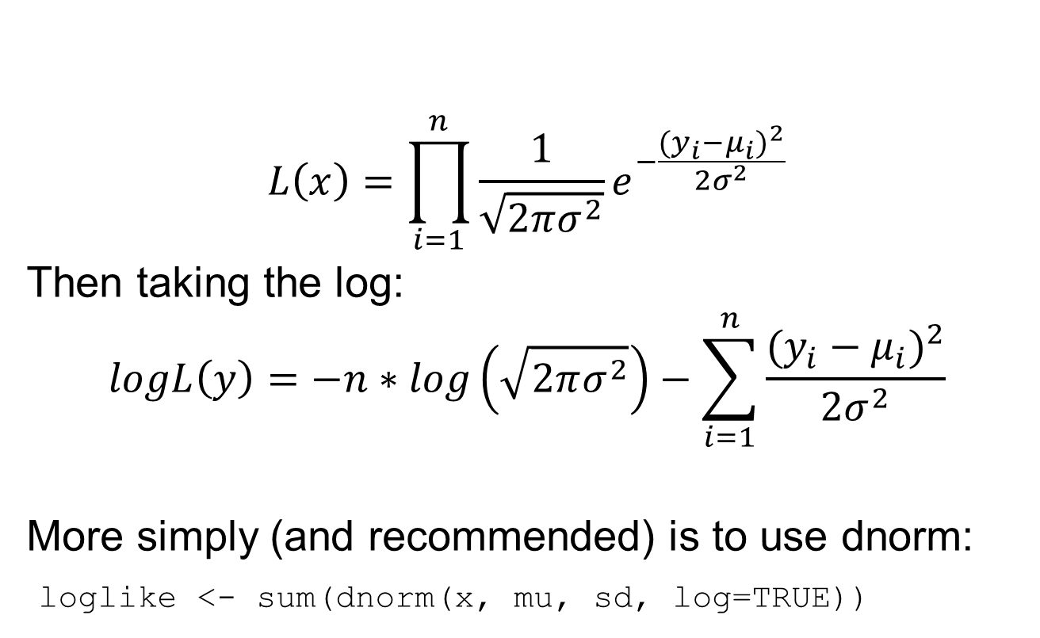
Example: Normal likelihood
$$L\left(x\right)=\prod_{i=1}^{n}{\frac{1}{\sqrt{2πσ^{2}}}e^{−\frac{{(y_{i}−μ_{i})}^{2}}{2σ^{2}}}}$$
Then taking the log:
$$logL\left(y\right)=−n∗log\left(\sqrt{2πσ^{2}}\right)−\sum_{i=1}^{n}{\frac{{(y_{i}−μ_{i})}^{2}}{2σ^{2}}}$$
More simply (and recommended) is to use dnorm:
loglike <- sum(dnorm(x, mu, sd, log=TRUE))
If independent, multiply data points together
Sum of squares

Slide 14
Example: Normal likelihood
μ is the expected value, a function of parameters
The “MLE” is the set of parameters which maximize the likelihood of the data
Constants have no effect on optimization, but often best to leave them in
Same ideas for other likelihoods (Poisson, binomial, etc.)

Slide 15
Exercise: Poisson likelihood
Look up the probability mass function (pmf)
Identify which terms are data and parameters
Take log by hand and write out R function to calculate log-likelihood for single data point
Evaluate for k=4 and lambda=5.5
Check answer with dpois(x, lambda, TRUE)
Plot NLL for lambda between 0 and 15
[Hint: Use log(factorial(k)) or lgamma(k+1)]

Slide 16
Fitting MLE models: basics
Goal: find the parameters that minimize the NLL
Usually need to use numerical optimization
These algorithms try to move “down” until minimum is attained (gradients are zero)
Need to specify starting value that is reasonable
Need to be careful to constrain parameters appropriately (e.g., σ>0; 0<p<1) with transformations

Slide 17
Fitting MLE models: details
Algorithm approaches minimum but may never achieve it
Thus, “convergence” = sufficiently close to global minimum
Typically when maximum gradient is <0.0001
Warning: Can get “stuck” in local minima (bad!)
Test: multiple initializations arrive at same MLE
You are responsible for assuring convergence!

Slide 18
Optimizers in R
R offers many numerical optimizers with different advantages/disadvantages
We will use nlminb but can also use optim
Allows use of box constraints (more later)
We pass it a NLL function, it gives us the parameters that minimize it
Reminder: accurate gradients really improve optimizer performance

Slide 19
Example: Linear model
We will use a simple linear model to demonstrate optimization
We will fit the model three ways:
Using the lm function in R
Using R optimizer with R NLL
Using R optimizer with TMB NLL
The goal is to introduce some key concepts and get practice with TMB

Slide 20
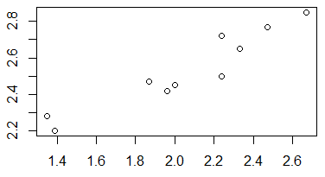
Linear model 1
x <- c(1.87, 1.96, 1.39, 2.24, 2.33, 2.24, 2.67, 2.47,
1.35, 2.00)
y <- c(2.47, 2.42, 2.2, 2.72, 2.65, 2.5, 2.85, 2.77,
2.28, 2.45)
We assume model: $y=intercept+slope∗x$
lm(y~x)

Slide 21
Linear model 2: by hand
nll <- function(pars){
intercept <- pars[1]
slope <- pars[2]
sd <- exp(pars[3])
## Predict y given parameters
mu <- intercept + slope*x
## Calculate log-likelihood
nll <-
-sum(dnorm(y, mu, sd, log=T))
return(nll)
}
fit.R <-
nlminb(start=pars, objective=nll)
R function that
Inputs parameters
Returns NLL
Need to explicitly model variance term
Note the use of exp() to keep it positive
We don’t have a gradient function

Slide 22
Linear model 3: with TMB
TMB looks similar to R
We have a gradient function!
[Look through TMB code]
… TMB code:
<ignore other code for now>
vector<Type> mu(y.size());
mu=intercept+slope*x;
nll=-sum(dnorm(y, mu, sd, true));
return nll;
…
fit.tmb <- nlminb(start=pars,
objective=obj$fn,
gradient=obj$gr)

Slide 23
Linear model comparisons
> fit.R
$par
[1] 1.5774 0.4647 -2.735
$objective
[1] -13.16127
$convergence
[1] 0
$iterations
[1] 13
$evaluations
function gradient
22 48
nlminb returns a list with elements:
Optimal parameters (par)
Minimum NLL (objective)
Convergence status (0=converged)
How many steps it took (iterations)
# of times it used the function (evaluations)
Finite difference

Slide 24
Linear model comparisons
TMB prints the maximum gradient component (mgc) at each iteration (step)
Getting smaller and smaller
What happens if we evaluate the gradient function at the MLE?
Note: R has no idea it is using TMB!
>fit.tmb <- nlminb(start=pars,
objective=obj$fn, gradient=obj$gr)
outer mgc: 99.40139
outer mgc: 5.990303
outer mgc: 132.3652
outer mgc: 108.0497
outer mgc: 4.673943
…
outer mgc: 0.1184033
outer mgc: 0.005721744
outer mgc: 0.0002056732
outer mgc: 1.404738e-05

Slide 25
What about the variance term?
R shows the variance estimate in the summary()
Residual standard error: 0.07255
Does this match our MLE?
> exp(fit.tmb$par[3]) [1] 0.06488976
No! lm does not use maximum likelihood to estimate the variance!!
It uses Restricted Maximum Likelihood (REML) which is better in this case (we will do this with TMB later)
Remember: MLEs can be biased (and are for variances)

Slide 26
Review of key concepts
To “fit” statistical models we minimize the –log-likelihood to find the MLE
We often minimize the NLL numerically
Optimization is better with gradients, and TMB calculates those easily
We use exp() to keep parameters positive
The MLE variance is biased

Slide 27
Questions?

