Slide 1
Estimating uncertainty with TMB
Fitting hierarchical models with TMB
15-19 January, 2018
University of Concepción, Chile
Dr. Cole Monnahan

Slide 2
Recap
We postulate a statistical model
Implement model in TMB by calculating NLL for parameters and data
Use optimizer to (MLEs)
But this tells us nothing about how much confidence we should have in our MLEs
We need to estimate uncertainty!

Slide 3
Estimating uncertainty
Uncertainty estimates can be calculated in several ways with TMB
Asymptotic approximation + delta method
Likelihood profiles
Non-parametric bootstrapping
Bayesian credible intervals (not covered)

Slide 4
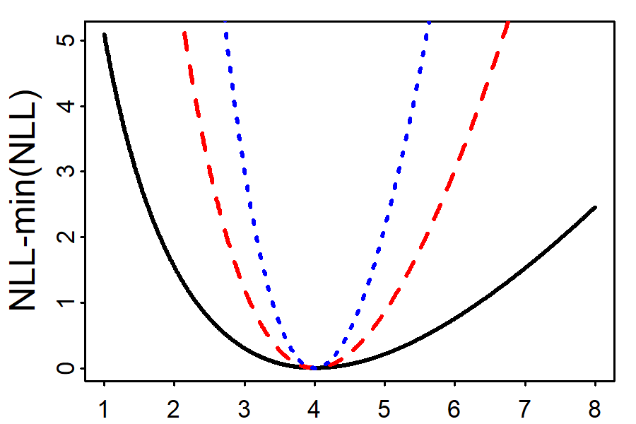

Asymptotic approximations
Let’s use a contrived Poisson example
3 curves have same MLE but different data
As data increases:
NLL gets narrower
Shape becomes more like a symmetric parabola
Remember that as
$n→∞$ MLE becomes normal

Slide 5
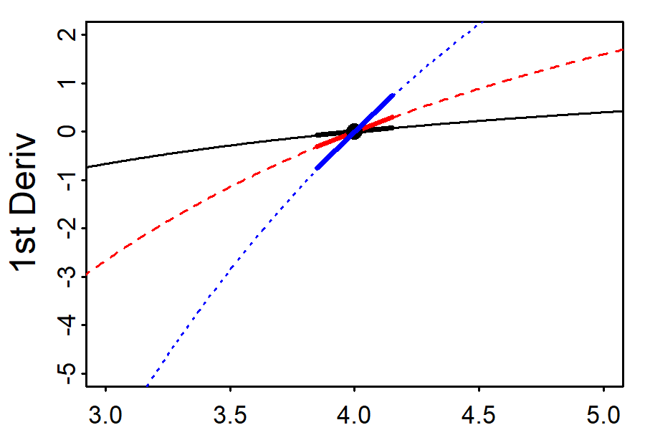

Asymptotic approximations
Remember: 2nd derivative = derivative of derivative
$$\frac{d}{dx}\left(\frac{dy}{dx}\right)$$
The derivatives are 0 at the MLE (by definition)
The slopes at the MLE are different
They are all positive (because it is a minimum)
Which is most uncertain?

Slide 6
Asymptotic approximations
2nd deriv = how “steep” the curve is at the MLE
For a 1d model, standard error = SE = 1/(2nd deriv)
(2nd derivative) | SE
1.75 | 0.76
2.00 | 0.71
5.00 | 0.45

Slide 7
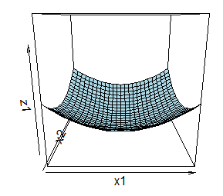
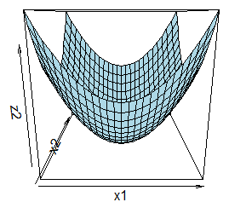
Multivariate asymptotics
For N-d model, the shape is represented by a NxN “Hessian” matrix of 2nd derivatives
Inverting the Hessian gives us a covariance matrix
Same intuition about “steepness”
Which will have smaller SEs?

Slide 8
Non-Invertible Hessians
The Hessian will not be invertible if the MLE is not a true minimum.
When could this occur? Usually mis-specified models
E.g., parameters confounded or overparameterized (too complex for data)
Here’s a confounded model:
x1 <- rnorm(50); x2 <- x1; lm(y~x1+x2)
Why confounded? lm estimates slope of x2 as NA
TMB will warn about uninvertible Hessian (NaNs)

Slide 9

Asymptotics in TMB
Hessian is hard to calculate.. How?
TMB uses AD to calculate the Hessian (obj$he)
This can be accessed with sdreport(obj) after optimizing
Under these assumptions we create a confidence interval as MLE +/- 1.96*SE
www.vix.com
summary(sdreport(obj), 'fixed')
fit.cov <- sdreport(obj)$cov.fixed
ses <- sqrt(diag(fit.cov))

Slide 10
Uncertainty for derived quantities
Inverting the Hessian only works for parameters
We often want uncertainty for functions of parameters (‘derived quantities’)
For instance, with the bevholt model, we may want to know the uncertainty of f(logA)=exp(logA)=A
We know the SE for logA from the inverted Hessian (it is a parameter)
For A we can use the “Delta method”

Slide 11
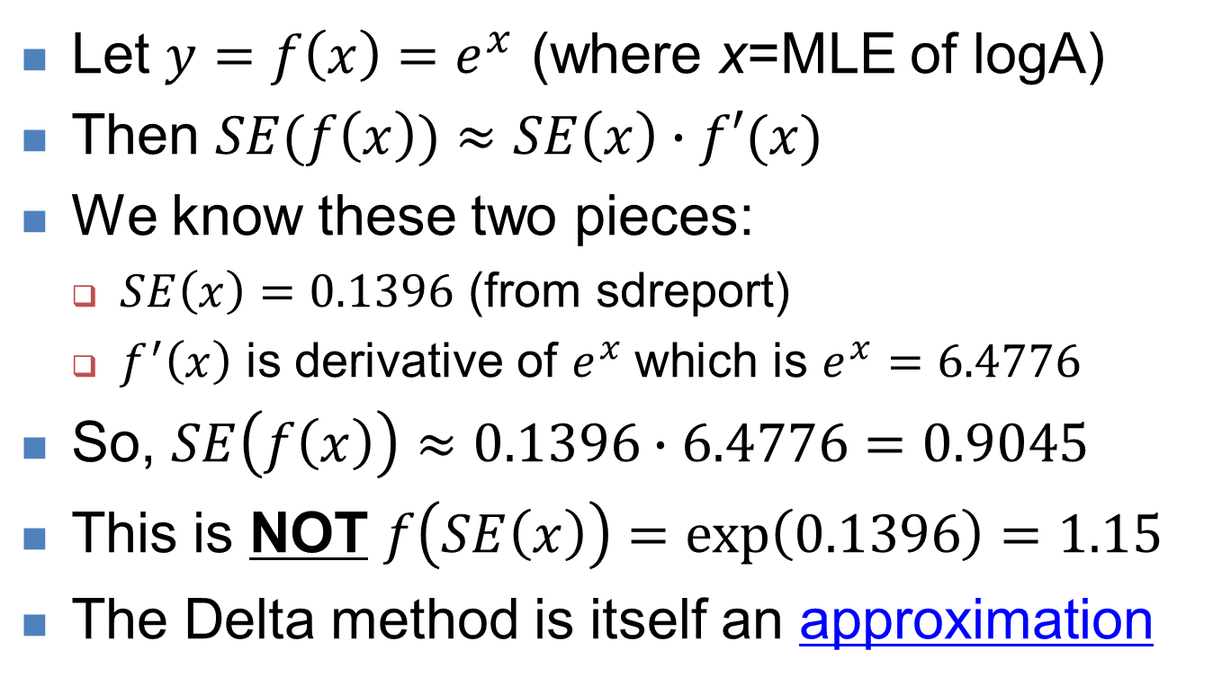
Univariate Delta method
Let $y=f\left(x\right)=e^{x}$ (where x=MLE of logA)
Then $SE(f\left(x\right))≈SE\left(x\right)∙f′(x)$
We know these two pieces:
$SE\left(x\right)=0.1396$ (from sdreport)
$f^{′}\left(x\right)$ is derivative of $e^{x}$which is $e^{x}=6.4776$
So, $SE\left(f\left(x\right)\right)≈0.1396∙6.4776=0.9045$
This is NOT $f\left(SE\left(x\right)\right)=\exp\left(0.1396\right)=1.15$
The Delta method is itself an approximation

Slide 12
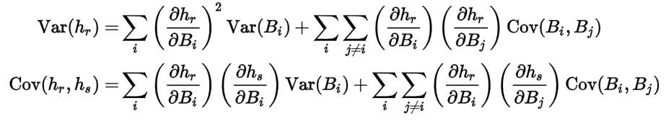
Multivariate Delta method
What about a combination of parameters, like a predicted logR which is a combination of both parameters?
It get’s ugly! From Wikipedia:
That’s a lot of derivatives to do… a better way?

Slide 13
Multivariate Delta method
What about a combination of parameters, like a predicted logR which is a combination of both parameters?
It get’s ugly! From Wikipedia:
That’s a lot of derivatives to do… a better way?
Let TMB do the calculations for you!
www.vix.com

Slide 14
Delta method in TMB
In the template add ADREPORT(x). x can be scalar, vector, etc., e.g.:
Type A=exp(logA);
ADREPORT(A);
In R, after optimizing, do rep <- sdreport(obj)
Then, summary(rep, ‘report’) prints the estimates and SEs (or rep$value, rep$sd)
> summary(rep, 'report')
Estimate Std. Error
A 6.477682e+00 9.044460e-01
Look familiar? It matches our by-hand calculation!

Slide 15
Exercise: Uncertainty in bevholt
Save bevholt2.cpp model as bevholt3.cpp
Add 95% confidence intervals to logR
Predict logR at SSB_pred=seq(20000, 300000, len=1000)
Pass it as data to TMB model, make predictions, calculate SE for each value
Plot MLE fit with 95% confidence on top of the original data

Slide 16
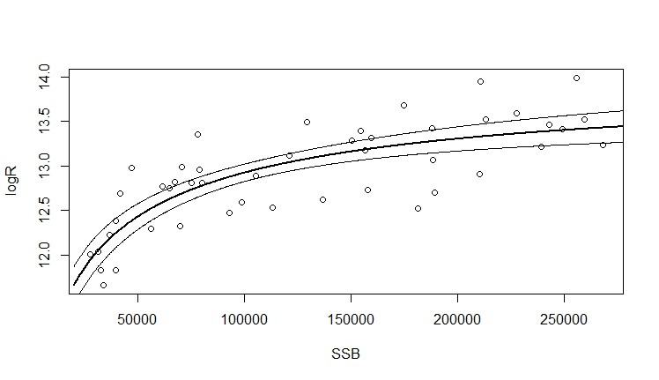

Slide 17
Likelihood profiles
Does not make the asymptotic normal assumption
Essentially: Refit model at series of points, doing likelihood ratio tests at each one
Theory not covered here, but a good approach.
Easy to do in TMB: prof <- likeprof(obj, ‘logA’, parm.range=c(1.5, 2.5))
Then plot(prof) and confint(prof) plot and give 95% range
This interval may not be symmetic nor finite

Slide 18
Uncertainty with bootstrapping
A non-parametric approach that makes no distributional assumptions
Instead, resample data with replacement, refit model, save estimates
Repeat many times (say 1000) and look at distribution of estimates
A whole literature on this approach, see e.g.:
Efron, Bradley, and Robert J. Tibshirani. An introduction to the bootstrap. CRC press, 1994.

Slide 19
Bootstrapping with TMB
A quick demonstration on our bevholt model
Note: we need to remake the model obj each time because the data change
Do not need to recompile or link
Nboot <- 1000
boot.results <- matrix(NA, nrow=Nboot, ncol=2)
N <- length(data$SSB)
for(i in 1:Nboot){
ind <- sample(1:N, size=N, replace=TRUE) # resample
data2 <- list(SSB=data$SSB[ind], logR=data$logR[ind])
obj <- MakeADFun(data2,parameters,DLL="bevholt2")
obj$env$beSilent() # silences console output
opt.temp <- with(obj, nlminb(par, fn, gr))
boot.results[i,] <- opt.temp$par
}

Slide 20
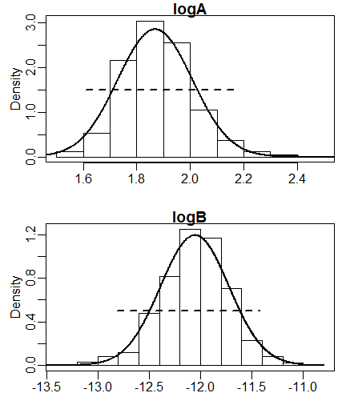
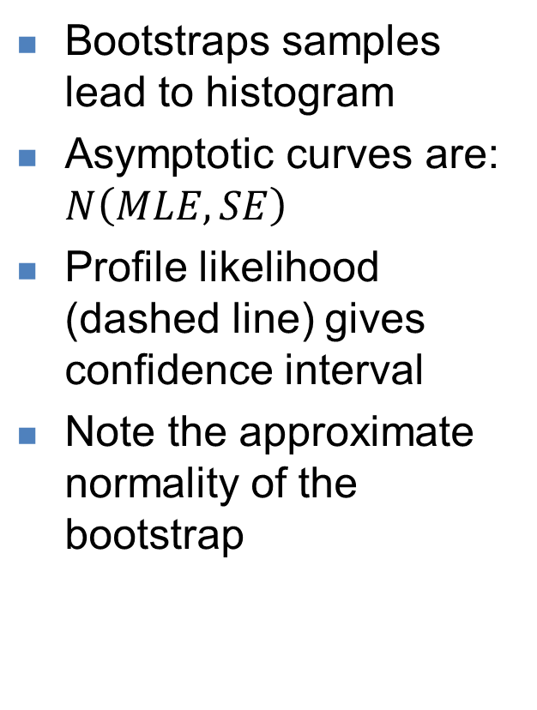
Comparing methods
Bootstraps samples lead to histogram
Asymptotic curves are: $N\left(MLE,SE\right)$
Profile likelihood (dashed line) gives confidence interval
Note the approximate normality of the bootstrap

Slide 21
Exercise: Bootstrapping in bevholt
Continue last exercise
Modify the bootstrapping code to work for your vector of predicted logR values
Run 200 bootstrap replicates and plot them as lines
Add your 95% asymptotic confidence interval
Overlay the data
Do you think the two methods produce similar uncertainty estimates?
What does that mean?

Slide 22
Recap
Estimating uncertainty is fundamental to a statistical analysis
TMB is designed for maximum likelihood + Delta method approach with asymptotic assumptions
However these symmetric estimates can fail, and if suspected check it with likelihood profile or bootstrapping
Parameter transformations can sometimes be used to make estimators more symmetric.

