Slide 1
Lab 3: Poisson GLM and hierarchical VB growth
Fitting hierarchical models with TMB
15-19 January, 2018
University of Concepción, Chile
Dr. Cole Monnahan

Slide 2
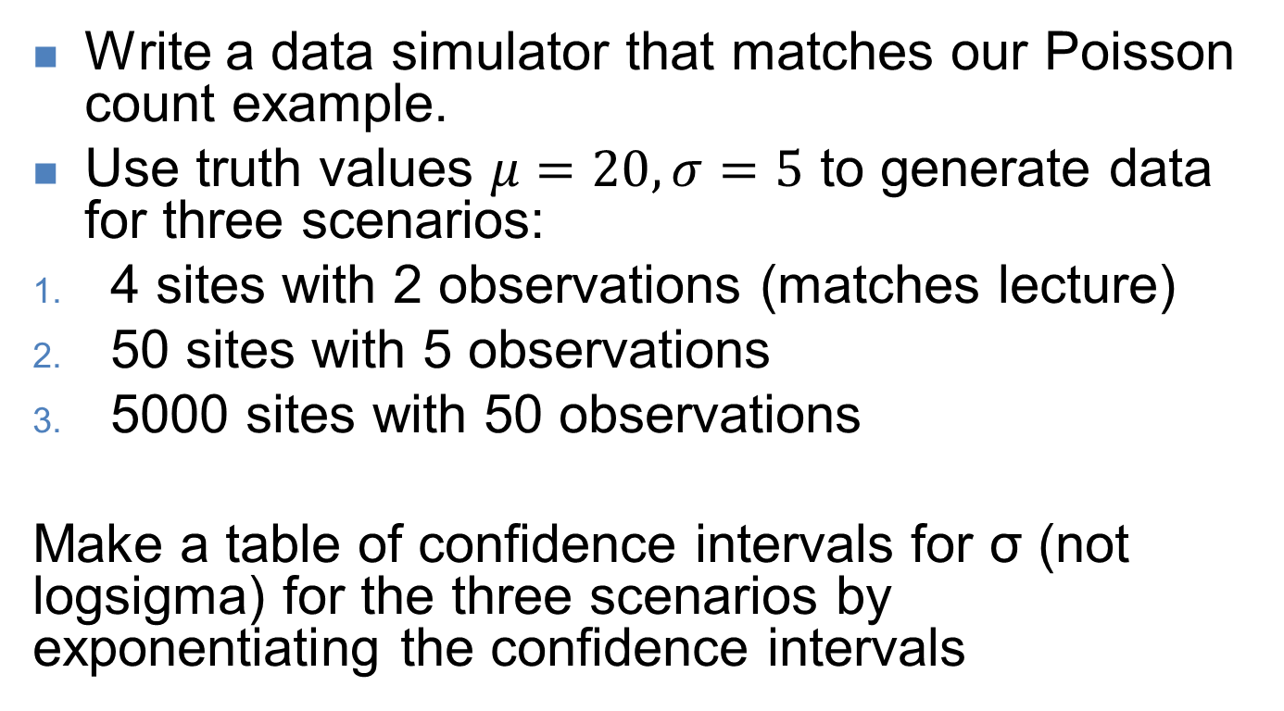
Exercise 1: Count data
Write a data simulator that matches our Poisson count example.
Use truth values $μ=20, σ=5$ to generate data for three scenarios:
4 sites with 2 observations (matches lecture)
50 sites with 5 observations
5000 sites with 50 observations
Make a table of confidence intervals for σ (not logsigma) for the three scenarios by exponentiating the confidence intervals

Slide 3
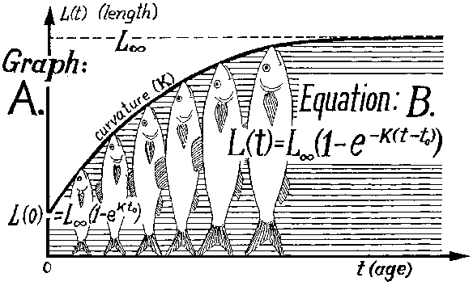
Exercise 2: Von Bertalanffy Growth
Image: fao.org

Slide 4
Exercise 2: Fit Linf, k random effects
Yesterday we modeled an independent Linf & k, for each fish
Change that model to have a hierarchical structure: a mean and variance for both Linf and k random effects.
Update template and R script
Build obj with random effects and fit
Get the Empirical Bayes estimates of random effects (use ADREPORT(logk) etc.)
Compare logk estimates vs the independent

Slide 5
Recap
You built your first hierarchical TMB model!
For scenario 3, we did a 5000 dimension integral hundreds of times, and it was trivial for TMB
…it was an easy model but hints at the power
The “no pooling” version assumed fish were totally independent from others
The partial pooling experienced “shrinkage”: estimates pulled toward mean because they are sharing information
This is a classic property of hierarchical models

