Slide 1
Lab 2: Fitting non-linear growth models

Slide 2
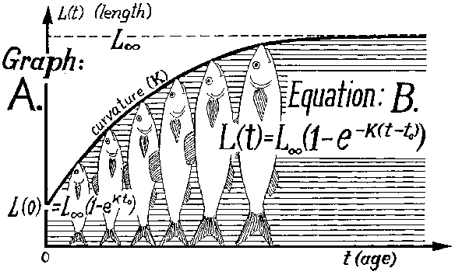
Von Bertalanffy Growth
Image: fao.org

Slide 3
The model
Length (L) is related to age (a) through three parameters: Linf, k, and t0.
Here we assume
t0=5 is known.
Length measured with log-normal error
We also consider that each fish may have their own growth trajectories (i.e., Linf and k)

Slide 4
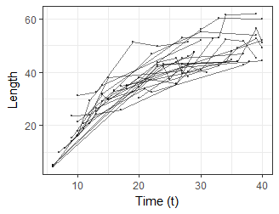
The simulated data
Tank experiment: measure 20 fish 5 times, but at random days
List of 6
$ Nfish : num 20
$ Nobs : int 100
$ loglengths: num [1:100] 3.69 3.74 3.62 3.76 1.48 ...
$ fish : int [1:100] 1 1 1 1 1 2 2 2 2 2 ...
$ ages : int [1:100] 31 24 25 27 6 14 39 33 27 34 ...
$ ages_pred : int [1:35] 6 7 8 9 10 11 12 13 14 15 ...

Slide 5
## Growth model with common parameters
data <- readRDS('tmb_models/growth_data.RDS')
parameters <- list(logsigma=0, logLinf=3, logk=-2)

Slide 6
Exercise 1: Fit to common Linf, k
Model will be similar to bevholt with 3 parameters:
Linf, k, and an observation variance (sigma)
What are the ranges of these?
Build ‘growth’ model (suggest starting from bevholt)
Then, modify to get confidence intervals around lengths (not log!) from 6:40 [hint, need a separate loop in Template file]

Slide 7
Exercise 2: Fit individual Linf, k
Instead of assuming all fish have the same Linf & k, assume each fish has its own
Linf and k are now vectors (what length?)
Will need to use the “fish” column to index which observation belongs to which fish:
k = exp(logk(fish(i)-1));
Why the “-1” ??
If nlminb doesn’t converge, restart from opt$par

Slide 8
[Send answer, discuss difficulties]

Slide 9
Recap
You built your first TMB model!
#2 had 42 parameters.. Big model right? NO! Trivial for TMB
We fit two versions of the model: a “full pooling” assumes no differences between fish
The “no pooling” version assumed fish were totally independent from others
What lies between these extremes is “partial pooling”
….. Enter random effects …. tomorrow

