Slide 1
Building TMB Models
Fitting hierarchical models with TMB
15-19 January, 2018
University of Concepción, Chile
Dr. Cole Monnahan

Slide 2
TMB modeling overview
Compile a “template” C++ to create a .dll file (compile)
Link R to this library (dyn.load)
Build a TMB object by passing data and parameters (MakeADFun)
The returned object (obj) is an R list with many elements, including fn and gr functions.
Calling obj$fn(pars) passes the parameters to the .dll file which calculates the answer, then returns it to R
R does NO calculations, the C++ (TMB) model does

Slide 3
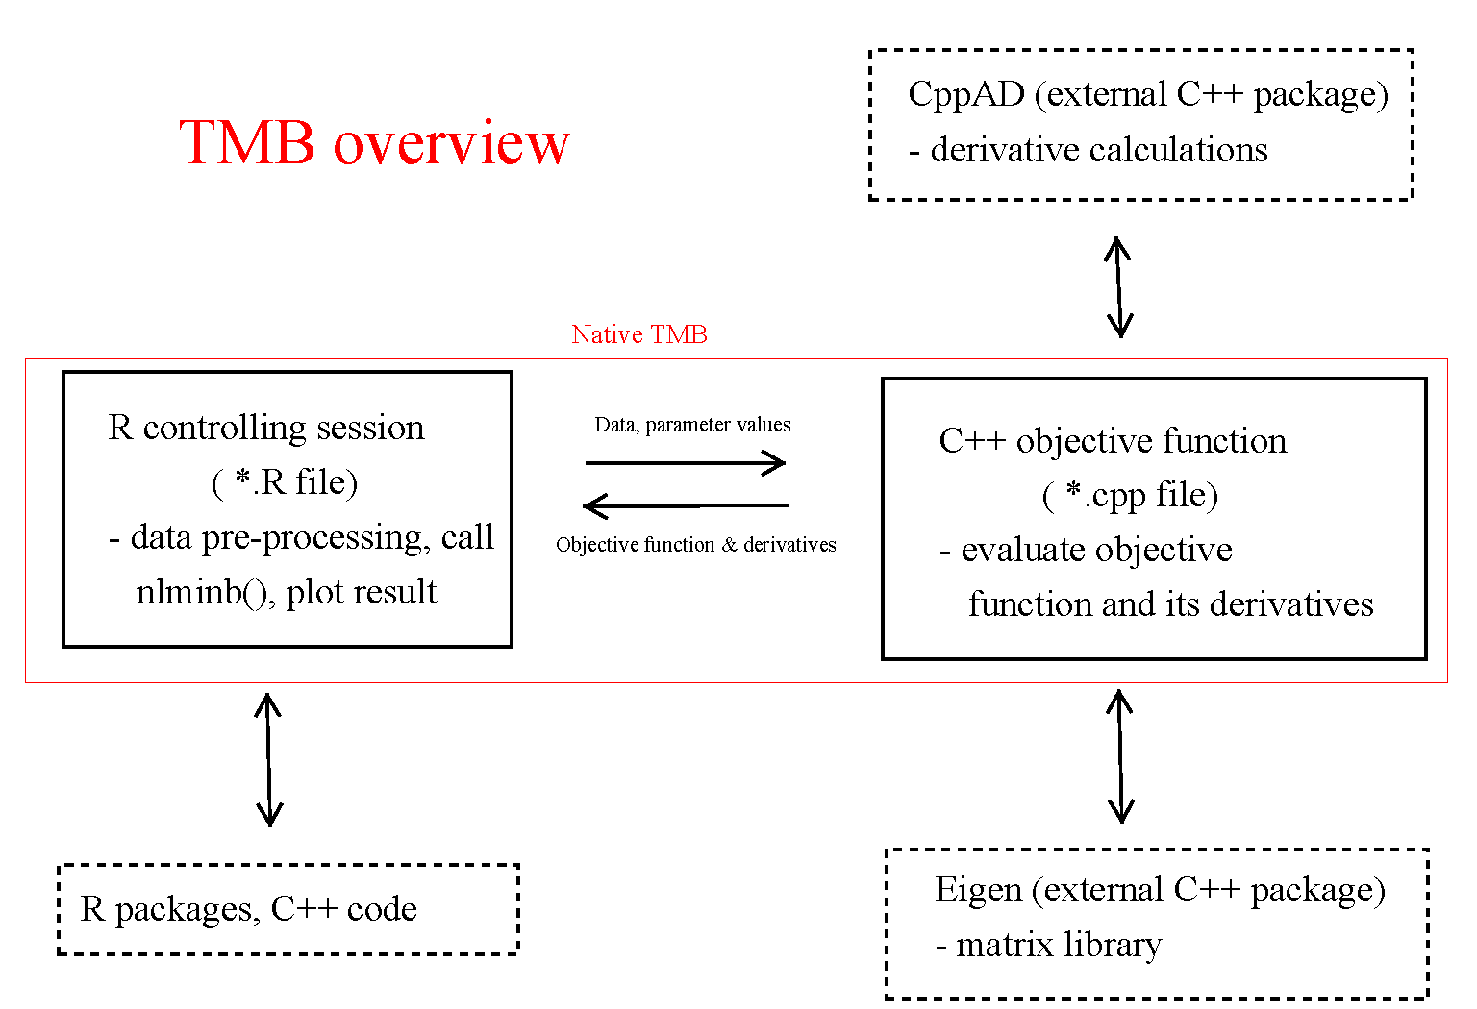
Taken from https://github.com/James-Thorson/2016_Spatio-temporal_models

Slide 4
Template sections
TMB models are written using simplified C++ code. This “template” file (.cpp) has these parts:
Import data from R
Declare parameters
Calculate:
Model expectation, given parameters
Negative log-likelihood (NLL)
Report quantities back to R
Return the NLL

Slide 5
C++ crash course
To write TMB models we have use C++
C++ is faster than R, but more strict
Unlike R, files are compiled down
C++ is very complex, we only need basics
TMB provides some shortcuts in the template to make it easier for users
Here we review the necessary basics

Slide 6
Calculations: C++ basics
C++ statements must end with a “;”
Assignment is only with “=“; “x -= 1“ is “x = x-1”
Math operators and functions are generally the same: +, /, *, >, >=, ==, &, sin, cos, log, exp
BUT “^” does not work; use pow(x,p) for x^p
“if” statements are allowed but NOT for NLL calculations (more later)
For loops are similar but indexed differently
Indexing vectors is possible but not as flexible as R

Slide 7
Review of variable types: R
“Data type” = possible value a variable can possess
R assigns them automatically (and can be changed)
x <- list(a=4L, b=2, c=rnorm(3), d='hello’,
e=factor(c('low', 'high')))
str(x)
List of 5
$ a: int 4
$ b: num 2
$ c: num [1:5] -0.0539 -2.0573 1.1056
$ d: chr "hello"
$ e: Factor w/ 2 levels "high","low": 2 1
Variable types
We do not tell R the variable type, it guesses

Slide 8
Review of variables types: TMB
As with R, C++ has vectors, matrices, arrays.
C++ is more strict: explicit type declaration and cannot be changed
For TMB we will only use two types:
Integers: int i=0;
Mostly used in loops and indexing
“Type” type: Type sigma;
Used in any numeric calculation involving NLL
Ensures the derivatives are tracked
We must declare variable type (int, Type)

Slide 9
DATA: Importing data from R
Pass data to template with these “macros”
Note: Do not specify the object dimension
TMB Syntax | C++ Type | R Type
DATA_VECTOR(x) | vector<Type> | vector
DATA_MATRIX(x) | matrix<Type> | matrix
DATA_SCALAR(x) | Type | numeric(1)
DATA_INTEGER(x) | int | integer(1)
DATA_FACTOR(x) | vector<int> | factor
DATA_ARRAY(x) | array<Type> | array
DATA_SPARSE_MATRIX(x) | Eigen::SparseMatrix<Type> | dgTMatrix
https://github.com/kaskr/adcomp/blob/master/TMB/inst/template.cpp

Slide 10
DATA: Importing data from R
Example from the big_orange model
DATA_VECTOR(y);
DATA_VECTOR(t);
DATA_INTEGER(M);
DATA_FACTOR(ngroup);
DATA_INTEGER(multiply);
TMB data inputs
These must match!!
R data list
$ y : num [1:35] 30 58 87 115 ...
$ t : num [1:35] 118 484 664 ...
$ M : num 5
$ ngroup : num [1:5] 7 7 7 7 7
$ multiply: num 1000

Slide 11
Declaring model PARAMETERs
No integer parameters allowed (WHY?)
Again, we do not specify the object dimension
TMB Syntax | C++ Type | R Type
PARAMETER_MATRIX(x) | matrix<Type> | matrix
PARAMETER_VECTOR(x) | vector<Type> | vector
PARAMETER_ARRAY(x) | array<Type> | array
PARAMETER(x) | Type | numeric(1)

Slide 12
Declaring model PARAMETERs
Example from the big_orange model
TMB parameter inputs
PARAMETER_VECTOR(beta);
PARAMETER(log_sigma);
PARAMETER(log_sigma_u);
PARAMETER_VECTOR(u);
These need to match!!
R parameter list
$ beta : num [1:3] 0 0 0
$ log_sigma : num 1
$ log_sigma_u: num 2
$ u : num [1:5000] 0 0 0 0 ...

Slide 13
Exercise: Adding a new parameter
Save copy of bevholt.cpp as bevholt2.cpp
Add a “logsigma” parameter, using exp to keep it positive
Modify the template and R parameter list
Compile, link, and refit the model
Should get these MLEs:
logA logB logsigma
1.868363 -12.054844 -1.096313

Slide 14
Working with TMB vectors
Declared as vector<Type> pred(N)
This will have length N, BUT:
pred(0) is the first element, pred(N-1)the last.
pred(N) causes a bad error…
Why? ... In R you can do this:
> pred <- 1:5
> pred[6] [1] NA
> pred[6] <- 6
> pred [1] 1 2 3 4 5 6
R extends the length of pred from 5 to 6. C++ is more strict; this is not allowed!
https://github.com/kaskr/adcomp/blob/master/tmb_syntax/matrix_arrays.cpp

Slide 15
Working with TMB vectors
DATA_VECTOR(v1); DATA_VECTOR(v2);
int v1_size = v1.size(); // Length of v1
// First 2 elements of v2:
vector<Type> a = v2.head(2);
//segment of 3 elements:
vector<Type> b = v3.segment(2,3);
Type c = v1.sum(); // sum of all cells in v1
Type d = sum(v1); // alternative summation
Type e = v1.prod(); // product of all cells in v1
vector<Type> f = v1 + v1; // elementwise addition
Type g = (v1*v1).sum(); // inner product
vector<Type> h = exp(v1); // exp of v1 (also log)
https://github.com/kaskr/adcomp/blob/master/tmb_syntax/matrix_arrays.cpp

Slide 16
Using for loops in TMB
“For” loops used often:
for(int i=0; i<N; i++){
pred(i)=logA+log(SSB(i))-log(Type(1)+B*SSB(i));
}
In R this would be:
for(i in 1:N){
pred[i]=logA+log(SSB[i])-log(1+B*SSB[i])
}
Loops are fast in TMB, but vectorize for readability
Remember: Index goes from 0 to (N-1)

Slide 17
REPORTing objects back to R
Can return objects to R via the REPORT() macro:
REPORT(pred);
Then in R:
obj$report()
This reports for the last parameter, or you can pass your own
obj$report(par)
Useful for inference and debugging
Can be vectors, matrices, etc.

Slide 18
Calculate the –log-likelihood
After making predictions, calculate likelihood using built-in functions, e.g,. dnorm
nll= -dnorm(logR,pred,sigma,true).sum();
Make sure to .sum() vectors!
Here is a link to more examples.
Make sure to return the negative!
The last C++ line should be return nll;
nll must be a scalar Type variable

Slide 19
Likelihood functions
Can also write our own functions
Put them at top of template file (but after #include statement
// inverse gamma density
template<class Type>
Type dinvgauss(Type x, Type mean, Type shape, int give_log=0){
Type logres = 0.5*log(shape) –
0.5*log(2*M_PI*pow(x,3)) –
(shape * pow(x-mean,2) / (2*pow(mean,2)*x)); if(give_log) return logres; else return exp(logres); }

Slide 20
Exercise: Vectorize bevholt model
Remove for loop in the bevholt model
Instead use vectorized calculations for the predictions
Recompile, link and build a new object
Make sure the before/after versions of model give the same fn and gr values.

Slide 21
Debugging I: Error types
Compile time errors
Fails with errors when compiling
E.g., missing ‘)’ or ‘;’ or ‘Pred’ instead of ‘pred’
Use wrong type: int instead of Type
Runtime errors
Compiles, but crashes when you MakeADFun
E.g, pass wrong data/parameters
Bad index in loop
Logical errors
Compiles, links & runs, but gives wrong answer
E.g., pass variance instead of SD to dnorm.
[Demonstrate in R with vonbert model]

Slide 22
Debugging II: Strategies
Build changes slowly, recompiling often
When compilation fails, look at first error only
For runtime errors, comment out sections to test and replace with simpler code (usually a wrong index)
Use REPORT macros to print intermediate steps in R (more later)
TMB has received an error from Eigen. The following condition was not met:
index >= 0 && index < size()
Please check your matrix-vector bounds etc., or run your program through a debugger.
This application has requested the Runtime to terminate it in an unusual way.
Please contact the application's support team for more information.

Slide 23
Recap
TMB workflow:
Template calculates NLL given pars and data
Compile it, link it, then build an obj with data
Use obj$fn and obj$gr functions to get MLEs
TMB templates:
DATA section needs to match data input list
PARAMETERs needs to match parameter input list
Calculate expected values & NLL; using Type variables
REPORT quantities of interest
Return nll;

