Slide 1
Lab 4: Catch rate standardization with zeroes

Slide 2
CPUE analysis
Used to estimate trends in relative abundance from fisheries catch data
Here we will use some data from a pollock survey in Alaska (one year only for simplicity)
Basically a regression
In this case, we have some 0 catches
This prevents taking the log (log(0)=-Inf)

Slide 3
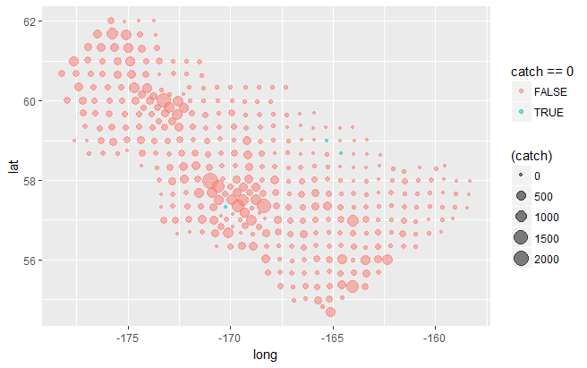
CPUE data

Slide 4
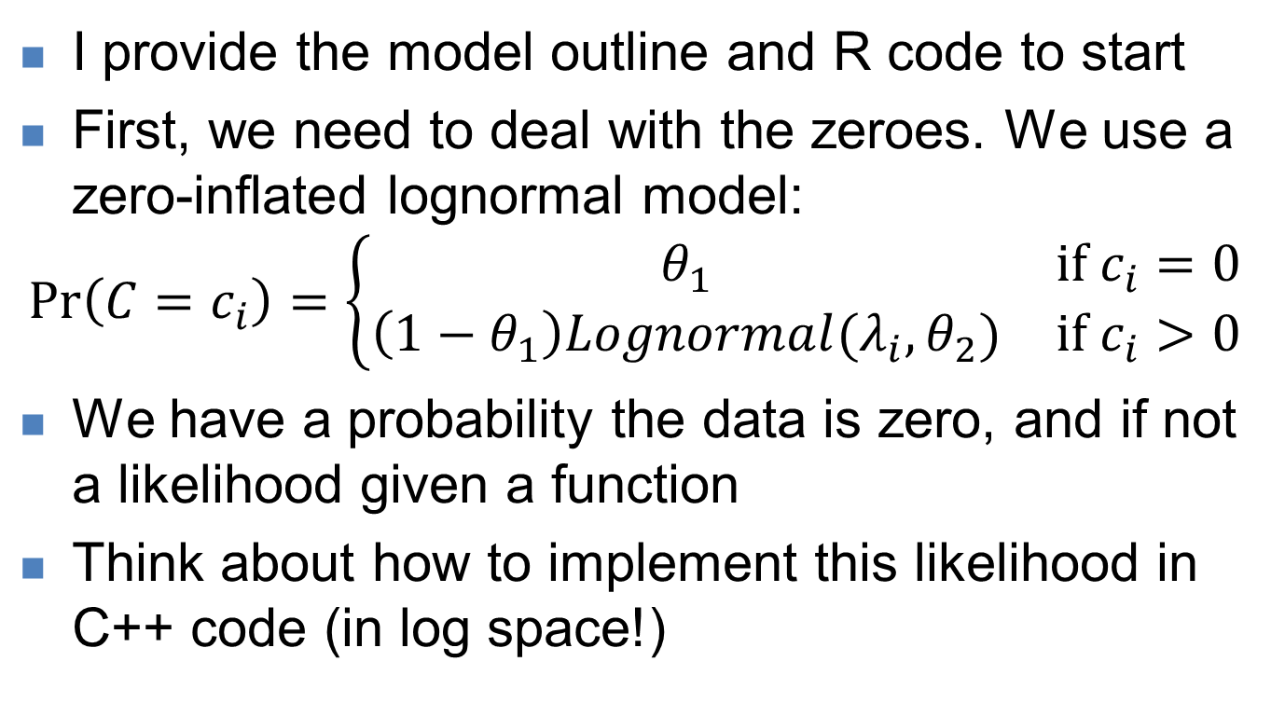
Exercise 1
I provide the model outline and R code to start
First, we need to deal with the zeroes. We use a zero-inflated lognormal model:
$$\operatorname{Pr}\left(C=c_{i}\right)=\left\{\begin{matrix}θ_{1} & if c_{i}=0 \\ \left(1−θ_{1}\right)Lognormal(λ_{i},θ_{2}) & if c_{i}>0\end{matrix}\right.$$
We have a probability the data is zero, and if not a likelihood given a function
Think about how to implement this likelihood in C++ code (in log space!)

Slide 5
Exercise 1
Add the likelihood calculations to the template based on this formulation and the function on the following slide.
Make sure model runs and calculate AIC
(Hint: use the zero_prob variable for the zero catches)
(Hint: Don’t forget the positive catch contribution when C>0)

Slide 6
//log-normal likelihood
template<class Type>
Type dlognorm(Type x, Type meanlog, Type sdlog, int give_log=0){
//return 1/(sqrt(2*M_PI)*sd)*exp(-.5*pow((x-mean)/sd,2));
Type logres = dnorm( log(x), meanlog, sdlog, true) - log(x);
if(give_log) return logres; else return exp(logres);
}
// Inverse Gaussian
template<class Type>
Type dinvgauss(Type x, Type mean, Type shape, int give_log=0){
Type logres = 0.5*log(shape) - 0.5*log(2*M_PI*pow(x,3)) - (shape * pow(x-mean,2) / (2*pow(mean,2)*x));
if(give_log) return logres; else return exp(logres);
}

Slide 7
Exercise 2
Add the second likelihood function (dinvgauss) as an option.
Add an input data variable “likelihood” to toggle the likelihood used
Call it like this: dinvgauss(y(i), exp(pred(i)), sigma, true)
Rerun and compare AIC for both likelihoods
Which is better?
Plot residuals vs lat/long [(pred-log(y))/sigma]

Slide 8
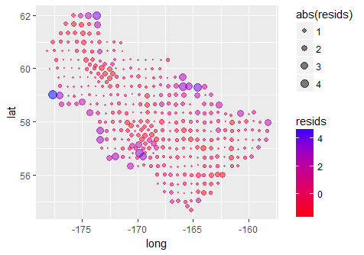
Not so good: clear spatial autocorrelation. We’ll fix that tomorrow!

Slide 9
Assessing fit with cross validation
One way to assess fit is “K-fold cross validation”
Divide data set into K even partitions
Calculate predictive probability for 1st partition
For each piece K, fit the model to all data except data in that partition
Calculate and save the predictive probability of data in partition K using this model
Repeat step 2 for all K partitions
Chose the model with the highest predictive probability (i.e., lowest mean NLL)

Slide 10
Cross validation in TMB
We pass a vector of 0’s and 1’s which tells the model whether to include data point I in the NLL calculation
Thus we calculate two NLL’s: within sample and without sample:
if( out_sample(i)==0 ) jnll += jnlltemp;
if( out_sample(i)==1 ) pred_jnll += jnlltemp;
Here pred_jnll is for the data the model doesn’t “see”

Slide 11
Exercise: CV in TMB
We repeat with all partitions of data left out
Then compare, on average, how well different model structures fit “out of sample” data.
Add this functionality to the template
Run K=10 fold cross validation on models with and without the lat/lon predictors
Compare which is lower (i.e., fits better)

Slide 12
Recap
We explored use of if() statements
Create more complex likelihood expressions (i.e., zero-inflated)
Allow toggling of different likelihood “options” without recompiling the model
Specify whether to include data point in NLL
Used cross validation to test the impact of lat/lon on prediction of out of sample data.
Thus without recompiling the model we can: change likelihood, do CV, turn off model parameters (via map)
These tools allow great flexibility in building complex models

