Slide 1
Bayesian inference in TMB
Fitting hierarchical models with TMB
15-19 January, 2018
University of Concepción, Chile
Dr. Cole Monnahan

Slide 2
Additive models (GAMS) with TMB
TMB includes functionality to fit splines
This is an “additive” model, which can be generalized to GAM.
Can also use random walk on parameters (as a hierarchical structure) to accomplish similar thing
See example: www.nielsensweb.org/bergen/spline.pdf

Slide 3
Bayesian inference
Bayesian inference is an alternative paradigm for statistical inference,
Outputs (e.g., uncertainty) are quantified with probability distributions
Typically uses Markov chain Monte Carlo (MCMC)
BUGS/JAGS are the most common, and particularly popular for hierarchical models.
All parameters are integrated, not just random effects

Slide 4
Bayesian inference
Maximum likelihood uses only the MLE for inference (i.e., a single point)
Bayesian inference comes from a “posterior” probability distribution
Outputs are quantified with probability statements
We generate samples from the posterior, and use those to approximate probabilities
Bayesian inference is a whole separate class

Slide 5
Bayesian inference with TMB
Today, Stan is state of the art software for Bayesian inference (Stan Development Team 2018; Carpenter et al. 2017, Monnahan et al. 2017)
It utilizes Hamiltonian Monte Carlo, a type of MCMC which requires accurate and fast gradients (Neal 2011; Hoffman and Gelman 2014)
TMB does this!
R package ‘tmbstan’ provides interface into the Stan software program

Slide 6
Bayesian inference for swallows
We demonstrate tmbstan on the swallows model from lecture 4 (hierarchical mark-recapture model)
To convert a maximum likelihood model to a Bayesian model:
Specify parameter priors
(Add Jacobian adjustments if needed)
Then, we simply run it like this:
fit <- tmbstan(obj, chains=1)
This uses Stan defaults, but we can change these
Monnahan and Kristensen (In review)

Slide 7

Stan output
We can use any of Stan’s tools to assess convergence, make inference, etc.
Especially the interactive tool ShinyStan:

Slide 8
Using tmbstan to test the LA
Remember the Laplace Approximation is an approximation
tmbstan provides a method to test the validity of this approximation
How? We run MCMC with Stan with the LA turned on, and with it turned off
That is, with parameters declared random or not
fit1 <- tmbstan(obj, laplace=FALSE)
fit2 <- tmbstan(obj, laplace=TRUE)

Slide 9
Using tmbstan to test the LA
For fit2, the LA is done at each step of the MCMC – Stan does not know this!
We are integrating the random effects in two ways: with MCMC (fit1) or with the LA (fit2)
(fit2 takes longer to run)
But we can compare distributions of the fixed effects and see if there are differences

Slide 10
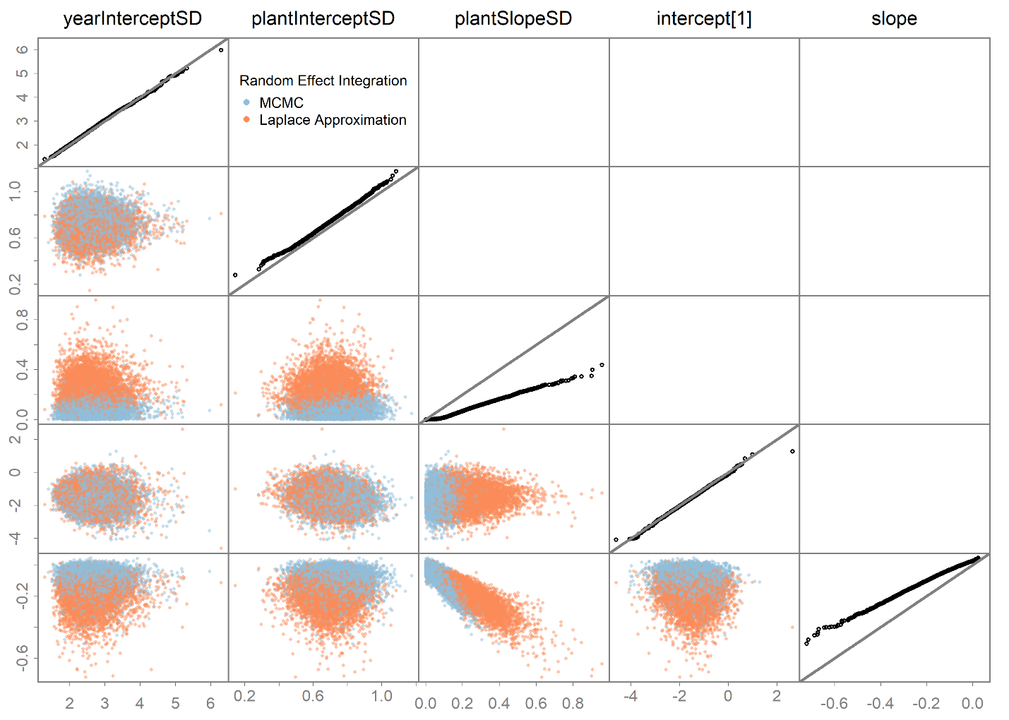

Slide 11
Using tmbstan to test the LA
We see clear differences in some fixed effects
Suggests the LA assumptions are not met, and we likely have biased inference
Whether this is meaningful to the analysis depends on the goals
BUT, this provides a unique opportunity to check our model assumptions (good thing)

Slide 12
Bayesian inference with TMB
What you need to know:
TMB has powerful Bayesian capabilities via Stan and its tool set (e.g., ShinyStan)
We have to adapt our template to include priors
We can toggle the LA on/off, and use this to test accuracies of the LA
Pure Bayesian analyses are also possible
Tend to take much longer to run than MLE
Learn more in Monnahan and Kristensen (in review)

Slide 13
Class review: hierarchical models
Hierarchical models occur naturally for many ecological processes
It is also a natural way to analyze the data
Includes many important model types, from GLMM, spatiotemporal, to fisheries stock assessments
Can be conceptually difficult: keep learning!
HM are difficult to fit (estimate), because complex integration is necessary

Slide 14
Class review: TMB workflow
TMB is an environment for fitting statistical models
We build a template C++ file, pass it data and parameters and it returns:
The –log-likelihood
Gradient vector, using automatic differentiation
We can integrate random effects easily, and maximize the marginal likelihood
It is more flexible, and more powerful than other software programs (R packages)
Has state-of-the-art MLE and Bayesian capabilities

Slide 15
Class review: TMB downsides
Harder to use:
We must write C++ code instead of a formula in R
Need to recreate R code, e.g., calculating Pearson residuals or AIC (done automatically in packages)
Must compile for model changes
Other packages, like lme4 are likely preferable for simpler regressions
If you have a GLMM, start there and built up to TMB when necessary
Try to match glmer or glmmTMB to TMB models where possible

Slide 16
Class review: TMB advantages
In my opinion, the most powerful and flexible statistical tool available
Nothing else does maximum marginal likelihood and Bayesian inference at such a high level
If you can write the likelihood, TMB can probably fit it
Use the same package for all models (e.g., not switching from INLA to lme4 to Stan)
Particularly useful for spatiotemporal models, and fisheries stock assessments

Slide 17
Class review: results
I hope you are comfortable up through GLMMS:
What TMB is/does & general workflow
How to fit hierarchical models
How to work with output (MLEs & REPORTs)
I don’t expect you understand more complex models (spatial models, stock assessments, etc.)
BUT, you should be aware of them and that this is where TMB outperforms other options
It may take a year (or more) to build a TMB model!

Slide 18
Class review: next steps
If you want to use TMB for an analysis:
Start with a simple model fitted to your data
Slowly add components + recompile often
Use simulated data to verify it’s working right
Look to existing models for C++ ideas and tricks (e.g., SAM, LIME, VAST)
TMB users group: (google group)
Evolving github wiki
Jim Thorson’s Spatiotemporal course

Slide 19
Thanks for participating!
Thanks to Jim Thorson for sharing TMB and spatiotemporal materials (used here)
US Department of State for postdoc funding
Billy and UdeC staff for putting on the workshop
Kasper for developing TMB!

Slide 20
References
Carpenter, B., Gelman, A., Hoffman, M. D., Lee, D., Goodrich, B., Betancourt, M., . . . Riddell, A. (2017). Stan: A Probabilistic Programming Language. Journal of Statistical Software, 76(1), 1-29. doi: 10.18637/jss.v076.i01
Stan Development Team. (2017). shinystan: Interactive visual and numerical diagnostics and posterior analysis for Bayesian models. (Version R package version 2.3.0). Retrieved from http://mc-stan.org/
Monnahan, C. C., Thorson, J. T., & Branch, T. A. (2017). Faster estimation of Bayesian models in ecology using Hamiltonian Monte Carlo. Methods in Ecology and Evolution, 8(3), 339-348. doi: 10.1111/2041-210X.12681
Monnahan, C.C and Kristensen K., No-U-turn sampling for fast Bayesian inference in ADMB and TMB: Introducing the adnuts and tmbstan R packages (in review).
tmbstan: https://github.com/kaskr/tmbstan (available on CRAN too)

