Slide 1


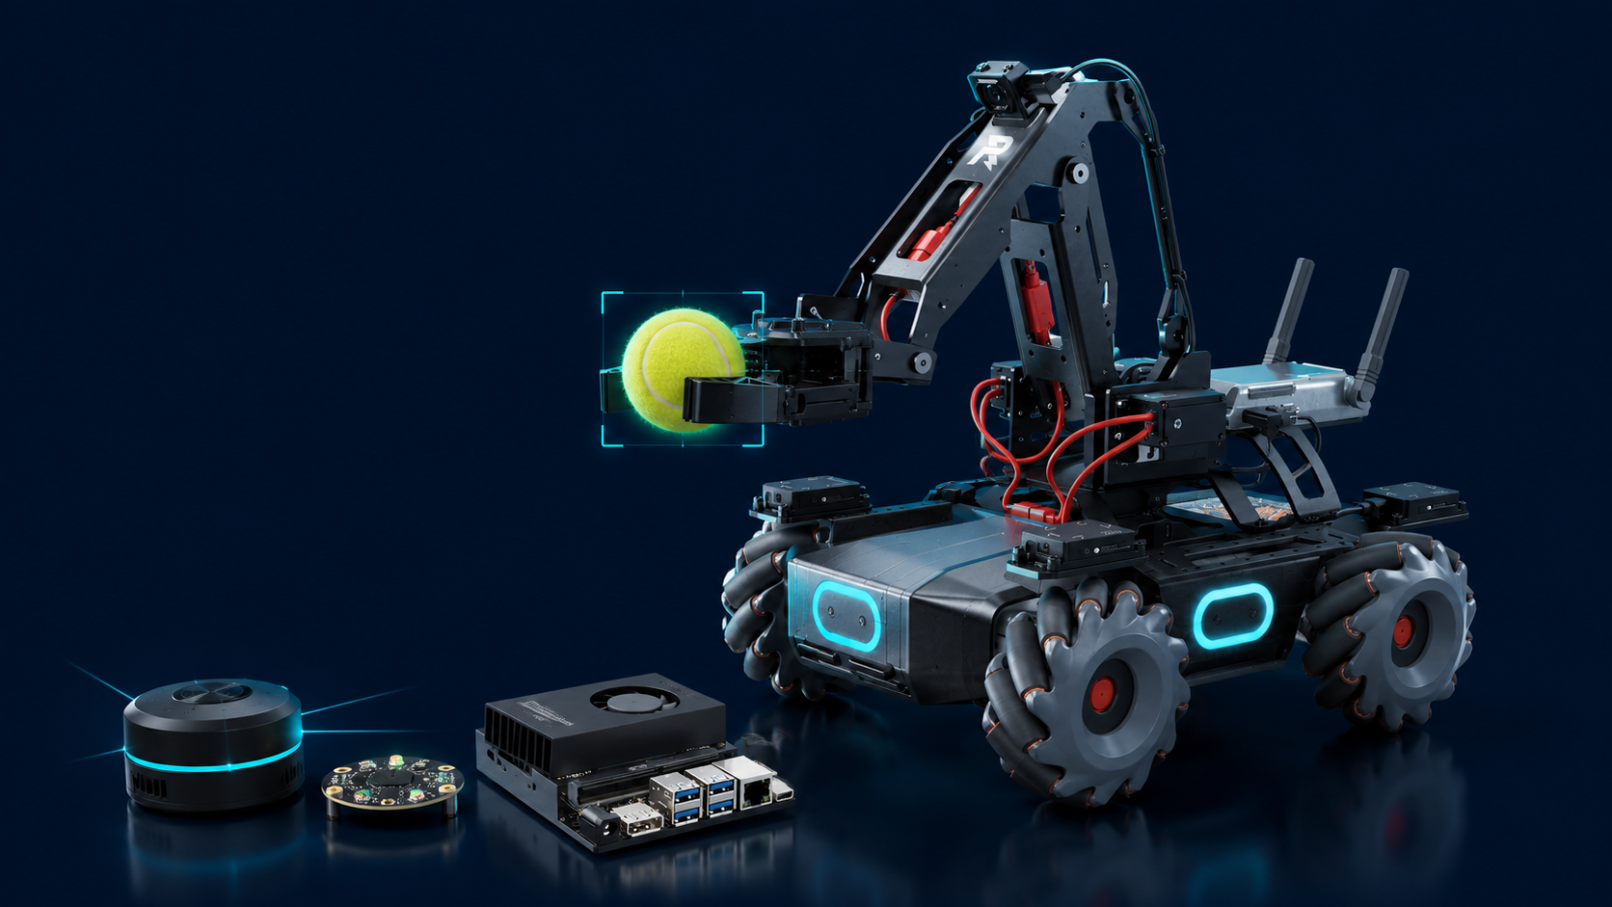
ACADEMIC PRESENTATION · GROUP 17
AUTONOMOUS MOBILE MANIPULATION
Tennis-Bot
Vision-Guided Pick-and-Place on a Mobile Robot
A ROS 2 system integrating YOLOv5 detection, Nav2 autonomous navigation, SLAM mapping and Vosk voice control — built on the DJI RoboMaster EP and Jetson Orin NX.
GROUP 17
Presenters: Yanshan Wang, Wentian Li
Team Members: Yanshan Wang, Wenxin Xiao, Wentian Li, Guanhong Chen
Robotics & Embedded Systems Project
2026/5/27
ROS 2
YOLOv5
NAV2
VOSK
SLAM

Slide 2

00
OVERVIEW
Presentation Agenda
01
Introduction
Project goal, motivation and target scenario on the tennis field.
PROJECT AT A GLANCE
02
Software & Hardware Stack
5
End-to-end system: vision, navigation, voice and embedded compute.
State machine stages
03
Code & Algorithm Flow
From static SLAM map to the SEARCHING → HOMING state machine.
4
04
User Interface
Sensor modalities fused
Interaction design for operators and end users.
100%
05
Project Highlights
Highlighting the key innovative and distinctive features of our project design.
Autonomous on-court ops
06
Project Team & Responsibilities
ROS 2
Clarifying the specific roles and contributions of each team member.
AGENDA
Middleware foundation
GROUP 17 · TENNIS-BOT
02 / 21

Slide 3
01
INTRODUCTION
Project Overview & Objective
WHAT WE BUILT
Tennis-Bot is an autonomous mobile manipulator that collects scattered tennis balls on a court and deposits them into a designated bin — without any human intervention.
01
02
03
PERCEIVE
NAVIGATE
MANIPULATE
Detect tennis balls in real time using a YOLOv5 detector running on the Jetson Orin NX.
Use SLAM-built map + Nav2 stack for autonomous obstacle avoidance and goal-directed motion.
Drive a vision-servo loop on the DJI EP arm to grasp the ball and release it at the bin.
DJI RoboMaster EP + manipulator
GOAL Zero-touch ball collection on the court.
INTRODUCTION
GROUP 17 · TENNIS-BOT
03 / 21

Slide 4
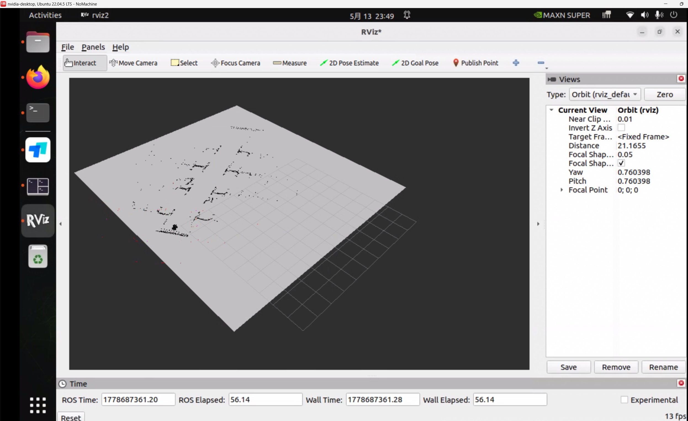
01
FIELD DEMONSTRATION
Project Overview & Objective - Autonomous Pick-and-Place Demonstration
Putting it all together — the robot autonomously scans the field, localizes against the SLAM map, and runs the full state machine end to end.
RViz2 — live AMCL particle cloud over the saved tennis_field map
Final Run · Live Demo
Full court Coverage area mapped
Auto Obstacle avoidance via Nav2
Vision-servo Grasp accuracy
Loop Repeats until court is empty
FIELD DEMO
GROUP 17 · TENNIS-BOT
04 / 21

Slide 5
02
SOFTWARE & HARDWARE
System Architecture
PERCEPTION LAYER
CAM
USB Camera
LDR
YDLidar X3
ToF
ToF Sensor
MIC
ReSpeaker 4-Mic
RGB · 640×360 @ 30 fps
2D Lidar · 360° SLAM scan
IR distance · grab trigger
UAC1.0 · voice command
COMPUTE & SOFTWARE LAYER
GPU
Jetson Orin NX
ROS
ROS 2 Humble
AI
YOLOv5 + Vosk
NAV
Nav2 + SLAM Toolbox
ARM64 · CUDA acceleration
DDS · MultiThreadedExecutor
Detector · Chinese ASR
Planning · costmap · AMCL
ACTUATION LAYER
DRV
Mecanum Chassis
ARM
Robotic Arm
GRP
Gripper
UI
Status Overlay
/cmd_vel · holonomic drive
MoveArm action · 2-DOF
GripperControl action
OpenCV HUD on camera feed
DATA FLOW
Sensor input
Perception & decision
Actuator commands
ARCHITECTURE
GROUP 17 · TENNIS-BOT
05 / 21

Slide 6
02
SOFTWARE & HARDWARE
Hardware Bill of Materials
Compact, ROS 2-native hardware stack — every component contributes a distinct sensing or actuation modality.
EDGE COMPUTE
MOBILE PLATFORM
2D LIDAR
Jetson Orin NX
DJI RoboMaster EP
YDLidar X3
ARM64 SoC with CUDA — runs YOLOv5, ROS 2 nodes, Nav2 and Vosk locally.
Mecanum-wheel chassis with built-in arm & gripper, accessed via robomaster_ros.
360° single-line scanner used by slam_toolbox for mapping and AMCL localization.
100 TOPS class
Holonomic drive
8 m range
VISION SENSOR
PROXIMITY
VOICE INPUT
USB RGB Camera
ToF IR Sensor
ReSpeaker 4-Mic
Streams 640×360 frames via ROS 2 Image topic into YOLOv5 inference.
Triggers the GRABBING transition once a ball is within ~13 cm of the gripper.
USB Audio Class 1.0 microphone array feeding Vosk Chinese ASR.
30 fps
TRIGGER 0.13 m
16 kHz mono
HARDWARE
GROUP 17 · TENNIS-BOT
06 / 21

Slide 7
02
SOFTWARE & HARDWARE
Software Stack
LAYER
TECHNOLOGY
ROLE IN THE SYSTEM
tennis_pick_nav2.py — imports
Perception
YOLOv5 (PyTorch)
Real-time tennis ball detection on Jetson GPU
# ROS 2 core
import rclpy
from rclpy.node import Node
from rclpy.action import ActionClient
# Vision and sensor msgs
import cv2, torch, numpy as np
from sensor_msgs.msg import Image, Range
from cv_bridge import CvBridge
# Nav2 and RoboMaster actions
from nav2_msgs.action import NavigateToPose
from robomaster_msgs.action import \
MoveArm, GripperControl, Move
# Detector and voice (subprocess)
from models.common import DetectMultiBackend
import multiprocessing as mp # Vosk
Vision Bridge
OpenCV + cv_bridge
Frame I/O, HUD overlay, debug visualization
Localization
SLAM Toolbox + AMCL
Build and localize against tennis_field.pgm
Navigation
Nav2 NavigateToPose
A* global planner + DWB local controller
Sensor Fusion
robot_localization
EKF fuses wheel odometry + IMU → /odom
Voice I/O
Vosk (small-cn-0.22)
Chinese keyword ASR — pause / resume
TF Tree
tf2_ros
Static base_link → laser_frame transform
Robot Driver
robomaster_ros
Chassis · arm · gripper · ToF action APIs
SOFTWARE STACK
GROUP 17 · TENNIS-BOT
07 / 21

Slide 8
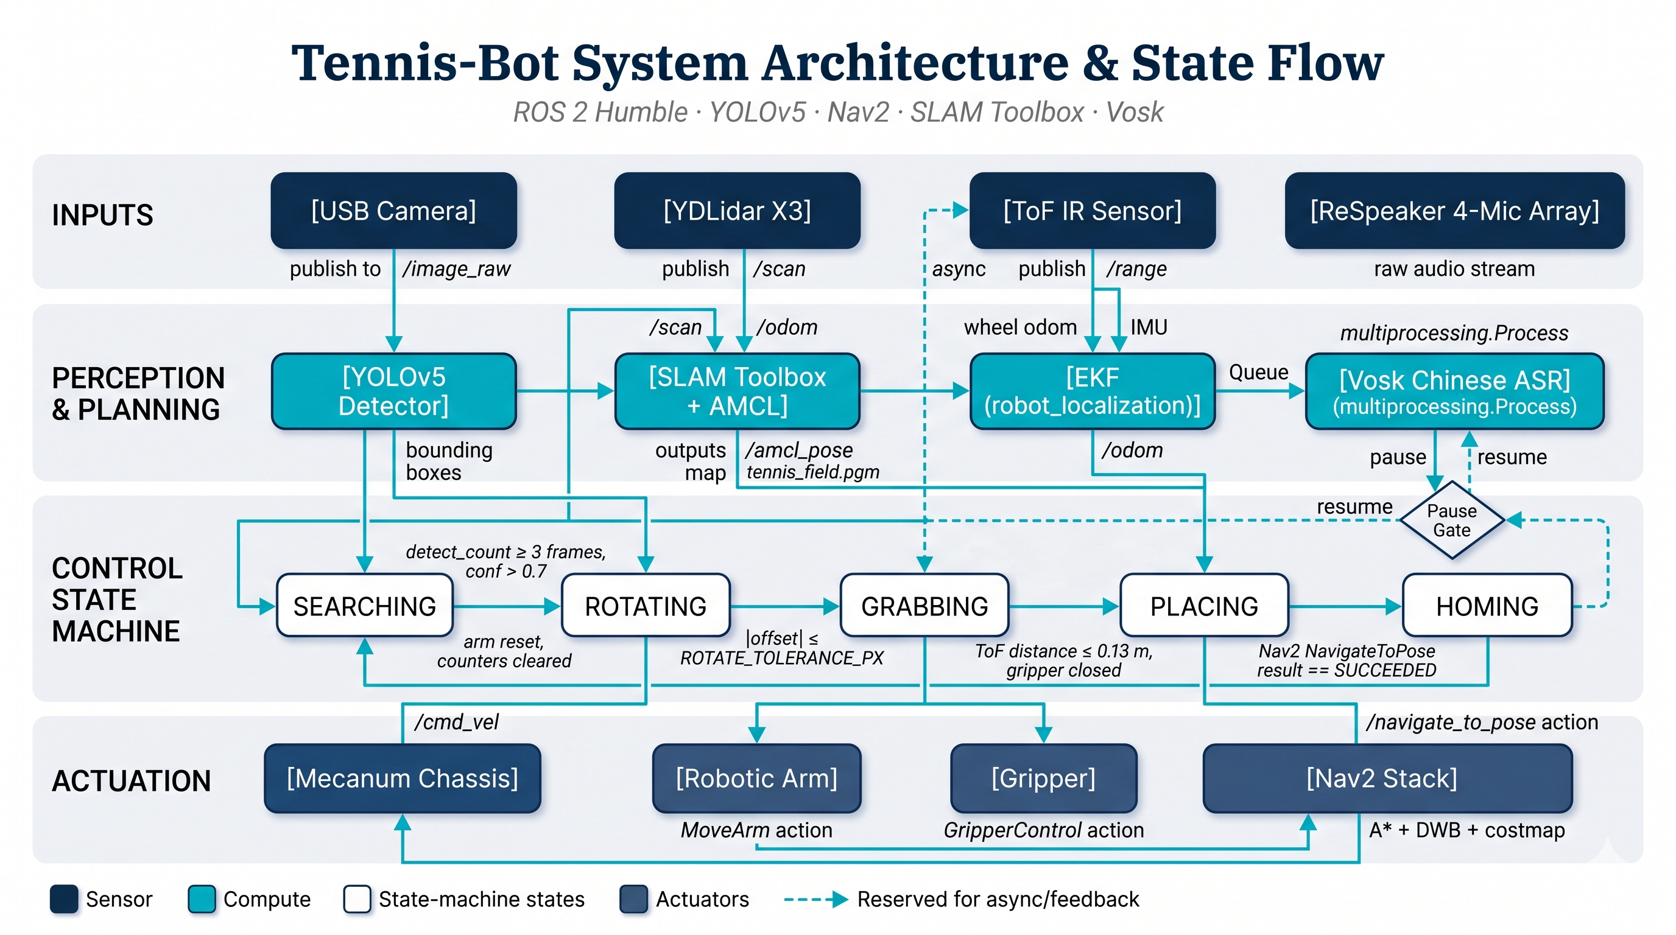
03
Architecture & State FLOW
STRUCTURE OVERVIEW
GROUP 17 · TENNIS-BOT
08 / 21

Slide 9
03
CODE FLOW
PIPELINE
Static Map
Bring-up
Nav2 Stack
Vision Loop
State Machine
Actuation
tennis_field.pgm
Lidar · EP · TF · EKF
AMCL + planner + DWB
YOLOv5 @ 30 fps
5-state controller
/cmd_vel + arm + grip
CONTROL STATE MACHINE
STATE 01
STATE 02
STATE 03
STATE 04
STATE 05
SEARCHING
ROTATING
GRABBING
PLACING
HOMING
scan for balls
align heading
approach + close
Nav2 to bin · drop
reset arm + gripper
loop back when HOMING completes
ASYNC INPUTS Vosk subprocess → pause/resume queue · ToF Range topic → grab trigger · AMCL pose → planner feedback
PIPELINE OVERVIEW
GROUP 17 · TENNIS-BOT
09 / 21

Slide 10
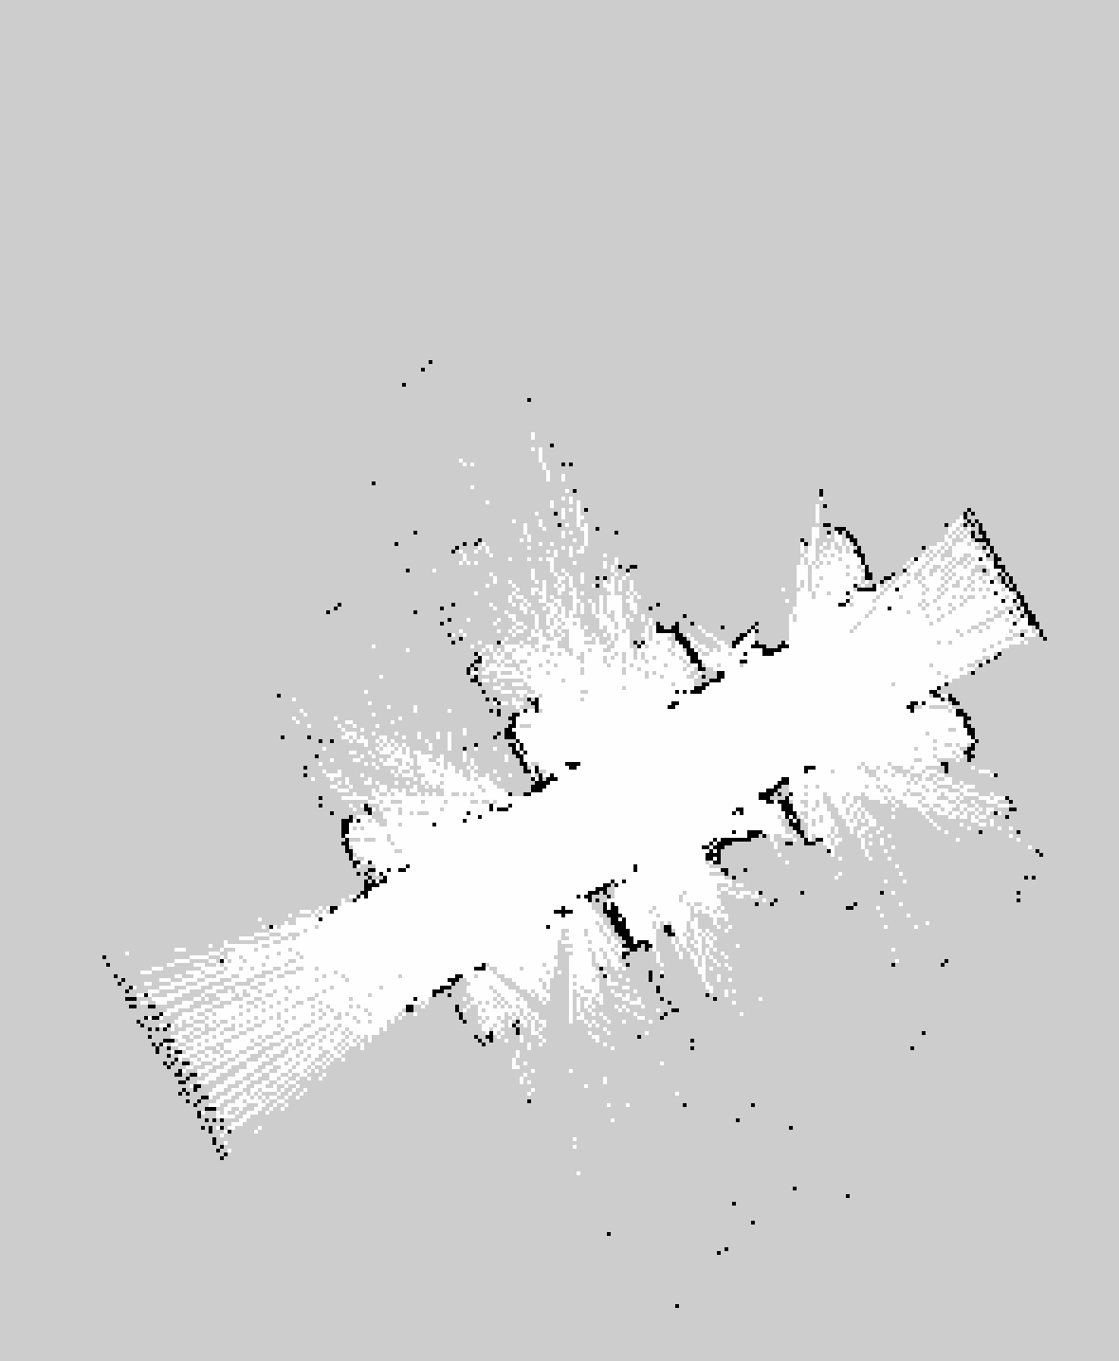
03
CODE FLOW · 01
Step 1 — Building the Static Map
OFFLINE PHASE
Capture the court with SLAM Toolbox
Before any autonomous run we tele-operate the robot once around the tennis court. YDLidar X3 scans, slam_toolbox accumulates an occupancy grid in RViz, and nav2_map_server snapshots the result to tennis_field.pgm + .yaml — the ground truth that Nav2 will localize against later.
LAUNCH SEQUENCE
1
ydlidar_ros2_driver
2
robomaster_ros (EP)
3
static TF base_link→laser
4
EKF (robot_localization)
5
slam_toolbox async
6
RViz2 visualization
7
nav2_map_server save
tennis_field.pgm — saved occupancy grid
white = free · black = obstacle · gray = unknown
MAP BUILDING
GROUP 17 · TENNIS-BOT
10 / 21

Slide 11
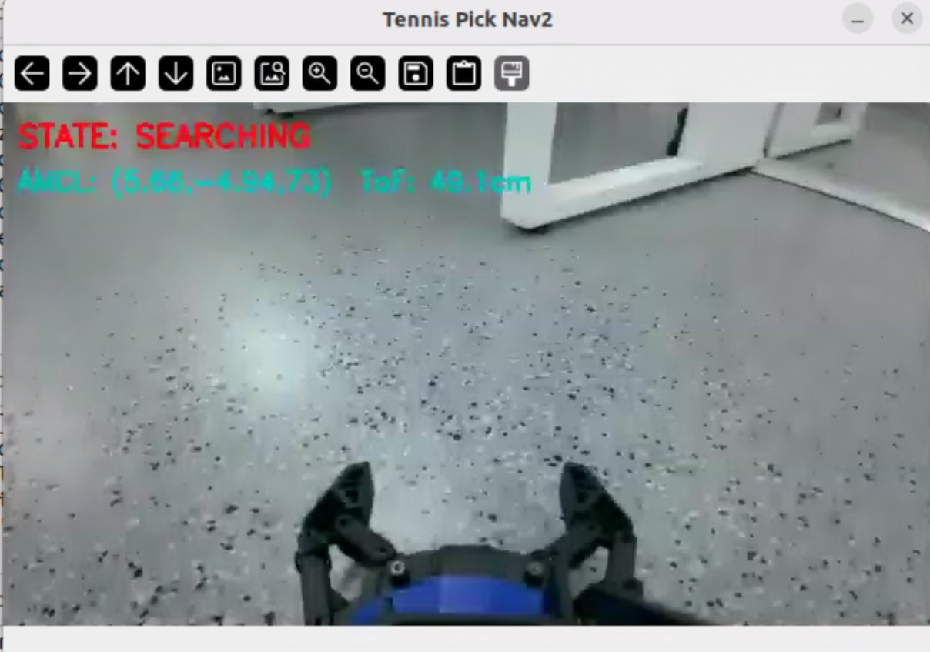
03
CODE FLOW · 02
State 1 — SEARCHING
INTENT
Drive YOLOv5 inference on every frame. When a tennis ball is confidently detected for several consecutive frames, lock onto the nearest one and hand off to ROTATING.
def run_searching(self):
def run_searching(self):
frame, detections = self._get_frame_and_detections()
high = [d for d in detections
if d['class_name'] == 'tennis'
and d['confidence'] > 0.7]
if high:
self.detect_count += 1
if self.detect_count >= DETECT_CONFIRM_FRAMES:
self.target_bbox = \
self._select_nearest_ball(high)['bbox']
return 'ROTATING' # transition
else:
self.lost_count += 1
if self.lost_count >= LOST_TRIGGER_FRAMES:
self._small_angle_search() # rotate
return 'SEARCHING'
Live HUD: STATE: SEARCHING — no detection above 0.7 confidence yet
DETECT_CONFIRM
3 frames
LOST_TRIGGER
5 frames
CONFIDENCE
> 0.7
STATE: SEARCHING
GROUP 17 · TENNIS-BOT
11 / 21

Slide 12
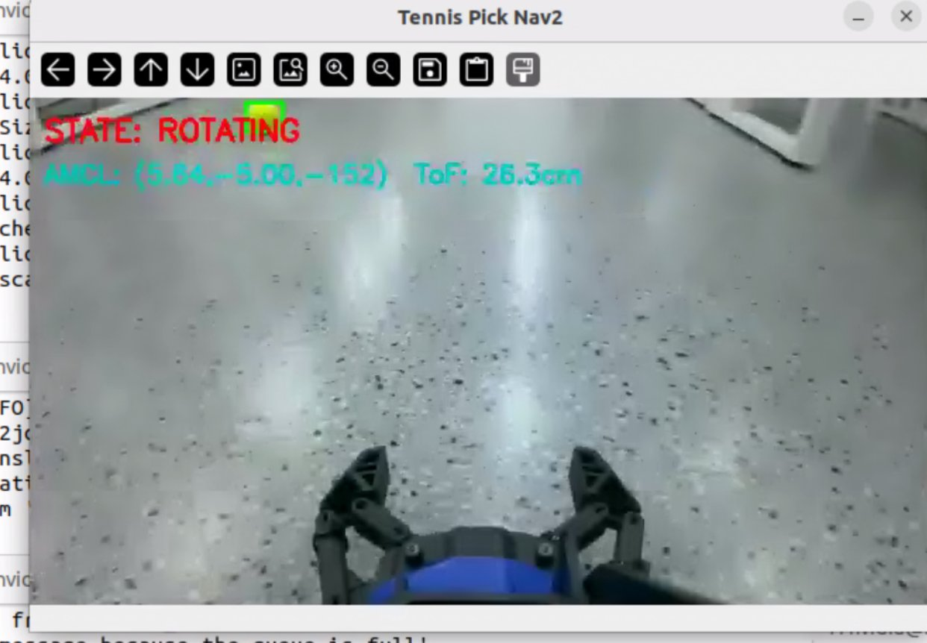
03
CODE FLOW · 03
State 2 — ROTATING
INTENT
Close a vision feedback loop: keep yawing the holonomic base until the ball's bounding-box center sits within ROTATE_TOLERANCE_PX of the image center.
run_rotating() — vision-servo align
for cnt in range(max_retry):
frame, detections = self._wait_fresh_frame(...)
nearest = self._select_nearest_ball(high)
x1, _, x2, _ = nearest['bbox']
offset = (x1 + x2)/2 - IMG_CENTER_X
if abs(offset) <= ROTATE_TOLERANCE_PX:
return 'GRABBING' # aligned
# adaptive damping to suppress oscillation
if last_offset is not None and \
last_offset * offset < 0:
damping *= 0.6
angle = (offset/(IMG_W/2)) * 50 * damping
self.chassis_move(0, 0, -angle, ...)
Live HUD: STATE: ROTATING — chassis yawing until ball is image-centered
Proportional control
angle ∝ offset · 50° · damping
Oscillation guard
damping ×= 0.6 on sign flip
Timestamp gate
Only frames newer than last rotate
STATE: ROTATING
GROUP 17 · TENNIS-BOT
12 / 21

Slide 13
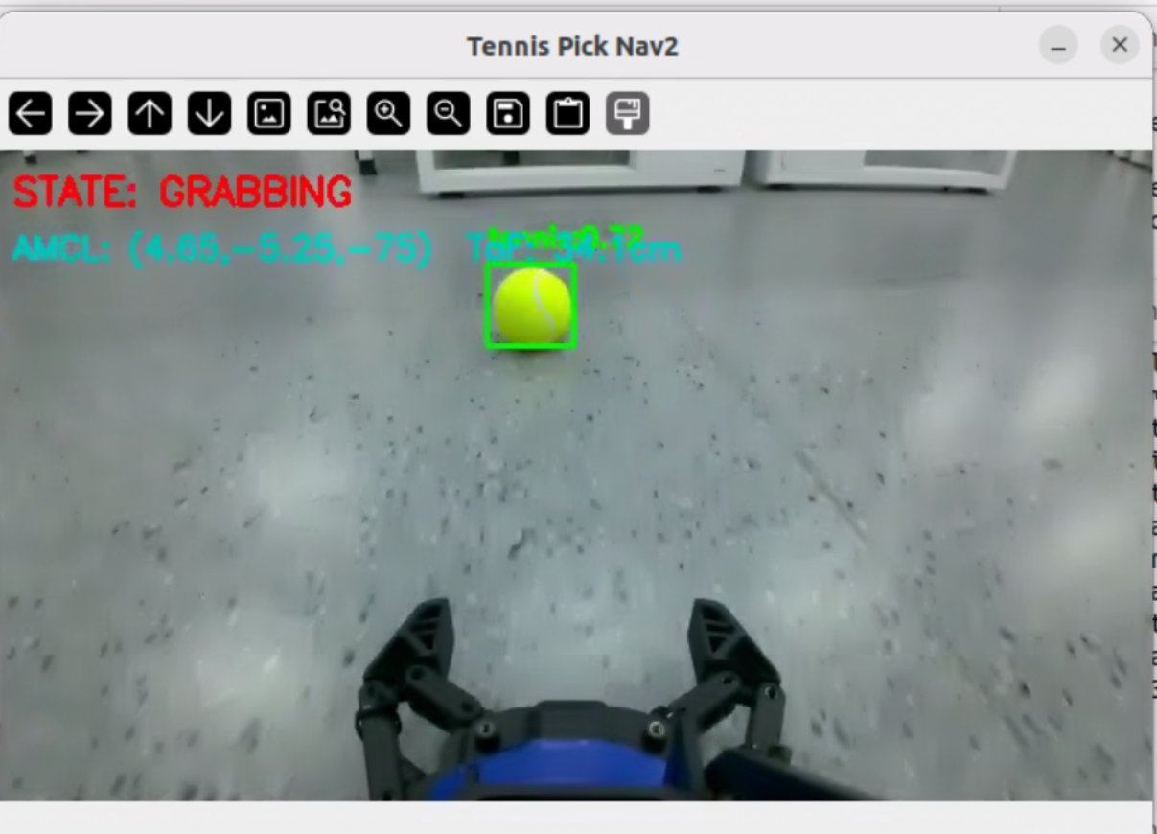
03
CODE FLOW · 04
State 3 — GRABBING
INTENT
Open the gripper, drive forward while keeping the ball centered, and trip the grasp when ToF returns < TOF_TRIGGER_M. Close the gripper, then lift the arm for transport.
run_grabbing() — visual servo + ToF trigger
self.gripper_set(target='open', power=0.8)
twist = Twist()
while time.time() - start < 10:
# 1) ToF triggers the grasp
if self.latest_tof_m <= TOF_TRIGGER_M:
arrived = True; break
# 2) visual centering correction
offset = self._current_ball_offset()
twist.linear.x = CHASSIS_LINEAR_SPEED
twist.angular.z = -k * offset
self.cmd_vel_pub.publish(twist)
self.gripper_set(target='close', power=0.8)
self.arm_move(ARM_GRAB_LIFT_X, ARM_GRAB_LIFT_Z)
return 'PLACING'
Tennis ball framed by YOLOv5 — ToF closing in on trigger threshold
ToF Trigger
≤ 0.13 m
Linear Speed
0.30 m/s
Outcome
→ PLACING
STATE: GRABBING
GROUP 17 · TENNIS-BOT
13 / 21

Slide 14
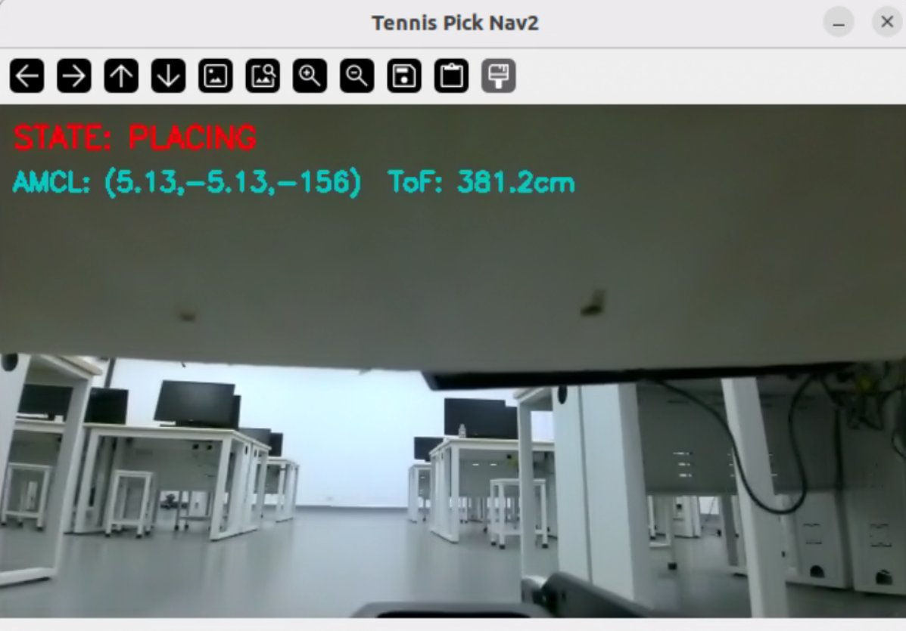
03
CODE FLOW · 05
State 4 — PLACING (Nav2 Autonomous Drive)
INTENT
Replaced the old open-loop trajectory with a Nav2 NavigateToPose call. Nav2 plans globally, dodges obstacles locally, AMCL refines the pose on arrival — release the ball, then reverse and rotate home.
run_placing() — Nav2 autonomous transit
def run_placing(self):
bx, by, byaw = self.box_pose
# delegate the full transit to Nav2
ok = self.navigate_to_pose_nav2(bx, by, byaw)
if not ok:
self.gripper_set(target='open', power=0.8)
return 'HOMING'
# arrived -> drop the ball
self.gripper_set(target='open', power=0.8)
self.chassis_move(-0.5, 0, 0, linear_speed=0.3)
self.chassis_move(0, 0, 180, angular_speed_deg=60)
return 'HOMING'
Robot autonomously navigating to the drop bin under Nav2
Action client
/navigate_to_pose
Global plan
A* / Dijkstra
Local plan
DWB + costmap
STATE: PLACING
GROUP 17 · TENNIS-BOT
14 / 21

Slide 15
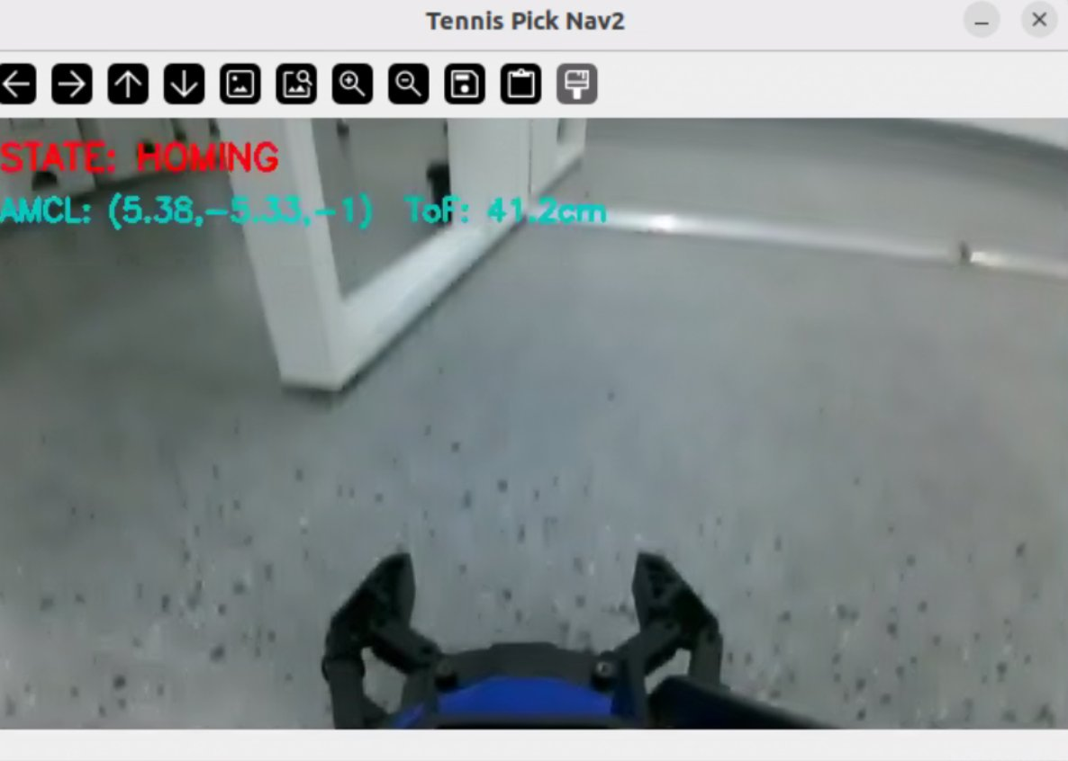
03
CODE FLOW · 06
State 5 — HOMING & Loop Back
INTENT
Reset the manipulator to its rest pose, re-open the gripper and clear the detection counters. Once HOMING completes, the state machine flows back to SEARCHING and the next ball is hunted.
run_homing() — reset and loop
def run_homing(self):
self.get_logger().info('>>> HOMING')
# bring the arm back to rest
self.arm_home()
self.gripper_set(target='open', power=0.8)
# clear vision counters for the next cycle
self.detect_count = 0
self.lost_count = 0
self.get_logger().info('>>> HOMING: done')
return 'SEARCHING' # loop
After release: arm retracts to ARM_HOME pose, gripper opens
CONTINUOUS OPERATION
HOMING → SEARCHING — the loop repeats until every ball on the court has been collected.
STATE: HOMING
GROUP 17 · TENNIS-BOT
15 / 21

Slide 16
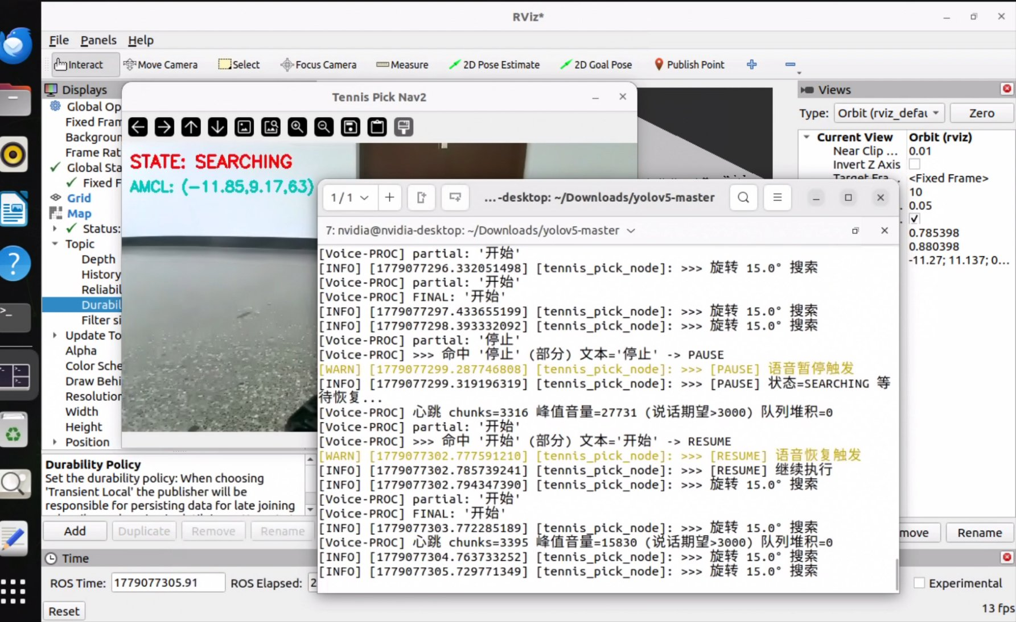
03
CODE FLOW · 07
Continuous Voice Monitoring — Async Safety Layer
INTENT
A voice-controlled override that runs in parallel with all 5 states. Vosk Chinese ASR listens continuously through the ReSpeaker array; the keyword 停止 (pause) instantly halts motion and cancels any active Nav2 goal, while 开始 (resume) releases the state machine to continue.
PROCESS ARCHITECTURE
VOICE WORKER PROCESS
MAIN ROS 2 NODE
ReSpeaker 4-Mic
→ sounddevice (float32)
→ Vosk (small-cn-0.22)
→ keyword match
mp.Queue
VoiceController.dispatcher
→ _on_voice_pause()
· publish zero Twist ×5
· cancel Nav2 goal
'pause' / 'resume'
EFFECT ON THE STATE MACHINE
Every motion routine calls _wait_if_paused() on entry — if a pause flag is set, the routine spins on a 100 ms idle until _pause_event is cleared. Result: every one of SEARCHING / ROTATING / GRABBING / PLACING / HOMING can be paused and resumed safely at any moment without breaking the loop.
Live terminal — Vosk hits '停止' → [PAUSE], then '开始' → [RESUME]
VOICE MONITORING
GROUP 17 · TENNIS-BOT
16 / 21

Slide 17
03
CODE FLOW · 07
Voice Monitoring — Code Excerpt
KEY CALLBACKS
Two callbacks bridge the voice subprocess and the state machine; one method blocks any state when paused.
voice ←→ state-machine callbacks
blocking gate used by every motion routine
def _on_voice_pause(self):
if self._pause_event.is_set():
return # idempotent
self.get_logger().warn(
'>>> [PAUSE] voice trigger')
self._pause_event.set()
# 1) zero-velocity stop
stop = Twist()
for _ in range(5):
self.cmd_vel_pub.publish(stop)
# 2) cancel active Nav2 goal
h = self._current_nav_handle
if h is not None:
h.cancel_goal_async()
def _on_voice_resume(self):
self._pause_event.clear()
def _wait_if_paused(self, log_tag=''):
if not self._pause_event.is_set():
return False
self.get_logger().info(
f'>>> [PAUSE] {log_tag}...')
# idle until '开始' clears flag
while (self._pause_event.is_set()
and self.running and rclpy.ok()):
time.sleep(0.1)
self.get_logger().info(
'>>> [RESUME] continuing')
return True
# Vosk grammar (small-cn-0.22)
PAUSE_WORDS = {'停','停下','停止'}
RESUME_WORDS = {'开始','继续','走'}
Always-on Listens through every state
Instant cut-off 0-Twist × 5 + Nav2 cancel
Safe loop Resumes where it paused
VOICE MONITORING · CODE
GROUP 17 · TENNIS-BOT
17 / 21

Slide 18
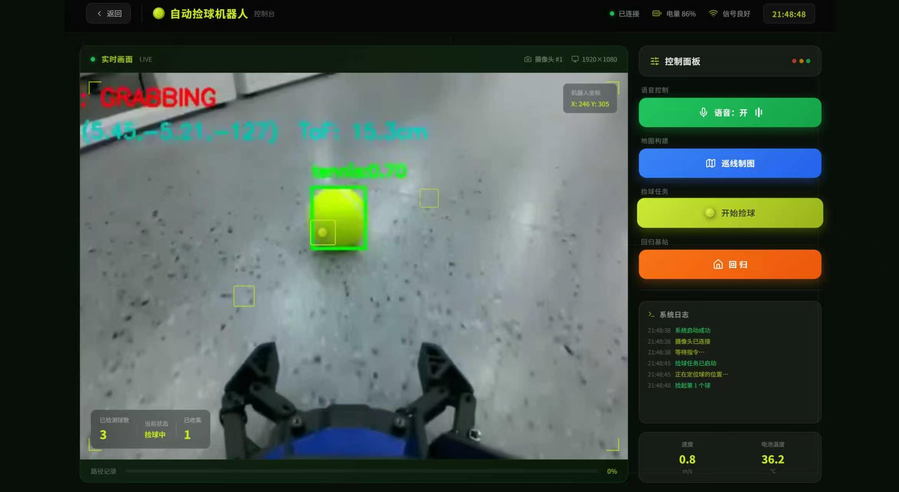
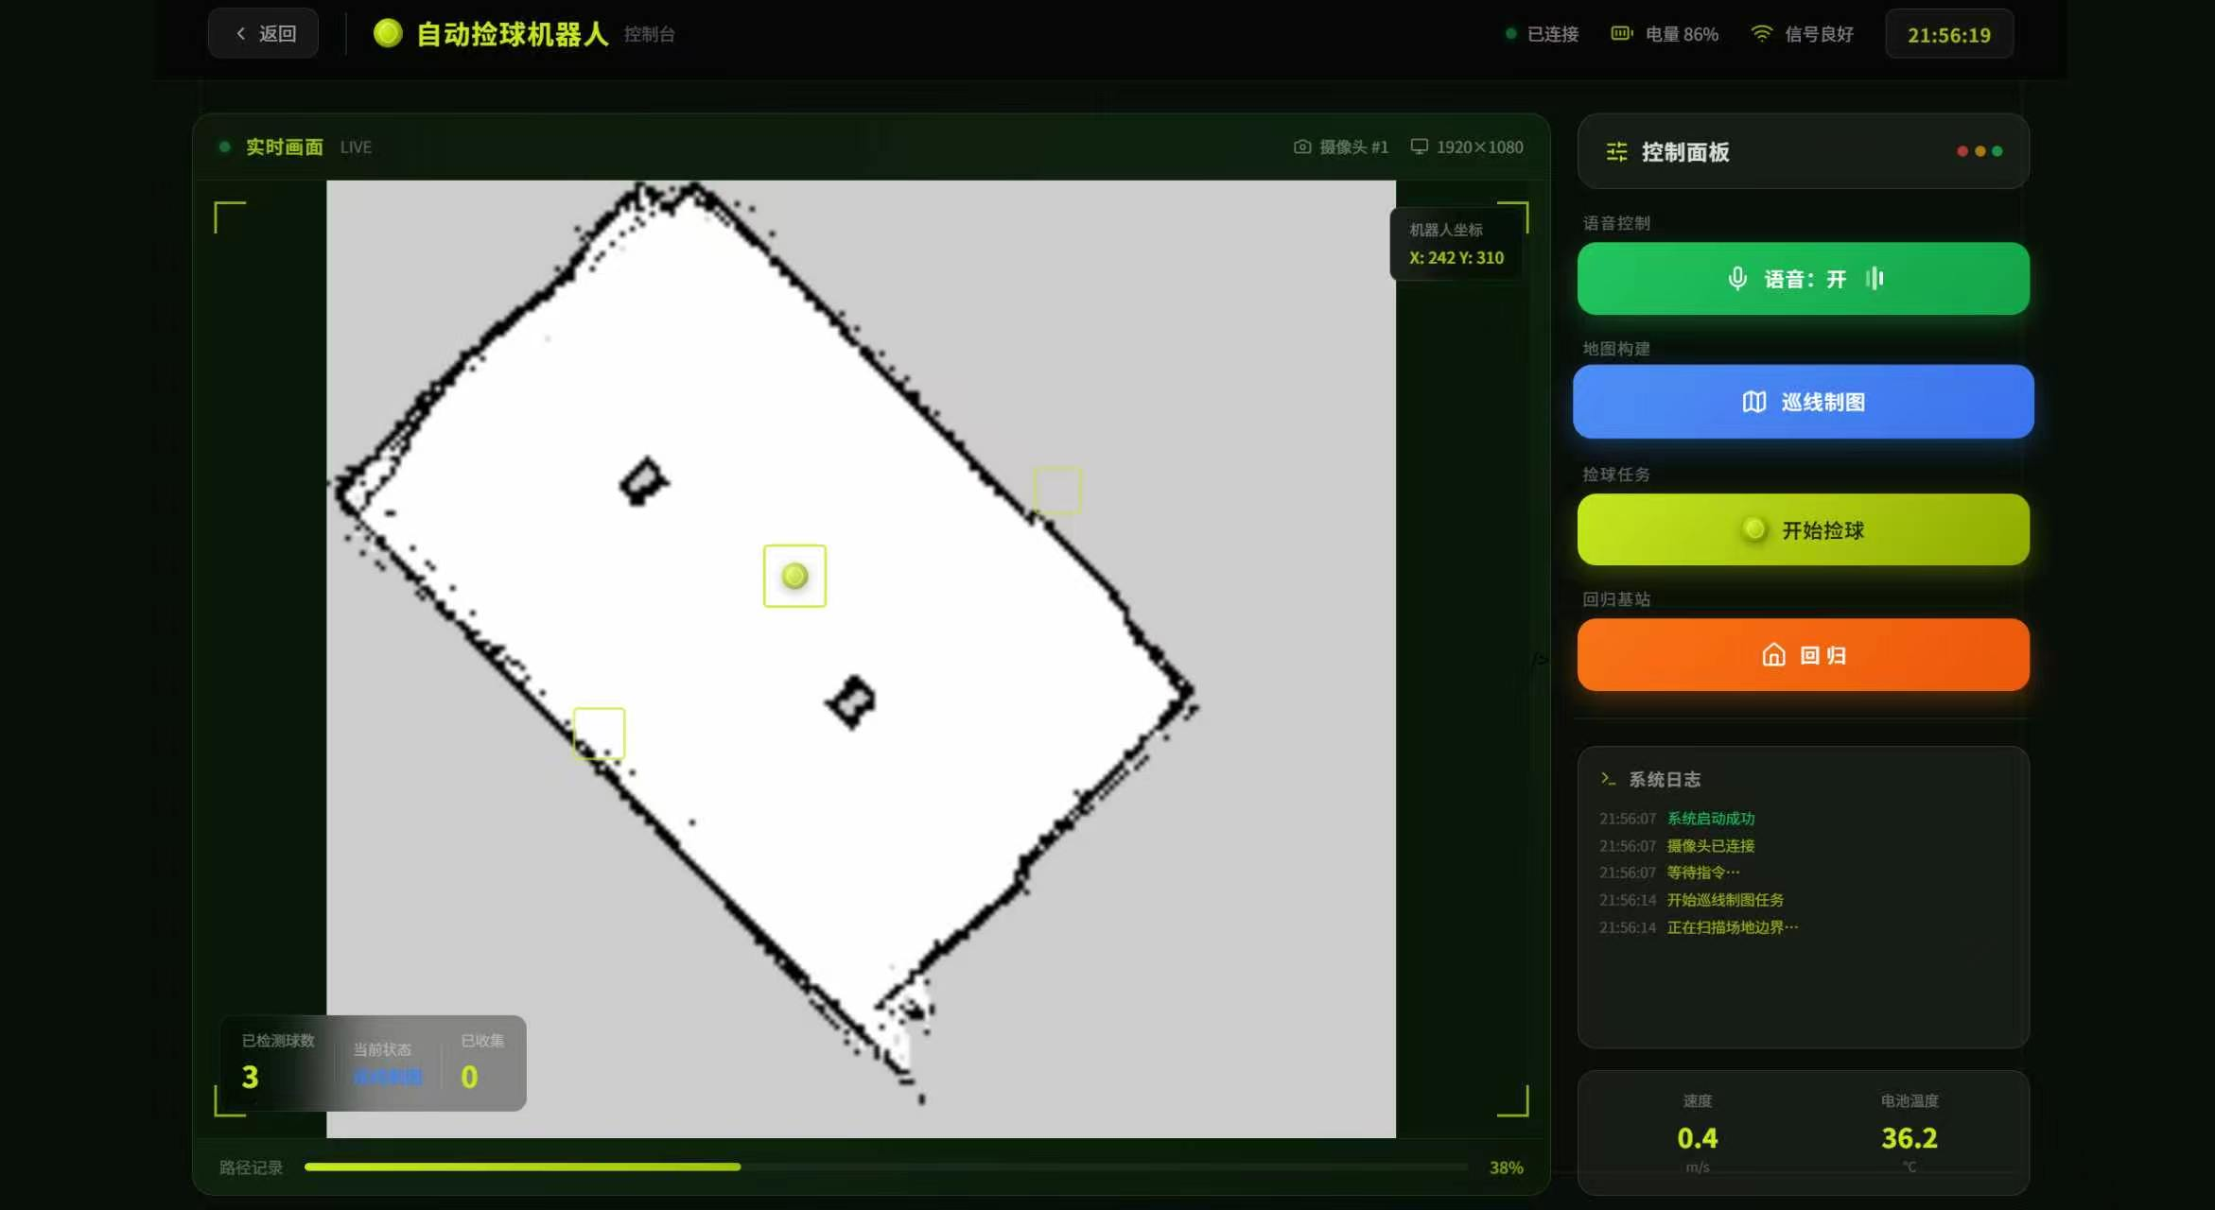
04
USER INTERFACE
Interaction Design — Operator Console
Design space reserved for the teammate-owned UI section: how an operator monitors, configures and steers the robot from a single screen.
Camera feed + YOLOv5 overlay, state badge and ToF distance bar.
Real-time AMCL pose on tennis_field map; bin and goal markers.
01 · LIVE VIEW
02 · MAP & NAV
Automatic ball-collecting robot console, with the left side displaying the real-time field map and ball position markers, and the right side integrating voice control, line-following mapping, system log recording, and field boundary scanning status.
Robot vision ball-picking interface, displaying the field scene and ball detection boxes in real time, with system logs updating continuously, and feedback on running speed and battery temperature at the bottom.
GROUP 17 · TENNIS-BOT
18 / 21
UI DESIGN

Slide 19
05
HIGHLIGHTS
Project Highlights & Design Innovations
What sets Tennis-Bot apart from a textbook pick-and-place demo — design choices that pay off in the field.
PIPELINE
PIPELINE
PIPELINE
Closed-Loop Vision-to-Grasp Servo
Nav2-Delegated Long-Range Transit
Multi-Target Nearest-First Selection
Continuous bounding-box feedback drives both yaw alignment (ROTATING) and forward approach (GRABBING), with adaptive damping that suppresses oscillation on sign flip.
Replaced open-loop trajectories with the official Nav2 NavigateToPose action — global A* planning + DWB local control + AMCL localization on the saved tennis_field map.
When several balls are detected simultaneously, the policy picks the largest bounding-box (≈ closest in 3-D) to minimize travel distance and avoid hunting between targets.
tolerance ≤ ROTATE_TOLERANCE_PX
A* / Dijkstra + DWB
bbox-area ranking
FUNCTION
FUNCTION
FUNCTION
Continuous Voice Override
Heterogeneous Sensor Fusion
On-Device Edge Compute
Vosk Chinese ASR in an isolated subprocess provides a true async safety channel — '停止' instantly cancels Nav2 goals & zeros /cmd_vel, '开始' resumes the exact same state.
YOLOv5 vision + ToF IR proximity + 2D LiDAR + wheel odom + IMU are fused through an EKF and a state machine, each sensor only triggering the state that needs it.
All perception, planning, ASR, and control run locally on a single Jetson Orin NX — no off-board GPU, no cloud, no network round-trips during a match.
停止 ⇄ 开始
4 modalities · 1 EKF
100% on-device
HIGHLIGHTS
GROUP 17 · TENNIS-BOT
19 / 21

Slide 20
06
TEAM
Project Team & Responsibilities
A balanced four-person team — each member owns one end-to-end module from algorithm design through code, hardware bring-up and field testing.
ROS 2 environment configuration on Jetson Orin NX
01
02
03
04
Yanshan Wang
Wenxin Xiao
Wentian Li
Guanhong Chen
System Design & Perception Lead
Mapping & Navigation Lead
HMI & UI Lead
Hardware & Voice Lead
RESPONSIBILITIES
RESPONSIBILITIES
RESPONSIBILITIES
RESPONSIBILITIES
Overall framework and control flow design — defined the five-state machine
SLAM environment setup — YDLidar X3 driver, slam_toolbox, EKF (robot_localization), TF tree configuration
Operator UI design and implementation — live camera + YOLO overlay panel, map & Nav goal panel, voice / control panel
Vosk + ReSpeaker voice-control subprocess design
YOLOv5 tennis-ball detector training, fine-tuning, and Jetson Orin NX deployment
Nav2 stack configuration (planner, DWB, costmap, AMCL)
On-screen status overlay — state badge, ToF distance bar, AMCL pose readout, voice ASR transcription stream
Async pause/resume safety layer & _wait_if_paused gate
Vision pipeline and nearest-ball selection policy — OpenCV HUD overlay, frame I/O, bounding-box ranking, detection-confirm logic
PLACING state — NavigateToPose action client integration
Operator UI mockups and on-screen status overlay
Robotic arm + gripper action clients (MoveArm, Gripper)
Indoor / outdoor mapping comparison experiments and failure-mode analysis
ToF IR sensor integration & grasp-trigger tuning
End-to-end system integration, packaging & field testing
ROS 2 environment configuration on Jetson Orin NX
PPT slide design
Demo recording, screen capture, and final video post-production
Demo recording, screen capture, and final project report
Demo recording, screen capture, and final project report
SHARED EFFORT Map building, on-court testing, demo recording and final paper / slide preparation were carried out jointly by all four members.
TEAM
GROUP 17 · TENNIS-BOT
20 / 21

Slide 21
END OF PRESENTATION
Thank You
Questions & Discussion
Team Members: Yanshan Wang, Wenxin Xiao, Wentian Li, Guanhong Chen
Group 17 · Tennis-Bot — Robotics & Embedded Systems Project · 2026
ROS 2
YOLOv5
Nav2
SLAM
Vosk
Orin NX
DJI EP
ReSpeaker
GROUP 17

