Slide 1

Comparative Study of HPCC and HADOOP based on PUMA Benchmarks
CSC 591-007 : Data Intensive Computing
Instructor: Dr. Vincent W. Freeh
Group No.2
Presentation by:
Haiyu Yao
Vishal Mishra
Nakul Shukla

Slide 2
Introduction
Develop and run benchmark scripts for HPCC and Hadoop
Hadoop, a popular framework for processing large data.
HPCC, a computing platform to process and deliver big data solutions.
PUMA is a benchmark suite for Hadoop.

Slide 3
Motivation
Lack of comparison results based on different types of problems.
Published available comparisons.
Based on TeraSort between HPCC and Hadoop
Last benchmark test on HPCC was performed in 2011 on Terasort.

Slide 4
Benchmark Scripts Used
Word Count
Inverted Index
Adjacency - List
Self - Join
K-means Clustering
Histogram - Movies

Slide 5
Environment
Virtual Machine Cluster
1 master node
8 slave nodes
Main Memory: 2 GB per node (usually 1 GB free)
CPU Cores: 2 per node (Intel(R) Xeon(R) E5645 @ 2.40GHz)
Storage: 30 GB per node
Operating System: Ubuntu Linux 14.04 Base

Slide 6
Environment (Cont.)
Hadoop
dfs.blocksize: 128 MB (64 MB for Adjacency-List)
dfs.replication: 1
mapreduce.map.java.opts: 512 MB
mapreduce.reduce.java.opts: 768 MB
mapreduce.task.io.sort.mb: 256MB
HPCC
2 thor slave processes per node
no roxie
replication factor: 2 (default configuration)

Slide 7
Methods
Same Input/Output
Same cluster environment
Consecutively run same benchmark task for Hadoop and HPCC
Execute each benchmark task at least twice
Test different size of data

Slide 8
Results
Unit: Minute
 | 10 GB |  | 20 GB |  | 30 GB
 | Hadoop | HPCC | Hadoop | HPCC | Hadoop | HPCC
Word Count | 7:42 | 2:03 | 21:25 | 4:05 | 29:07 | 29:53
Inverted Index | 10:01 | 6:19 | 21:49 | 10:52 | 27:42 | 16:22
Adjacency-List | 19:46 | 11:58 | 44:09 | 30:20 | N/A | 51:56
Self-Join | 4:58 | 5:46 | 11:20 | 13:52 | 16:01 | 21:28
 | 1 GB |  | 10 GB |  | 30 GB
 | Hadoop | HPCC | Hadoop | HPCC | Hadoop | HPCC
K-Means | 00:36 | 2:14 | 3:16 | 13:45 | 8:17 | 34:19
Histogram | 00:36 | 19:56 | 2:59 | 3:02:57 | 7:27 | 9:08:51(Est.)

Slide 9
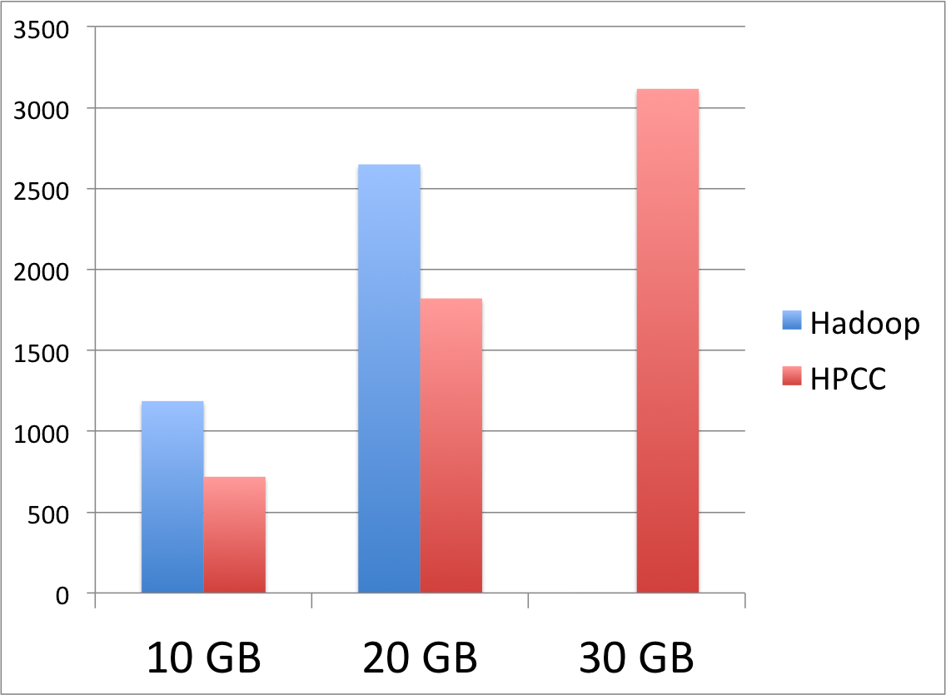
Interesting Facts (Adjacency-List)

Slide 10
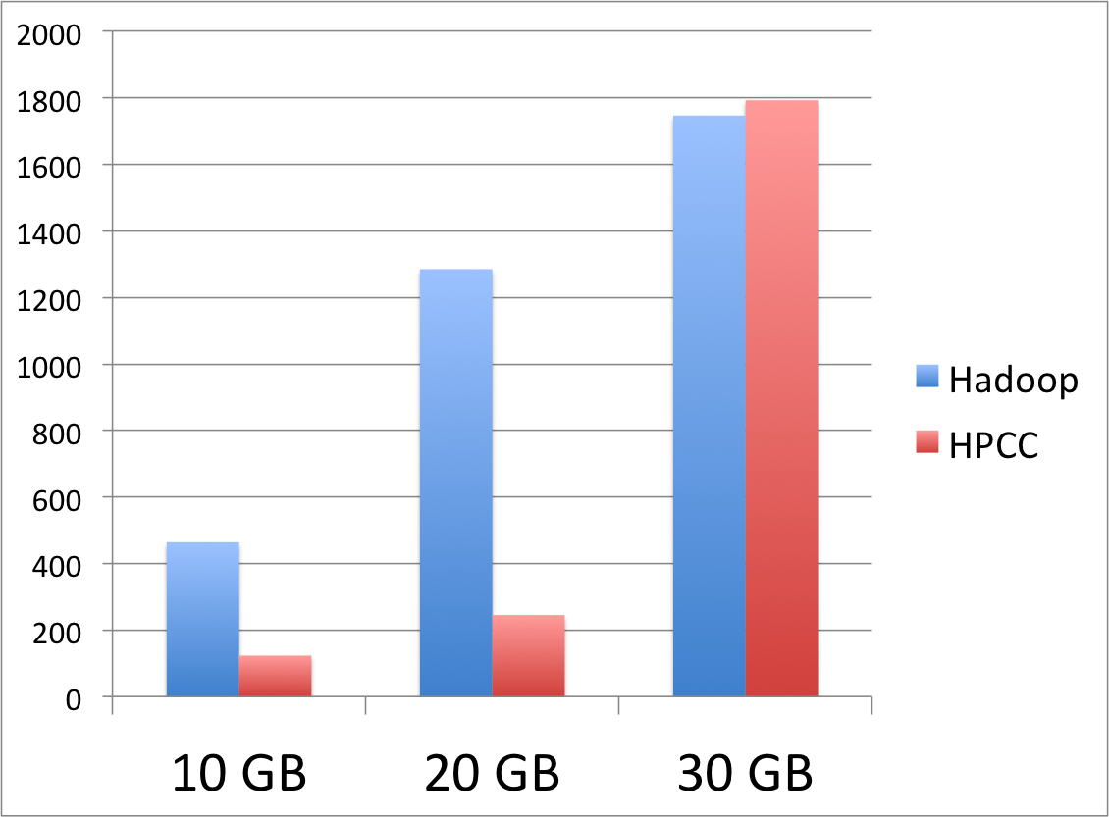
Interesting Facts (Word Count)

Slide 11
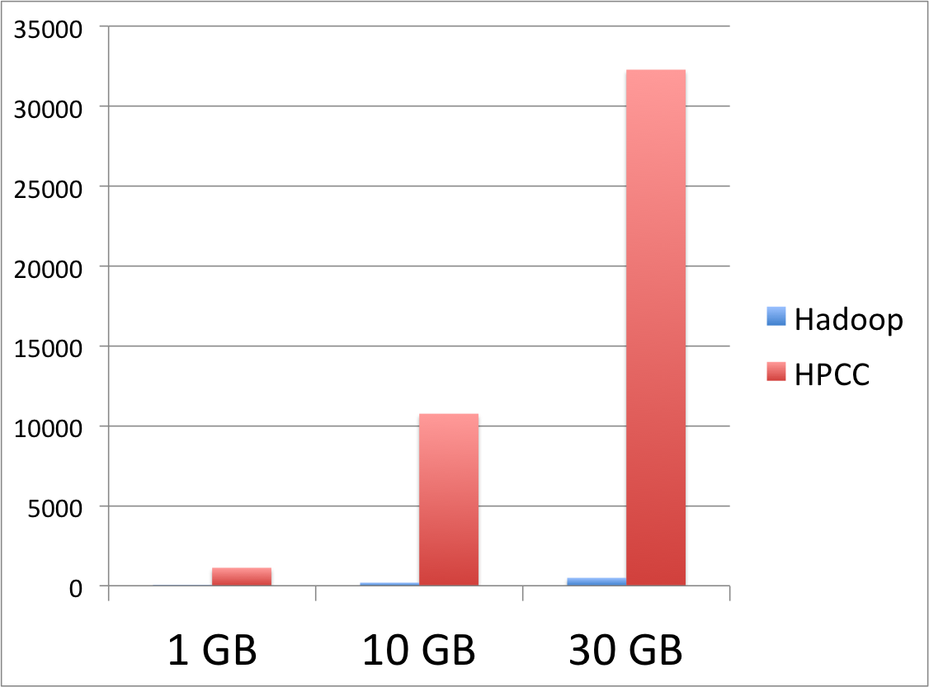
Interesting Facts (Histogram)

Slide 12
Lessons Learned (HPCC)
Pros
HPCC is quite fast when less data pre-processing required
HPCC is easy to deploy
Works well with non- embarrassingly independent tasks
Easier to work with different distributions of data
Cons
HPCC is not ideal for data pre-processing
Learning curve of ECL is steep
ECL is difficult to debug
Notes:
GUI for configuration
Have DISTRIBUTE function to distribute

Slide 13
Lessons Learned (Hadoop)
Pros
Faster for data pre-processing
Flexible in dealing with data in different formats
Good community support and documentation
Cons
Configuration is complicated
Sensitive to memory shortage
Requires embarrassingly independent tasks

Slide 14
Q & A

