Slide 1
Applied Analytics Assignment 2
BBC Text Analytics
Leo Yun Tao / S10219150

Slide 2
Table of contents
00.
01.
02.
03.
Introduction
Text Data Preprocessing
Problem understanding & approaches
Using python to clean & transform data
Text Data Understanding
Summary & Improvement
Extracting keywords
Findings and further improvement
Leo Yun Tao / S10219150

Slide 3
0. Introduction
bbc-text.csv
BBC news website corresponding to stories in five topical areas from 2004-2005 (Greene, 2022).
Unstructured text data
2 attributes and 2225 rows
Extract keywords and analyze them
Associate various meaningful keywords using association rule mining
Leo Yun Tao / S10219150

Slide 4
01
Text Data Preprocessing
Using python to clean & transform data
Leo Yun Tao / S10219150

Slide 5
1.1
Importing Libaries
Importing essential libaries for this project
Leo Yun Tao / S10219150

Slide 6
Importing Libaries
import pandas as pd
import numpy as np
import nltk
import string
import re
from sklearn.feature_extraction.text import CountVectorizer, TfidfTransformer
from mlxtend.preprocessing import TransactionEncoder
from mlxtend.frequent_patterns import apriori, association_rules
from sklearn.preprocessing import LabelEncoder
from sklearn.model_selection import cross_val_score, GridSearchCV, train_test_split
from sklearn.linear_model import LogisticRegression
from sklearn.metrics import accuracy_score
Leo Yun Tao / S10219150

Slide 7
1.2
Loading Data
Understanding about the data loaded
Leo Yun Tao / S10219150

Slide 8
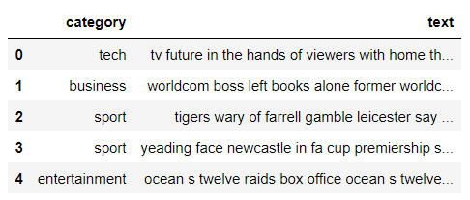
Reading bbc-text.csv
df = pd.read_csv("bbc-text.csv")
df.head()
Leo Yun Tao / S10219150

Slide 9
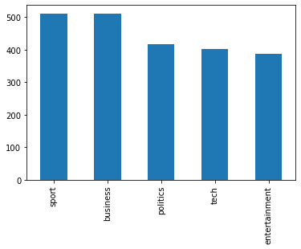
Distribution of Category
df.category.value_counts().plot(type="bar")
Sightly unbalanced dataset
Leo Yun Tao / S10219150

Slide 10
1.3
Cleaning Data
Cleaning the text data
Leo Yun Tao / S10219150

Slide 11
Get Stop Words
def get_stop_words(stop_file_path):
"""load stop words """
with open(stop_file_path, 'r', encoding="utf-8") as f:
stopwords = f.readlines()
stop_set = set(m.strip() for m in stopwords)
return frozenset(stop_set)
#load a set of stop words
stopwords=get_stop_words("stopwords.txt")
Read stop words from the file given
Remove duplicate word and ‘\n’
Return in frozenset
Leo Yun Tao / S10219150

Slide 12
Preprocess, Tokenize, Lemmatize
def preprocessor(word):
return re.sub("(\\d|\\W|_)+"," ",word)
wn = nltk.WordNetLemmatizer()
def LemmaTokenizer(text):
tokens = re.split('\\W+', text)
return [wn.lemmatize(word) for word in tokens if word not in stopwords]
Removes any special characters that is not alpha neumeric
Split text that is not alpha neumeric
Tokenize, lemmatize the word
Remove stop words
Leo Yun Tao / S10219150

Slide 13
Original Text
df.text[0][:100]
'tv future in the hands of viewers with home theatre systems plasma high-definition tvs and digital'
Leo Yun Tao / S10219150

Slide 14
Text After Processing
[i for i in LemmaTokenizer(preprocessor(df.text[0][:100])) if i not in stopwords]
['tv', 'future', 'hand', 'viewer',
'home', 'theatre', 'system', 'plasma', 'definition', 'tv', 'digital']
Leo Yun Tao / S10219150

Slide 15
1.3
Bag-of-word
Counting number of word in a sentence using CountVectorizer
Leo Yun Tao / S10219150

Slide 16
Transforming Text
count_vect = CountVectorizer(max_df=0.15, max_features=5000, lowercase=True,
preprocessor=preprocessor, tokenizer=LemmaTokenizer)
X_counts = count_vect.fit_transform(df.text)
Instantiate CountVectorizer class
max_df=0.15 to remove any words that appear in > 15% of the corpous.
Custom preproccessor, tokenizer
fit_transform df.text to convert it into bag of word format
Leo Yun Tao / S10219150

Slide 17
Visualizing Bag of Words
pd.DataFrame(X_counts.toarray(), columns=count_vect.get_feature_names())
Leo Yun Tao / S10219150

Slide 18
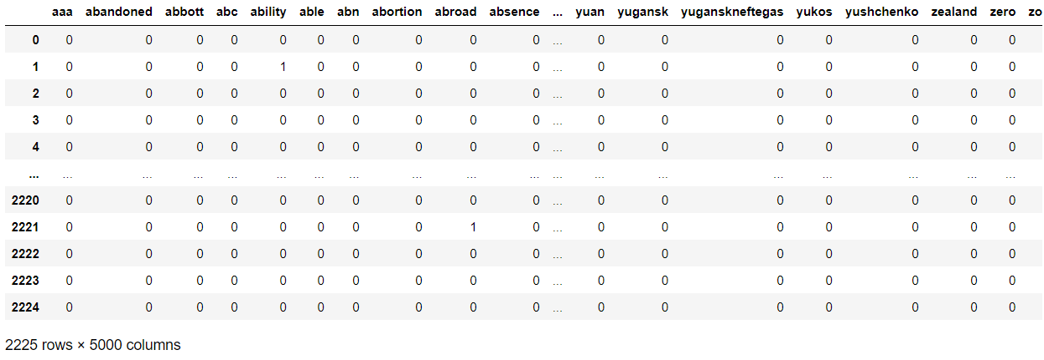
Output

Slide 19
1.4
TF-IDF
Calculating frequency–inverse document frequency score for each words in tokens
Leo Yun Tao / S10219150

Slide 20
Calculating TF-IDF Score
tfidf_transformer=TfidfTransformer()
X_tfidf = tfidf_transformer.fit_transform(X_counts)
Instantiate TfidfTransformer class
fit_transform from bag of words to convert into tfidf score format
Leo Yun Tao / S10219150

Slide 21
Visualizing TF-IDF Score
pd.DataFrame(X_counts.toarray(), columns=count_vect.get_feature_names())
Leo Yun Tao / S10219150

Slide 22
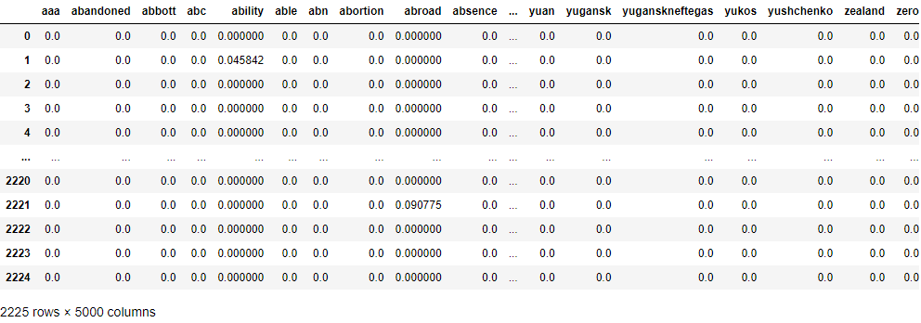
Output
Leo Yun Tao / S10219150

Slide 23
2
Text Data Understanding
Extracting keywords using association rule mining
Leo Yun Tao / S10219150

Slide 24
2.1
Extract Keywords
Extracting keywords using TF-IDF matrix
Leo Yun Tao / S10219150

Slide 25
Get Top 500 TF-IDF Score
max_value = X_tfidf.max(axis=0).toarray().ravel()
sorted_by_tfidf = max_value.argsort()
highestTfidf = np.array(count_vect.get_feature_names_out())[sorted_by_tfidf[-500:]]
Reduce from 5000 terms to top 500 terms with highest TF-IDF Score
Runtime complexity of Apori Algorithm: O(2^n)
Save computing time
Leo Yun Tao / S10219150

Slide 26
Get Top 500 TF-IDF Score
def extract_keywords(paragraph):
paragraph = LemmaTokenizer(preprocessor(paragraph.lower()))
keywords = [word for word in paragraph if word in highestTfidf]
return keywords
cleaned_array = df.text.apply(lambda x: extract_keywords(x))
cleaned_array
Extract top 500 terms in each paragraph
Return in a list format
To be encoded using TransactionEncoder
Leo Yun Tao / S10219150

Slide 27
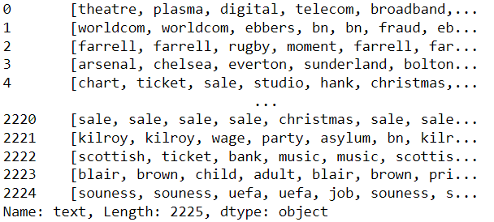
Output
Leo Yun Tao / S10219150

Slide 28
Visualize most Frequent Keywords
full_list = []
for row in cleaned_array:
for value in row:
full_list.append(value)
full_list = pd.Series(full_list)
# looking at the frequency of most popular items
plt.figure(figsize=(18,7))
full_list.value_counts().head(50).plot.bar()
plt.title('frequency of most popular items', fontsize = 20)
plt.xticks(rotation = 90 )
plt.grid()
plt.show()
Leo Yun Tao / S10219150

Slide 29
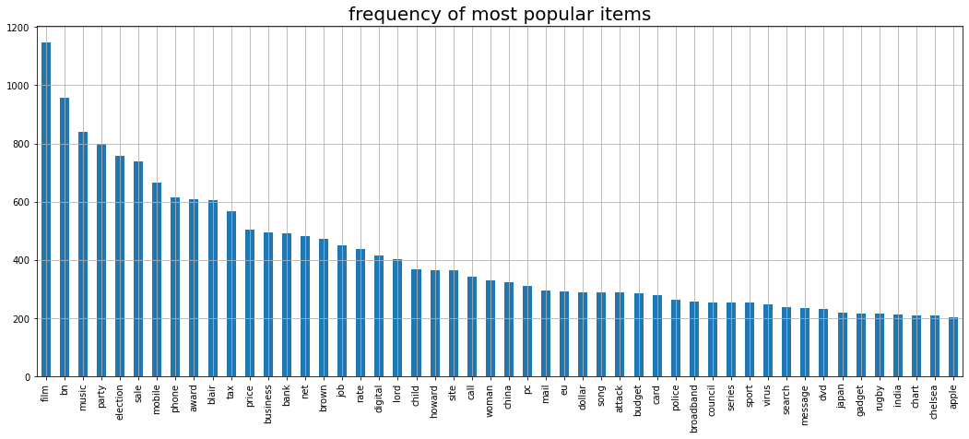
Output
Leo Yun Tao / S10219150

Slide 30
TransactionEncoder
te = TransactionEncoder()
data_encoded = te.fit_transform(cleaned_array)
data_encoded = pd.DataFrame(data_encoded, columns = te.columns_)
data_encoded
Convert list to one-hot boolean array format
Used for Apori Algorithm
Similar to one hot encoding
Leo Yun Tao / S10219150

Slide 31
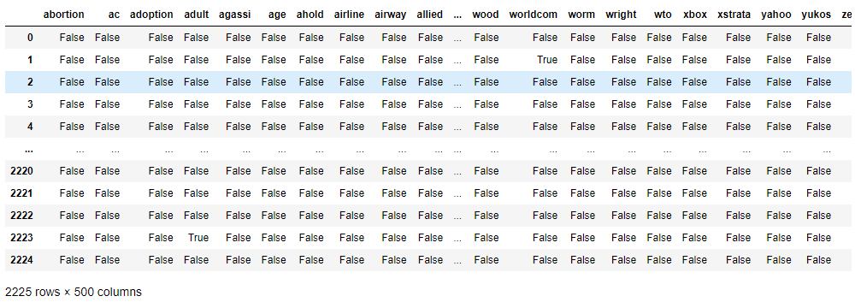
Output
Leo Yun Tao / S10219150

Slide 32
2.2
Association Rules Mining
Association rules mining on keywords
Leo Yun Tao / S10219150

Slide 33
Apori
frequent_itemsets=apriori(data_encoded, min_support = 0.01, use_colnames = True)
frequent_itemsets.sort_values("support", ascending = False, inplace=True)
frequent_itemsets.head(10)
Find support value for all itemsets
min_support = 0.01 to remove itemset that apperars in < 1% of the corpous to speed up computation (Apori principle)
Sort the itemsets and display top 10 itemsets with the highest support value
Leo Yun Tao / S10219150

Slide 34
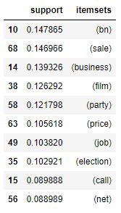
Output
(bn) occurs in the most corpus followed by (sale), (business) …
Leo Yun Tao / S10219150

Slide 35
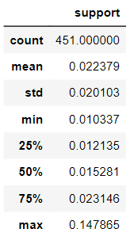
Describe
frequent_itemsets[['support']].describe()
451 itemsets >= 1% support value
Leo Yun Tao / S10219150

Slide 36
Association Rules
rules = association_rules(frequent_itemsets, metric="lift", min_threshold=1.5)
rules.sort_values("lift", ascending=False, inplace=True)
rules = rules[rules.confidence > 0.5]
rules["antecedent_len"] = rules["antecedents"].apply(lambda x: len(x))
rules.head(15)
Form an association rules for all itemsets
Remove itemsets with < 1.5 lift and <= 0.5 confidence
Find the length of the itemsets in the antecedent for further exploration
Sort and display top 15 lift values
Leo Yun Tao / S10219150
Notes:
Lift is nothing but the ratio of Confidence to Expected Confidence.

Slide 37
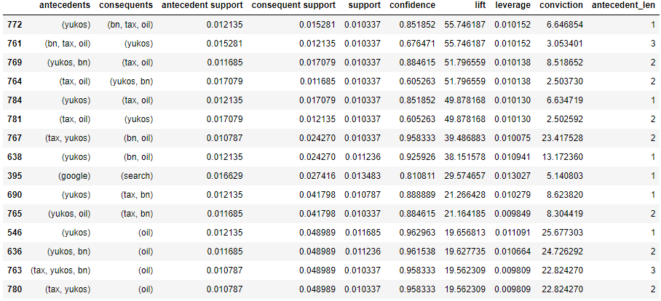
Output

Slide 38
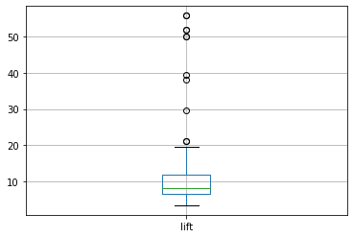
Boxplot
rules[['lift']].boxplot()
Most lift values falls between 6-12
Some outliers with very high lift values

Slide 39
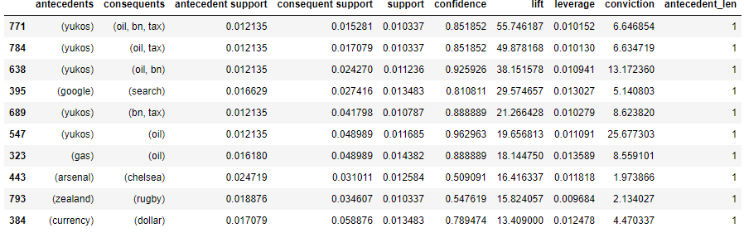
Antecedent length = 1
rules[rules.antecedent_len == 1].head(10)

Slide 40
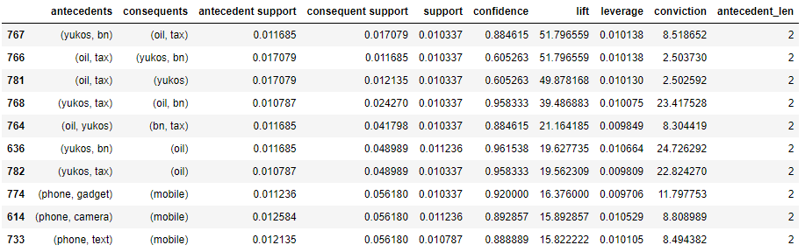
Antecedent length = 2
rules[rules.antecedent_len == 2].head(10)

Slide 41
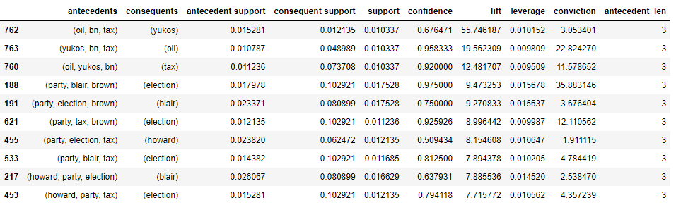
Antecedent length = 3
rules[rules.antecedent_len == 3].head(10)

Slide 42
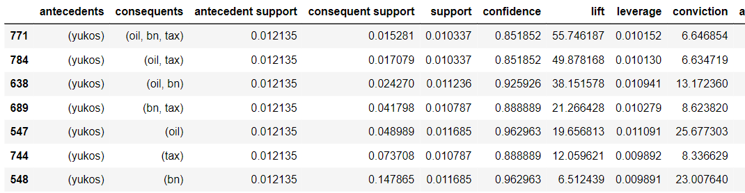
Antecedent: yukos
rules[rules['antecedents'] == {'yukos'}]

Slide 43
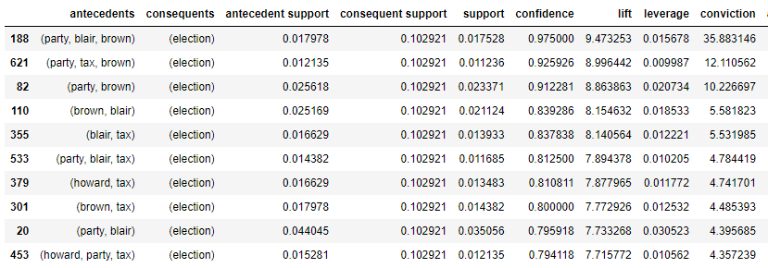
Consequents: election
rules[rules['consequents'] == {'election'}]

Slide 44
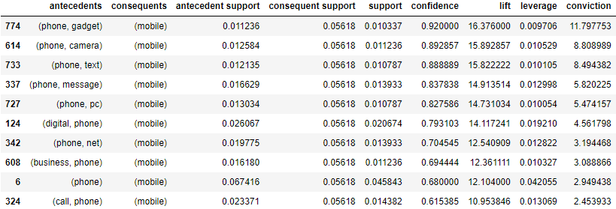
Consequents: mobile
rules[rules['consequents'] == {‘mobile'}]

Slide 45
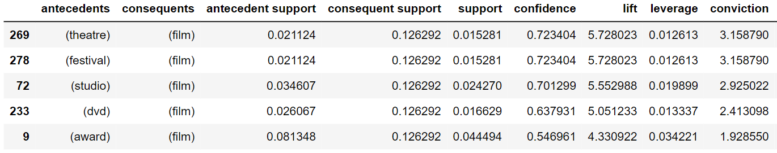
Consequents: film
rules[rules['consequents'] == {‘film'}]

Slide 46
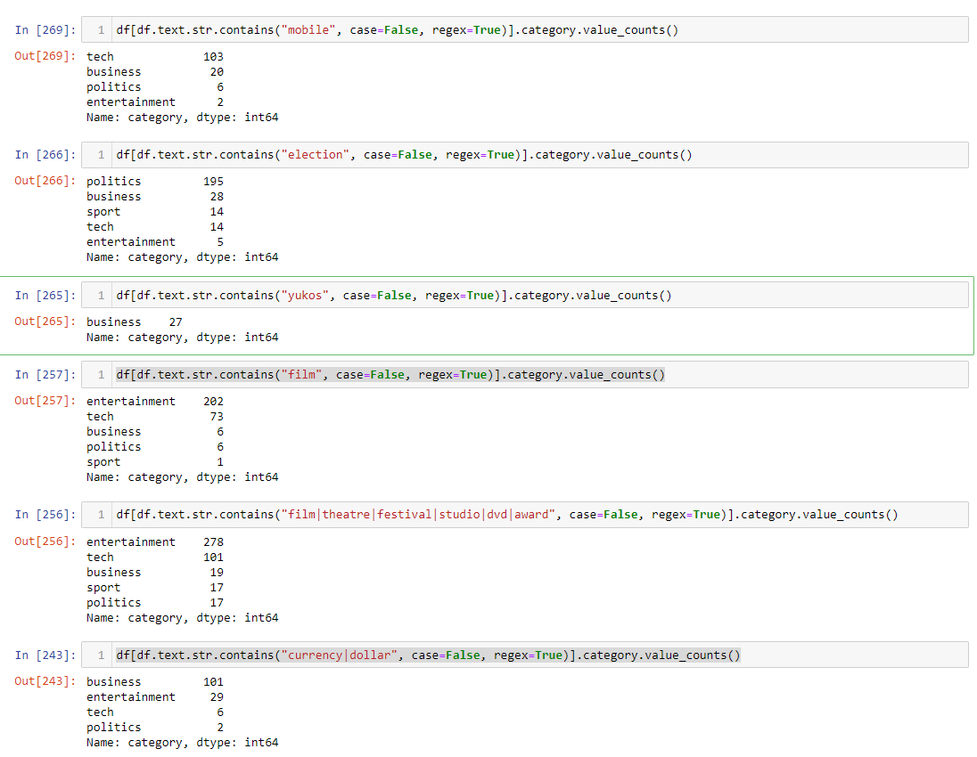
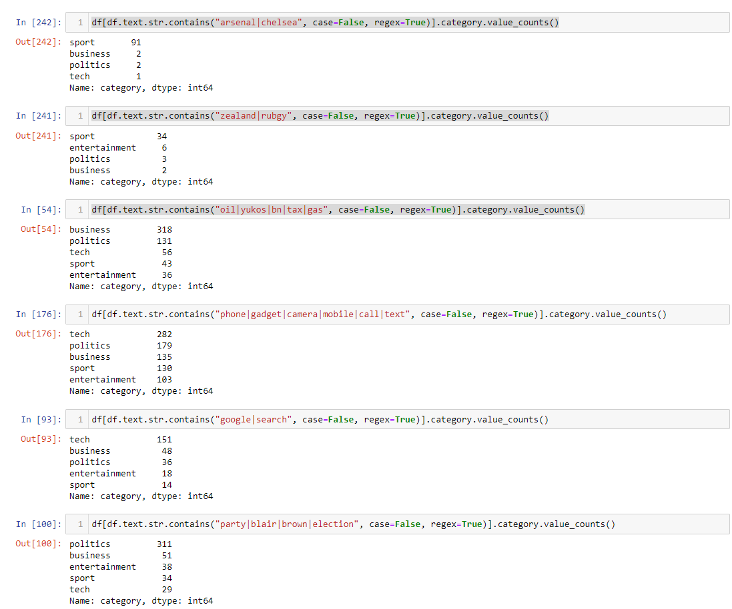
Finding categories

Slide 47
3
Summary & Improvement
Findings and further improvement
Leo Yun Tao / S10219150

Slide 48
Summary
Keywords | Category
yukos, oil, bn, tax | Business
google, search | Tech
party, blair, brown, election | Politics
phone, gadget, camera, mobile, call, text | Tech
zealand, rubgy | Sport
arsenal, chelsea | Sport
Leo Yun Tao / S10219150

Slide 49
Summary
Keywords | Category
currency, dollar | Business
film, theatre, festival, studio, dvd, award | Entertainment
Highly related to each other
High chance of seeing these keywords together in a document
Leo Yun Tao / S10219150

Slide 50
Possible Improvements
Use leverage and conviction to understand the association rules more

Slide 51
Thank You!
Leo Yun Tao / S10219150

Slide 52

Thanks!
Do you have any questions?
youremail@freepik.com
+91 620 421 838
yourcompany.com
Please keep this slide for attribution
Elegant Lines Pitch Deck // 2021

Slide 53


