Slide 1
The AT&T Developer Program Webcast Series
Honeycomb Fragments
Presented by:
Elle Tabares
Marketing Coordinator
AT&T Developer Program
Blake Meike
Author
O'Reilly's “Programming Android”

Slide 2
The AT&T Developer Program
Helping developers deliver the right application on the right device to over 97 million customers
Information / web content
Detailed device specifications
Network services, APIs, toolkits, and sample code
White papers on new technology
Technical support and educational opportunities
Webcasts
Meet the expert
Live Chat
Social Media (Twitter, Facebook, forums and blogs)
http://developer.att.com
Twitter: attdeveloper

Slide 3
The AT&T Developer Program News
AT&T Mobile App Hackathon- Chicago, WA on August 27
developer.att.com/events
Next webcast on Thursday, September 15
Building Multi-Platform Native Mobile Applications with Canappi

Slide 4
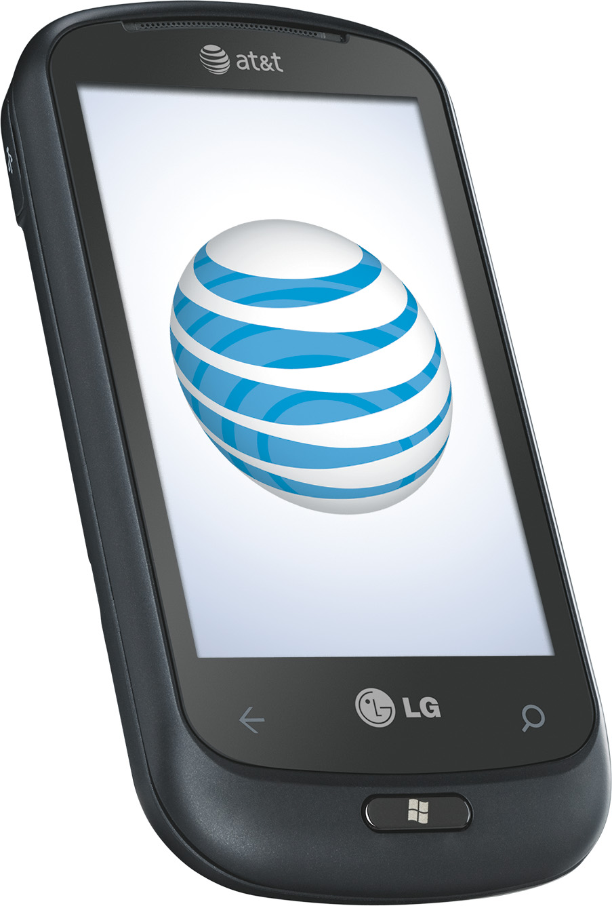
Win an AT&T Smartphone!
Answer the question at the end of the webcast and win an AT&T Smartphone!

Slide 5
Honeycomb Fragments
Presented by: Blake Meike
Part 1: Using Fragments
Part 2: The ACP and Backward Capability

Slide 6
Part 1: Using Fragments
Fragments, Views and Activities
Fragment Essentials
Recovering State
Dynamic Fragments and Essentials
Passing Arguments
Using the ACP

Slide 7
Fragments, Views and Activities

Slide 8
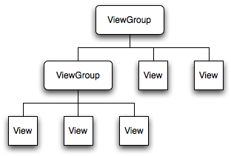
Views and Activities
Like a View
Visible on the screen
Attached to the View hierarchy
Fragment

Slide 9
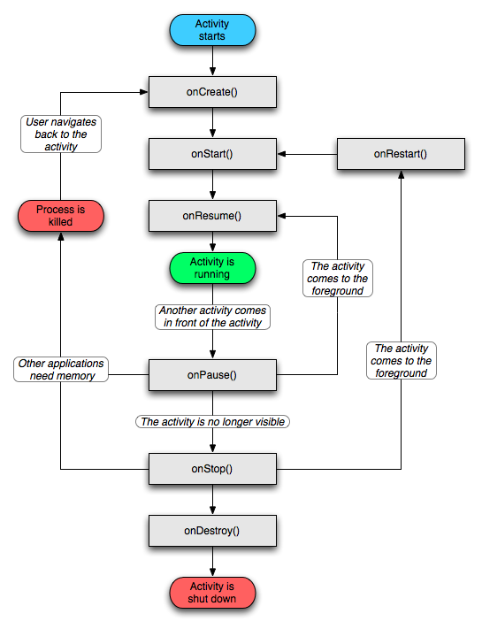
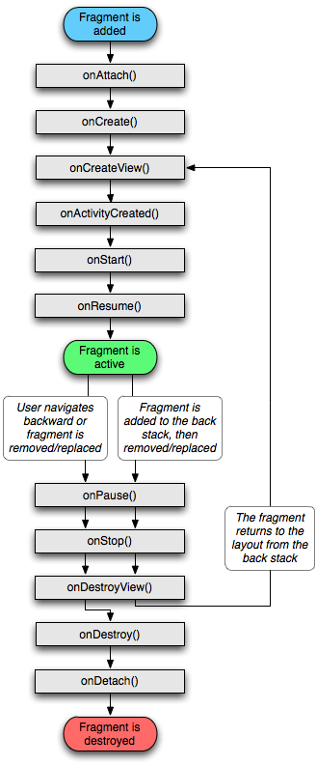
Views and Activities
Like an Activity
Has a lifecycle, always shorter than the parent Activity

Slide 10
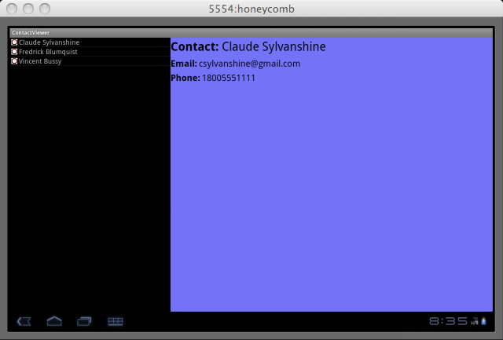
A Fragment

Slide 11
Fragment Essentials

Slide 12
Static Fragment Layout
<?xml version="1.0" encoding="utf-8"?>
<LinearLayout
xmlns:android="http://schemas.android.com/apk/res/android"
android:orientation="vertical"
android:layout_width="fill_parent"
android:layout_height="fill_parent"
>
<fragment
class="com.oreilly.demo.android.demo.simplefragment.DateTime"
android:id="@+id/date_time"
android:layout_width="fill_parent"
android:layout_height="fill_parent"
/>
</LinearLayout>

Slide 13
Using the Fragment
public class SimpleFragment extends Activity {
@Override
public void onCreate(Bundle state) {
super.onCreate(state);
setContentView(R.layout.main);
}
}

Slide 14
Fragment Implementation
public class TrivialFragment extends Fragment {
private static String getDateTimeString(Date time) {
return new SimpleDateFormat("d MMM yyyy HH:mm:ss")
.format(time);
}
private String time = getDateTimeString(new Date());
@Override
public View onCreateView(
LayoutInflater inflater,
ViewGroup container,
Bundle b)
{
View view = inflater.inflate(
R.layout.date_time,
container,
false); //!!! this is important
((TextView) view.findViewById(R.id.last_view_time))
.setText(time);
return view;
}
}

Slide 15
Fragment Essentials
Class named in the layout fragment tag must exist and be public
Fragment class must be a subclass of fragment
The third argument to Inflater.inflate() must be ‘false’!
Google recommends no explicit constructor (more on this in a minute...)
The plug-in could easily check all of this... but it doesn't

Slide 16
Recovering State

Slide 17
Fragment Can Be Destroyed!
Just like Activities, fragments can be destroyed to reclaim memory
When a fragment is re-created, it should recover the state it had when it was deleted
It works the same way it does for an Activity

Slide 18
Recovering Fragment State
public class DateTime extends Fragment {
public static final String TAG_DATE_TIME = "DateTime";
// ...
@Override
public void onCreate(Bundle state) {
super.onCreate(state);
time = (null == state)
? getDateTimeString(new Date())
: state.getString(TAG_DATE_TIME);
}
@Override
public void onSaveInstanceState(Bundle state) {
super.onSaveInstanceState(state);
state.putString(TAG_DATE_TIME, time);
}
// ...
}

Slide 19
Dynamic Fragments and Transactions

Slide 20
Dynamic Fragment
The fragments in the apps above were “static” or “layout” fragments
Dynamic fragments, as you might expect, are much more versatile
Do NOT mix them! Never replace a layout fragment with a dynamically created fragment! This is why:
java.lang.IllegalStateException: Fragment did not create a view.

Slide 21
Dynamic Fragment Layout
<Button
android:id="@+id/new_fragments"
android:layout_width="fill_parent"
android:layout_height="0dp"
android:layout_weight="1"
android:textSize="24dp"
android:text="@string/doit"
/>
<FrameLayout
android:id="@+id/date_time2"
android:layout_width="fill_parent"
android:layout_height="0dp"
android:layout_weight="2"
android:background="@color/blue"
/>
<FrameLayout
android:id="@+id/date_time"
android:layout_width="fill_parent"
android:layout_height="0dp"
android:layout_weight="2"
android:background="@color/green"
/>

Slide 22
Creating Dynamic Fragments
public void onCreate(Bundle state) {
super.onCreate(state);
setContentView(R.layout.main);
FragmentManager fragMgr = getFragmentManager();
FragmentTransaction xact = fragMgr.beginTransaction();
if (null == fragMgr.findFragmentByTag(FRAG1_TAG)) {
xact.add(
R.id.date_time,
new DateTime(),
FRAG1_TAG);
}
if (null == fragMgr.findFragmentByTag(FRAG2_TAG)) {
xact.add(
R.id.date_time2,
new DateTime(),
FRAG2_TAG);
}
xact.commit();
//...
}

Slide 23
Introducing Transactions
Get the Fragment Manager from the context
Get a Transaction from the manager
Modify the fragment
Commit!
Just as you would expect from the name, all or nothing
The back-stack backs out an entire transaction!

Slide 24
Updating Dynamic Fragments I
public void onCreate(Bundle state) {
// …
((Button) findViewById(R.id.new_fragments))
.setOnClickListener(
new Button.OnClickListener() {
@Override
public void onClick(View v) { update(); }
});
}

Slide 25
Updating Dynamic Fragments II
void update() {
FragmentTransaction xact
= getFragmentManager().beginTransaction();
xact.replace(
R.id.date_time,
new DateTime(),
FRAG1_TAG);
xact.replace(
R.id.date_time2,
new DateTime(),
FRAG2_TAG);
xact.addToBackStack(null);
xact.setTransition(FragmentTransaction.TRANSIT_FRAGMENT_OPEN);
xact.commit();
}

Slide 26
Passing Arguments to Fragments

Slide 27
Fragment Static Constructor
public class DateTime extends Fragment {
public static final String TAG_DATE_TIME = "DateTime";
public static DateTime newInstance(Date time) {
Bundle init = new Bundle();
init.putString(
DateTime.TAG_DATE_TIME,
getDateTimeString(time));
DateTime frag = new DateTime();
frag.setArguments(init);
return frag;
}
// …
}

Slide 28
Fragment Initialization
public void onCreate(Bundle state) {
super.onCreate(state);
if (null == state) { state = getArguments(); }
time = (null != state)
? state.getString(TAG_DATE_TIME)
: getDateTimeString(new Date());
}

Slide 29
Passing Arguments to the Fragment
void update() {
Date time = new Date();
FragmentTransaction xact
= getFragmentManager().beginTransaction();
xact.replace(
R.id.date_time,
DateTime.newInstance(time),
FRAG1_TAG);
xact.replace(
R.id.date_time2,
DateTime.newInstance(time),
FRAG2_TAG);
xact.addToBackStack(null);
xact.setTransition(
FragmentTransaction.TRANSIT_FRAGMENT_OPEN);
xact.commit();
}

Slide 30
The ACP

Slide 31
The Android Compatibility Package
Fragments are cool
So what? Check out these stats (Wikipedia):
Your app needs to be backwards compatible
Good new: The ACP
VERSION | DISTRIBUTION
Honeycomb | 0.9%
Gingerbread | 18.6%
Froyo | 59.4%
Eclair | 17.5%
Donut | 2.2%
Cupcake | 1.4%

Slide 32
Introducing the ACP
A library that supports fragments
Backports as far as Donut, v1.6 (API 4)
$ADK_HOME/extras/android/compatibility/v4/android-support-v4.jar

Slide 33
Using the ACP
Add the ACP to your application ($PROJ/lib)
Put the ACP on the Eclipse build path
Change the build target from 3.0 to 2.1
Change broken imports of “android.app...” to “android.support.v4.app...”
Activities that use fragments must be updated to subclass FragmentActivitity instead of Activity
Use SupportFragmentManager instead of FragmentManager

Slide 34
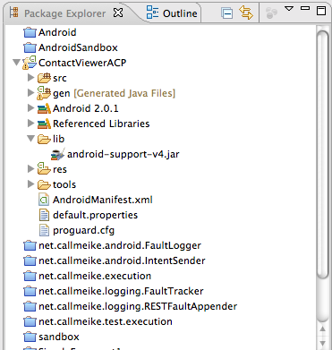
Using the ACP
Add the ACP to your application ($PROJ/lib)

Slide 35
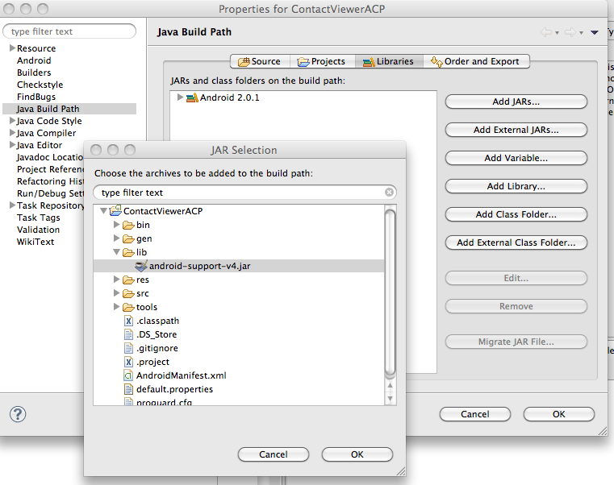
Using the ACP
Put the ACP on the Eclipse build path

Slide 36
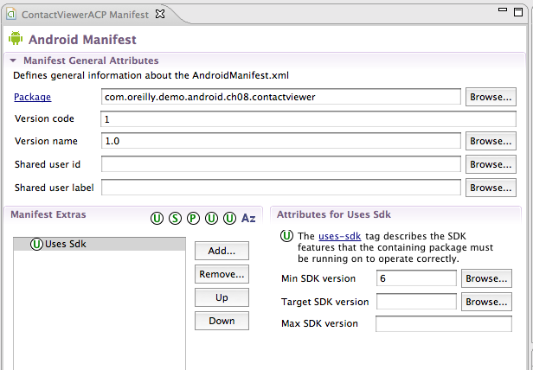
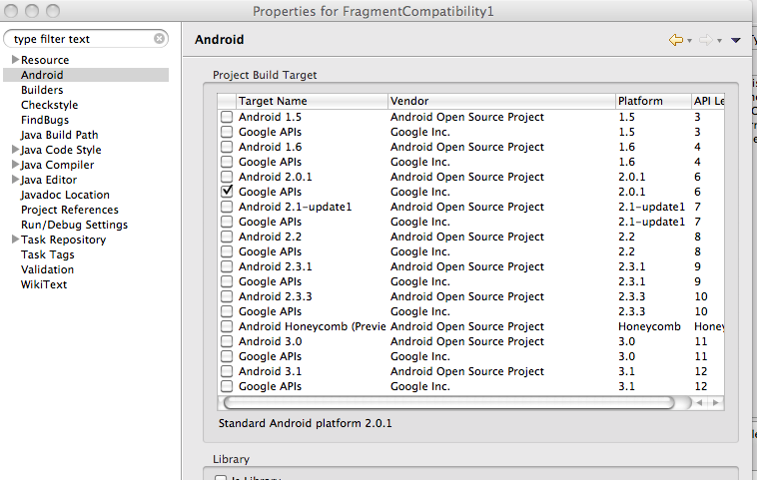
Using the ACP
Change the build target from 11 to >=4

Slide 37
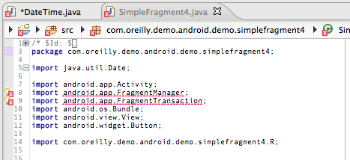
Using the ACP
Change broken imports of “android.app...” to “android.support.v4.app...”

Slide 38
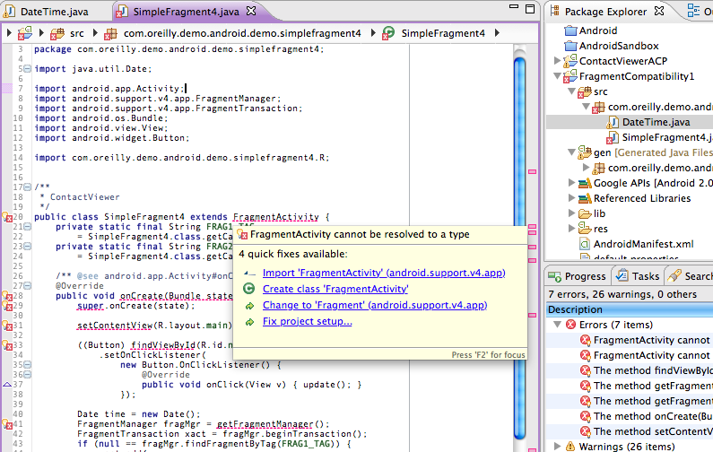
Using the ACP
Activities that use fragments must be updated to subclass FragmentActivitity instead of Activity

Slide 39
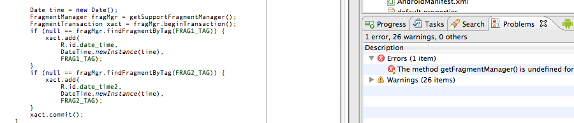
Using the ACP
Use SupportFragmentManager instead of FragmentManager

Slide 40
Using the ACP
That's it!
Covered back to API v6
Not forward compatible!

Slide 41
Multi-Platform Layout

Slide 42
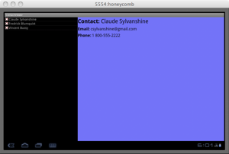
Handling Portrait Screen Orientation
So, that's great: your app builds under Froyo.
Unfortunately, when you run it, instead of this:

Slide 43
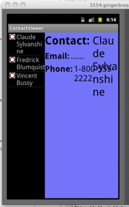
Handling Portrait Screen Orientation
On most devices, it looks like this:
Well, that's no good!

Slide 44
A Different Layout for Small Screens
In the directory res/layout-port
No fragment!
<LinearLayout
xmlns:android="http://schemas.android.com/apk/res/android"
android:orientation="vertical"
android:layout_width="fill_parent"
android:layout_height="fill_parent"
>
<ListView
android:id="@+id/contacts"
android:layout_width="fill_parent"
android:layout_height="fill_parent"
android:layout_weight="2"
/>
</LinearLayout>

Slide 45
Handling Fragment and Deck Metaphor
In onCreate, check to see if the layout item is there:
public void onCreate(Bundle state) {
super.onCreate(state);
setContentView(R.layout.main);
final boolean useFrag
= null != findViewById(R.id.contact_detail);
if (useFrag) { installFragment(); }
// …
}

Slide 46
Handling Fragment and Deck Metaphor
If it is, add a fragment:
private void installFragment() {
FragmentManager fragMgr = getSupportFragmentManager();
if (null != fragMgr.findFragmentByTag(FRAG_TAG)) { return; }
FragmentTransaction xact = fragMgr.beginTransaction();
xact.add(
R.id.contact_detail,
ContactDetailFragment.newInstance(null, null),
FRAG_TAG);
xact.commit();
}

Slide 47
Handling Fragment and Deck Metaphor
… and stack a new one, on a click:
private void stackFragment(String id, String name) {
FragmentTransaction xact
= getSupportFragmentManager().beginTransaction();
xact.replace(
R.id.contact_detail,
ContactDetailFragment.newInstance(id, name),
FRAG_TAG);
xact.addToBackStack(null);
xact.setTransition(FragmentTransaction.TRANSIT_FRAGMENT_OPEN);
xact.commit();
}

Slide 48
Handling Fragment and Deck Metaphor
If it isn't, just use the normal deck metaphor:
private void stackActivity(String id, String name) {
Intent intent = new Intent();
intent.setClass(this, ContactDetailActivity.class);
intent.putExtra(ContactDetails.TAG_ID, id);
intent.putExtra(ContactDetails.TAG_CONTACT, name);
startActivity(intent);
}

Slide 49
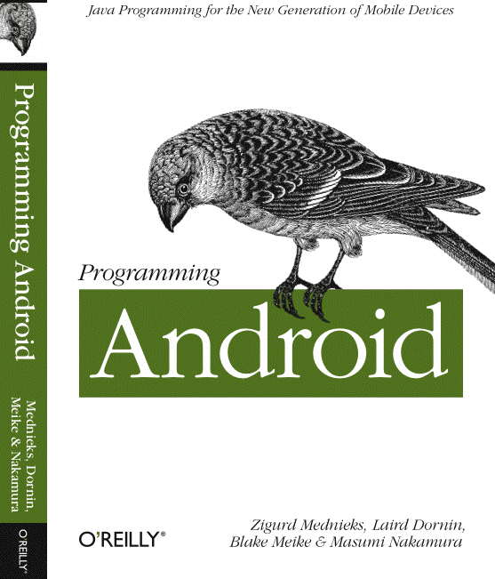
Go Write Fragments!
G. Blake Meike
blake.meike@gmail.com
http://portabledroid.wordpress.com/
Slides and code are available:
https://github.com/bmeike/Fragments
Also in Chapter 8 of Programming Android
Mednieks, Dornin, Meike, Nakamura, O'Reilly Media

Slide 50
Honeycomb Fragments
QUESTION & ANSWERS
Webcast slides will be posted shortly on
http://developer.att.com/events

Slide 51
CONTEST
Send answers to:
developer.program@att.com
Winners will be selected randomly from the correct responses.
How many times does Android call a View’s onMeasure() method, in response to a request re-layout (requestLayout):
Zero or more times
One or more times
Zero or one times
Exactly once

Slide 52
THANK YOU

