Slide 1

Honeycomb Fragments
G. Blake Meike
blake.meike@gmail.com
http://portabledroid.wordpress.com/
Slides and code are available:
https://github.com/bmeike/Fragments
Also in Chapter 8 of Programming Android
Mednieks, Dornin, Meike, Nakamura, O'Reilly Media
Notes:
I'll give these links again at the end.
Also take questions

Slide 2
Honeycomb Fragments
Fragments, Views and Activities
Fragment Essentials
Recovering State
Dynamic Fragments and Transactions
Passing Arguments
Using the ACP
Multi-Platform Layout

Slide 3
Honeycomb Fragments
Fragments, Views and Activities
Fragment Essentials
Recovering State
Dynamic Fragments and Transactions
Passing Arguments
Using the ACP
Multi-Platform Layout
Notes:
Why fragments?
They are moderately complex. So why do we need them?
On devices with small screens (your phone, ipod, etc) a card-deck metaphor works great
On screens with more real-estate, that's not sufficient. There's room for two cards side by side.
A fragment is like a View with the lifecycle of an Activity

Slide 4
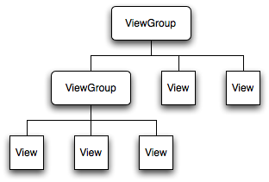
Views and Activities
Like a View
  Visible on the screen
  Attached to the View hierarchy
Fragment
Notes:
Like a view, a fragment goes into the View hierachy

Slide 5
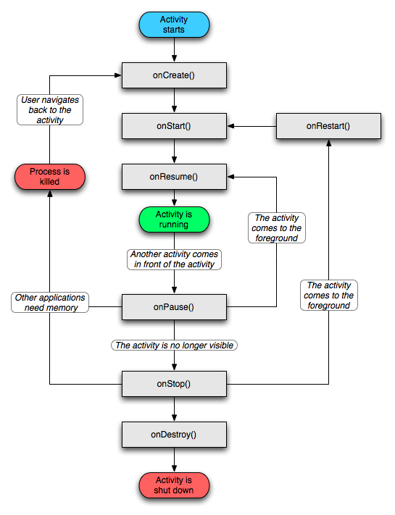
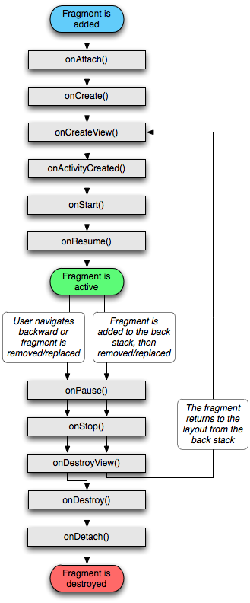
Views and Activities
Like an Activity: Has a lifeycle, always shorter than the parent Activity.
Notes:
Like an activity, on the other hand it has a lifecycle and lifecycle methods.

Slide 6
Honeycomb Fragments
Fragments, Views and Activities
Fragment Essentials
Recovering State
Dynamic Fragments and Transactions
Passing Arguments
Using the ACP
Multi-Platform Layout
Notes:
Let's do it!
I'm going to start with a very simple fragment based program and, gradually, extend it
I'm going to use two different applications, interchangeably: The simpler one simply displays a date/time. The second is a simple contact viewer.

Slide 7
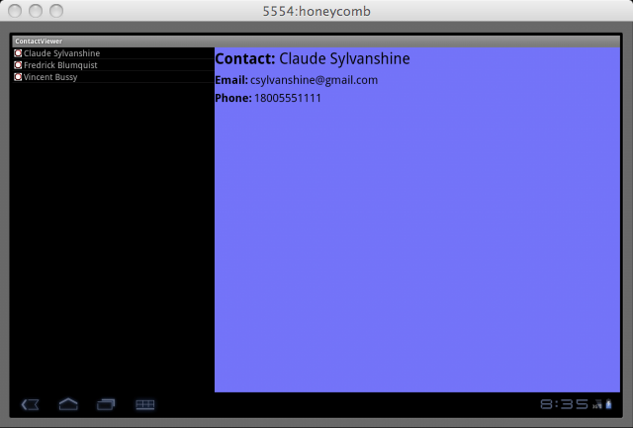
A Fragment
Notes:
Blue area is a fragment
Clicking a new element in the list view on the left causes new information to appear on the right
Android is providing a framework that will make UI behavior consistent across applications

Slide 8
Static Fragment Layout
<?xml version="1.0" encoding="utf-8"?>
<LinearLayout
xmlns:android="http://schemas.android.com/apk/res/android"
android:orientation="vertical"
android:layout_width="fill_parent"
android:layout_height="fill_parent"
>
<fragment
class="com.oreilly.demo.android.demo.simplefragment.DateTime"
android:id="@+id/date_time"
android:layout_width="fill_parent"
android:layout_height="fill_parent"
/>
</LinearLayout>
Notes:
This is a “static” fragment: it is instantiated during layout.
Note the fragment tag.

Slide 9
Using the Fragment
public class SimpleFragment extends Activity {
@Override
public void onCreate(Bundle state) {
super.onCreate(state);
setContentView(R.layout.main);
}
}
Notes:
Here's how you use it: Again, this should all be pretty familiar...
Note that, because the fragment is inflated behind your back, adding a constructor doesn't buy you much. The fragment still had to o something reasonable without initialization...

Slide 10
Fragment Implementation
public class TrivialFragment extends Fragment {
private static String getDateTimeString(Date time) {
return new SimpleDateFormat("d MMM yyyy HH:mm:ss")
.format(time);
}
private String time = getDateTimeString(new Date());
@Override
public View onCreateView(
LayoutInflater inflater,
ViewGroup container,
Bundle b)
{
View view = inflater.inflate(
R.layout.date_time,
container,
false); //!!! this is important
((TextView) view.findViewById(R.id.last_view_time))
.setText(time);
return view;
}
}
Notes:
This is the code for a simple fragment
It is simpler that the one shown in the previous slide. Switching over to this app, for a while
OnCreate Is reminiscent of Activity... Fragments are also managed objects.
OnCreateView called when the Fragment becomes visible
Note that the fragment creates its view normally, by inflating a layout
Note the “false” in the call to inflate!!
Inflate needs the parent to do layout
Without the “false” it will try to attach it!

Slide 11
Fragment Essentials
Class named in the layout fragment tag must exist and be public
Fragment class must be a subclass of Fragment
Google recommends no explicit constructor (more on this in a minute...).
The plugin could easily check all of this... but it doesn't.
Notes:
These are the minimum requirements for a creating a fragment.

Slide 12
Honeycomb Fragments
Fragments, Views and Activities
Fragment Essentials
Recovering State
Dynamic Fragments and Transactions
Passing Arguments
Using the ACP
Multi-Platform Layout
Notes:
So, that's a very simple fragment.
It is too simple: it must remember its state...

Slide 13
Fragments Can Be Destroyed!
Just like an Activity, Fragments can be destroyed to recover memory
When a Fragment is re-created, it should recover the state it had when it was deleted
State recovery works just as it does for Activities
Notes:
You'd hate it if, while you were watching some video in your browser, you received a phone call, and, when you returned to the browser, found that you'd been returned to your default page

Slide 14
Recovering Fragment State
public class DateTime extends Fragment {
public static final String TAG_DATE_TIME = "DateTime";
// ...
@Override
public void onCreate(Bundle state) {
super.onCreate(state);
time = (null == state)
? getDateTimeString(new Date())
: state.getString(TAG_DATE_TIME);
}
@Override
public void onSaveInstanceState(Bundle state) {
super.onSaveInstanceState(state);
state.putString(TAG_DATE_TIME, time);
}
// ...
}
Notes:
Use the lifecycle states and the passed bundle, just as they are for an Activity
Save the state in onSaveInstanceState, recover it in onCreate
That's it
Note, again, that time cannot be final. This, again, reduces the value of a constructor.

Slide 15
Honeycomb Fragments
Fragments, Views and Activities
Fragment Essentials
Recovering State
Dynamic Fragments and Transactions
Passing Arguments
Using the ACP
Multi-Platform Layout
Notes:
The fragments so far have been “static” or “layout” fragments (my terms). Real power comes from fragments that are created on the fly

Slide 16
Dynamic Fragments
The Fragments in the apps above were “static” or “layout” fragments.
Dynamic fragments, as you might expect, are much more versatile.
Do NOT mix them! Never replace a layout fragment with a dynamically created fragment!
java.lang.IllegalStateException: Fragment did not create a view.

Slide 17
Dynamic Fragment Layout
<Button
android:id="@+id/new_fragments"
android:layout_width="fill_parent"
android:layout_height="0dp"
android:layout_weight="1"
android:textSize="24dp"
android:text="@string/doit"
/>
<FrameLayout
android:id="@+id/date_time2"
android:layout_width="fill_parent"
android:layout_height="0dp"
android:layout_weight="2"
android:background="@color/blue"
/>
<FrameLayout
android:id="@+id/date_time"
android:layout_width="fill_parent"
android:layout_height="0dp"
android:layout_weight="2"
android:background="@color/green"
/>
Notes:
Simply replace the “fragment” tag with a “FrameLayout” tab
Also adding a button that will create a new fragment

Slide 18
Creating Dynamic Fragments
public void onCreate(Bundle state) {
super.onCreate(state);
setContentView(R.layout.main);
FragmentManager fragMgr = getFragmentManager();
FragmentTransaction xact = fragMgr.beginTransaction();
if (null == fragMgr.findFragmentByTag(FRAG1_TAG)) {
xact.add(
R.id.date_time,
new DateTime(),
FRAG1_TAG);
}
if (null == fragMgr.findFragmentByTag(FRAG2_TAG)) {
xact.add(
R.id.date_time2,
new DateTime(),
FRAG2_TAG);
}
xact.commit();
//...
}
Notes:
Get the fragment manager
Get a transaction from the manager
Add the two fragments
Commit the transaction
Note that if you are restoring state, the fragment may already exist! If you automatically create fragments, you will leak them!
Fragment tags are unique: there can be only one with a given tag.

Slide 19
Introducing Transactions
Get the Fragment Manager from the Context
Get a Transaction from the Manager
Modify the Fragment
Commit!
Just as you would expect from the name: all or nothing
The back-stack backs out the entire transaction
Notes:
Those fragment tags are important: they are unique over the life of an app. There can be only one fragment at any time, in the context of an application, with a given tag.
Without tags, you can leak fragments.

Slide 20
Updating Dynamic Fragments I
public void onCreate(Bundle state) {
// …
((Button) findViewById(R.id.new_fragments))
.setOnClickListener(
new Button.OnClickListener() {
@Override
public void onClick(View v) { update(); }
});
}
Notes:
Let's give that button some behavior.
Here's the rest of the onCreate method.
Should look fairly familiar: wires the onClickListener to the update method

Slide 21
Updating Dynamic Fragments II
void update() {
FragmentTransaction xact
= getFragmentManager().beginTransaction();
xact.replace(
R.id.date_time,
new DateTime(),
FRAG1_TAG);
xact.replace(
R.id.date_time2,
new DateTime(),
FRAG2_TAG);
xact.addToBackStack(null);
xact.setTransition(FragmentTransaction.TRANSIT_FRAGMENT_OPEN);
xact.commit();
}
Notes:
Here's update, very similar to create:
Get the fragment manager
Get a transaction from the manager
Replace the two fragments
Commit the transaction

Slide 22
Honeycomb Fragments
Fragments, Views and Activities
Fragment Essentials
Recovering State
Dynamic Fragments and Transactions
Passing Arguments
Using the ACP
Multi-Platform Layout
Notes:
As mentioned earlier, Google advises against initializing a fragment in its constructor
Instead, use the set/getArguments framework and Bundles.

Slide 23
Fragment Static Constructor
public class DateTime extends Fragment {
public static final String TAG_DATE_TIME = "DateTime";
public static DateTime newInstance(Date time) {
Bundle init = new Bundle();
init.putString(
DateTime.TAG_DATE_TIME,
getDateTimeString(time));
DateTime frag = new DateTime();
frag.setArguments(init);
return frag;
}
// …
}
Notes:
Add a static constructor to the fragment. It a lot like a normal constructor.
Use setArguments to attach a Bundle to the fragment.
You have to be able to marshal all of the arguments into the Bundle.
Document and version your protocol!

Slide 24
Fragment Initialization
public void onCreate(Bundle state) {
super.onCreate(state);
// highest priority is previous state
// if there is none, 2nd priority is args
if (null == state) { state = getArguments(); }
// use state (previous or args) if it exists
// else use default
time = (null != state)
? state.getString(TAG_DATE_TIME)
: getDateTimeString(new Date());
}
Notes:
Use getArguments, in onCreate, to accept arguments.
Restored state over-rides args, args override default.

Slide 25
Passing Arguments to a Fragment
void update() {
Date time = new Date();
FragmentTransaction xact
= getFragmentManager().beginTransaction();
xact.replace(
R.id.date_time,
DateTime.newInstance(time),
FRAG1_TAG);
xact.replace(
R.id.date_time2,
DateTime.newInstance(time),
FRAG2_TAG);
xact.addToBackStack(null);
xact.setTransition(
FragmentTransaction.TRANSIT_FRAGMENT_OPEN);
xact.commit();
}
Notes:
This is the same update function, except that it is now guaranteed that both fragments will display the same time, regardless of how long it take to initialize one.
Note the static constructor syntax:
Class.newInstance(args)
As opposed to
new Class(args)

Slide 26
Honeycomb Fragments
Fragments, Views and Activities
Fragment Essentials
Recovering State
Dynamic Fragments and Transactions
Passing Arguments
Using the ACP
Multi-Platform Layout
Notes:
So, that's basic fragments

Slide 27
The Android Compatibility Library
Fragments are cool
So what? Check out these stats (Wikipedia):
Your app must be backwards compatible!
Good new: The ACP
Version | Distribution
Honeycomb | 0.9%
Gingerbread | 18.6%
Froyo | 59.4%
Eclair | 17.5%
Donut | 2.2%
Cupcake | 1.4%
Notes:
Compatibility!!

Slide 28
Introducing the ACP
A library that supports fragments
Backports as far as Donut, v1.6 (API 4)
$ADK_HOME/extras/android/compatibility
  /v4/android-support-v4.jar
Notes:
The ACP, Android Compatibility Package is a library that allows backporting Fragments as far as Donut, v1.6, API level 4
It is just a jar file.

Slide 29
Using the ACP
Add the ACP to your application ($PROJ/lib)
Put the ACP on the Eclipse build path
Change the build target from 3.0 to 2.1
Change broken imports of “android.app...” to “android.support.v4.app...”
Activities that use fragments must be updated to subclass FragmentActivitity instead of Activity.
Use SupportFragmentManager instead of FragmentManager
Notes:
These are the steps necessary to make your app backwards compatible.
Skip to 36 if time is tight

Slide 30
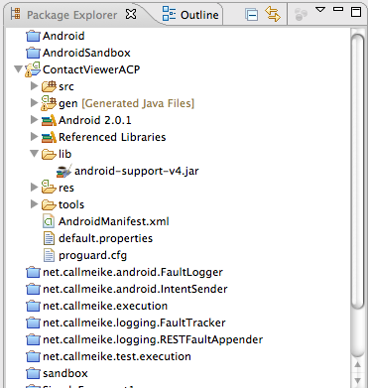
Using the ACP
Add the ACP to your application ($PROJ/lib)
Notes:
1
You can also use Eclipse (context menu) > Android Tools > Add Compatibility Library...

Slide 31
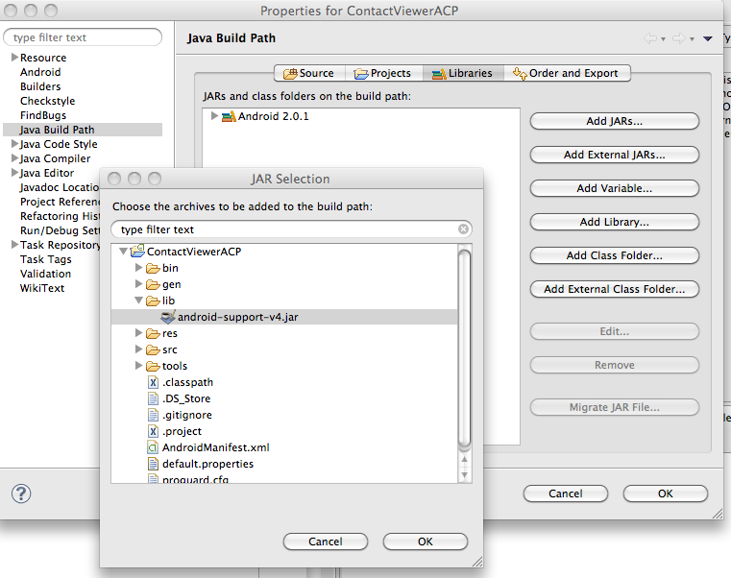
Using the ACP
Put the ACP on the Eclipse build path

Slide 32
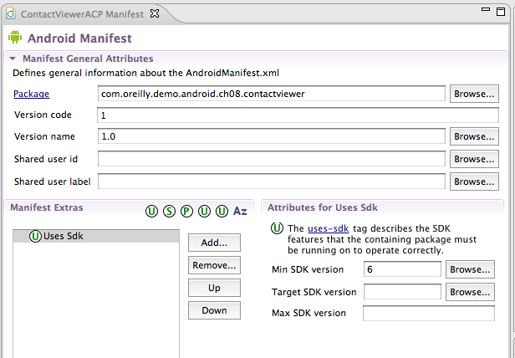
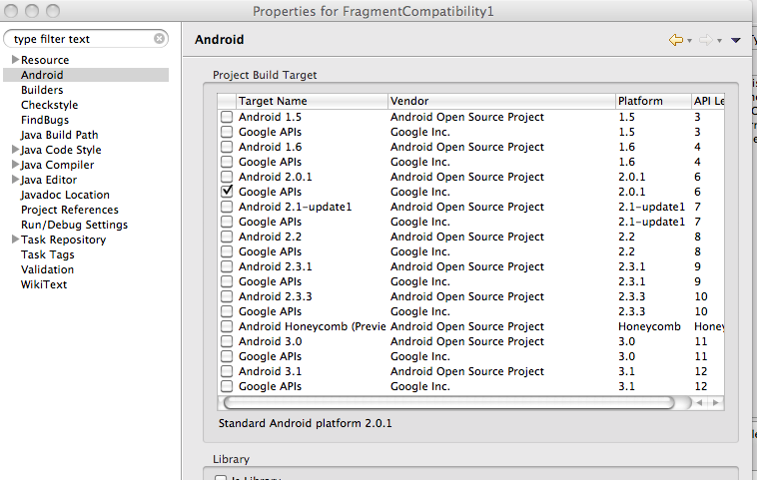
Using the ACP
Change the build target from 11 to >=4
Notes:
Change the build target for the project.
There are 3 places that you have to do this:
1) the manifest
2) the eclipse android properties
3) the eclipse run target

Slide 33
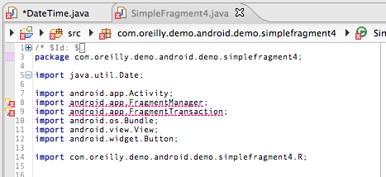
Using the ACP
Change broken imports of “android.app...” to “android.support.v4.app...”
Notes:
That last change will have cause all sorts of errors to appear. That's good!!

Slide 34
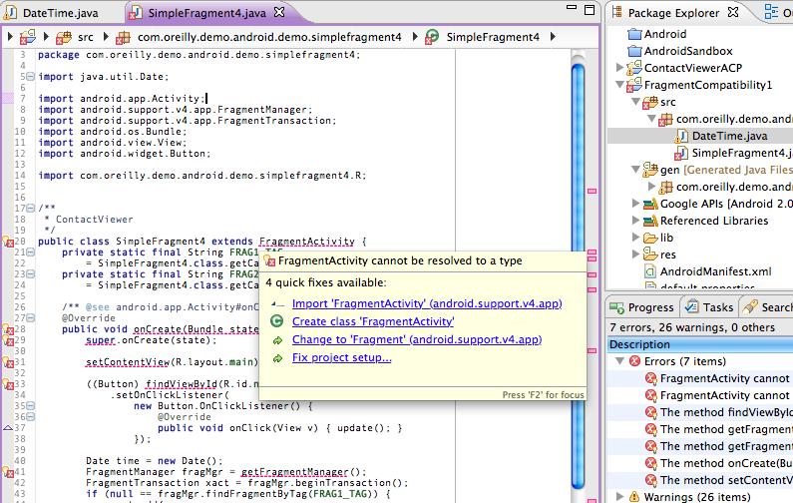
Using the ACP
Activities that use fragments must be updated to subclass FragmentActivitity instead of Activity.
Notes:
FragmentActivity is the ACP version of Fragment

Slide 35
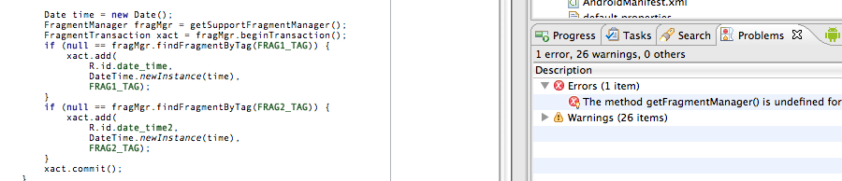
Using the ACP
Use SupportFragmentManager instead of FragmentManager
Notes:
… and SupportFragmentManager is the ACP name for FragmentManager

Slide 36
Using the ACP
That's it!
Covered back to API v6
Not forward compatible!
Btw, the source for the compatibility lib is and excellent resource for finding out how fragments work.
Notes:
Note that this is not running on Honeycomb Fragments. When changes appear in IceCream, it won't be running on those either. It is running on ACP fragments, for ever and ever.

Slide 37
Honeycomb Fragments
Fragments, Views and Activities
Fragment Essentials
Recovering State
Dynamic Fragments and Transactions
Passing Arguments
Using the ACP
Multi-Platform Layout
Notes:
So, now you are all compatible, right?

Slide 38
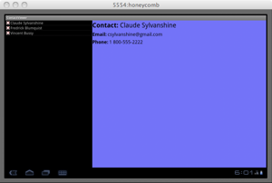
Handling Portrait Screen Orientation
So, that's great: your app now runs on Froyo
Unfortunately, when you run it, instead of this:
Notes:
Well, almost...

Slide 39
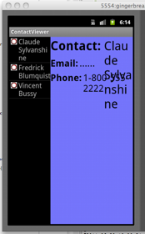
Handling Portrait Screen Orientation
On most devices, it looks like this:
Well, that's no good!
Notes:
Debugging tip!
Demo Ctl-F11, FTW

Slide 40
Handling Multiple Screens
Configuration Qualifiers
  small, normal, large, xlarge
  land, port
  Also density and aspect ratio
Documented here:
http://developer.android.com/guide/practices/screens_support.html
http://developer.android.com/guide/topics/resources/providing-resources.html#BestMatch
Notes:
It turns out that you can include multiple layouts in a single app. The one chosen is the one that comes closest to matching the configuration qualifiers on the name of the directory that contains the resource
The algorithm for choosing the best fit is a little complicated; it takes a few reads to understand that it does pretty much exactly what you want.... most of the time.

Slide 41
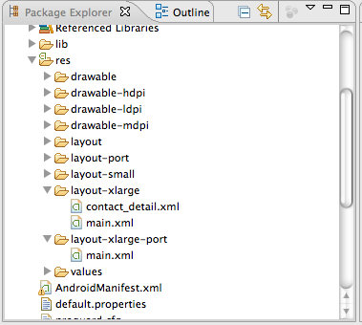
Handling Multiple Screens
We want a vertical layout for portrait mode:
Create a second layout named “main” in the portrait directory
Notes:
Here's an example of a resource tree with layouts for multiple screen sizes in multiple layouts.

Slide 42
Handling Multiple Screens
Layout: the original layout, the default (landscape):
<?xml version="1.0" encoding="utf-8"?>
<LinearLayout
xmlns:android="http://schemas.android.com/apk/res/android"
android:orientation="horizontal"
android:layout_width="fill_parent"
android:layout_height="fill_parent"
>
<ListView
android:id="@+id/contacts"
android:layout_width="0dp"
android:layout_height="fill_parent"
android:layout_weight="1"
/>
<FrameLayout
android:id="@+id/contact_detail"
android:layout_width="0dp"
android:layout_height="fill_parent"
android:layout_weight="2"
android:background="@color/blue"
/>
</LinearLayout>
Notes:
This is our original layout

Slide 43
Handling Multiple Screens
Layout: small, portrait screens
It's missing the fragment!
<LinearLayout
xmlns:android="http://schemas.android.com/apk/res/android"
android:orientation="vertical"
android:layout_width="fill_parent"
android:layout_height="fill_parent"
>
<ListView
android:id="@+id/contacts"
android:layout_width="fill_parent"
android:layout_height="fill_parent"
android:layout_weight="2"
/>
</LinearLayout>
Notes:
This layout would go in res/layout-port

Slide 44
Handling Multiple Screens
Code: in onCreate, check to see if the layout item is there:
public void onCreate(Bundle state) {
super.onCreate(state);
setContentView(R.layout.main);
final boolean useFrag
= null != findViewById(R.id.contact_detail);
if (useFrag) { installFragment(); }
// …
}
Notes:
Now, all we have to do is check to see if the fragment is there!

Slide 45
Handling Multiple Screens
Code: … if it is, add a fragment (new):
private void installFragment() {
FragmentManager fragMgr = getSupportFragmentManager();
if (null != fragMgr.findFragmentByTag(FRAG_TAG)) { return; }
FragmentTransaction xact = fragMgr.beginTransaction();
xact.add(
R.id.contact_detail,
ContactDetailFragment.newInstance(null, null),
FRAG_TAG);
xact.commit();
}
Notes:
This is the initialization code: create a new fragment.

Slide 46
Handling Multiple Screens
Code … or stack a new one, on a click.
private void stackFragment(String id, String name) {
FragmentTransaction xact
= getSupportFragmentManager().beginTransaction();
xact.replace(
R.id.contact_detail,
ContactDetailFragment.newInstance(id, name),
FRAG_TAG);
xact.addToBackStack(null);
xact.setTransition(FragmentTransaction.TRANSIT_FRAGMENT_OPEN);
xact.commit();
}
Notes:
This is called from the onClick method for the ListView, if usingFrags is true.

Slide 47
Handling Multiple Screens
Code: if it isn't, just use the normal deck metaphor:
private void stackActivity(String id, String name) {
Intent intent = new Intent();
intent.setClass(this, ContactDetailActivity.class);
intent.putExtra(ContactDetails.TAG_ID, id);
intent.putExtra(ContactDetails.TAG_CONTACT, name);
startActivity(intent);
}
Notes:
Here's the code for onClick if usingFrags is false
Sending the intent navigates to the next page: the typical android mechanism.

Slide 48
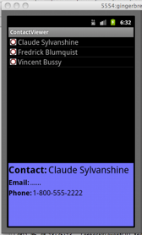
Handling Portrait Screen Orientation
Sweet!
This application will now, dynamically, switch appearance to suite the screen orientation.
Notes:
It now looks pretty good in portrait mode without losing landscape. You're now pretty compatible

Slide 49
Thanks!!
G. Blake Meike
blake.meike@gmail.com
http://portabledroid.wordpress.com/
Slides and code are available:
https://github.com/bmeike/Fragments
Also in Chapter 8 of Programming Android
Mednieks, Dornin, Meike, Nakamura, O'Reilly Media
Notes:
Thanks! This was a quick tour... but the outline should give you a context for Honeycomb coding.
The code and this stack are available on GitHub.

