Slide 1
LMI-Based Multirate Steady-State Kalman Filter Design: Comparison of Offline and Recursive Gains
Léo AHMED MUSHTAQ

Slide 2
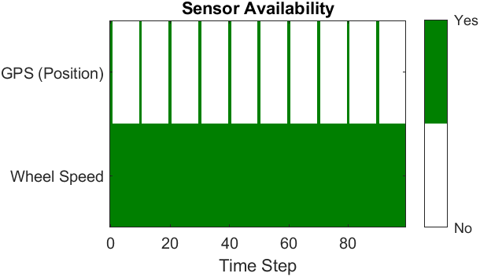
N = 10

Slide 3
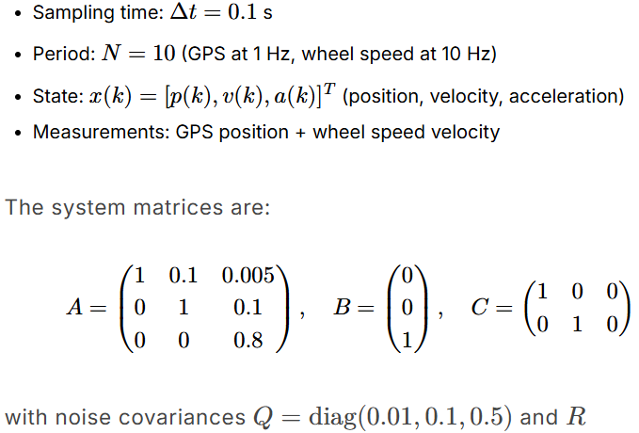
Our system

Slide 4
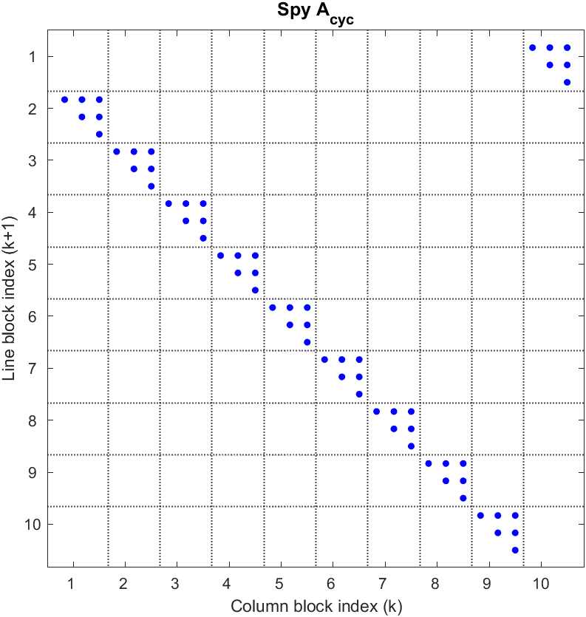
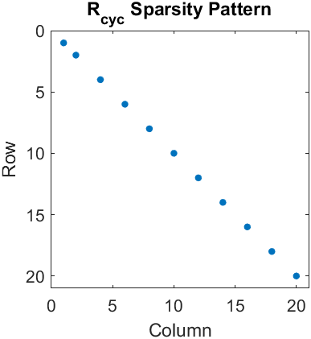
State space representation : x_cyc(k+1) = A_cyc·x_cyc(k) + Val·w
Measurement noise covariances

Slide 5
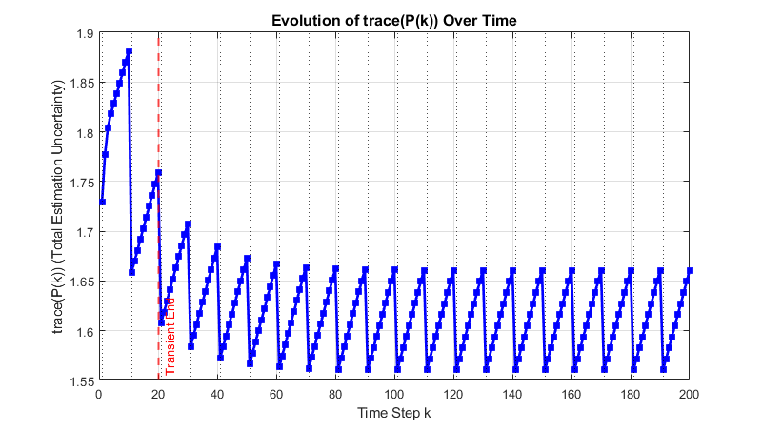
With arbitrary choice of P(0/0):
P0 = eye(3,3);
GPS
trace(P(k)) measures the total estimation uncertainty (the sum of the error variances for position, velocity, and acceleration).

Slide 6
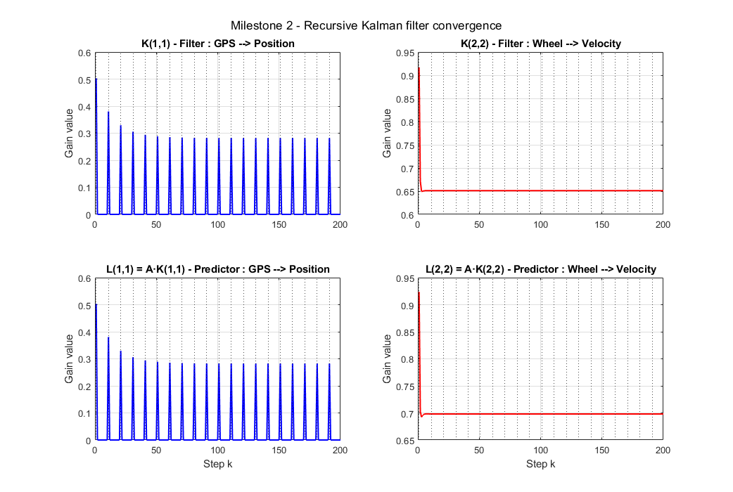
N = 10
~0,28
~0,28

Slide 7
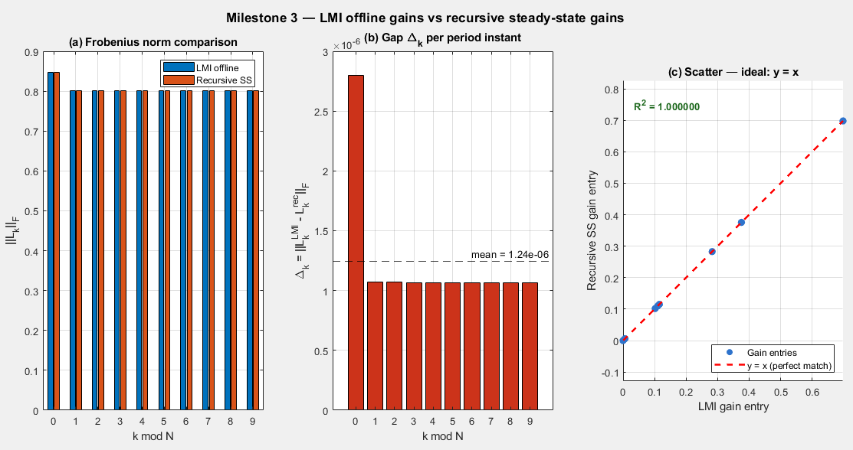

Slide 8
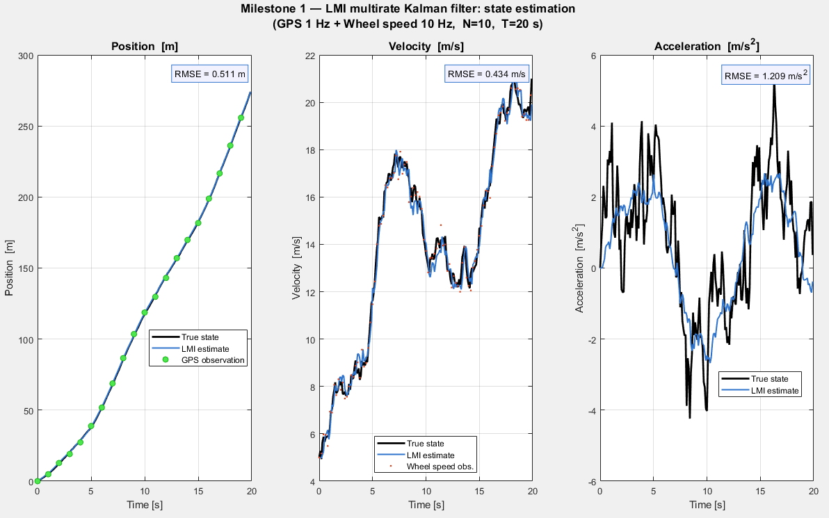

Slide 9
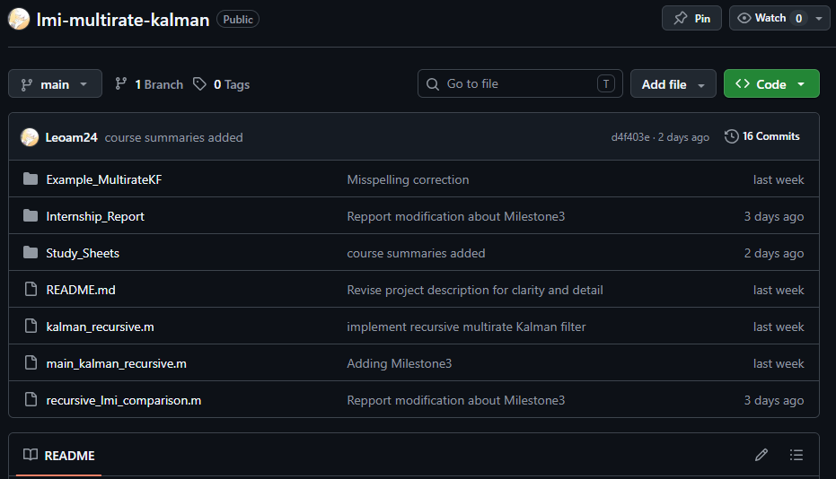
https://github.com/Leoam24/lmi-multirate-kalman

