Slide 1
LMI-Based Multirate Steady-State Kalman Filter Design: Comparison of Offline and Recursive Gains
Robustness Simulation
Léo AHMED MUSHTAQ

Slide 2
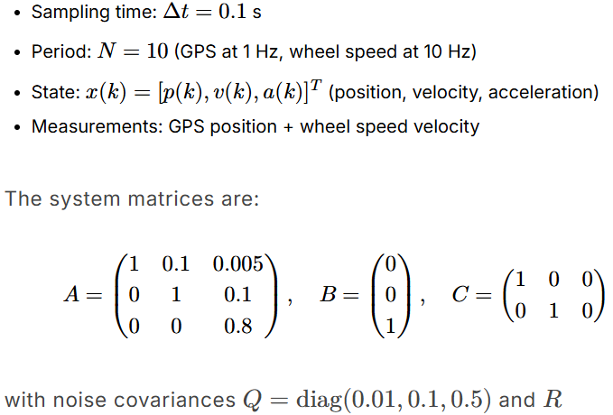
The nominal case
Initial covariance P0 = diag(1, 1, 1)
= diag(1.0, 0.1)

Slide 3
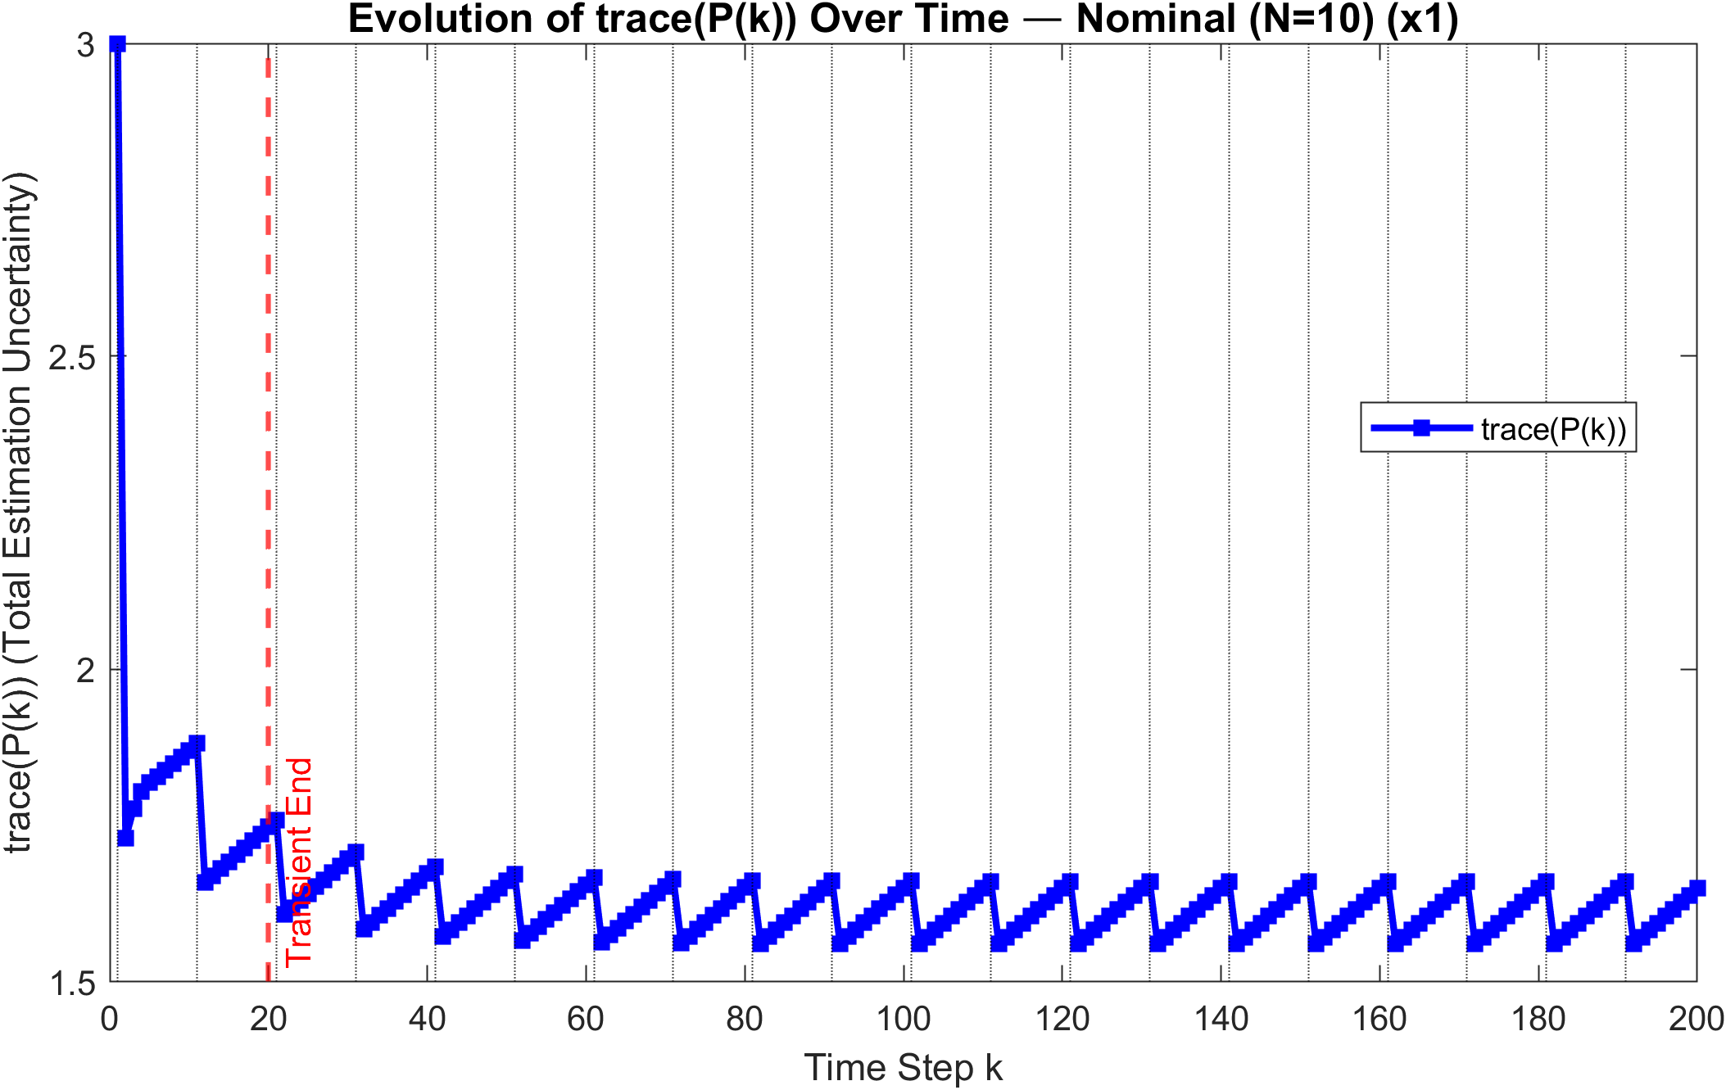
Nominal case
~1,65
~1,55

Slide 4
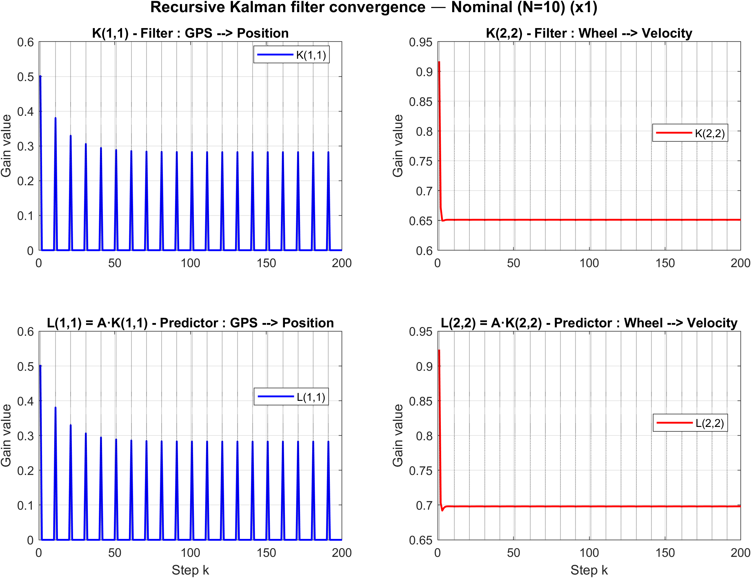
Nominal case

Slide 5
Periodic impact (N)

Slide 6
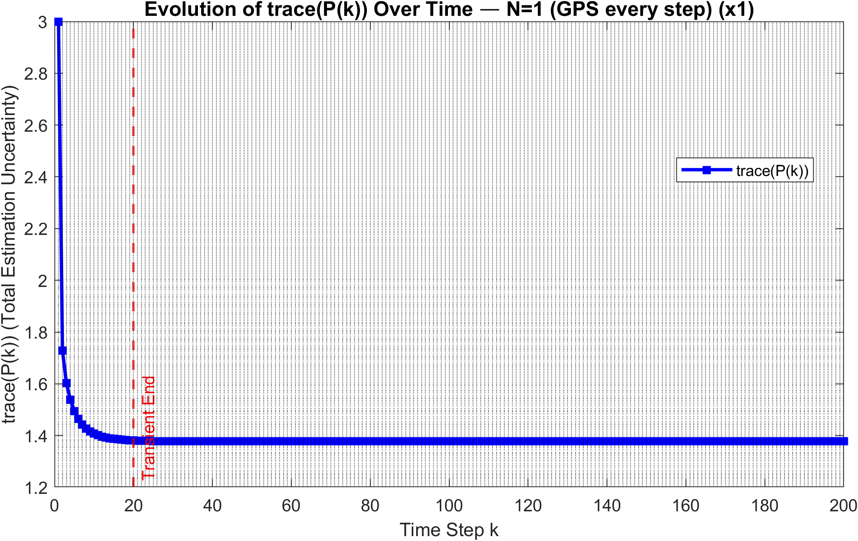
N=1
No sawtooth
~1,38

Slide 7
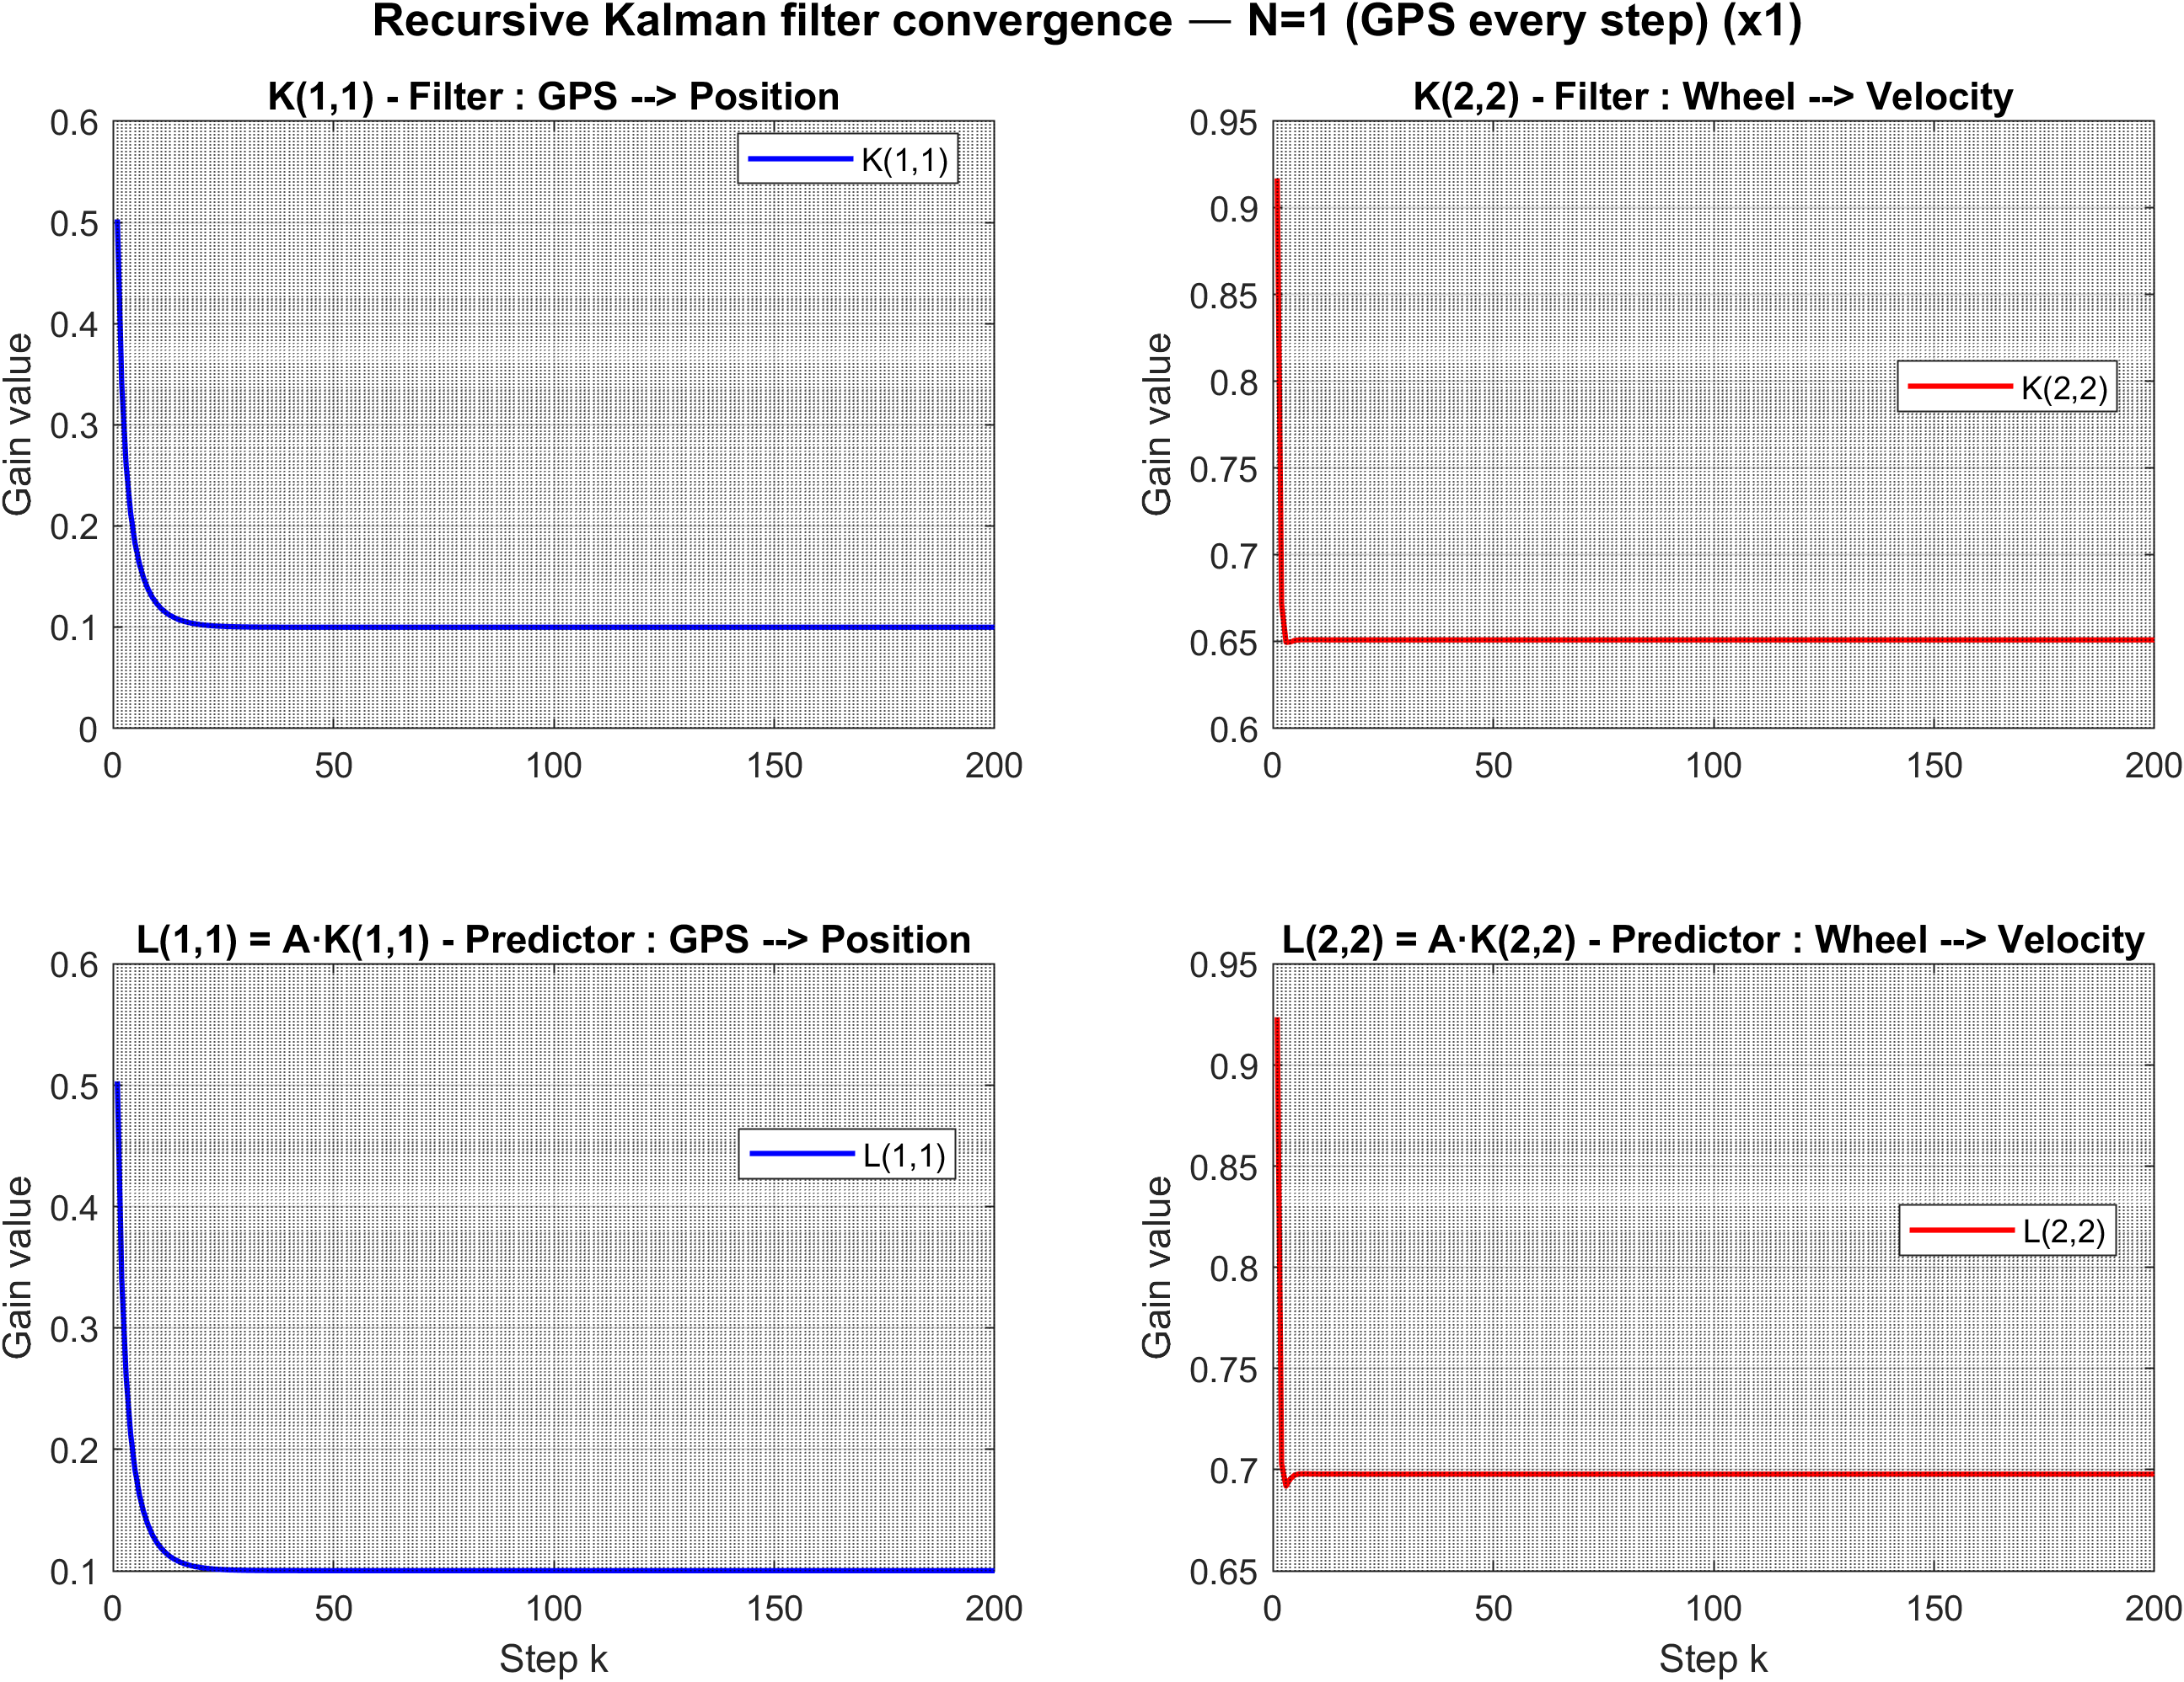
N=1

Slide 8
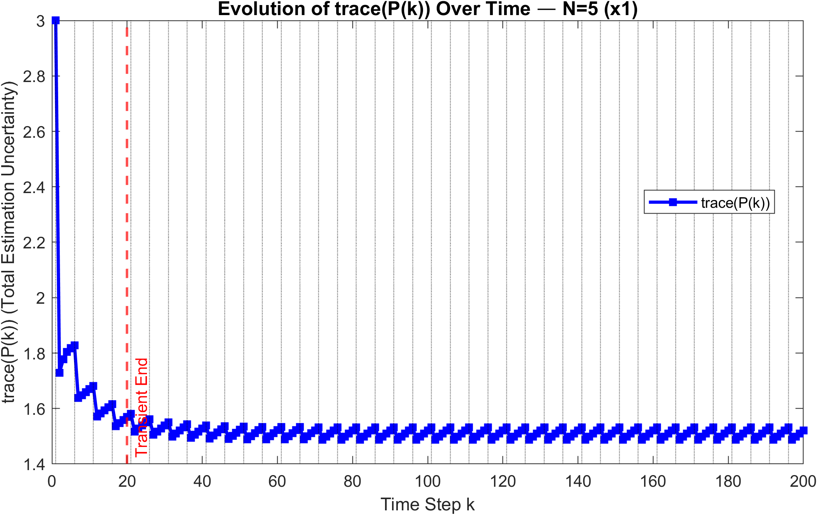
N=5
~1,52
~1,45

Slide 9
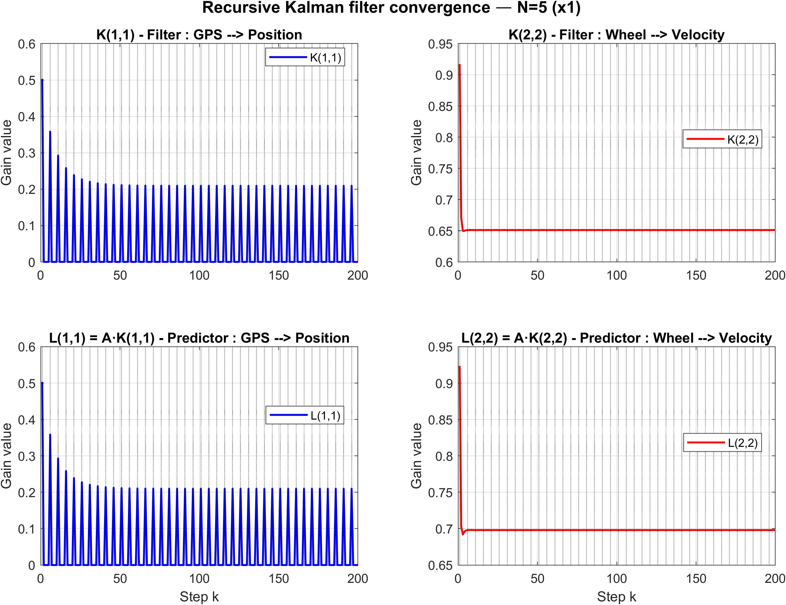
N=5

Slide 10
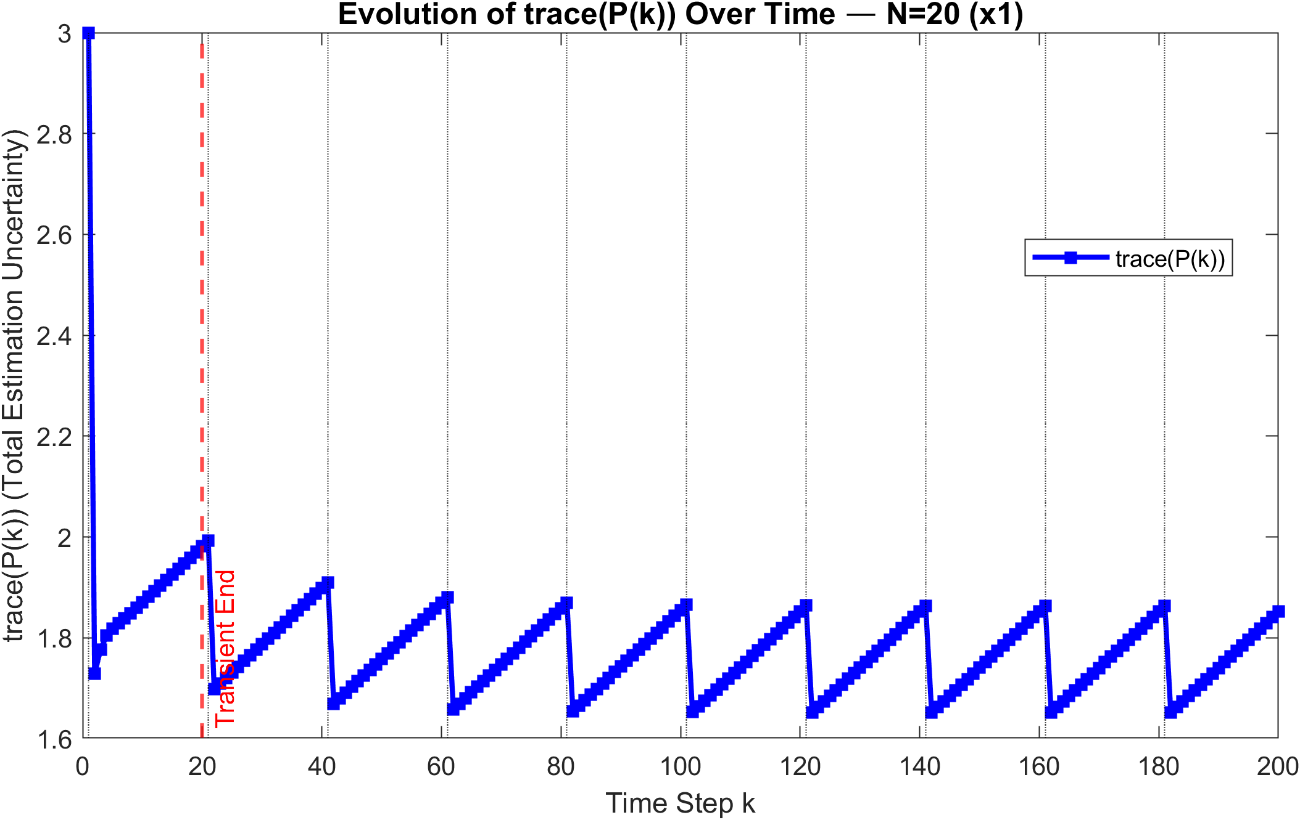
N=20
~1,85
~1,65

Slide 11
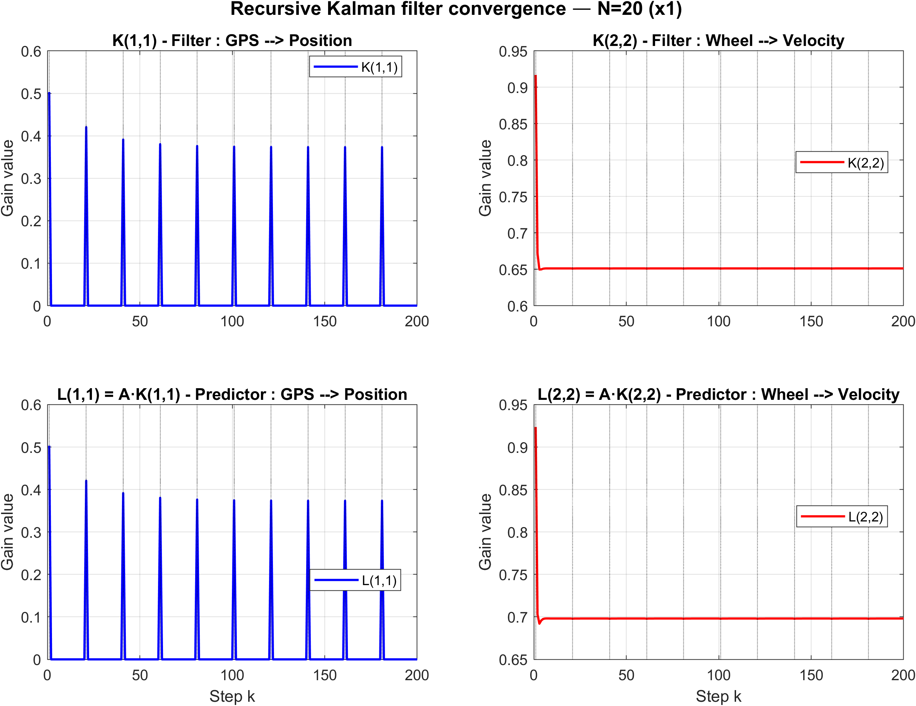
N=20

Slide 12
Larger N --> longer GPS outage --> higher steady-state uncertainty.
The sawtooth amplitude grows monotonically with N.

Slide 13
Initial Covariance Impact (P0)

Slide 14
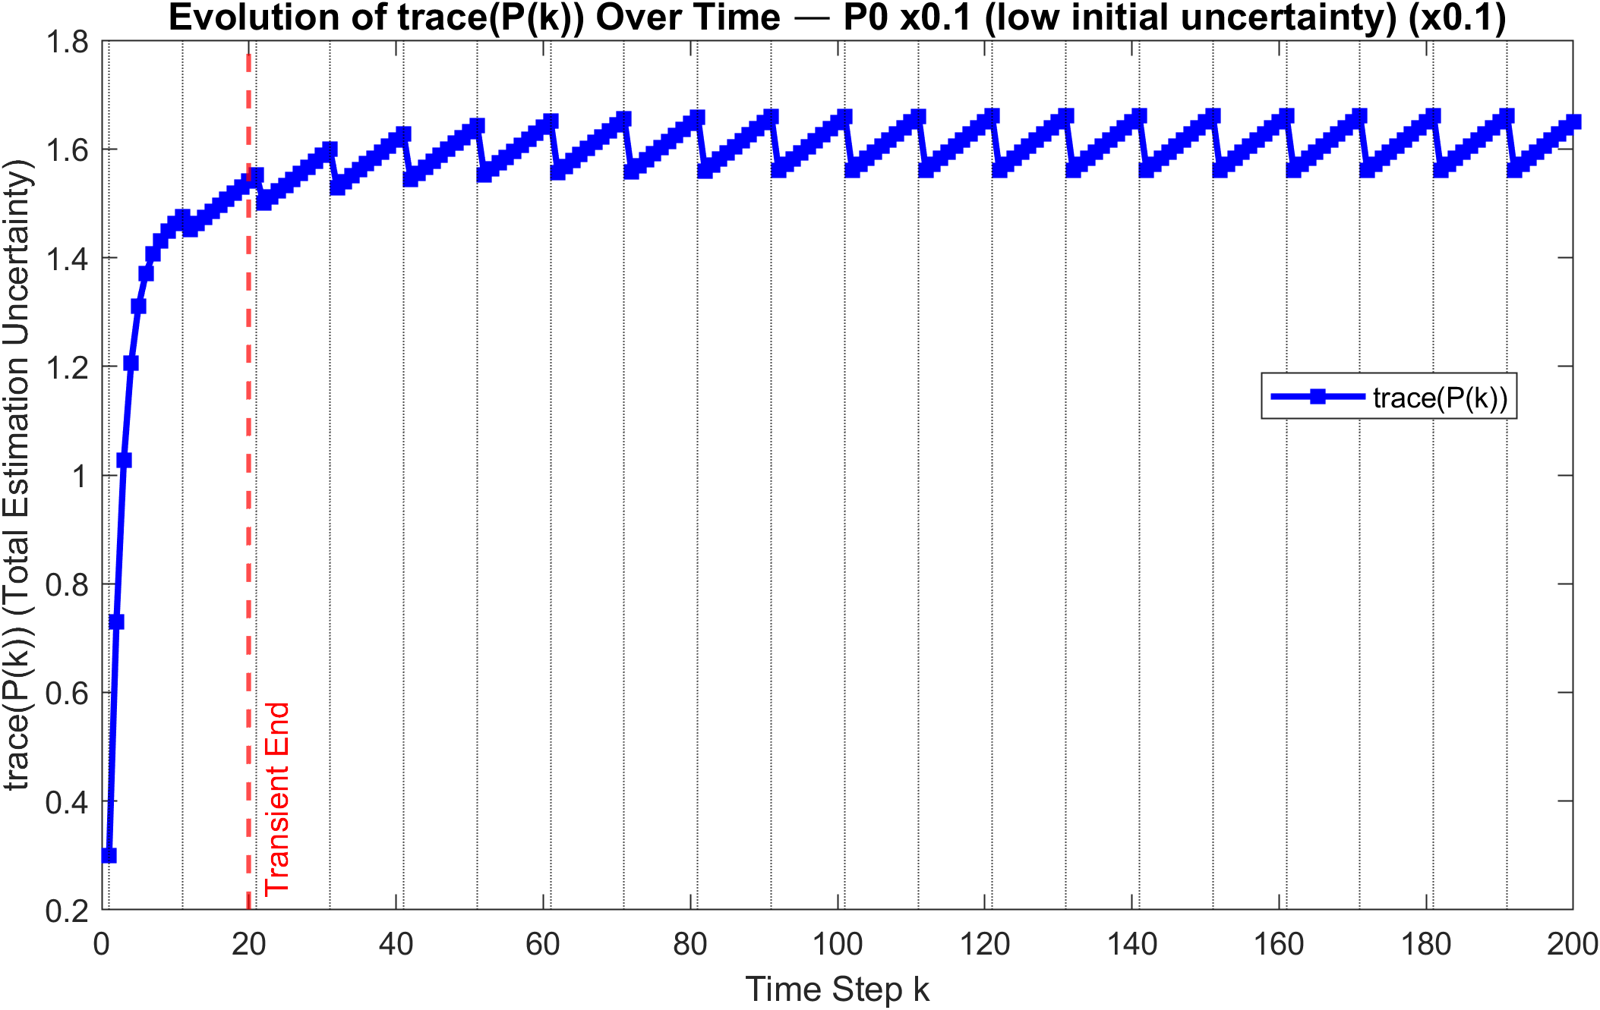
P0 = Id*0,1
~1,65
~1,51

Slide 15
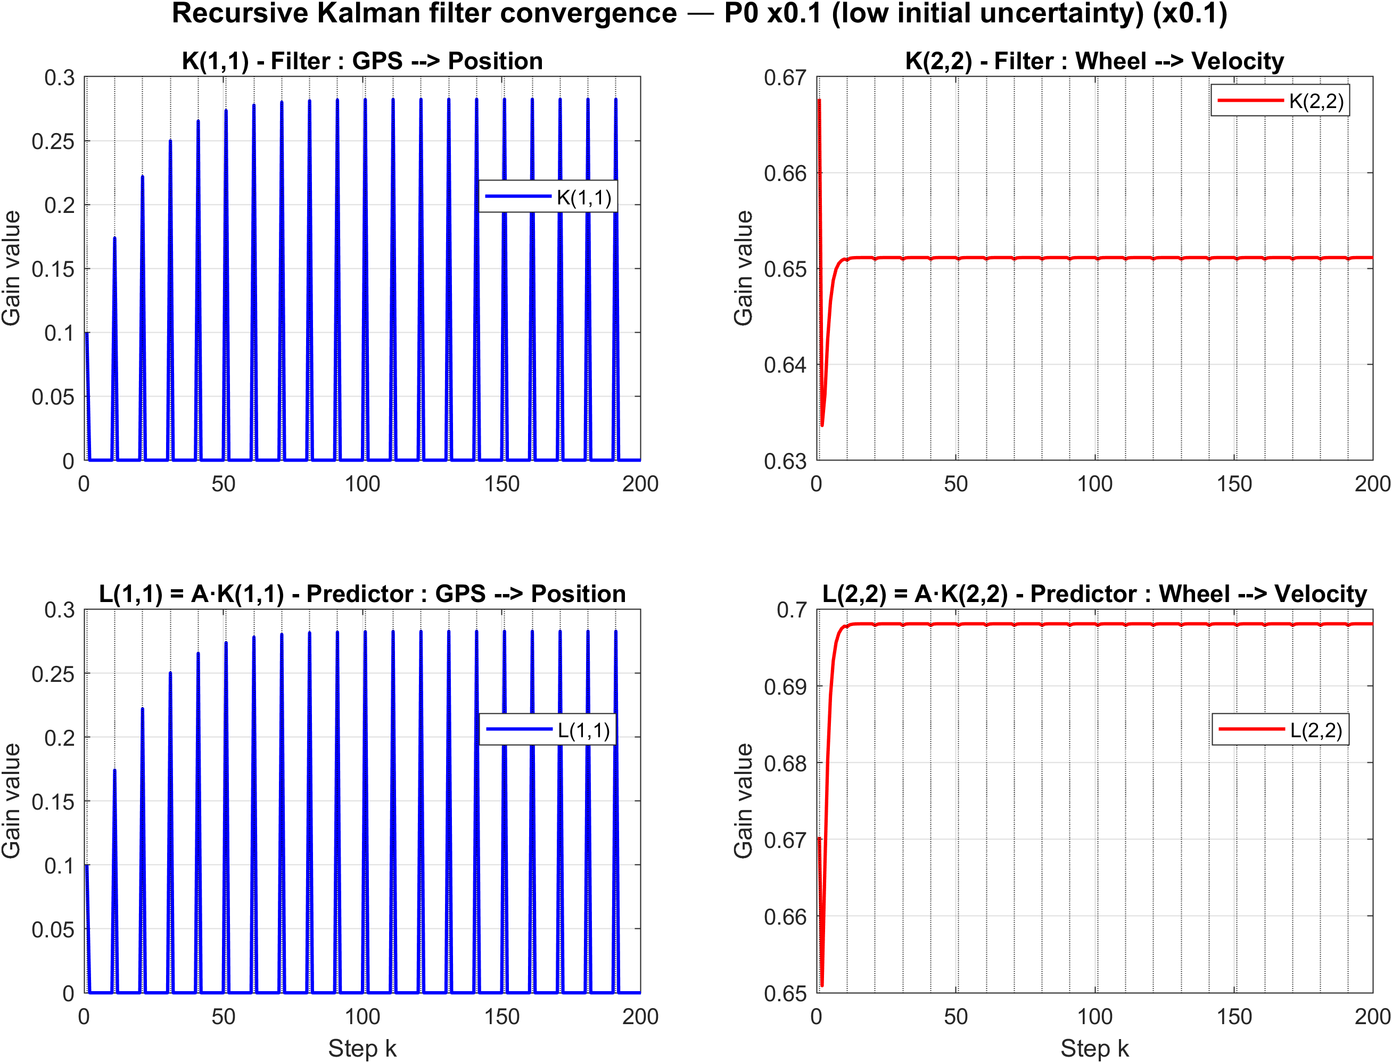
P0 = Id*0,1
Initial gain value is very good

Slide 16
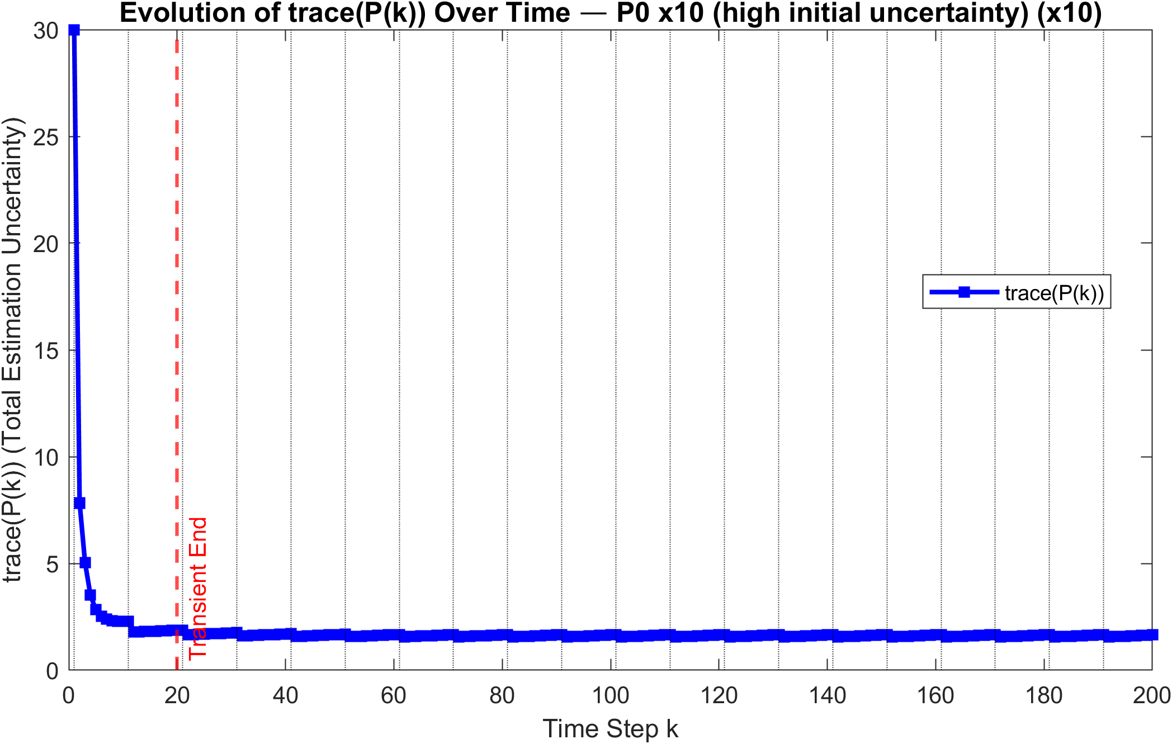
P0 = Id*10
~1,65

Slide 17
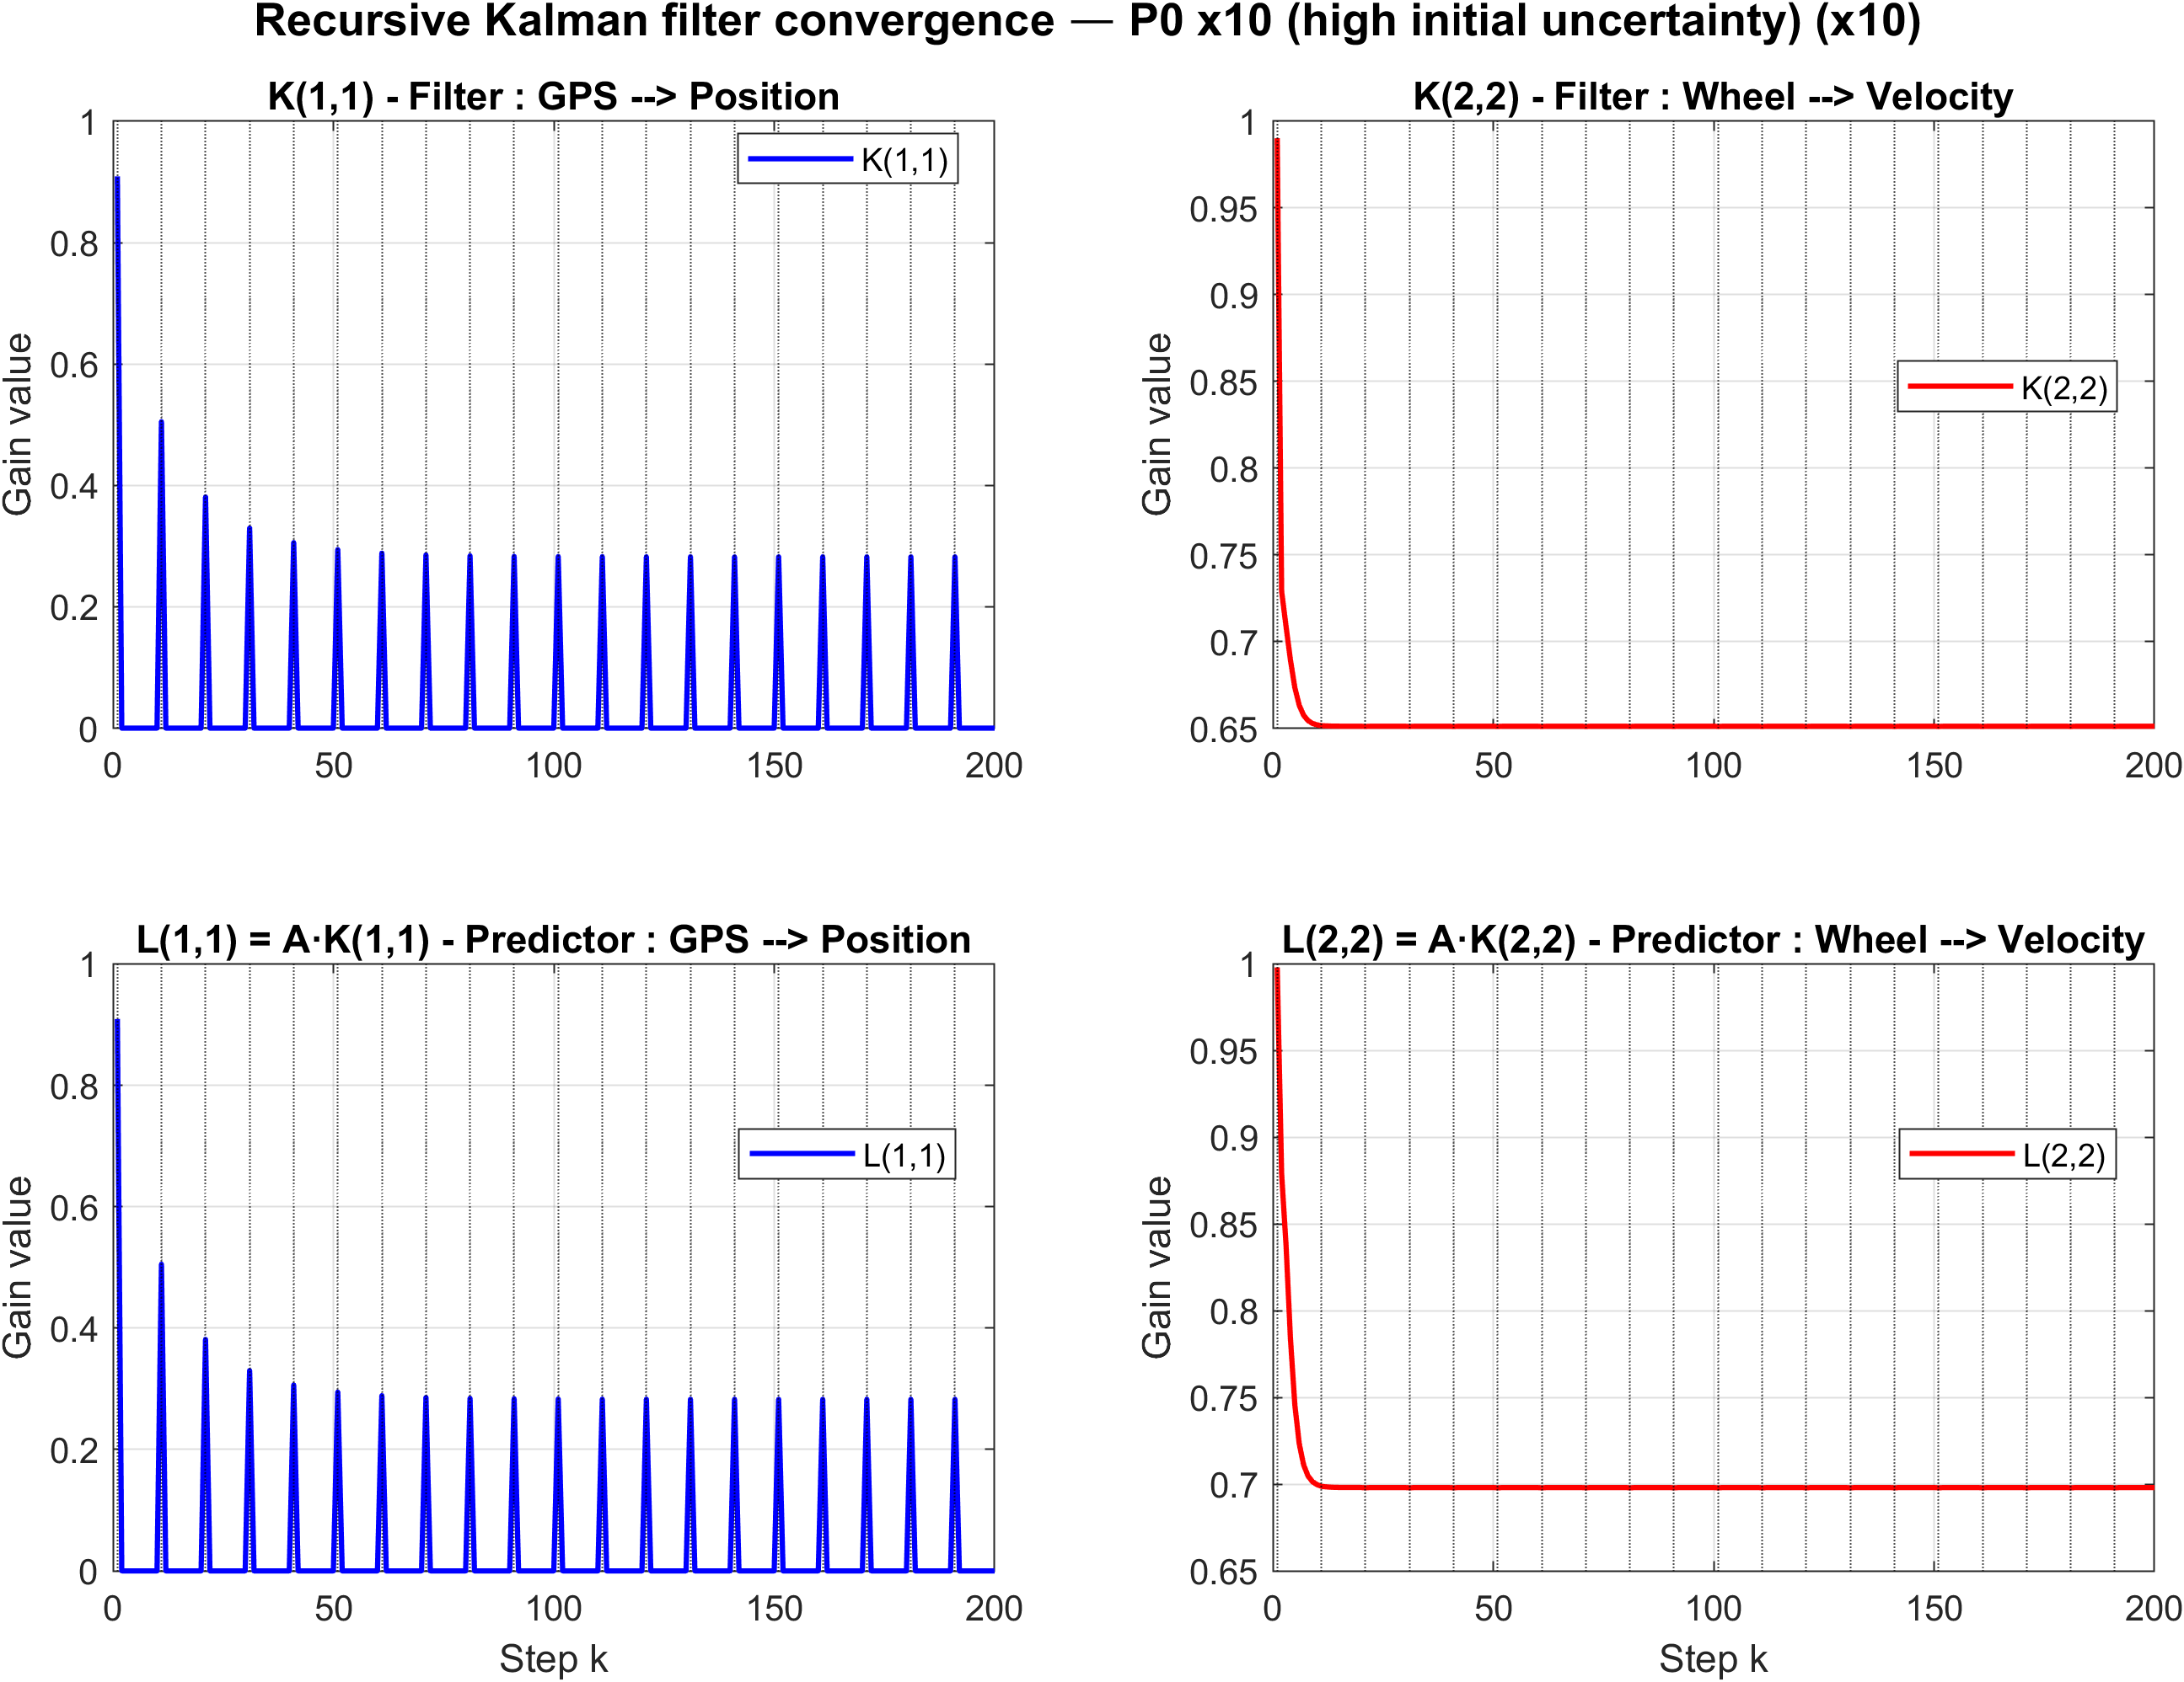
P0 = Id*10

Slide 18
P0 only affects the transient.
Regardless of initial uncertainty (×0.1 or ×10), the filter always converges to the same periodic steady state.

Slide 19
Process Noise Covariance Impact (Q)

Slide 20
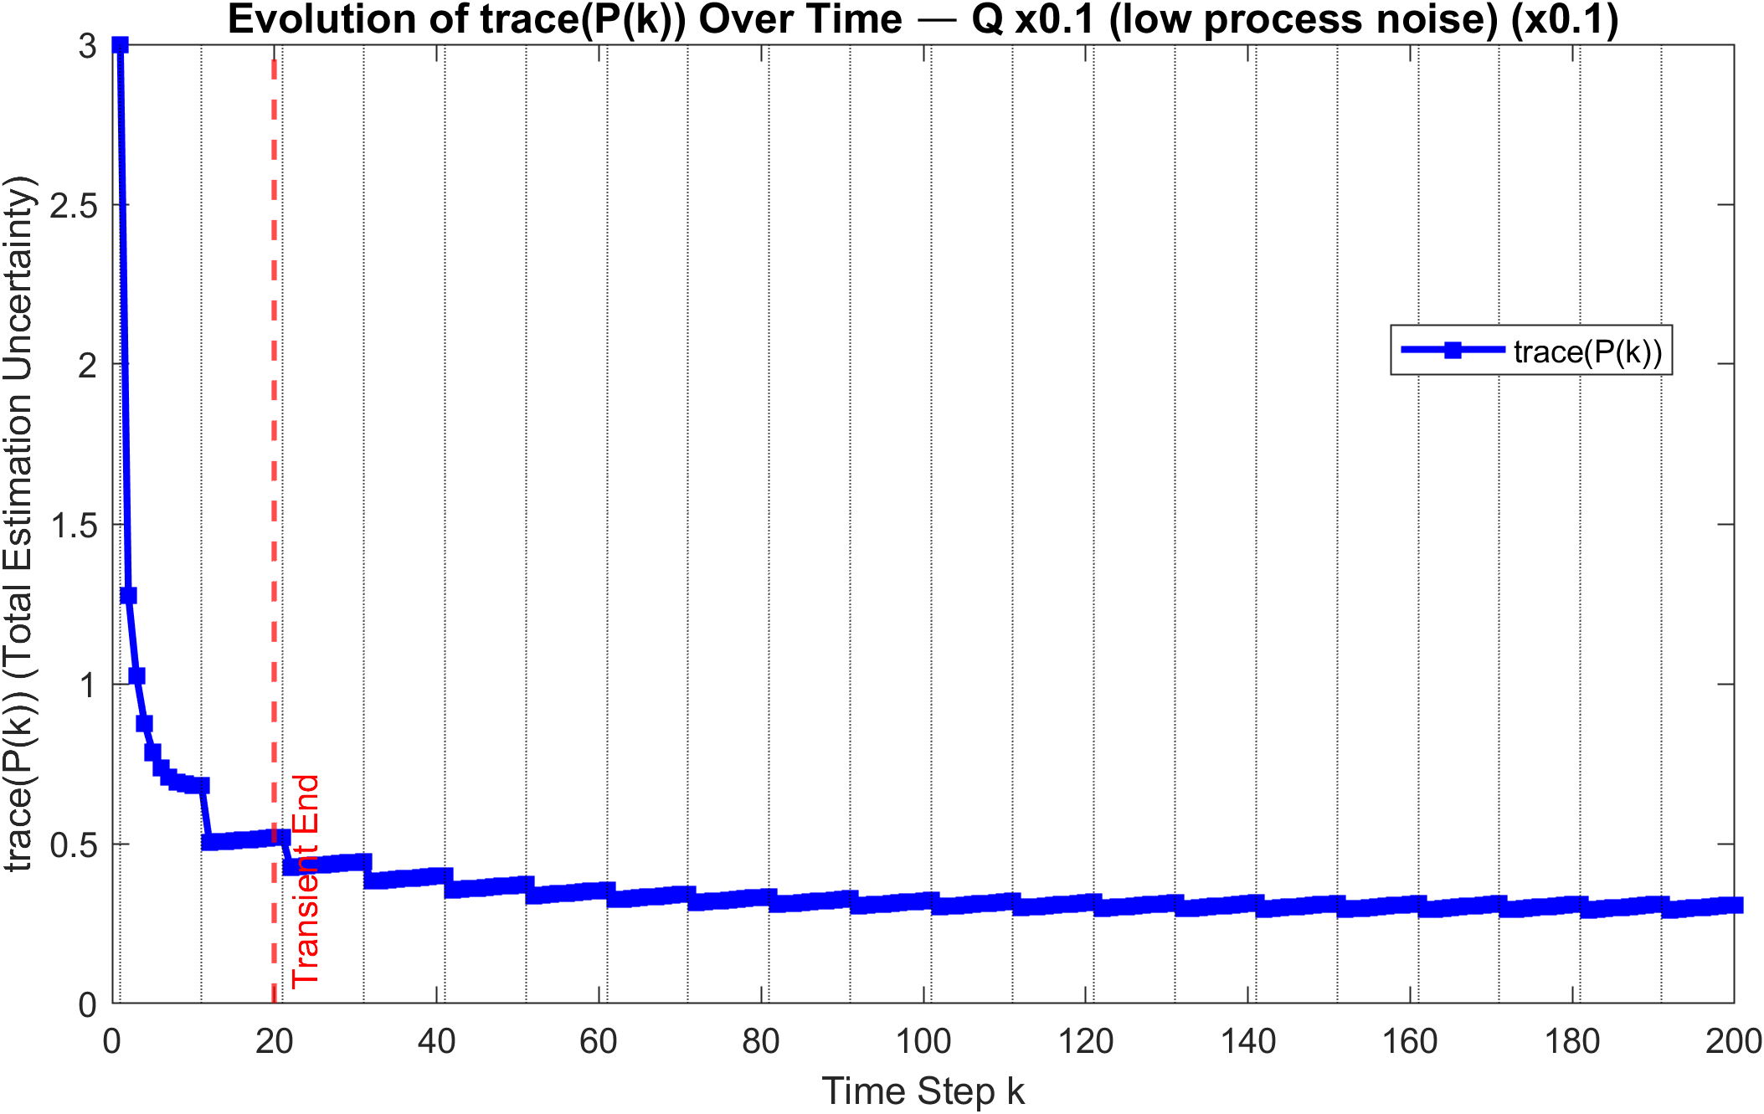
Q = diag([0.01, 0.1, 0.5]) * 0,1
~0,31

Slide 21
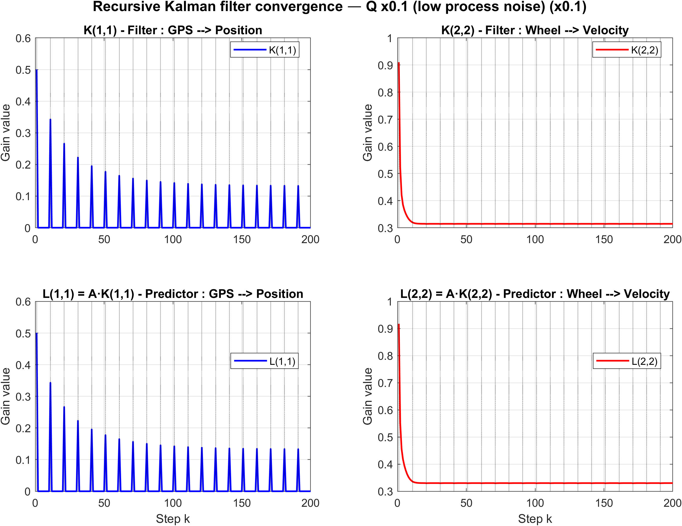
Q = diag([0.01, 0.1, 0.5]) * 0,1
Low gain as the model is nearly perfect

Slide 22
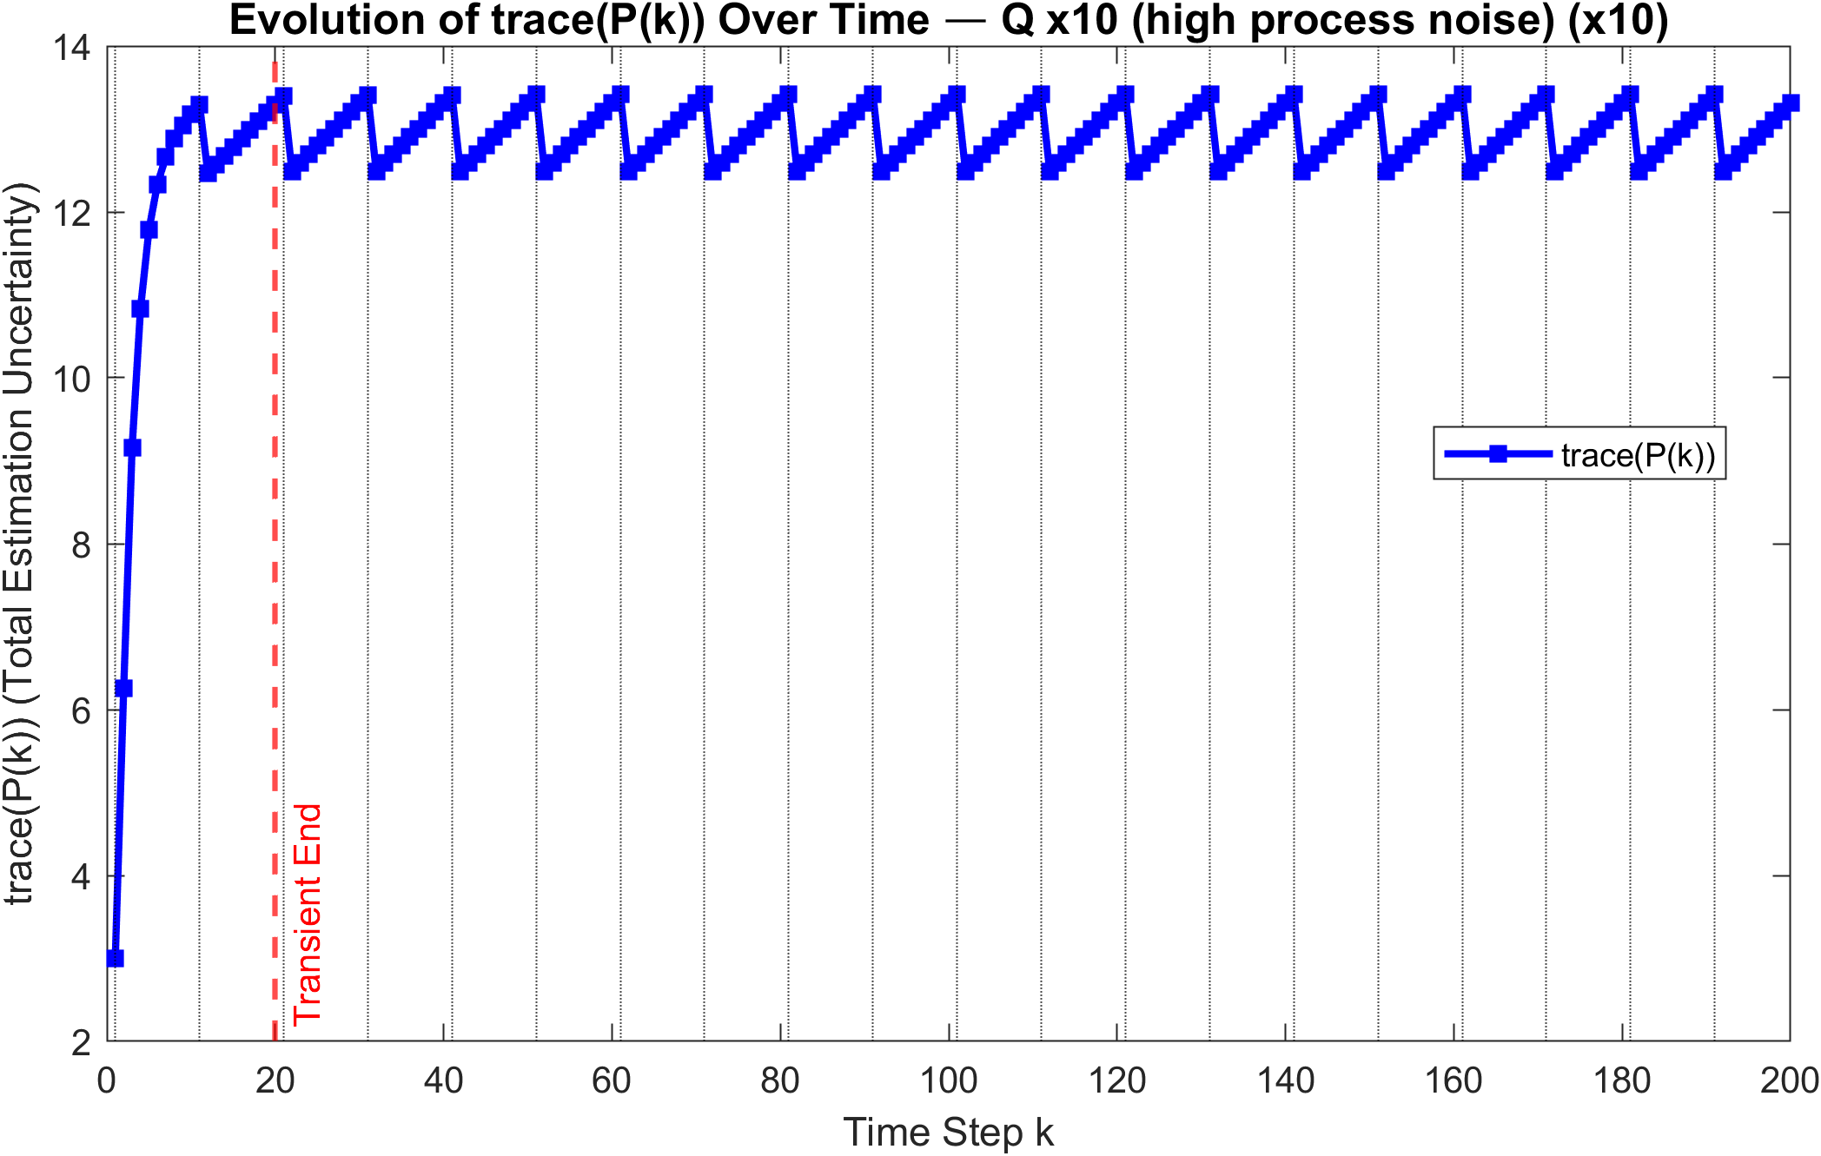
Q = diag([0.01, 0.1, 0.5]) * 10
~13,3
~12,2

Slide 23
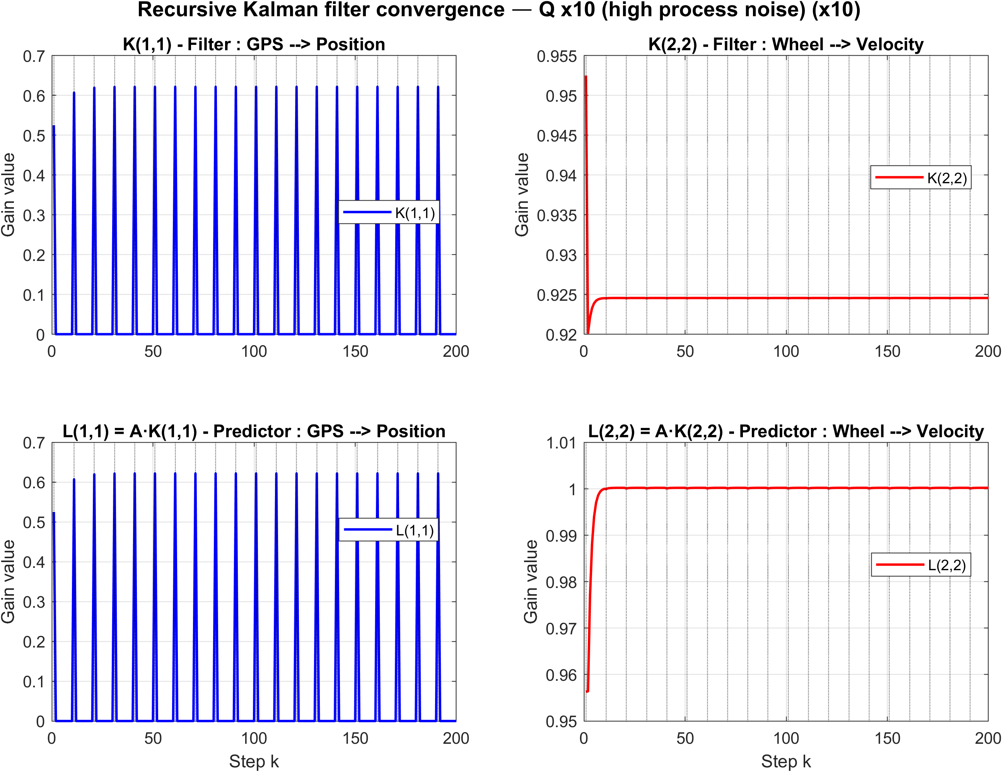
Q = diag([0.01, 0.1, 0.5]) * 10
Higher gain compared to the nomial one (was 0,65)

Slide 24
Q tunes the balance between model trust and sensor trust.
High Q --> filter relies on measurements, gains rise and steady-state uncertainty explodes.
Q has the largest effect on trace(P) of all tested parameters.

Slide 25
Measurement Noise Covariance Impact (R)

Slide 26
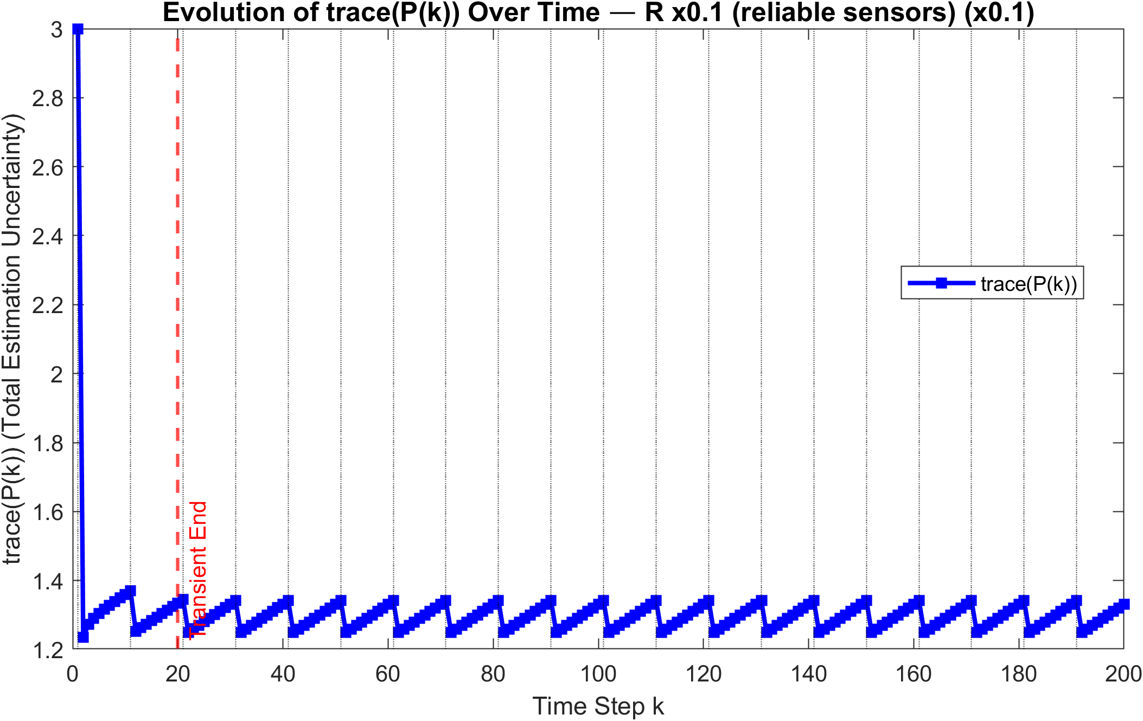
R = diag([1, 0.1]) * 0,1
~1,33
~1,21

Slide 27
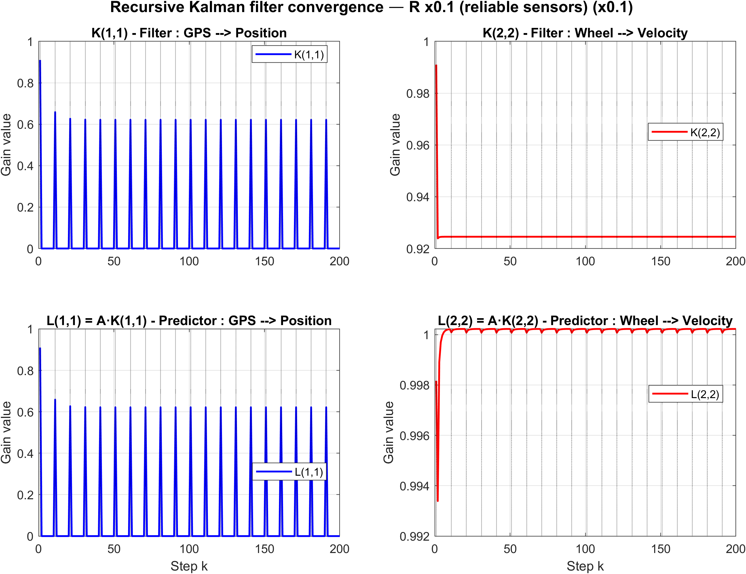
R = diag([1, 0.1]) * 0,1
High gain as the sensor output are reliable

Slide 28
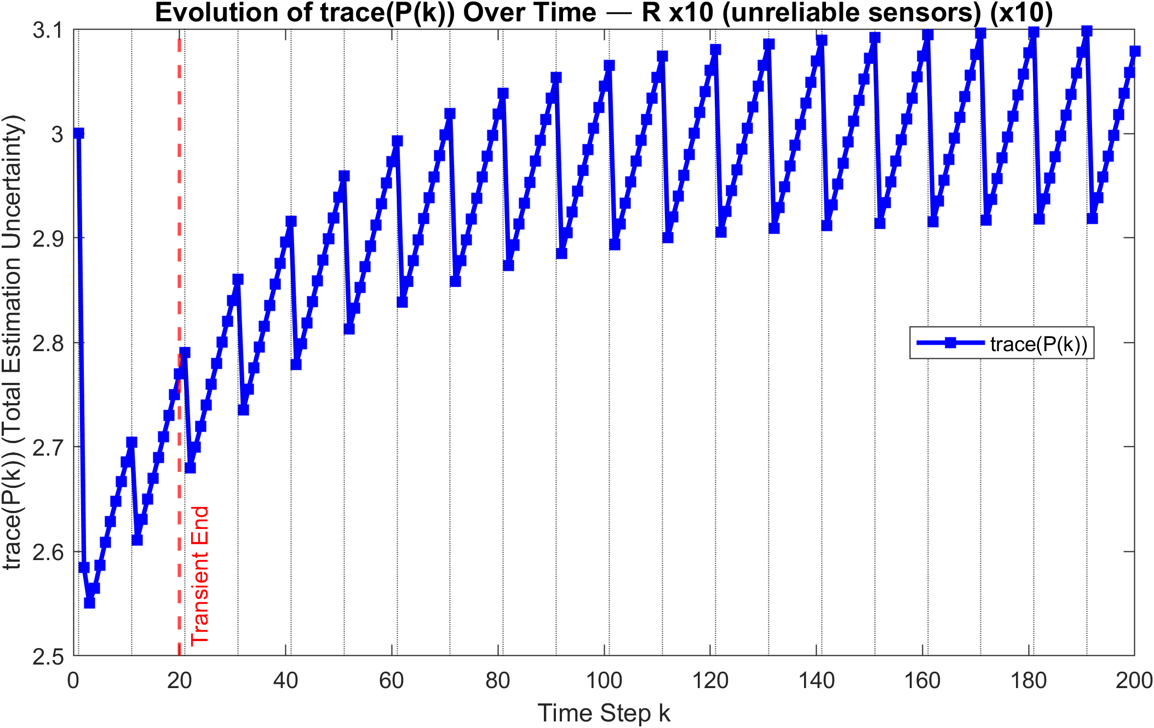
R = diag([1, 0.1]) * 10
Not Converging for k = 200

Slide 29
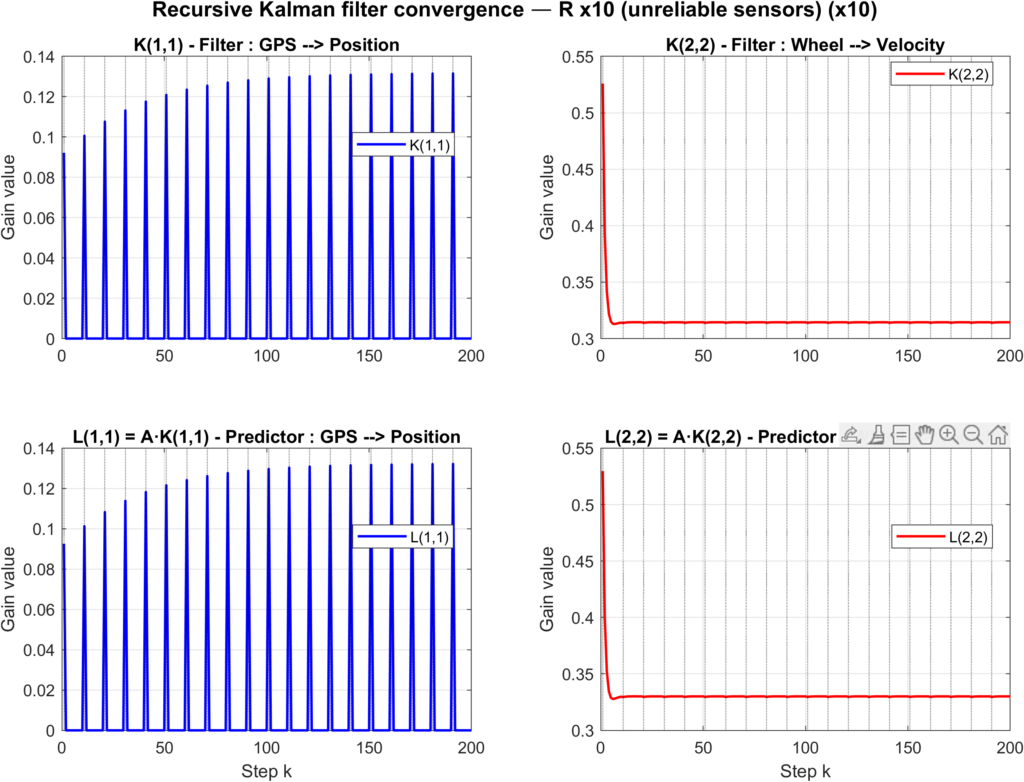
R = diag([1, 0.1]) * 10

Slide 30
R×0.1 improves accuracy modestly.
R×10 is a practical limitation: the periodic steady state is not reached within 200 steps.
When sensors are too unreliable, convergence is too slow for the simulation horizon the filter is theoretically stable but practically unusable at this timescale.

Slide 31
The filter is robust with the initialisation but sensitive to the noise process and might not converge in the wanted time lenght if the sensors are not reliable

Slide 32
To do
Faire une simulation avec Q et R élevé .
Faire un tableau pour mettre en evidence les valeurs haute et basse de la trace de P. Pour chaque cas . Ainsi que pour les gains

