Slide 1
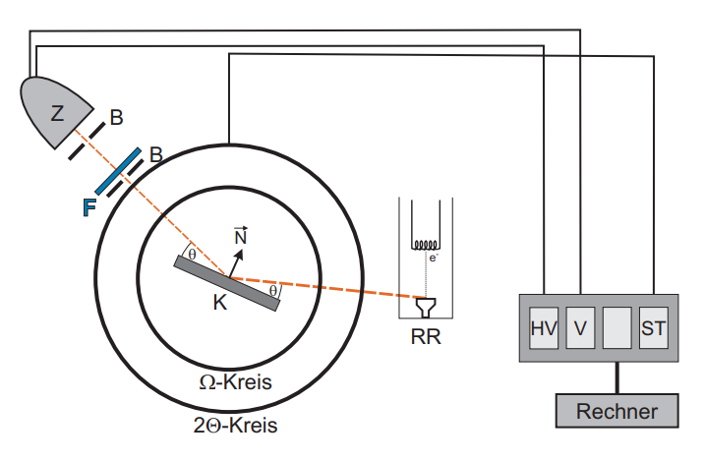
S
M
circle
Computer
circle

