Slide 1
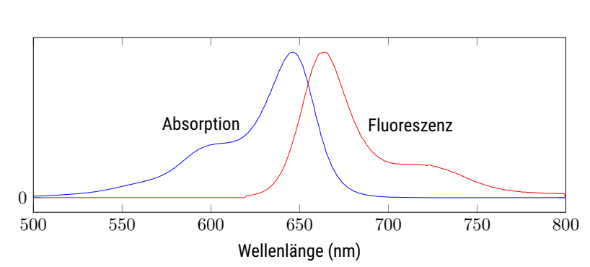
wavelength (nm)

