Slide 1
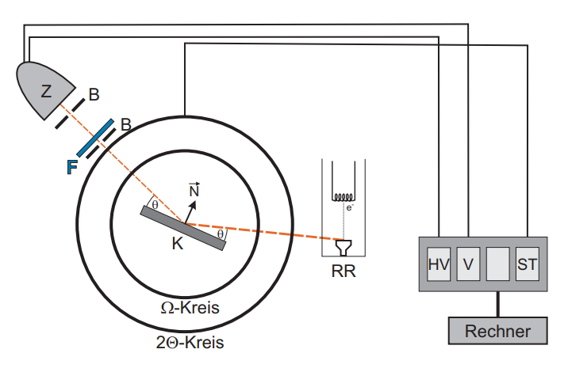
circle
Computer
circle

