Slide 1
APPLIED DATA SCIENCE CAPSTONE
FINDING A LOCATION TO OPEN A RESTAURANT IN MANHATTAN
LEOBARDO GÓMEZ

Slide 2
INTRODUCTION
Given that New York City is one of the biggest cities in the world, it is very difficult to find the best place to start a new business. Manhattan is one of the most important boroughs in New York City, because it is very densely populated and for the fact that is the economic, administrative and cultural center of the city. This makes Manhattan and ideal spot for starting a restaurant.

Slide 3
INTRODUCTION Business Problem
Is it possible to find a good location in Manhattan to start a resturant?
The goal of this project is to use Data Science to discover the answer to the previous question. So, the target audience for this project are entrepeneurs with the idea of starting a restaurant in Manhattan.

Slide 4
DATA
The web article:
https://fitsmallbusiness.com/choose-a-restaurant-location/
Contains some guidelines to choose a location for a new restarutant

Slide 5
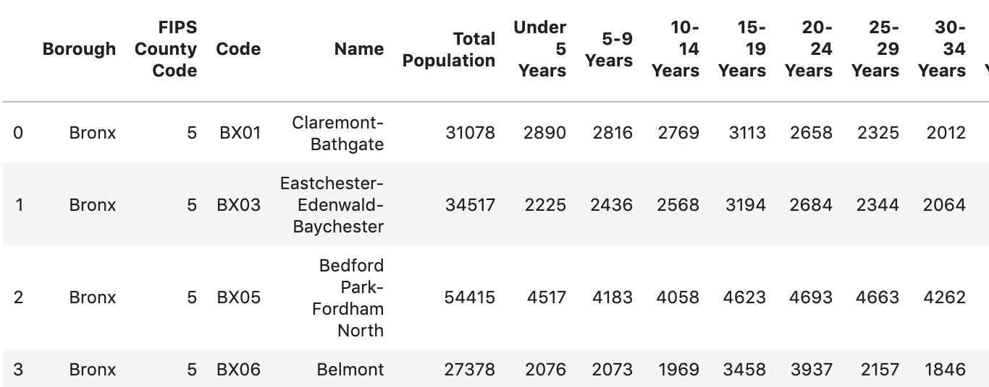
DATA
The following URL contains information about groups of age in New York, divided by Borough:
https://www1.nyc.gov/site/planning/planning-level/nyc-population/census-2010.page
From this site, it's possible to download information about age.

Slide 6
DATA
The information about the neighborhoods and their respective coordinates are in the dataset:
https://geo.nyu.edu/catalog/nyu_2451_34572

Slide 7
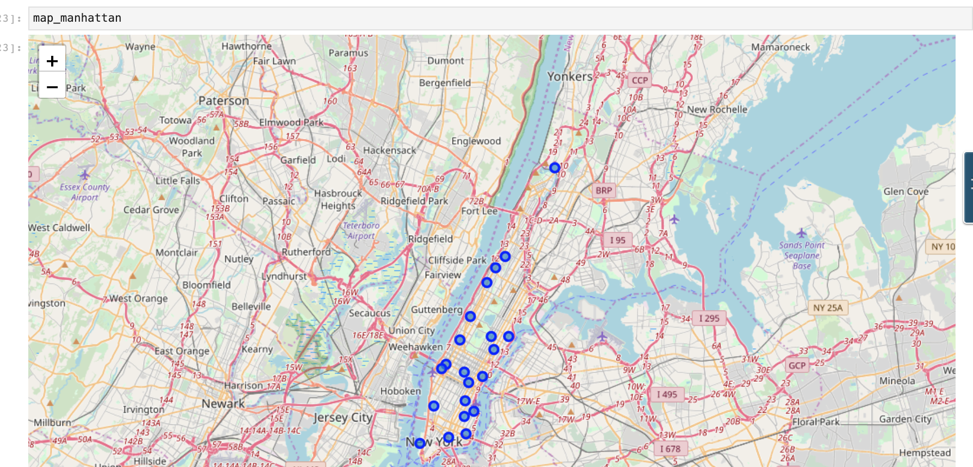
DATA

Slide 8
METHODOLOGY
The article suggest that the required data to determine a good location could be:
Demographic information, specifically about age and economics of the population
Types of venues in the location
Restaurant concept (meaning the type of cuisine and the style of the business)

Slide 9
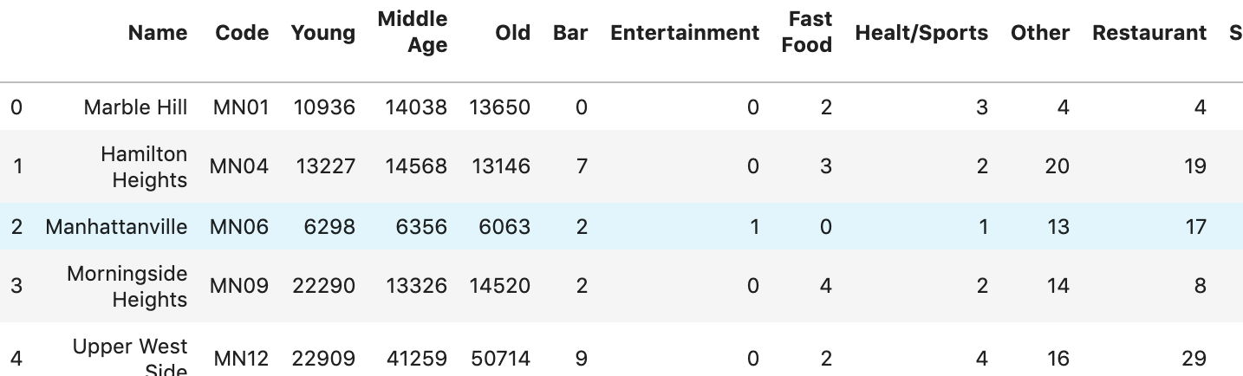
METHODOLOGY
The demographic information from the web resources (downloaded in CSV format) could be segmented in three categories or age groups of population; the types of venues were classified using the information available from FourSquare.

Slide 10
METHODOLOGY
The K-Means algorithm was selected because of its simplicity to cluster information into groups with similar features. The number of clusters selected were 6.

Slide 11
RESULTS
Cluster | Age | Type of venue
Cluster 1 | OLD & MIDDLE AGE groups | Restaurants are the most common Other & Shopping venues are popular
Cluster 2 | OLD group | Restaurants are the most common Other & Shopping venues are popular
Cluster 3 | Balanced in all groups, with more OLD | Other venues are the most common Restaurant & Shopping venues are popular
Cluster 4 | YOUNG group | Restaurant venues are the most common Other & Shopping venues are popular
Cluster 5 | YOUNG & MIDDLE AGE groups | Shopping venues are the most common Spots of interest & Other venues are popular
Cluster 6 | MIDDLE AGE group | Other venues are the most common Restaurant & Shopping venues are popular

Slide 12
CONCLUSION
The web article:
https://fitsmallbusiness.com/choose-a-restaurant-location/
Gives some guidelines to choose the correct spot for open a restaurant. These guidelines could be related to the CLUSTERS that were obtained with the K-Means algorithm.

Slide 13
CONCLUSION
Type of Restaurant | Description | Related cluster
Fast Food | 15 – 35 age range. Regularly is connected to another activity like shopping or activities with friends | CLUSTER 4 – The age group is similar, and there are not much fast food places in this cluster. Also, there are shopping venues around.
Bar & Bistro | 25-45 age range. Takes places after work, relaxed social ambiance. The customer could drink alcohol | CLUSTER 5 – The age group is similar and there are not much competitors around. CLUSTER 6 – The age group is somewhat similar
Casual Dining | Families with children, often connected to another activity like shopping or going to movies | CLUSTER 3 – This cluster has a balanced population in all groups of age. It could be possible to have customers (families). There are shopping and other venues nearby CLUSTER 5 – The majority of the population is young and middle age people. There are shopping venues around
Fine Dining | 35 years or more, couples and executives. High price point | CLUSTER 1 – The population is primarily in 35 + range of age. This could mean higher income as well CLUSTER 2 – The population is in the 50 + range of age.

Slide 14
CONCLUSION
Is it possible to find a good location in Manhattan to start a resturant?
Could be answered if the type of restaurant is given:
Type of Restaurant | Related cluster | Location/Manhattan neighborhood
Fast Food | CLUSTER 4 | Murray Hill, Gramercy, East Village
Bar & Bistro | CLUSTER 5 | Battery Park City
 | CLUSTER 6 | Hudson Yards, Lincoln Square, Clinton
Casual Dining | CLUSTER 3 | Marble Hill, Manhattanville, Stuyvesant Town
 | CLUSTER 5 | Battery Park City
Fine Dining | CLUSTER 1 | Morningside Heights, Upper West Side, West Village, Lower East Side, Lenox Hill, Yorkville
 | CLUSTER 2 | Hamilton Heights, Midtown, Turtle Bay, Chinatown, Upper East Side

