Slide 1
CDE CAPSTONE PROJECT presented by OSIGBEMHE LEO

Slide 2
Overview
A Travel Agency reached out to Core Data Engineers(CDE), their business model involves recommending tourist location to their customers based on different data points.
I have been approached by management to build a Data Platform that will process the data from a Country rest API into their cloud based Database/Data Warehouse for predictive analytics by their Data Science Team.

Slide 3
Methodology
After careful consideration, I decided to build the Data Platform leveraging Docker to host an Orchestration tool, Airflow which would extract the raw data from the Country API and load it into an AWS DataLake, s3. Some columns have been requested by the Data Science Team of the Travel Agency to aid their analysis. These columns are selected and transformed into an Object Storage in the DataLake. The transformed columns are then loaded into a Snowflake Data WareHouse/Database. dbt is used to access the Data WareHouse to aid transforming and modelling of the data into Fact and Dimension tables. Terraform was used as an IaC service to provision the necessary resources in AWS and Snowflake.

Slide 4
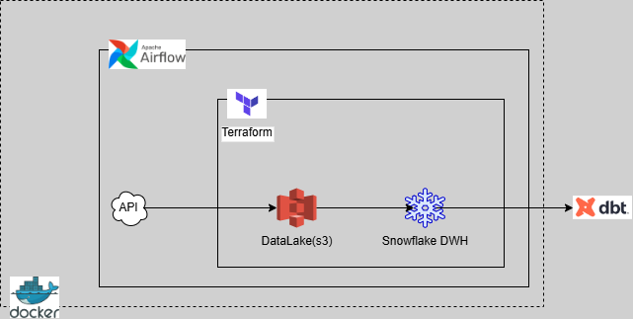
Architectural diagram of the project

Slide 5
Choice of tools
Terraform: It leverages code to build infrastructures seamlessly. In this project, it has been used to setup the needed infrastructures within AWS and Snowflake.
Docker: This is a technology that provides containerization. Hence, it is used in this project to host Airflow on my local machine without putting pressure on the underlying resources of the system.
Airflow: An open-source technology served as the Orchestration tool because of it’s ability to easily scheduler and trigger jobs. Also, it’s integration with AWS cloud and Snowflake Data warehouse.
AWS-Cloud: AWS is the preferred cloud provider for this project because of its scalability and ease of use as a Datalake. Also, its accessibility and compatibility with Terraform.
Snowflake: A snowflake data warehouse was provisioned because of its easy integration with other cloud service providers (in this case, AWS).
dbt: Data Build Tool is used for data transformation within a data warehouse and allows the ELT (Extract, Load, Transform) principle which is used in this project.

Slide 6
Processing involved
Terraform is used to build all the infrastructures asides dbt. The command terraform init is ran in the infrastructure folder which contains all the files needed. After which terraform plan and terraform apply commands are used to set up the infrastructures.
AWS-Cloud and Snowflake DWH are accessed to confirm that the resources provisioned were in place.
Airflow is then setup using the docker-compose.yaml file which contains a built image from the Dockerfile and requirements.txt files. After the containers from the build have been confirmed to be in a healthy state, the Airflow GUI is then accessed via https://localhost:8080.
Note: The dag and task dependences to run in Airflow is initiated in the capstone_prj_dag.py file.
Within the project folder, dbt init is run, which initializes the dbt tool by inputting the required arguments to establish connection to the Snowflake DWH.
The required transformations are carried out in the two sub-folders, staging and processed, of the models folder, which has which contain different sql files that helps to create the following tables, travel_agency, updated_travel_agency, fact_country, dim_country, dim_region, dim_sub_region, dim_independence, dim_un_member and dim_continents in the DWH for the Travel Agency company by running dbt run. Also, within the test folder, a generic test (string_not_empty) was created. Generic and custom test were carried out on specified columns within the models to ensure the columns were not empty, unique and accepted only some particular values by running dbt test.

Slide 7
Insights from the dataset
-- Highest population
Countries with the highest population in the world are 1st, China (1,402,112,000) followed closely by India (1,380,004,385) with the USA (329,484,123) coming 3rd.
-- Continents by population and land mass
Asia has the highest population (4,508,832,965) and land mass (31,253,314 Kmsqr), followed by Africa (population of 1,362,092,235 and land mass of 30,318,357 Kmsqr). Antarctica has the lowest population (1,430) and land mass (14,012,111 Kmsqr).
It is observed from the data that the population and land mass by continent are proportional to each other.
*** The population of India is more than the population of the continent, Africa.

Slide 8
THANK YOU

