Slide 1
PROJECT PROPOSAL ON qr code authentication for students attendance BY GROUP 68 NAME MAT. NO LEVEL nzeako chioma blessing 2020/140629cs HND II Abraham david 2020/136905CS HND II adeboye abbas oshinuga 2020/136158cs HNDII ON COM 425 SECOND SEMESTER UNDER THE SUPERVISION OF mr. Yusuf yakubu DEPARTMENT OF COMPUTER SCIENCE SCHOOL OF INFORMATION AND COMMUNICATION TECHNOLOGY THE FEDERAL POLYTECHNIC BIDA, NIGER STATE JUNE, 2022

Slide 2
INTRODUCTION
QR CODE: A QR code (an initialism for quick response code) is a type of matrix barcode (or two-dimensional barcode) invented in 1994 by the Japanese automotive company Denso Wave (Wikipedia, 2022).
AUTHENTICATION: This is the process or action of proving or showing something to be true, genuine, or valid (Wikipedia, 2022).
QR CODE AUTHENTICATION: QR Code Authentication utilizes a QR code on a printed badge that acts as a contactless card. Instead of using a traditional card reader, a computer's internal camera is utilized to read the QR code badge no additional hardware required (Identity Automation, 2022).
QR CODE AUTHENTICATION SYSTEM: The QR Code authentication system is a security feature that allows a registered device to authenticate a user by scanning a QR Code. It provides a user authentication technique that is fundamentally different from using a password(Idris O. 2022).
Student attendance system is needed to measure student participation in a classroom,

Slide 3
It is a well-known fact that virtually all organizations whether educational or commercial need to properly record the attendance of its students or employees for effective planning, management and functioning of the organization. Regular attendance in all classes at school or university is essential to improving academic achievement.
Saheed et. al., (2012), from his findings stated that most universities in the developing countries, student’s attendance is usually taken by old file system approach by calling students name and using paper sheets, this approach is being used for a long time.
According to P. Taxila et. al., (2009), outline the difficulties involved for the administration of universities educational institutions to regularly update the attendance record and manually calculate the percentage of classes absented and attended for the purpose of subsequent results processing and examinations
Thus, Quick-Response Code is meant to improve the manual attendance system and therefore the aim of this paper is to review the existing research.

Slide 4
Gaps in the study
Several attendance systems is been used by department of computer science, Federal polytechnic Bida, which are based on manual presence. This is a highly important problem, as the current systems are inefficient in term of processing time and low in accuracy.

Slide 5
Scope of the research
The area of the research work will be the student of computer science, the Federal Polytechnic Bida, Niger state.

Slide 6
Problem statement
It is compulsory for each classes in universities or colleges to take an attendance for each students. However, most of the lectures in colleges and universities used manual sheet paper for class attendance. Obviously, the manual record system is not efficient and requires more time. Sometimes it may also not accurate because most of the students that skipped the class tends to cheat by asking their peers to sign or cover their attendance. This give rise to the need for an automated way of verifying students attendance in the department of Computer Science, Federal Polyethnic Bida, which cannot be easily manipulated.

Slide 7
Aim & objectives of the study
Generally, the project aim at developing is a new system that can replace the older manually system such as system that using manual timesheets which is not systematic and efficient to be used in today’s environment.
The objectives of this project are as follows:
To study the user authentication based on QR Code.
To design and develop an application that can generate a new QR Code, scan and record the attendance.
To evaluate and testing the functionality of the application.
PURPOSE OF THE STUDY
The purpose of this project is to develop a QR code authentication for students attendance for the department of Computer Science, Federal Polytechnic Bida.

Slide 8
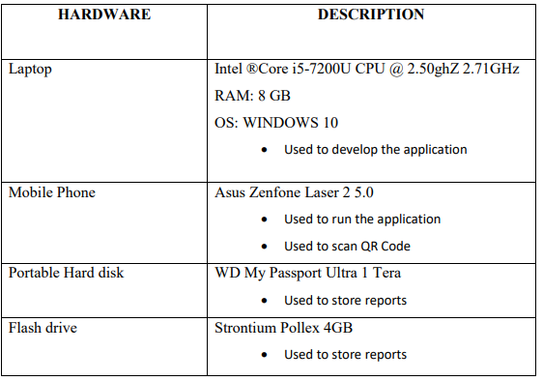
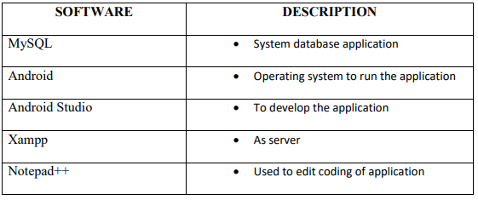
Proposed Methodology & design
The proposed project is going to be a web based application, and the languages to be used include, HTML, PHP, Javascript & MySQL
SOFTWARE & HARDWARE REQUIREMENT

Slide 9
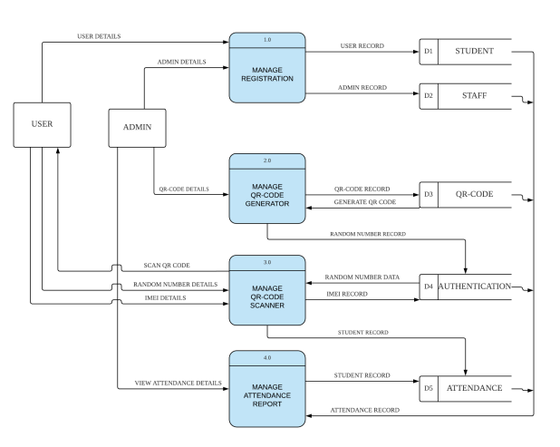
Data flow diagram

Slide 10
IMPLEMENTATION / TESTING
Testing of the proposed software will be done using students from Computer Science Department of the Federal Polytechnic Bida.

Slide 11
References
Idris Olubisi (2022) A blogging community for software developers, Olanetsoft's Blog January, 2022
Y. Saheed, M. A. Hambali, A. A. Adedeji, and I. Adeniji.: Attendance Management System Using Barcode Identification on Students’ Identity Cards. 2. H. Subramaniam and M. Hassan.: Barcode scanner based student attendance system (sas). Jurnal TICom, vol. 1, 2013. Wikipedia, 2022).
P. Taxila, "Development of academic attendance monitoring system using fingerprint identification," IJCSNS, vol. 9, pp. 164 (2009).
Wikipedia, 2022).

