Slide 1
Installation
Integrated Development Environment (IDE) – IntelliJ
Git
Maven & Java installations

Slide 2
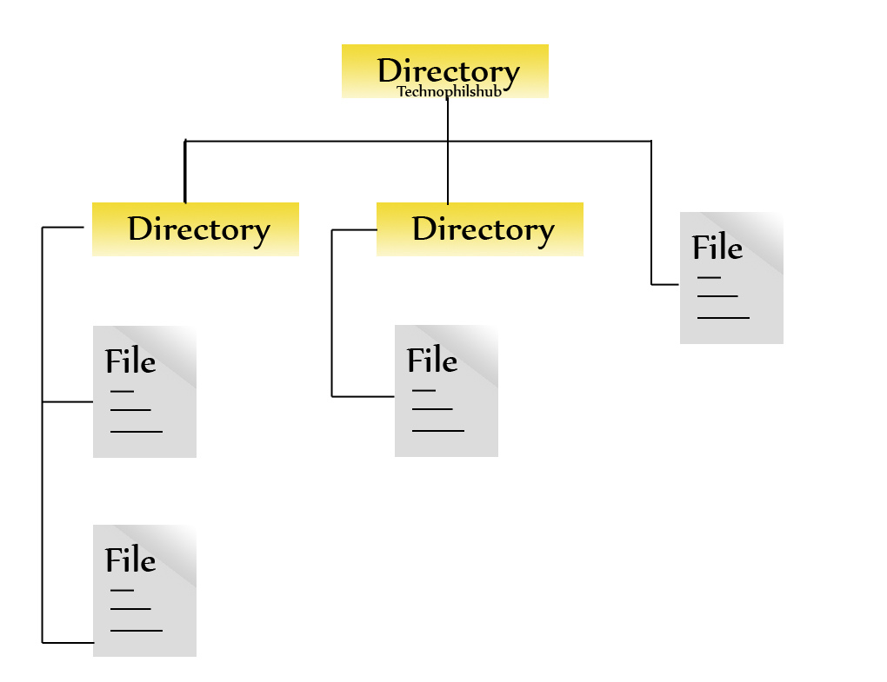
Repository (Files & Folders)
a place or container where something is deposited or stored
.docx, .xlsx, .html, .xml, .cs, .java, .py, .js, .ts, .txt

Slide 3
How Git Works
ugo.txt
Screen.png
Git status (check the status)
Git add ugo.txt
Git commit –m “modified ugo.txt”
Git push –u origin uc_branch
ugo.txt
Git status (check the status)
Git add ugo.txt
Git commit –m “modified ugo.txt”
Git pull origin main
If conflict, resolve and repeat 1-3 steps above.
Git push –u origin uc_branch
voilet.xlsx
wip.txt
Ifeanyi
Merge Uc_branch → main
Ugo
Github Project
Main (ugo.txt, violet.xlsx, wip.txt, screen…png)
Git clone
made a modification on ugo.txt file
Ikc_branch
Git clone / git pull origin main
uc_branch
Push – (uc_branch)
ugo.txt
Screen.png
ugo.txt
Phil
Git clone clone / git pull origin main
voilet.xlsx
wip.txt
P_branch
Git clone clone / git pull origin main
ugo.txt
Screen.png
ugo.txt
Git clone clone / git pull origin main
Chiamaka
voilet.xlsx
wip.txt
C_brnach
Key
V_brnach
Green (branch)
Red (modified file)
Purple (unmodified)
Yellow (not latest)
Violet
ugo.txt
Screen.png
ugo.txt
ugo.txt
Screen.png
ugo.txt
voilet.xlsx
wip.txt
voilet.xlsx
wip.txt

Slide 4
Commands
“ls – to list everything within the path
“cd name_of_directory/ “ change directory
“cd ..” means stepping back to previous directory

Slide 5
Git Commands
Git Clone: this is to clone a copy of the repository into your local machine. This command is used only to create a copy of the repo on your machine. When it is in your local machine, there is no need to use it again. To use you need to use the command below.
git clone link_of_the_repo
Git Status: This command is used to check the status of files on your machine. To use you need to use the command below.
git status
Git Add: This command is used to add untracked files from working directory to staging area (tracked). To use you need to use the command below.
git add name_of_file (for single file); git add . (for all untracked files)

Slide 6
Git Commands
Git Commit: this is to commit changes from the staging area to the local repository, ready for push into the remote. To use you need to use the command below.
git commit –m “commit message here!”
Git push: This is to push committed items from local repository to remote repository. To use you need to use the command below.
git push –u origin branch_name
Git checkout –b branch_name: This command is used create a branch and move all files from the current branch into the new branch and also switching into the new branch. To use you need to use the command below.
Git checkout –b branch_name

Slide 7
Git Commands
Git checkout branch_name: This command is used to switching into the existing branch. To use you need to use the command below.
Git checkout branch_name
Git branch: This command is used to list available branches. To use you need to use the command below.
Git branch

Slide 8
