Slide 1
Prediction of Obesity
by your devoted
Leonard Desportes
Romain Girodet

Slide 2
Summary
I- Presentation of the BDD
II- Creation of groups of variables
III- Analysis of Data
III.A- Global analysis
III.B- Local analysis
IV- Modeling
V- Modeling with reduced features
VI- How to use our FLASK application ?
VII- Conclusion

Slide 3
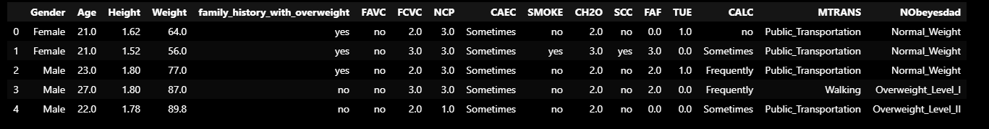
I- Presentation of the BDD
Name: ObesityDataSet_raw_and_data_sinthetic
Dimension: 2111 rows × 17 columns

Slide 4
II- Creation of groups of variables
ID of the subject: Gender, Age, Height, Weight, Family_history_with_overweight, NObeyesdad
Addictions naucify: Smoke, Consumption of alcohol (CALC)
Good eating habits: Frequency of consumption of vegetables (FCVC) Consumption of water daily (CH20)
Bad eating habits: Frequent consumption of high caloric food (FAVC), Consumption of food between meals (CALC)
Quantification of food consomption : Number of main meals (NCP), Calorie’s consumption monitoring (SCC)
Lifestyle habits: Physical activity frequency (FAF), Time using technology devices (TUE), Transportation used (MTRANS)

Slide 5
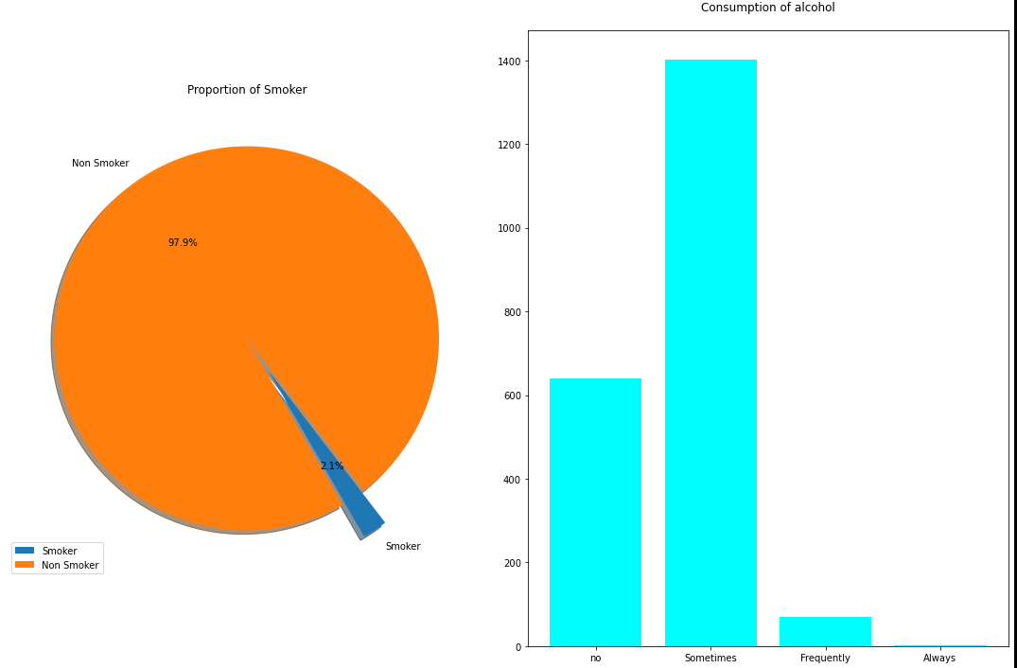
III- Analysis of Data, global analysis Harmful addictions
SMOKE {yes,no}
Answering to the question:
“Do you smoke?”
CALC {no,Sometimes,Frequently,Always}
Answering to the question:
“How often do you drink alcohol?”

Slide 6
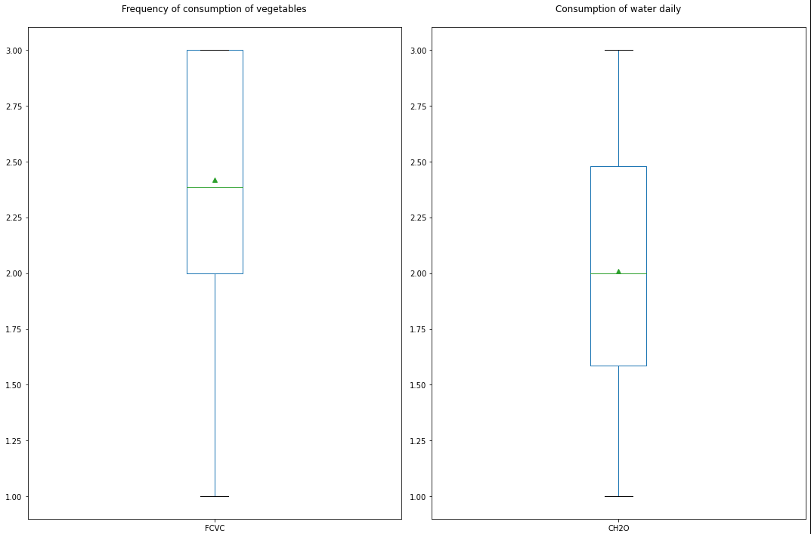
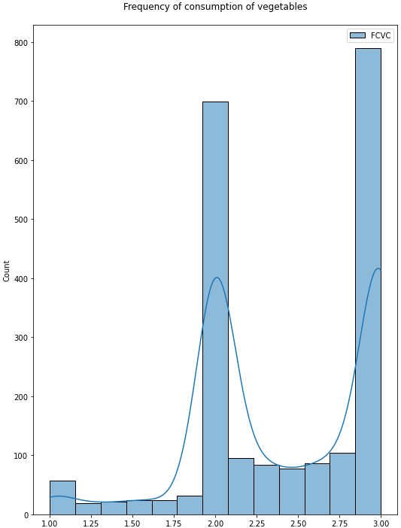
III- Analysis of Data, global analysis of good eating habits
FCVC {numeric value from 1 to 3}
1= Never
2= Sometimes
3= Always
Answering to the question:
“Do you usually eat vegetables in your meals?”

Slide 7
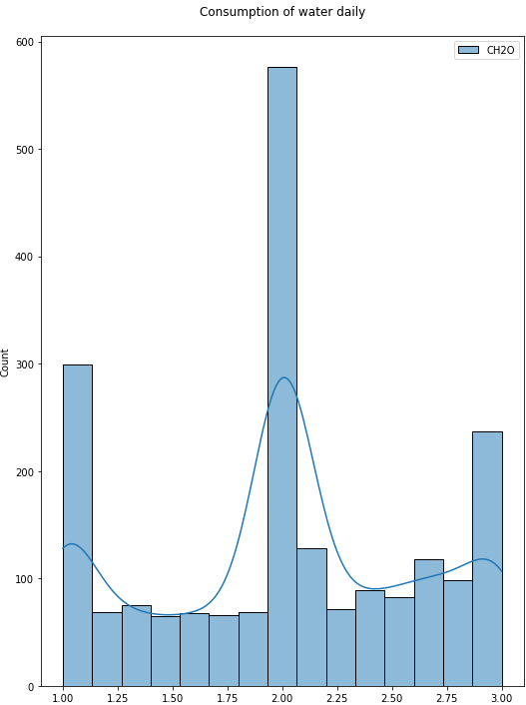
III- Analysis of Data, global analysis of good eating habits
CH2O {numeric value from 1 to 3}
First interpretation:
1= Less than a liter
]1,3[= Between 1 and 2 L
3= More than 2 L
Second Interpretation:
The measuring unit is the liter.
Answering to the question:
“How much water do you drink daily?”
This feature wasn’t significant enough. We didn’t keep it in our final model.

Slide 8
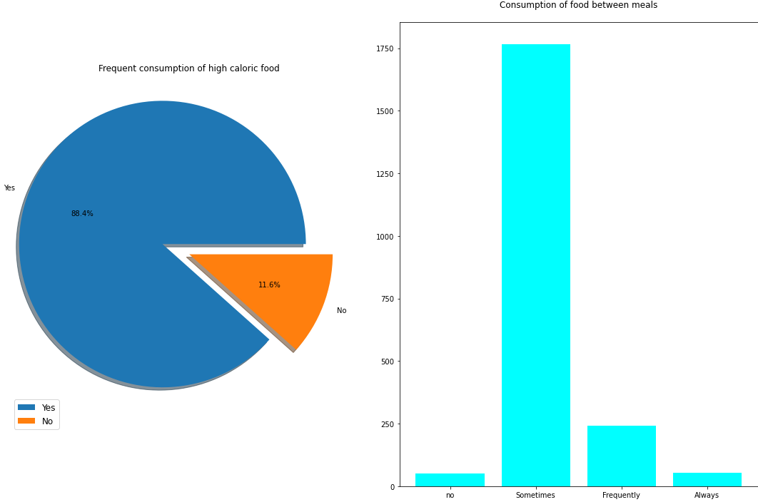
III- Analysis of Data, global analysis of bad eating habits
FAVC {yes,no}
Answering to the question:
“Do you eat high caloric food frequently?”
CALC {no,Sometimes,Frequently,Always}
Answering to the question:
“Do you eat any food between meals?”

Slide 9
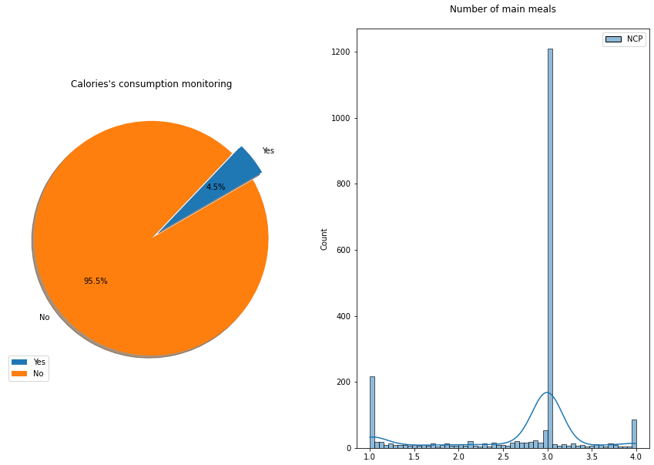
III- Analysis of Data, global analysis of Quantification of food consomption
SCC {yes,no}
Answering to the question:
“Do you monitor the calories you eat daily?”
NCP {numeric value from 1 to 3}
“How many main meals do you have daily?”

Slide 10
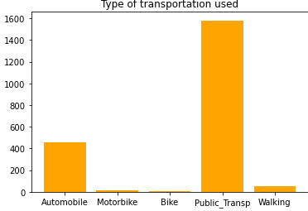
III- Analysis of Data, global analysis of Lifestyle habits
MTRANS {Automobile,Motorbike,Bike,Public_Transportation,Walking}
Answering to the question:
“Which transportation do you usually use?”

Slide 11
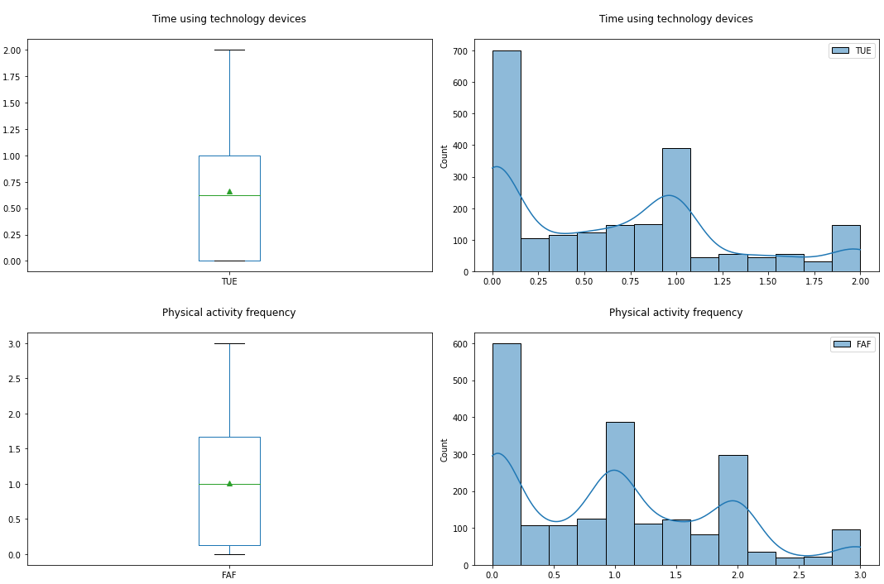
III- Analysis of Data, global analysis of Lifestyle habits
TUE numeric{from 0 to 2}
[0,1[= 0–2 hours
[1,2[ =3–5 hours
2=More than 5 hoursAnswering to the question:
“How much time do you use technological devices such as cell phone, videogames, television, computer and others?”
FAF numeric{from 0 to 3}
0=I do not have
]0,1]=1 or 2 days
]1,2]= 2 or 4 days
]2,3]= 4 or 5 days
Answering to the question:
“How often do you have physical activity?”

Slide 12
III- Analysis of Data, local analysis
TRY IT YOURSELF !
If you go to the Notebook section “Local Data-visualization: studies of the different obesity type groups”
You will be able to Try Two Functions :
def visualization_ID_Variable(obesity_variable,df):
def visualization_ID_Variable_Table(obesity_variable,df):
These functions will allow you to visualize and understand the following variable:
“ Gender, Age, Height, Weight, Family_history_with_overweight, Nobeyesdad”

Slide 13
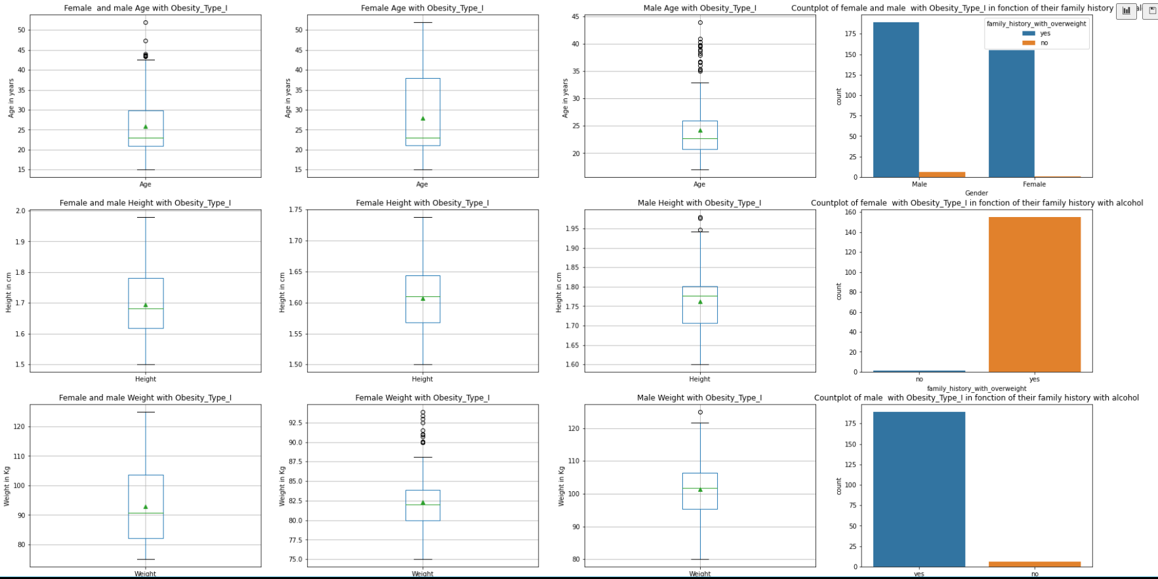
III- Analysis of Data, local analysis
def visualization_ID_Variable(obesity_variable,df):
The visualisation you will see there is for the type of obesity Nobeyesdad=“Obesity_Type_I”

Slide 14
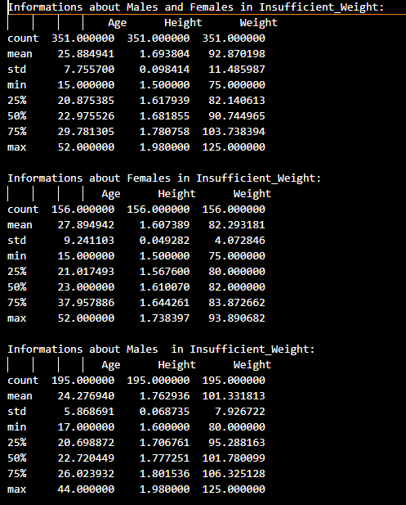
III- Analysis of Data, local analysis
def visualization_ID_Variable_Table(obesity_variable,df):
The visualisation you will see there is for the type of obesity Nobeyesdad=“Obesity_Type_I”

Slide 15
IV- Modeling (manuel encoding)
Variable sous forme qualitative | Variable Encodée
Gender | male = 0 | female = 1
Family_history_with_overweight FAVC (Frequent consumption of high caloric food) SCC (Calorie’s consumption monitoring) SMOKE | no = 0 | yes = 1
CAEC (Consumption of food between meals) CALC (Consumption of alcohol) | no = 0 | Sometimes = 1 | Frequently = 2 | Always = 3
MTRANS (Transportation used) | Automobile = 0 | Motorbike = 1 | Bike = 2 | Public Transportation = 3 | Walking = 4
NObeyesdad (target variable) | Insufficient Weight = 0 | Normal Weight = 1 | Overweight level I = 2 | Overweight level II = 3 | Obesity Type I = 4 | Obesity type II = 5 | Obesity Type III = 6.

Slide 16
IV- Modeling (encoding)
Encoding by labels
We simply transform the type of the column to ‘category’, this assigns each variable of the column to a category. Example for the gender column: the categories ‘Male’ and ’Female’ are generated.
Once this is done, we just have to ad the code part ‘.cat.codes’ which transforms the qualitative categories into numerical categories.
Ordinal encoding
This type of encoding enables us to transform the qualitative data into numeric data in only one line of code. Indeed, we create a model OrdinalEncoder() than is directly applied to the columns of the dataframe we chose.

Slide 17
IV- Modeling (test set and train set)
Splitting the data into a training set and a test set :
The shapes of the train and test set :
Once the data split, we scale the data, to get a more precise result

Slide 18
IV- Modeling (Creation of the models)
Creation of the Models
We decided to test different models to see which one was the more precise.
1- Neighbors Classifiers
K-Neighbors
2- SVM Classifiers
SVC (Support Vector Classification)
3- Grid-search on SVC model
For this model we chose parameters adapted to our SVC Mode
and obtained :

Slide 19
IV- Modeling(Creation of the models)
4- Bagging Classifiers
Bagging, RandomForest
5-Boosting Classifiers
AdaBoost, GradientBoosting, HistGradientBoosting
6-Voting Classifiiers
HardVoting, SoftVoting

Slide 20
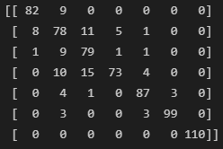
IV- Modeling (Testing of the models)
Testing of the models
To test the model, we created a list of prediction of our test set that we compered to its already known results. That is how we obtained the accuracy of each model.
We also created a confusion matrix for each model, to illustrate our results.
Example for the SVC Classification model :
Prediction thanks to the function “.predict()”
Final accuracy of the model :
Confusion matrix :

Slide 21
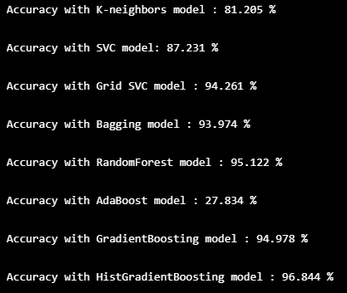

IV- Modeling (Testing of the models)
Using VotingClassifier we selected only the classifier with a score above 0,50 (We deleted the AdaBoostClassifier).
We tried both Hard and soft VotingClassifier.

Slide 22
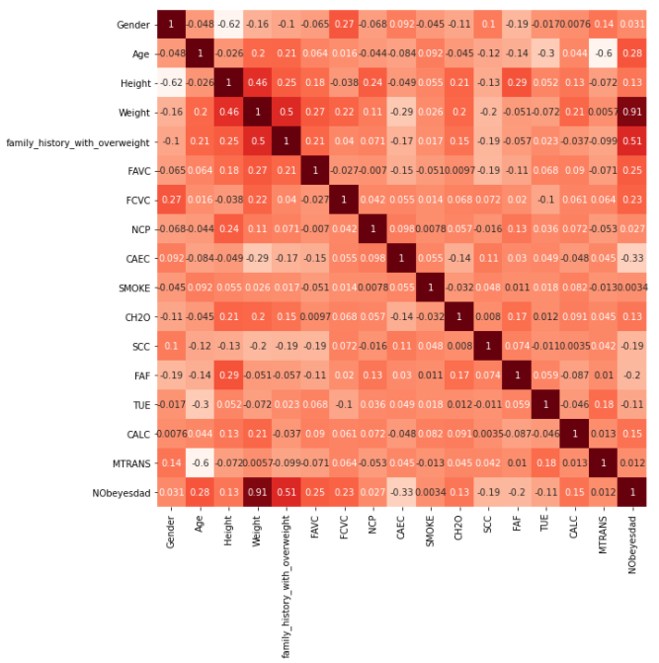
V- Modeling with reduced features (To go futher)
We can look at the correlation matrix of the encoded data to see which columns/variables are the more correlated to our target variable.
It will allow us to see what variable are really useful for our classification.

Slide 23

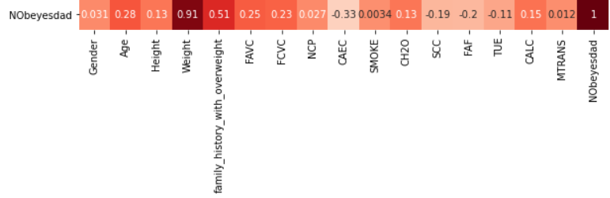
V- Modeling with reduced features (Correlation matrix)
After encoding the variables, we did a correlation matrix to see with parameter are the most correlated to the type of Obesity.
We can see that the most correlated variable is, unsurprisingly, the Weight. But we can also see that the family history with overweight is highly correlated to the type of obesity.
The Age, Frequency of consumption of vegetables (FCVC) and if the person has a high consumption of high caloric food (FAVC) are also highly correlated parameters.

Slide 24
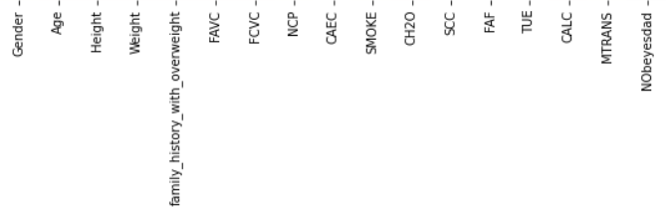
V- Modeling with reduced features (Correlation matrix)
Since Weight is the most correlated variable to Obesity, we decided to study the correlation of this parameter with all the others
We can see that the Weight has also a high correlation with family history with overweight, but also with the Height.
As for Obesity, the correlation between Weight and the parameters Age, FAVC and FCVC is high, but we can also see a high correlation with new parameters as daily water consumption CH2O and consumption of alcohol (CALC)

Slide 25
V- Modeling with reduced features (Drop of the unusfull data)
Looking at the correlation matrix, we decided to drop the variables with a correlation with our target variable under 0,15. This would enable us to use only very correlated variables and be more precise in our prediction.
Those are the columns we dropped :

Slide 26
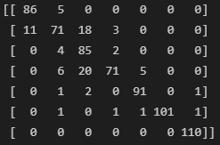
V- Modeling with reduced features (Testing of the reduced models)
Example for the SVC Classification model :
Prediction thanks to the function “.predict()”
Final accuracy of the model :
Confusion matrix :

Slide 27


V- Modeling with reduced features (Results)
We can see that the reduced models (with only significant features) have globally a higher accuracy than the models with all features.

Slide 28
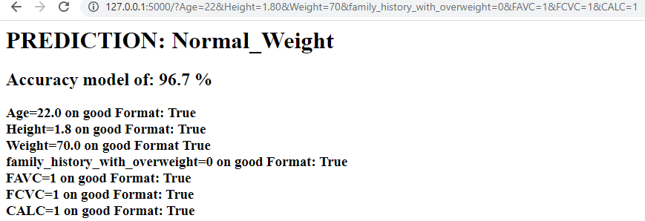
VI- How to use our FLASK application ?
ON our GitHub You will find a READ_ME_FLASK.docx
You will find all the explanation here.

Slide 29
VI- Conclusion
Our objective: get a Classifier with at least an accuracy of 90%.
Our result: Classifier with an accuracy of 97%.
We obtain our a SoftVotingClassifier
using the the following classifier : Bagging, RandomForest, GradientBoosting, HistGradientBoosting, SVC (optimize with Grid-search)
Using the features : Age, Weight, Height, Family History With Overweight, FAVC, FCVC and CALC

Slide 30
VI- Conclusion (If we had to start the Project again )
What we did Well ?
The Analysis of the dataset.
Realization of a flask App (using few html)
Our collaboration (use of github, division of tasks)
Selection of the most significant features to improve our models.
How to proceeded to find a model with a good accuracy ?
Or what we should have done if we didn’t found conclusive first results.
For a list of features:
Select a list of classifier.
For each classifier :
applied a grid Search to find the best parameters and create new optimize classifier.
Keep only optimize classifier having an accuracy above 50%.
Proceed to a Voting Classifier.

