Slide 2
Summary
I- Presentation of the BDD
II- Creation of groups of variables
III- Analysis of Data
III.A- Global analysis
III.B- Local analysis
IV- Prediction
V- Classification
VI- Conclusion
VII- Bonus : study of alcohol

Slide 3
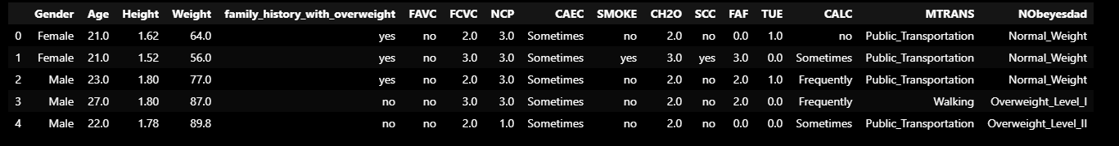
I- Presentation of the BDD
Name: ObesityDataSet_raw_and_data_sinthetic
Dimension: 2111 rows × 17 columns

Slide 4
II- Creation of groups of variables
ID of the subject: Gender, Age, Height, Weight, Family_history_with_overweight, NObeyesdad
Addictions naucify: Smoke, Consumption of alcohol (CALC)
Good eating habits: Frequency of consumption of vegetables (FCVC) Consumption of water daily (CH20)
Bad eating habits: Frequent consumption of high caloric food (FAVC), Consumption of food between meals (CAEC)
Quantification of food consomption : Number of main meals (NCP), Calorie’s consumption monitoring (SCC)
Lifestyle habits: Physical activity frequency (FAF), Time using technology devices (TUE), Transportation used (MTRANS)

Slide 5
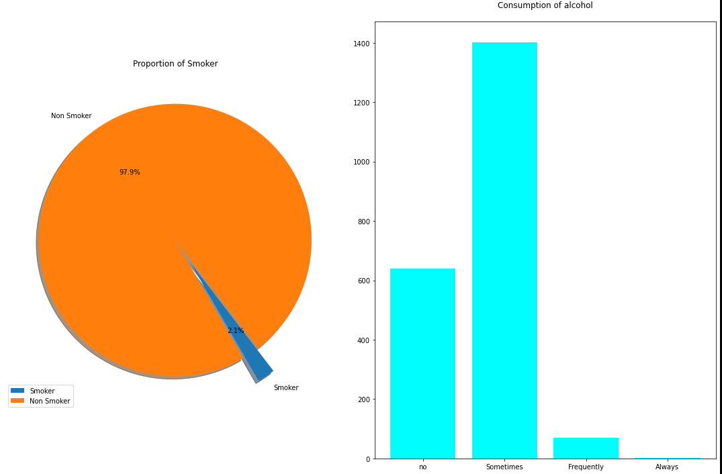
III- Analysis of Data, global analysis Harmful addictions
SMOKE {yes,no}
Answering to the question:
“Do you smoke?”
CAEC {no,Sometimes,Frequently,Always}
Answering to the question:
“How often do you drink alcohol?”

Slide 6
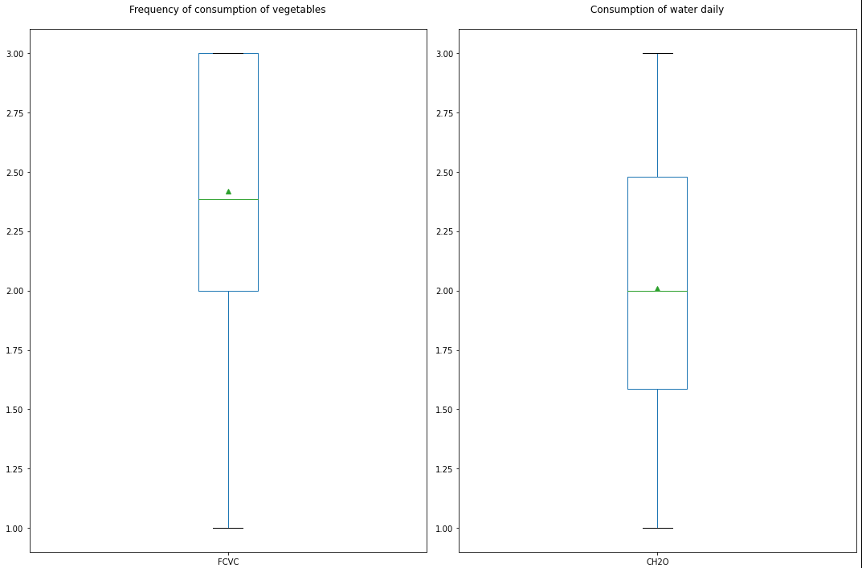
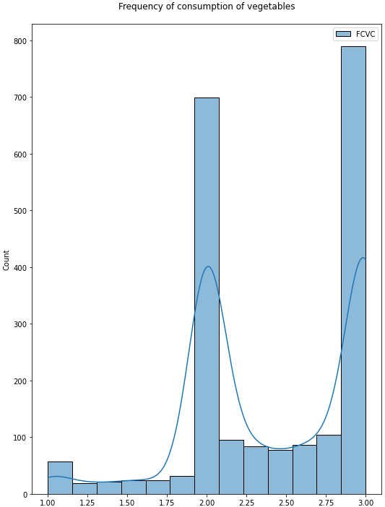
III- Analysis of Data, global analysis of good eating habits
FCVC {numeric value from 1 to 3}
1= Never
2= Sometimes
3= Always
Answering to the question:
“Do you usually eat vegetables in your meals?”

Slide 7
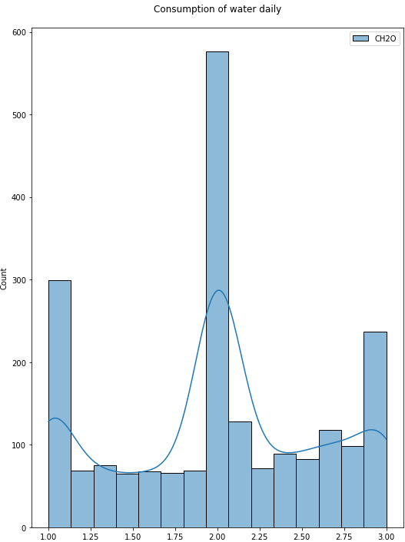
III- Analysis of Data, global analysis of good eating habits
CH2O {numeric value from 1 to 3}
1= Less than a liter
[1,2[= Between 1 and 2 L
3= More than 2 L
Answering to the question:
“How much water do you drink daily?”

Slide 8
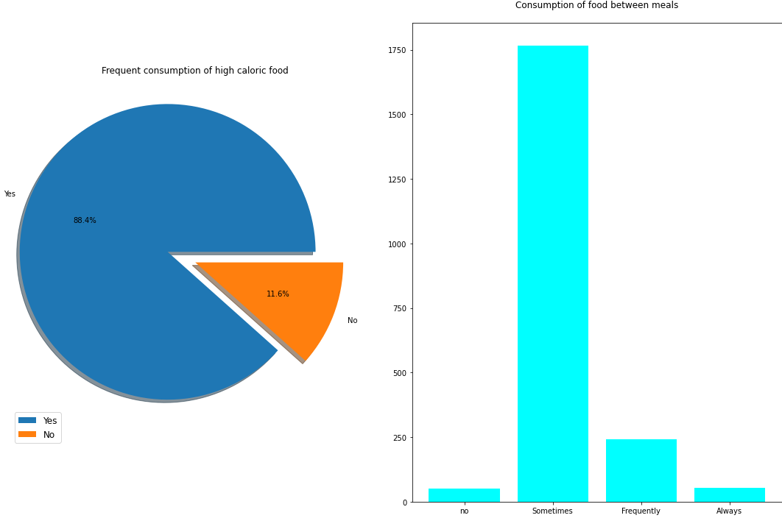
III- Analysis of Data, global analysis of bad eating habits
FAVC {yes,no}
Answering to the question:
“Do you eat high caloric food frequently?”
CAEC {no,Sometimes,Frequently,Always}
Answering to the question:
“Do you eat any food between meals?”

Slide 9
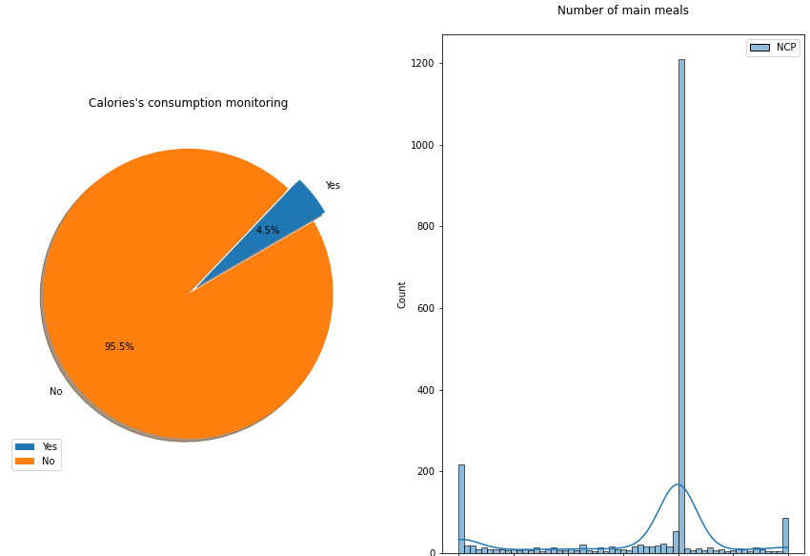
III- Analysis of Data, global analysis of Quantification of food consomption
SCC {yes,no}
Answering to the question:
“Do you monitor the calories you eat daily?”
NCP {numeric value from 1 to 3}
1= Between 1 and 2
2= Three
3= More than three
“How many main meals do you have daily?”

Slide 10
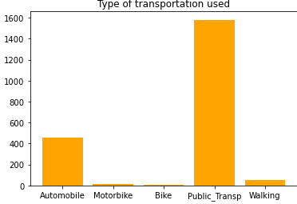
III- Analysis of Data, global analysis of Lifestyle habits
MTRANS {Automobile,Motorbike,Bike,Public_Transportation,Walking}
Answering to the question:
“Which transportation do you usually use?”

Slide 11
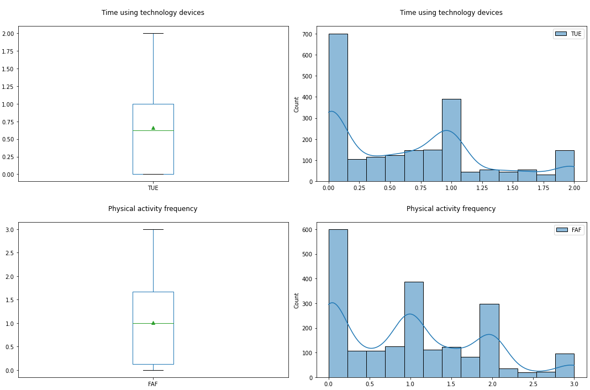
III- Analysis of Data, global analysis of Lifestyle habits
TUE numeric{from 0 to 2}
[0,1[= 0–2 hours
[1,2[ =3–5 hours
2=More than 5 hoursAnswering to the question:
“How much time do you use technological devices such as cell phone, videogames, television, computer and others?”
FAF numeric{from 0 to 3}
0=I do not have
]0,1]=1 or 2 days
]1,2]= 2 or 4 days
]2,3]= 4 or 5 days
Answering to the question:
“How often do you have physical activity?”

Slide 12
III- Analysis of Data, local analysis
The visualisation you will see there is for the type of obesity Nobeyesdad=“Insufficient_Weight”

Slide 13
IV- Prediction
Ligne correlation typeOb et poids

Slide 14
V- Classification

