Slide 1
Shoot Tutorial
Honglei Han

Slide 2
Outline
New scene
3rd Person controller
Using Mecanim
Weapon system
Adding interactive items
Dropping random items

Slide 3
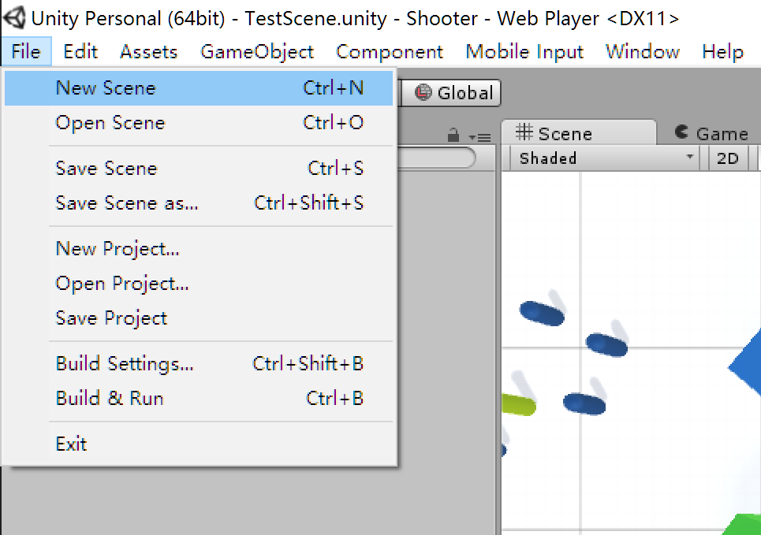
New scene

Slide 4
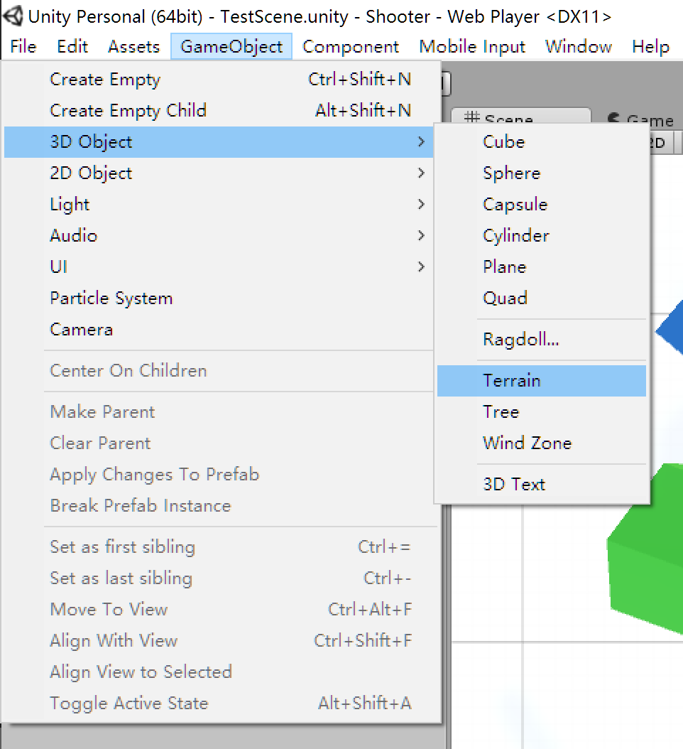
Add terrain

Slide 5
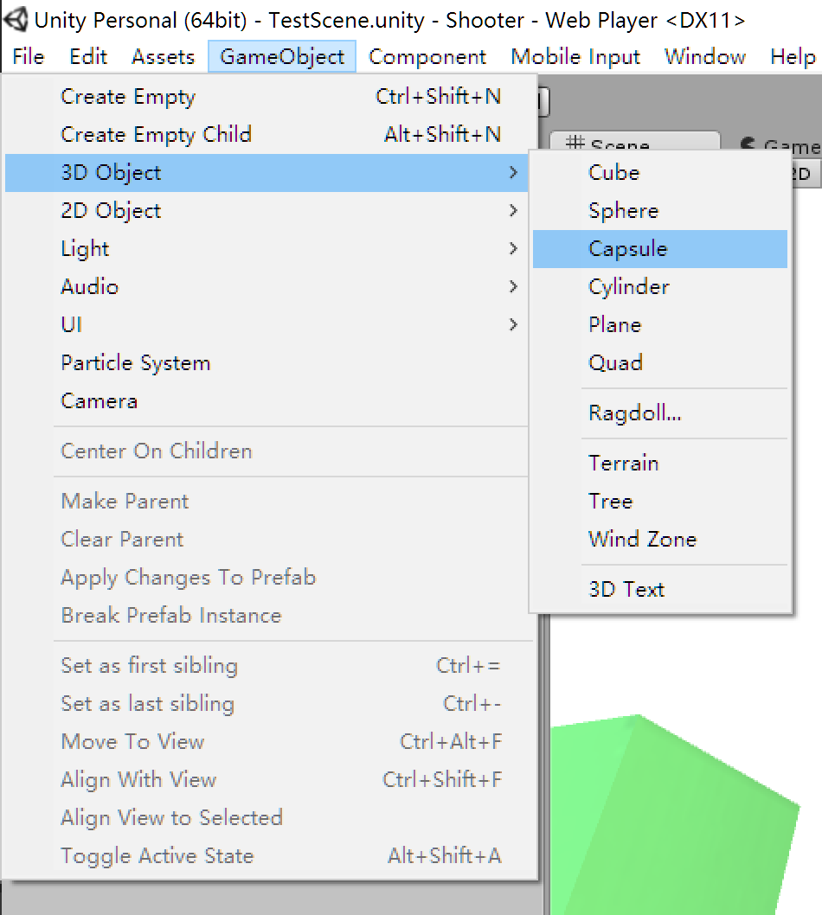
And other game objects

Slide 7
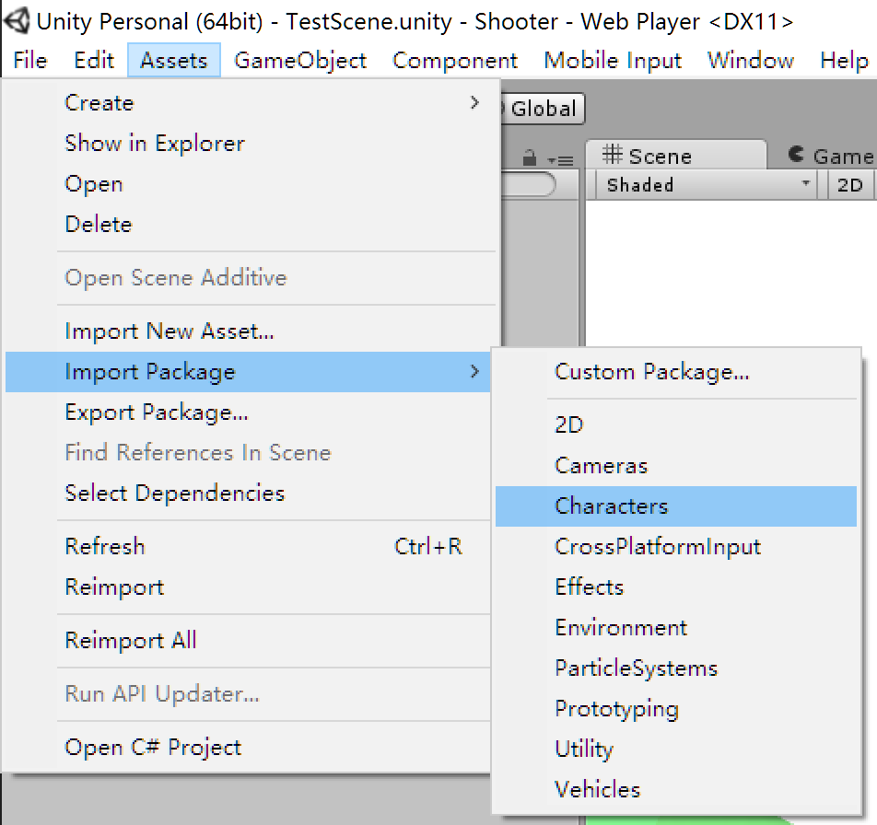
Drag a 3rd person controller into the scene

Slide 8
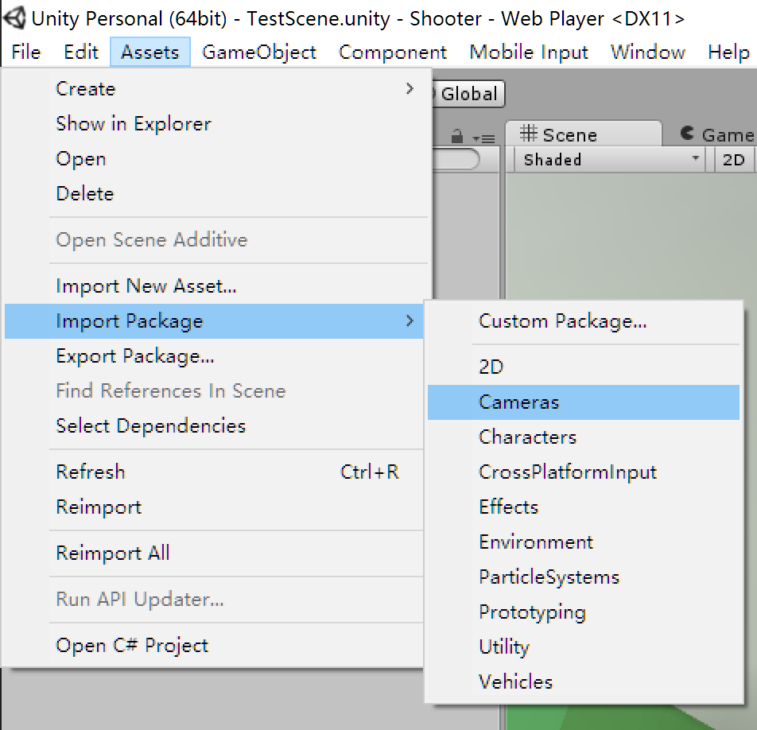
Configure a proper camera

Slide 9
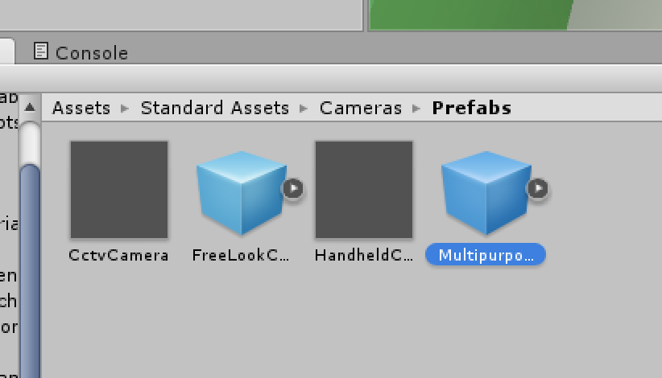

Slide 10
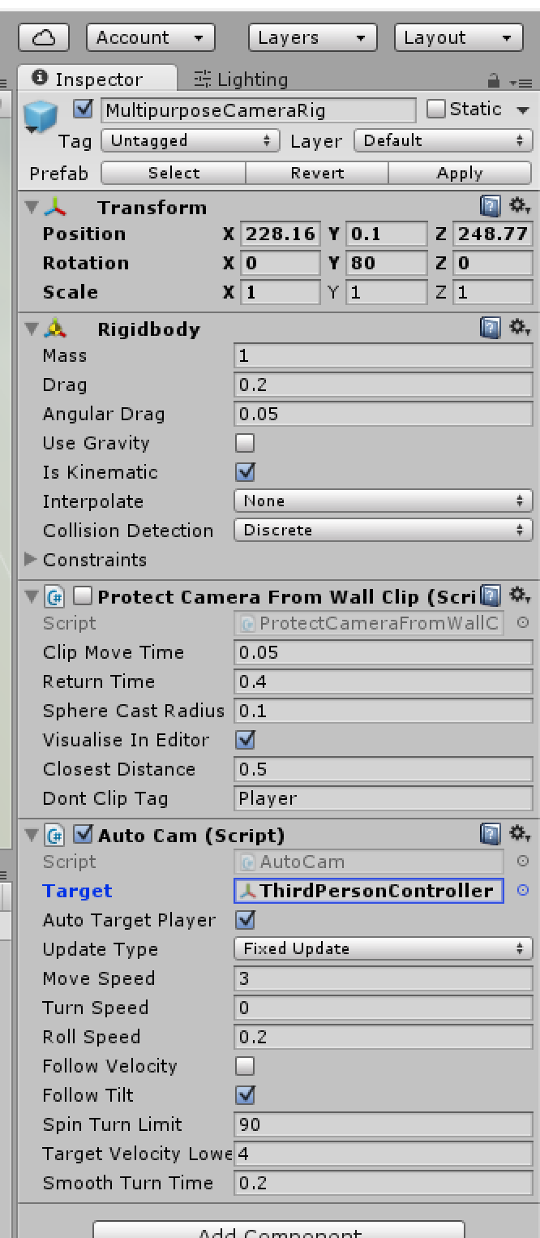
Setting proper parameters

Slide 12
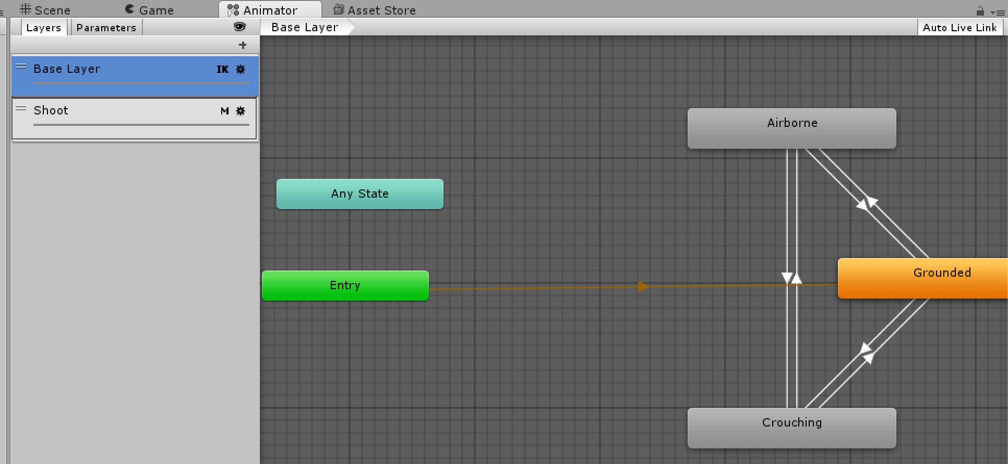
Using multi-layer animation

