Slide 1
Titanic - ML for Disaster
Ting-Liang (Leo) Huang

Slide 2

Introduction
Titanic
Data Analysis
Machine Learning Models

Slide 3
Data Analysis Process
Ask
Process
Preprocess
Share
Prepare
Analyze
Model
Act
Notes:
What is our business objective?

Slide 4

Ask & Prepare
What is our business objective?
What kind of data we need?
Where is datasets from?

Slide 5
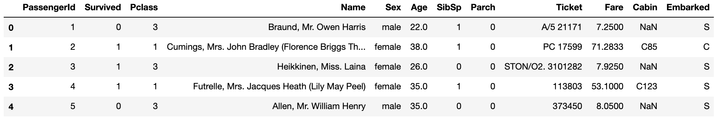
Process
Data type
Data duplicate
Data Integrity
Data privacy
Is our data clean enough?

Slide 6
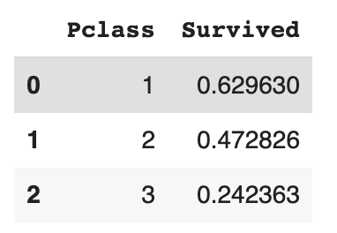
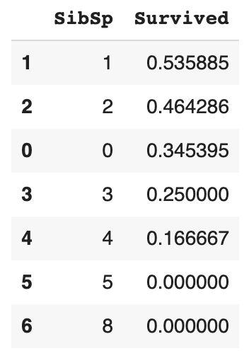
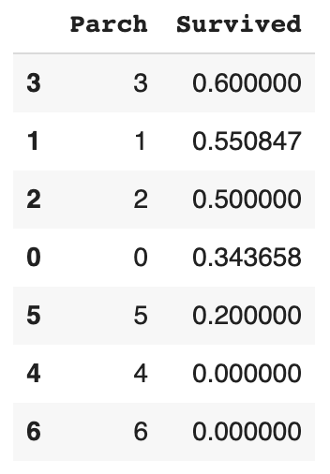
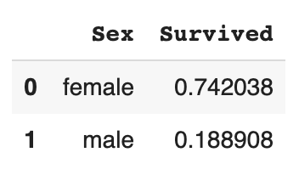
Analyze

Slide 7
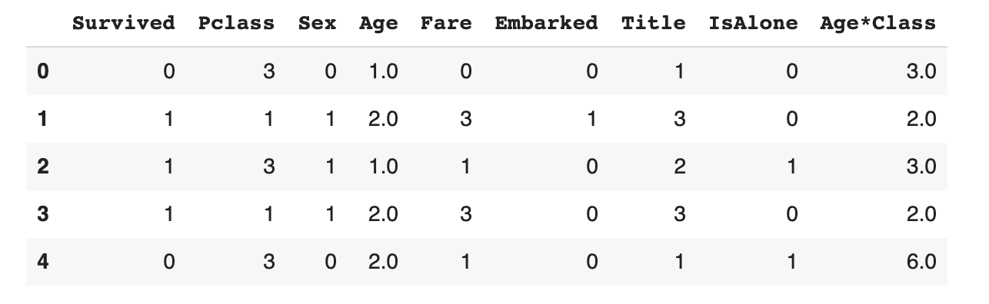
Preprocess
Drop useless features
Convert categorical features to numeric
Fill null values
Create new features from existing features
Complete a numerical continuous feature

Slide 8
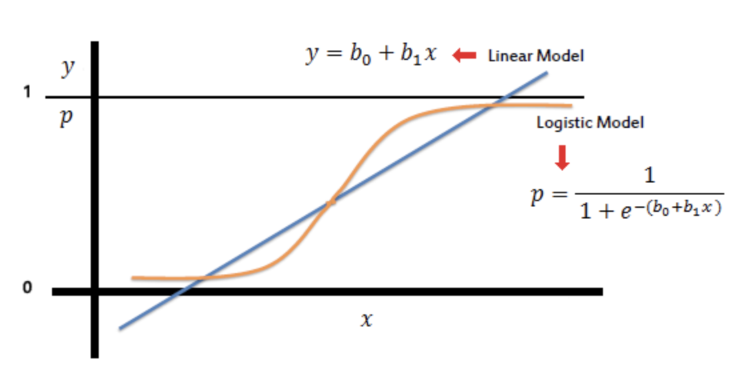
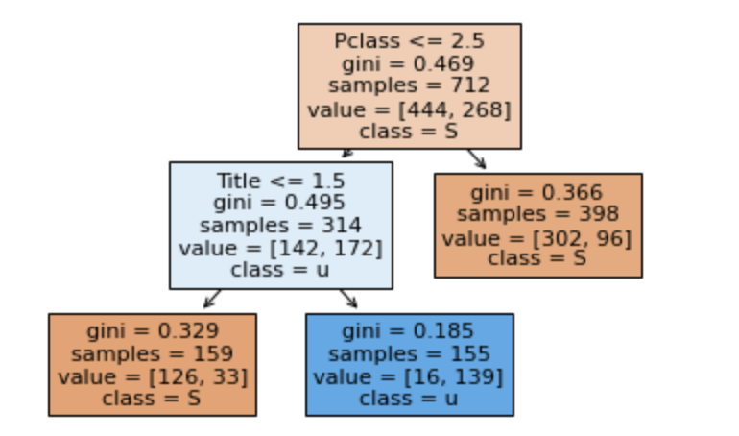
Model
Logistic & Linear Model
Decision Tree

Slide 9
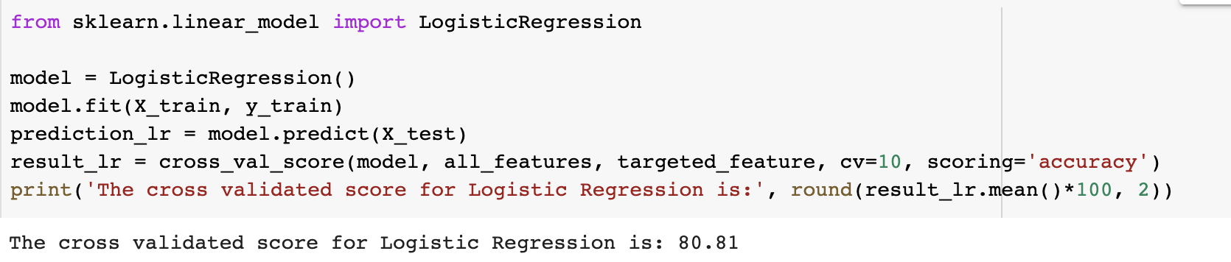
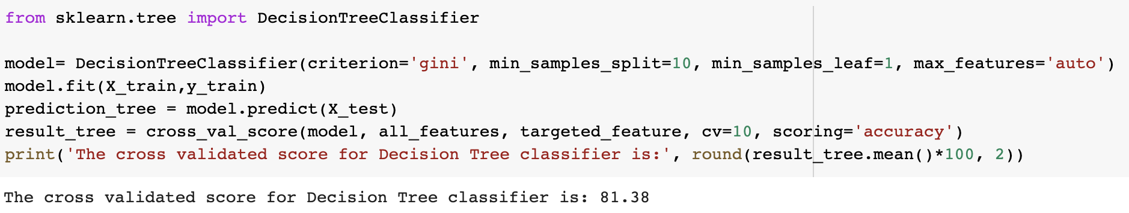
Model

Slide 10
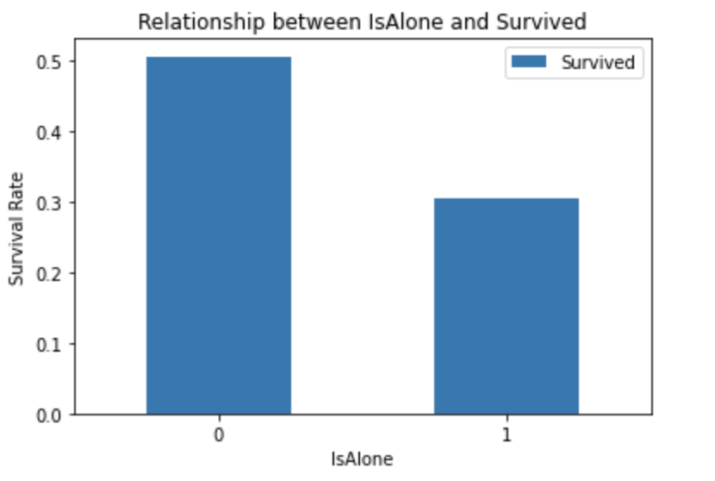
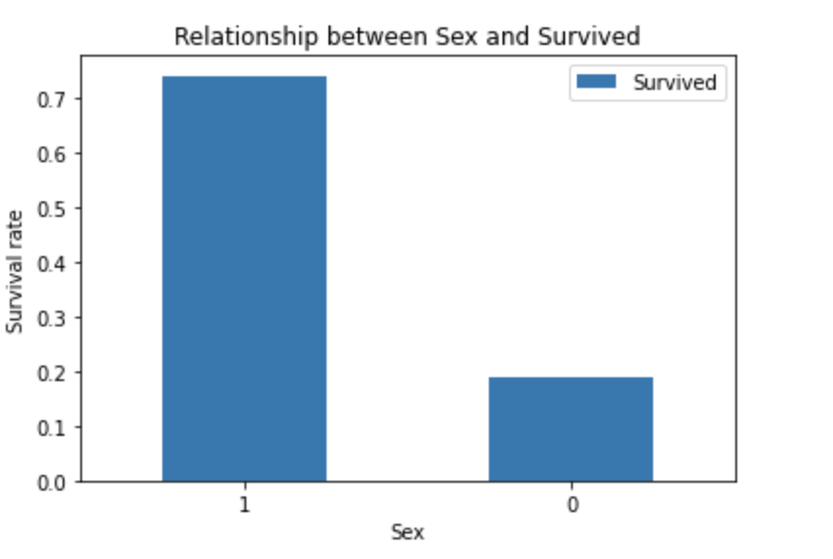
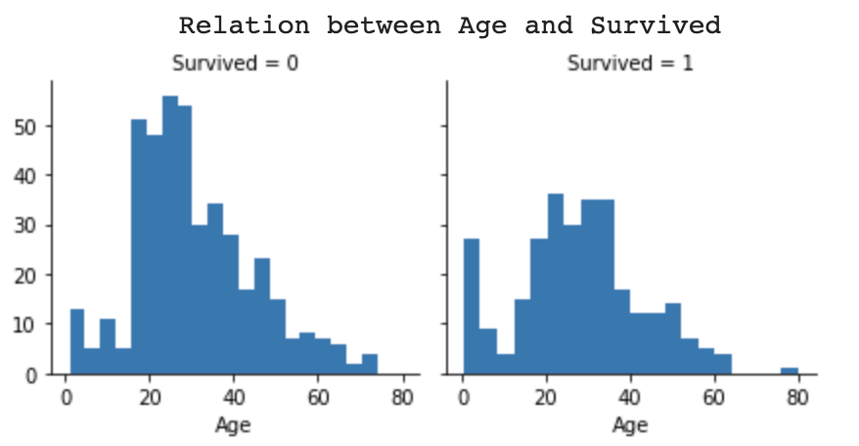
Share & Act
Pclass = 1 has higher survived rate
Female has higher survival rate
Age doesn’t have much relationship with survived

Slide 11

Key Concepts
Pivoting Features
Model Comparison
Decision Tree
Confusion Matrix
Data Visualization

Slide 12
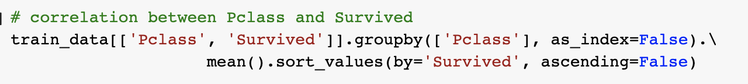
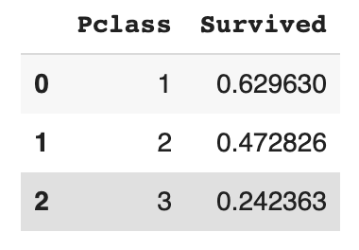
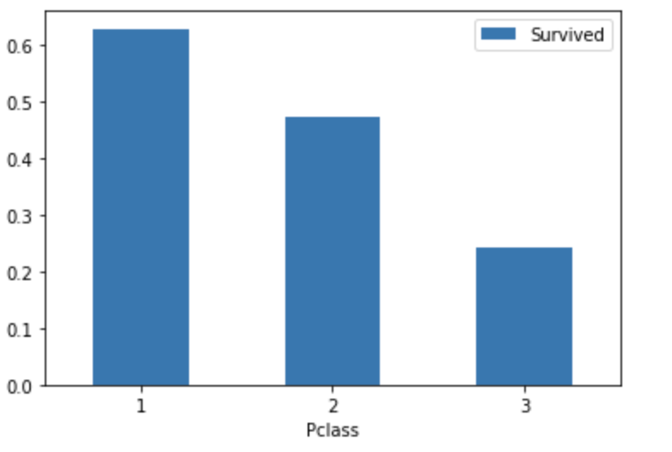
Pivoting Features

Slide 13
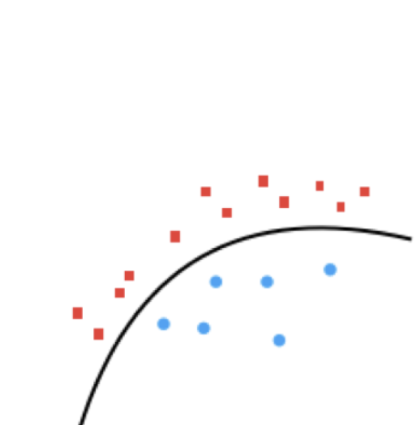
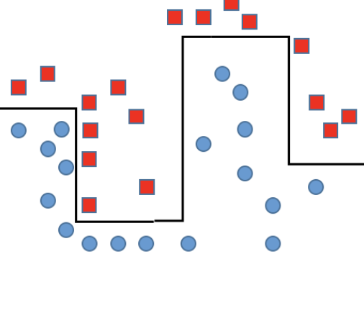
Model Comparison
Logistic Regression
 | Decision Tree | Logistic Regression
Handle Non-linear | V | X
Categorical data type | V | X
Continuous data type | X | V
Skewed | V | X
Outlier | V | X
Decision Tree

Slide 14
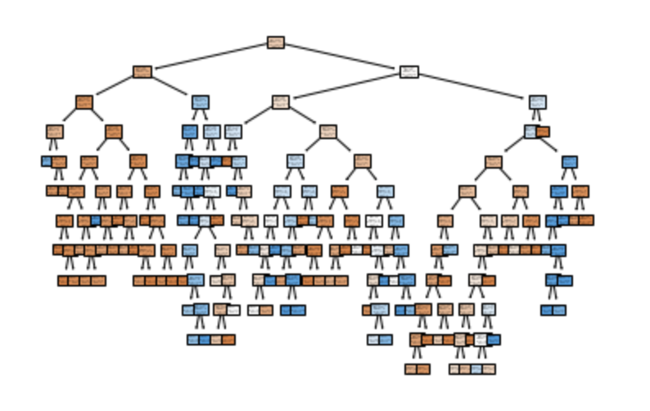
Decision Tree
Gini index measures the probability of a particular variable being wrongly classified when it is randomly chosen.

Slide 15
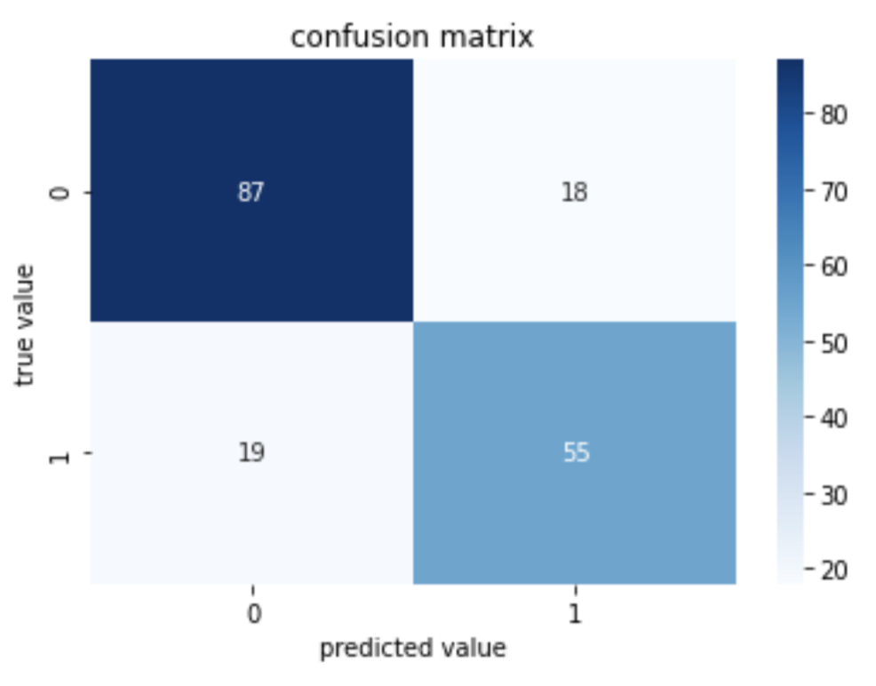
Confusion Matrix
Precision = tp / (tp + fp)
Recall = tp / (tp + fn)
tp = 55, tn = 87, fp = 18, fn = 19
tn
fp
fn
tp

Slide 16
Data Visualization
Keep in mind for 5 seconds role
title
legend
y-axis
x-axis

Slide 17
Ｑ＆Ａ

